Slide 1

50:50
A
Automat
C
Autograph
Autograph
B
Autocrat
D
Autobahn
1. What is the name for a signature given by a celebrity?

Slide 2
50:50
Japan
A
Germany
C
Japan
B
USA
D
Italy
2. The Yen is the basic monetary unit of which country?

Slide 3
50:50
Starfish
A
Starfish
C
Fish
B
crab
D
Jelly-fish
3. Which creature doesn’t have brain?

Slide 4
50:50
21
23
A
C
22
B
22
D
20
4. How many hours a day does Koala spend on sleeping?

Slide 5
50:50
Black
A
Black
C
Brown
B
White
D
Yellow
5. The White bear in North Pole has………….skin.

Slide 6
50:50
A
1846
C
1832
1833
1847
B
D
1847
6. Thomas Alva Edison was born in…………..

Slide 7
50:50
Michael Faraday
C
Thomas Edison
A
Galileo Galilei
Albert Einstein
Galileo Galilei
D
B
7. Who is known as the father of modern science?

Slide 8
50:50
Havana
Zagreb
C
Havana
A
B
Nicosia
D
Moroni
8. Which city is the capital of Cuba?

Slide 9
50:50
Four
Three
A
Four
C
B
Two
D
Five
9. How many colors are there in Myanmar’s flag?

Slide 10
50:50
A
Ten
C
One hundred
One
B
One
D
Twenty
10. How many wheels does a unicycle have?

Slide 11
50:50
A
Flyer Grove
C
Glyder Grove
Ryder Grove
Byker Grove
B
D
Byker Grove
11. Which TV series is set in a youth center in the north-east of England?

Slide 12
50:50
1563
1564
A
C
1564
B
1567
D
1565
12. William Shakespeare was born in…………

Slide 13
50:50
Twelfth Night
A
Twelfth Night
C
Fourth Night
B
Ninth Night
D
Tenth Night
13. Which of these is a play by William Shakespeare?

Slide 14
50:50
Heart
Eyes
A
C
Eyes
B
Bones
D
Ears
14. Which part of body is affected by conjunctivitis?

Slide 15
50:50
A
Tweediedash
C
Tweediedot
Tweediedim
Tweediedee
B
D
Tweediedee
15. Who is the partner of Tweediedum in the novel “Through the Looking Glass”?

Slide 16
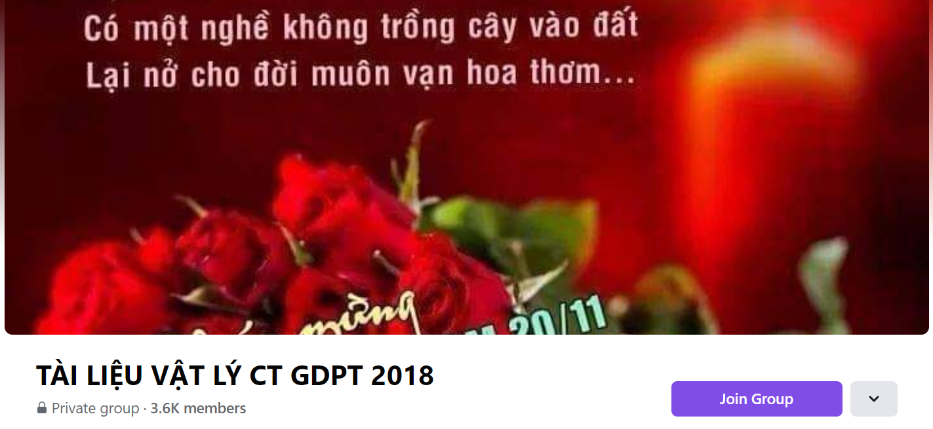
SƯU TẦM: ĐOÀN VĂN DOANH, NAM TRỰC, NAM ĐỊNH
LINK NHÓM DÀNH CHO GV BỘ MÔN VẬT LÝ TRAO ĐỔI TÀI LIỆU VÀ CHUYÊN MÔN CT 2018
https://www.facebook.com/groups/299257004355186

