Slide 1

Unit 2: Every Day
Lesson 2c: Vocabulary
Page 42

Slide 2
Lesson Outline
Warm-up
Presentation
Practice
Production
Consolidation
Wrap-up

Slide 3
Objectives
By the end of this lesson, students will be able to…
know free time activities.
talk about what they like doing in their free time.

Slide 4

WARM-UP

Slide 5
Discussion
Tell your friend what you do for fun after school / in the evening / at the weekend.
I play basketball after school.
I play video games in the evening.

Slide 6

It’s time to learn …

Slide 7

Presentation

Slide 8
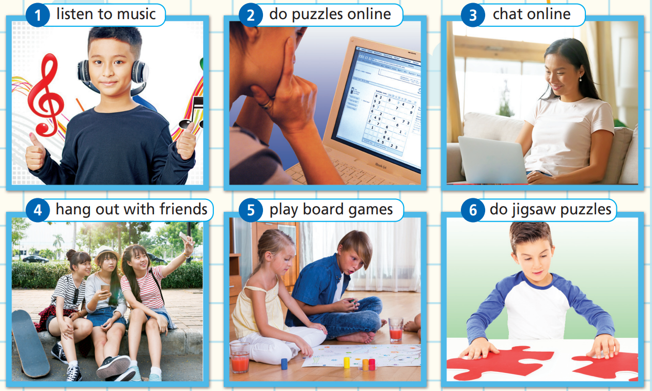
Free-time activities
Match the pictures with the correct activities.
- Hang out with friends
- Chat online
- Go bowling
- Play board games
- Go to the theatre
- Do puzzle online
- Watch a film
- Go to the mall
- Go skateboarding
- Listen to music
- Do jigsaw puzzles
- Go to the amusement park
Listen to music
Do puzzles online
Chat online
Hang out with friends
Play board games
Do jigsaw puzzles

Slide 9
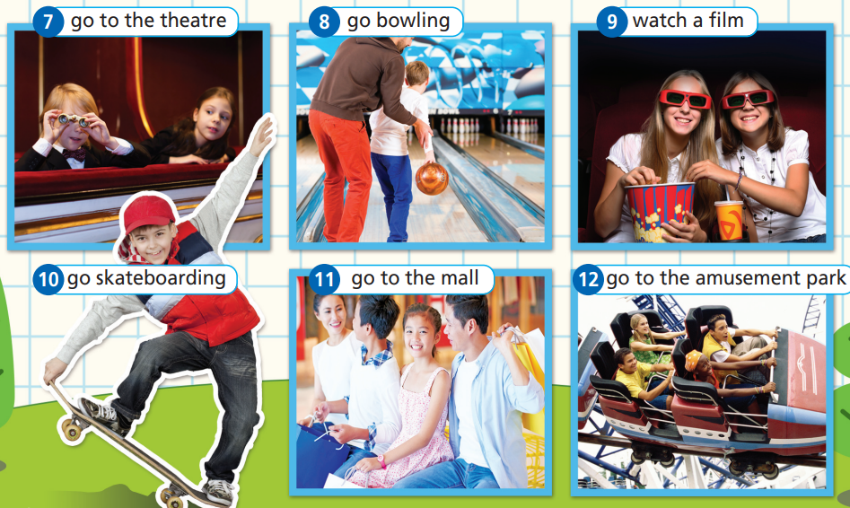
Match the pictures with the correct activities.
Go to the theatre
Go bowling
Watch a film
- Hang out with friends
- Chat online
- Go bowling
- Play board games
- Go to the theatre
- Do puzzles online
- Watch a film
- Go to the mall
- Go skateboarding
- Listen to music
- Do jigsaw puzzles
- Go to the amusement park
Go skateboarding
Go to the mall
Go to the amusement park

Slide 10

Listen and repeat. Click on each phrase to hear the sound.
Listen to music (v phr) /ˈlɪsən tə ˈmjuːzɪk/: nghe nhạc
Do puzzles online (v phr) /du ˈpʌzəlz ˈɒnlaɪn/: giải câu đố trực tuyến
Chat online (v phr) /tʃæt ˈɒnlaɪn/: trò chuyện trực tuyến
Hang out with friends (v phr) /hæŋ aʊt wɪð frendz/: đi chơi với bạn
Play board games (v phr) /pleɪ ˈbɔːd ɡeɪmz/: chơi trò chơi cờ bàn
Do jigsaw puzzles (v phr) /du ˈdʒɪɡsɔː ˈpʌzəlz/: chơi xếp hình
Notes:
Focus on phrases that may be new to your students. Review those which are familiar to them.

Slide 11
Listen and repeat. Click on each phrase to hear the sound.
Go to the theatre (v phr) /ɡəʊ tə ðə ˈθɪətər/: đi xem phim ở rạp
Go bowling (v phr) /ɡəʊ ˈbəʊlɪŋ/: chơi bowling
Watch a film (v phr) /wɒtʃ ə fɪlm/: xem phim
Go skateboarding (v phr) /ɡəʊ ˈskeɪtbɔːdɪŋ/: chơi trượt ván
Go to the mall (v phr) /ɡəʊ tə ðə mɔːl/: đi mua sắm
Go to an amusement park (v phr) /ɡəʊ tə ən əˈmjuːzmənt pɑːk/: đi công viên giải trí

Slide 12
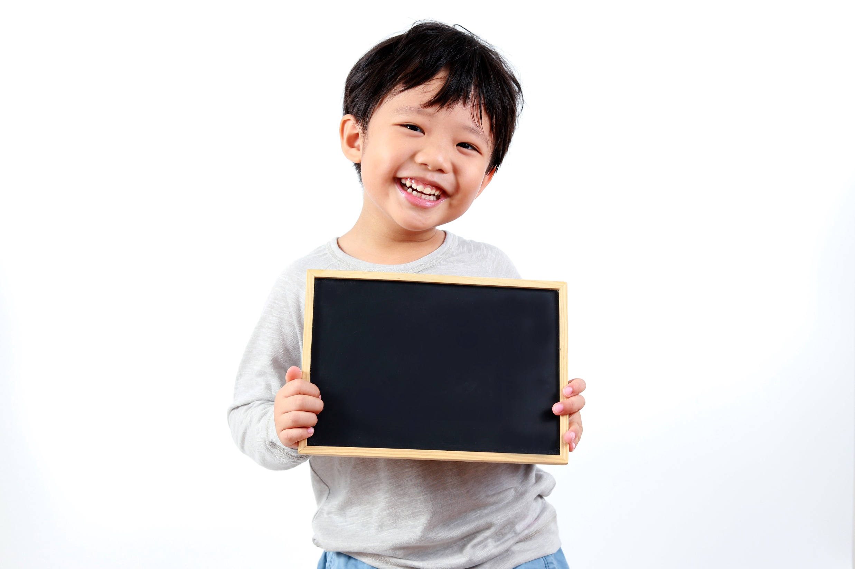
Practice

Slide 13
★ Match the words to form phrases
go to 1
play 2
do 3
watch 4
chat 5
hang out 6
a jigsaw puzzles
b online
c a film
d the theatre
e with friends
f board games

Slide 14
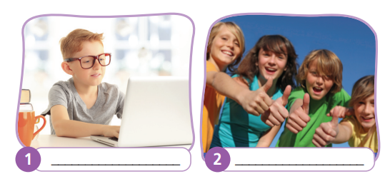
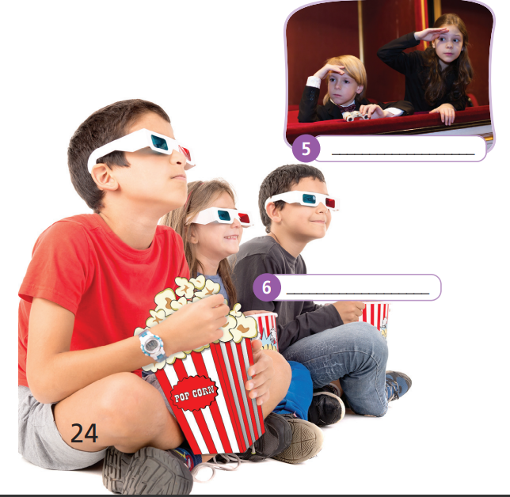
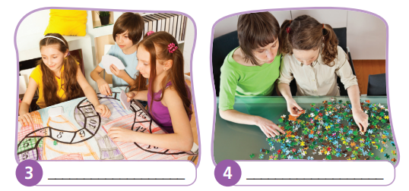
Use the phrases in Exercise 1 to label the pictures (a-f).
go to the theatre
chat online
hang out with friends
watch a film
play board games
do jigsaw puzzles

Slide 15
Production

Slide 16
Talking about hobbies or interests
like
love
don’t
like
hate
+ V-ing
e.g. I like listening to music.

Slide 17
2. Which of the activities in Exercise 1 do you like/love/not like/hate doing in your free time? Tell your partner. You can use your own ideas as well.
In my free time, I like chatting online and hanging out with my friends. I
don’t like going to the mall. I hate playing board games.

Slide 18

CONSOLIDATION

Slide 19
Write four sentences about what you like/love/not like/hate doing in your free time, using the vocabulary you have studied today.

Slide 20

WRAP-UP

Slide 21
Today’s lesson
Vocabulary
Free time activities
Grammar
Like/love/not like/hate + V-ing

Slide 22
Homework
Learn the vocabulary about free time activities.
Do exercises 3&4 in TA 6 Right on WB (p. 24)
Do the exercises in TA 6 Right on Notebook (p. 23)
Prepare the next lesson (p. 43 SB)

Slide 23
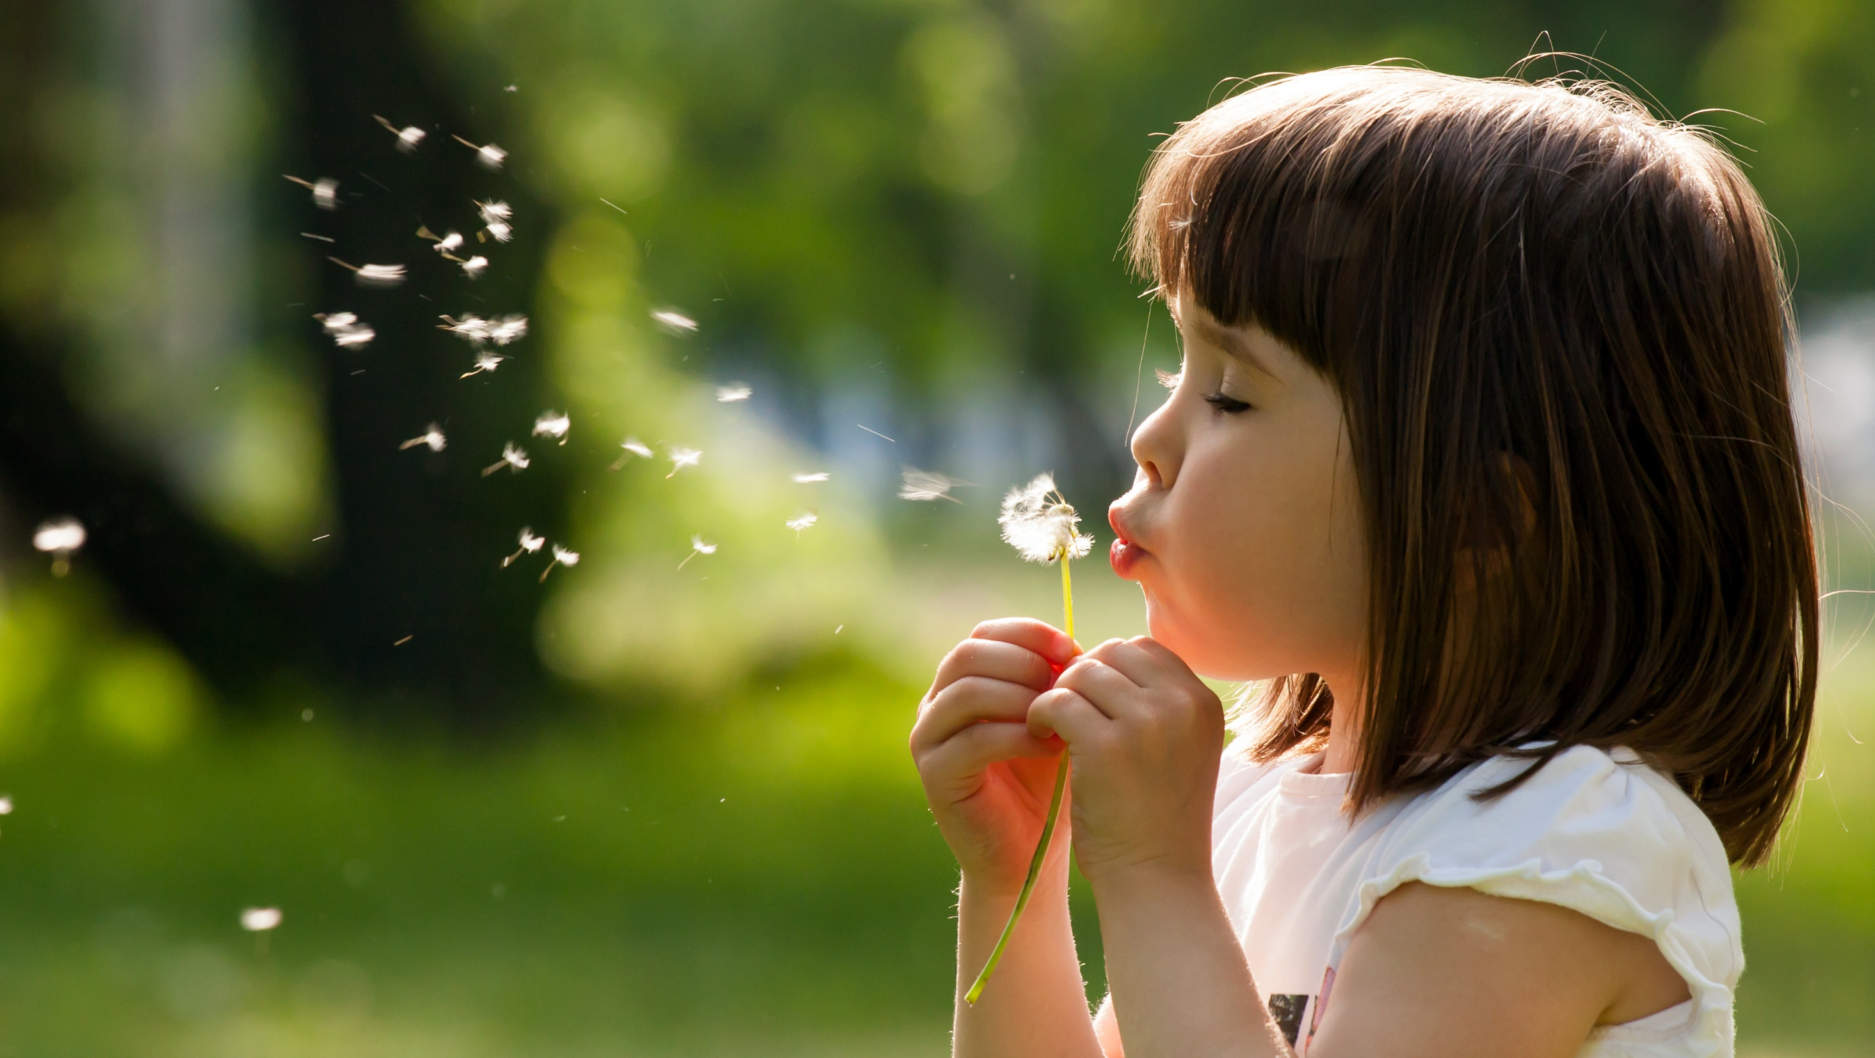
Enjoy your day!

