Slide 2



Unit
4
MY NEIGHBOURHOOD
LESSON 1: GETTING STARTED
Lost in the old town!
1

Slide 3
LESSON 1: GETTING STARTED
LESSON 1: GETTING STARTED
WARM-UP
Chitchatting
PRESENTATION
Vocabulary
Task 1: Listen and read.
Task 2: Find the sentences.
Task 3: Put the actions in order.
Task 4: Find and underline the directions.
PRACTICE
PRODUCTION
Game: Find places
CONSOLIDATION
Wrap-up
Homework

Slide 4

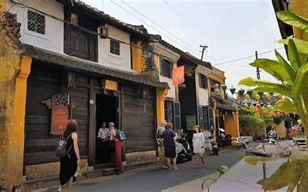
WARM-UP
Look at the pictures and answer the questions:
1.Do you know where it is?
2. Have you ever been to Hoi An?
3. Do you remember anything special in Hoi An?
CHIT-CHATTING

Slide 5
PRESENTATION
It’s the area surrounding a particular place.
What is it?
neighbourhood (n)
/ˈneɪbəhʊd/
Khu vực lân cận

Slide 6
PRESENTATION
You go to the new town and you do not know how to get back. It means you …
to be lost/get lost
/tuˈbɪ lɒst / /get lɒst/
đi lạc

Slide 7
PRESENTATION
New words | Pronunciation | Meaning
1. neighbourhood (n) | /ˈneɪbəhʊd/ | khu vực lân cận
2. to be/get lost | /tuˈbɪ lɒst/ /get lɒst/ | đi lạc

Slide 8
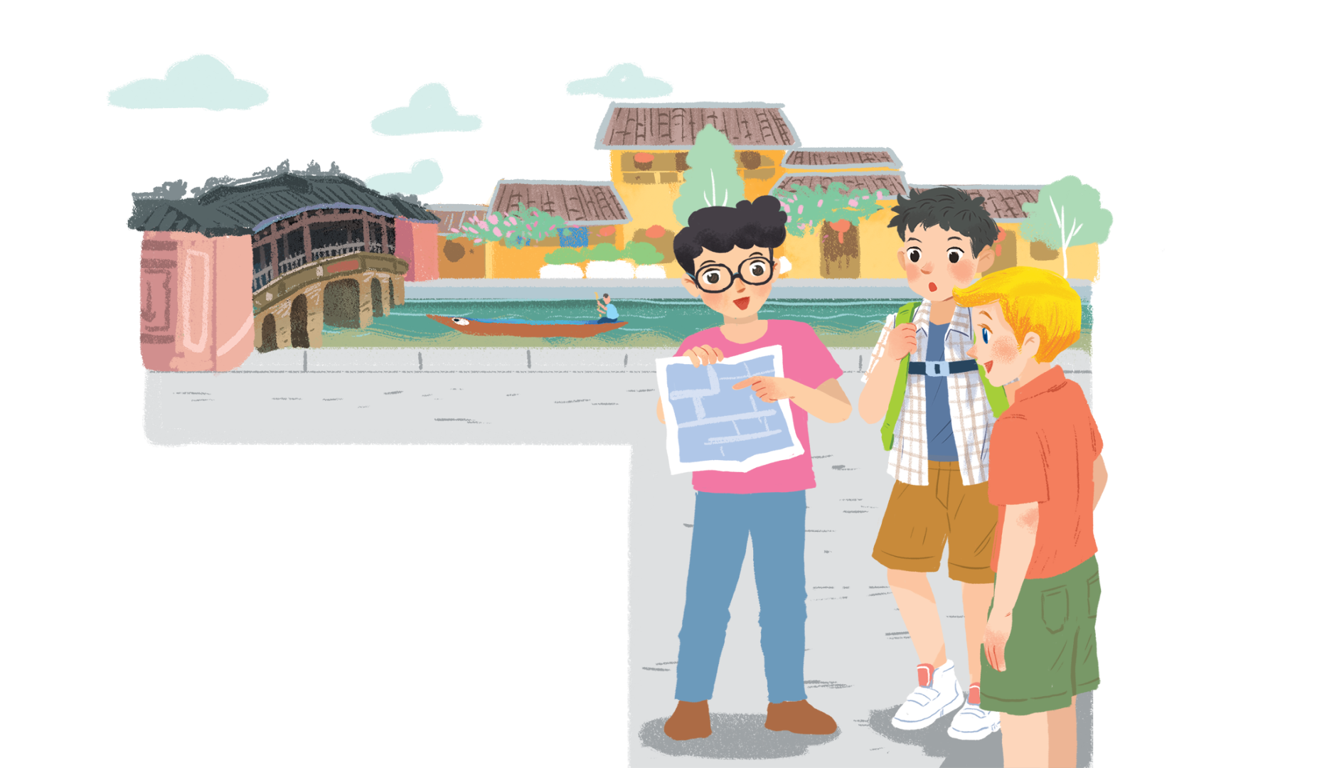

PRACTICE
Lost in the old town!
1. What are Nick, Phong and Khang doing?
2. Where are they?
3. What might be happening to them?
4. Have you ever got lost?
5. How did you feel? What did you do?

Slide 9
PRACTICE
1
Find in the conversation the sentences used to make suggestions.
Phong: Wow! We’re in Hoi An. I’m so excited.
Nick: Me too. It’s so beautiful. Where shall we go first?
Khang: Let’s go to Chua Cau.
Phong: Well, but Tan Ky house is nearer. Shall we go there first?
Nick & Khang: OK, sure.
Phong: First, cross the road, and then turn left.
Nick: Fine, let’s go.
Phong: Wait.
Khang: What’s up, Phong?
Phong: I think we’re lost.
Nick: Look, there’s a girl. Let’s ask her.
Phong: Excuse me? Can you tell us the way to Tan Ky House?
Girl: Sure. Go straight. Take the second turning on the left, and then turn right.
Phong, Nick & Khang: Thank you.

Slide 10

PRACTICE
2
Find in the conversation the sentences used to make suggestions.
Let’s go to Chua Cau.
Example:
We can use shall we and let’s to make suggestions.

Slide 11
PRACTICE
3
Read the conversation again. Put the actions in order.
a. The girl shows them the way to Tan Ky House.
b. Nick, Khang and Phong arrive in Hoi An.
c. Nick, Khang and Phong decide to go to Tan Ky House.
d. Nick, Khang and Phong get lost.
e. Phong asks a girl how to get to Tan Ky House.
5
1
2
3
4

Slide 12
PRACTICE
4
Find and underline the following directions in the conversation.
Phong: Wow! We’re in Hoi An. I’m so excited.
Nick: Me too. It’s so beautiful. Where shall we go first?
Khang: Let’s go to Chua Cau.
Phong: Well, but Tan Ky house is nearer. Shall we go there first?
Nick & Khang: OK, sure.
Phong: First, cross the road, and then turn left.
Nick: Fine, let’s go.
Phong: Wait.
Khang: What’s up, Phong?
Phong: I think we’re lost.
Nick: Look, there’s a girl. Let’s ask her.
Phong: Excuse me? Can you tell us the way to Tan Ky House?
Girl: Sure. Go straight. Take the second turning on the left, and then turn right.
Phong, Nick & Khang: Thank you.

Slide 13
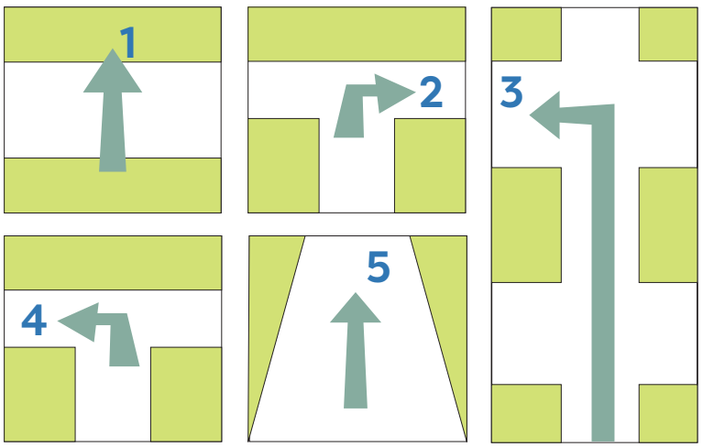
PRACTICE
* Now match these directions with the diagrams below.
turn right
take the second turning on the left
cross the road
turn left
go straight

Slide 14

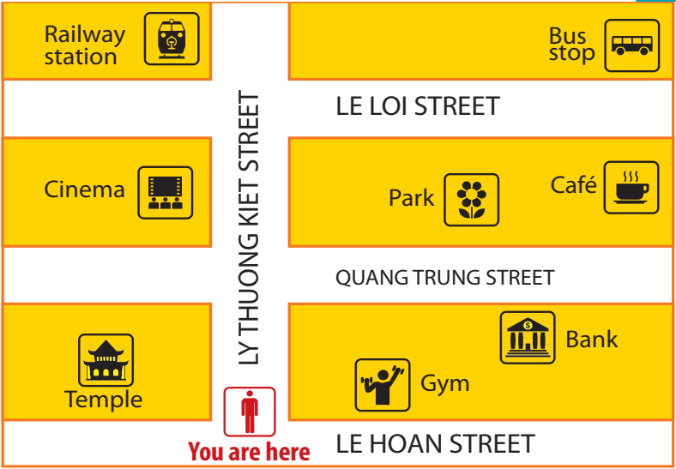
PRODUCTION
5
Find places
Example:
A: Go straight. Take the second turning on the left. It’s on your right.
B: Is that the gym?
A: No, try again.

Slide 15

CONSOLIDATION
1
Wrap-up
What have we learnt in this lesson?
identify the topic of the unit
use lexical items related to the unit topic
identify the language features that are covered in the unit

Slide 16

CONSOLIDATION
2
Homework
- Do exercises in the workbook.
- Start preparing for the Project in Lesson 7

Slide 17






Website: hoclieu.vn
Fanpage: facebook.com/www.tienganhglobalsuccess.vn/

