Slide 1
UNIT 4: DISASTERS
Lesson 2.2 – Grammar
pages 39 & 40

Slide 2
Lesson Outline
Warm-up
Vocabulary
Grammar
Practice
Consolidation
Wrap-up

Slide 3
By the end of this lesson, students will be able to…
Practice and use Preposition of place and movements correctly

Slide 4
WARM UP

Slide 5
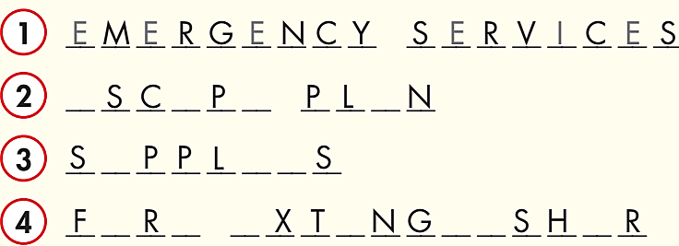
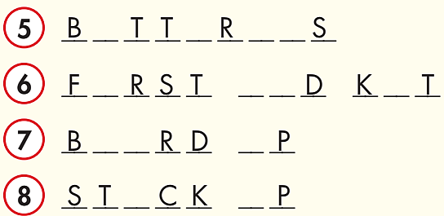
Look at the pictures. Complete the words about
EMERGENCY SERVICES
BATTERIES
ESCAPE PLAN
FIRST AID KIT
SUPPLIES
BOARD UP
FIRE EXTINGUISHER
STOCK UP

Slide 6
Listen and repeat.
board up (phr v) /bɔːrd ʌp/ bịt kín
escape plan (n) /ɪˈskeɪp plæn/ sơ đồ thoát hiểm
fire extinguisher (n) /ˈfaɪər ɪkˌstɪŋɡwɪʃə/ bình cứu hỏa
first aid kit (n) /ˌfɜːrst ˈeɪd kɪt/ bộ sơ cứu
battery (n) /ˈbætəri/ pin
supplies (n) /'səplaɪz/ nhu yếu phẩm
stock up (phr v) /stɑːk ʌp/ dự trữ
emergency services (n) /ɪˈmɜːrdʒənsi sɜːrvɪsɪz/ dịch vụ cấp cứu, cứu hộ

Slide 7
Grammar

Slide 8
We can use Prepositions of place to show
where something or someone is.
Note:
- Use “inside” to describe the location of things in buildings or containers.
- Do not use “inside” for things in outdoor locations like cities, parks, or beaches.

Slide 9
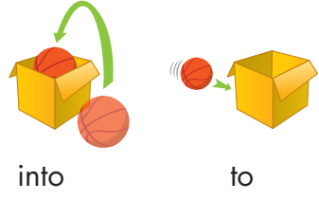
We can use Prepositions of movement to show movement from one place to another.

Slide 10
a. Read about prepositions of place and movement, then fill in the blanks.

Slide 11
b. Listen and check your answers. Listen again and repeat.


to



into

Slide 12
Practice

Slide 13
We can use Prepositions of place and movement before a noun or a noun phrase.
Read:
Keep a fire extinguisher in a safe place. Keep children and pets inside the house. You shouldn't go outside of your house. Keep your phone near you at all times. Get under a desk because something could fall on you. Move to higher ground. Don't drive or walk into flood water.
Keep a fire extinguisher in a safe place.
Keep children and pets inside the house.
You shouldn't go outside of your house.
Keep your phone near you at all times.
Get under a desk because something could fall on you.
Move to higher ground.
Don't drive or walk into flood water.

Slide 14
a. Read the sentences, then circle the correct words.
Stock up on supplies and stay inside/under your home.
In a flood, don't go outside/into the water.
Keep a phone near/to you and call emergency services if you are in danger.
If there's a tsunami, move into/to higher ground.
If there's an earthquake, get outside/under a table.
Board up doors and windows, and don't go near/outside of your house.

Slide 15
inside to near outside in
Tips to Stay Safe in a Wildfire
Have an escape plan. If the fire comes close, leave your home and follow your escape plan (1) ______ a safe place.
Keep fire extinguishers and first aid kits (2) ______ a safe place.
Move wooden outdoor furniture (3) ______ your house, to the center of rooms and away from windows.
Keep a phone (4) ______ you and make sure your phone has enough battery.
Make sure your car has enough gas.
Stay inside your house during the fire. Close doors and windows to keep smoke (5) _______ of your house.
Listen to local news report. Leave if news reports tell you to leave.
to
in
inside
near
outside

Slide 16
c. In pairs: Describe where things are in the classroom and where you can move classroom objects to.

Slide 17
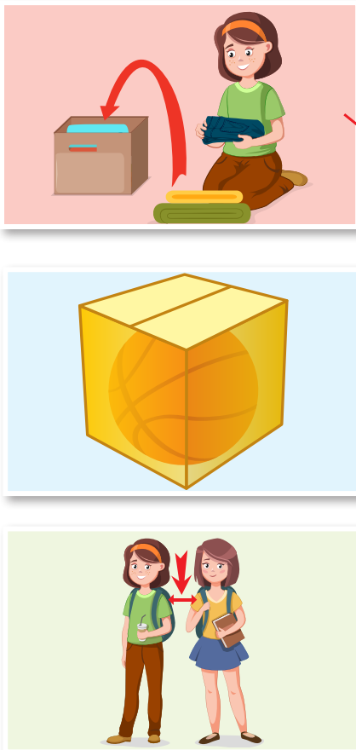
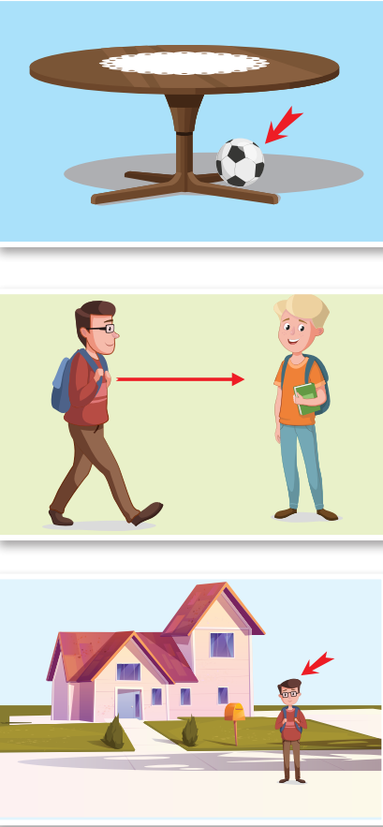
Draw lines to match the prepositions of place and movement to the pictures.
Extra Practice
WB, page 23
1.
2.
3.
4.
5.
6.
inside
to
near
into
under
outside

Slide 18
Extra Practice
NB, page 33
in
in
near
to
under
outside

Slide 19
CONSOLIDATION

Slide 20
Complete each sentence with a preposition of place or movement:
Keep a fire extinguisher _______ a safe place.
Keep children and pets _______ the house.
You shouldn't go _______ of your house.
Keep your phone _______ you at all times.
Get _______ a desk because something could fall on you.
Move _______ higher ground.
Don't drive or walk _______ flood water.
in
inside
Keep your book closed!
outside
near
under
to
into

Slide 21
WRAP-UP

Slide 22
Today’s lesson
To practice and use Preposition of place and movements correctly

Slide 23
Homework
Review Prepositions of place and movement.
Do the exercises on page 23 WB.
Do the exercises in Tiếng Anh 8 i-Learn Smart World Notebook on pages 33.
Prepare the next lesson (page 40-41, SB)
Play the consolidation games on www.eduhome.com.vn

Slide 24
Lesson 3
Stay positive and have a nice day!

