Slide 2
Unit 2
A multicultural world
LESSON I
GETTING STARTED
At the International Cultural Festival

Slide 3
LESSON I
GETTING STARTED
WARM-UP
Game: What is this?
PRESENTATION
Vocabulary
Task 1: Listen and read.
Task 2: Read and complete the table.
Task 3: Find words and a phrase.
Task 4: Complete the sentences.
PRACTICE
PRODUCTION
Poster design
CONSOLIDATION
Wrap-up
Homework

Slide 4
WARM-UP
Game: What is this?

Slide 5
WARM-UP
Rules
- Work in two teams.
- There are 6 pictures of 6 signature dishes of Viet Nam, Japan and Korea.
- Only one student from each group sees a picture.
- Use your own words to describe the food.
- Others guess the name of the food.
+ If the answer is correct ➔ one point for your team.
+ If the answer is incorrect ➔ the chance to answer is transferred to the other team.
+ The team having more points is the winner of the game.

Slide 6
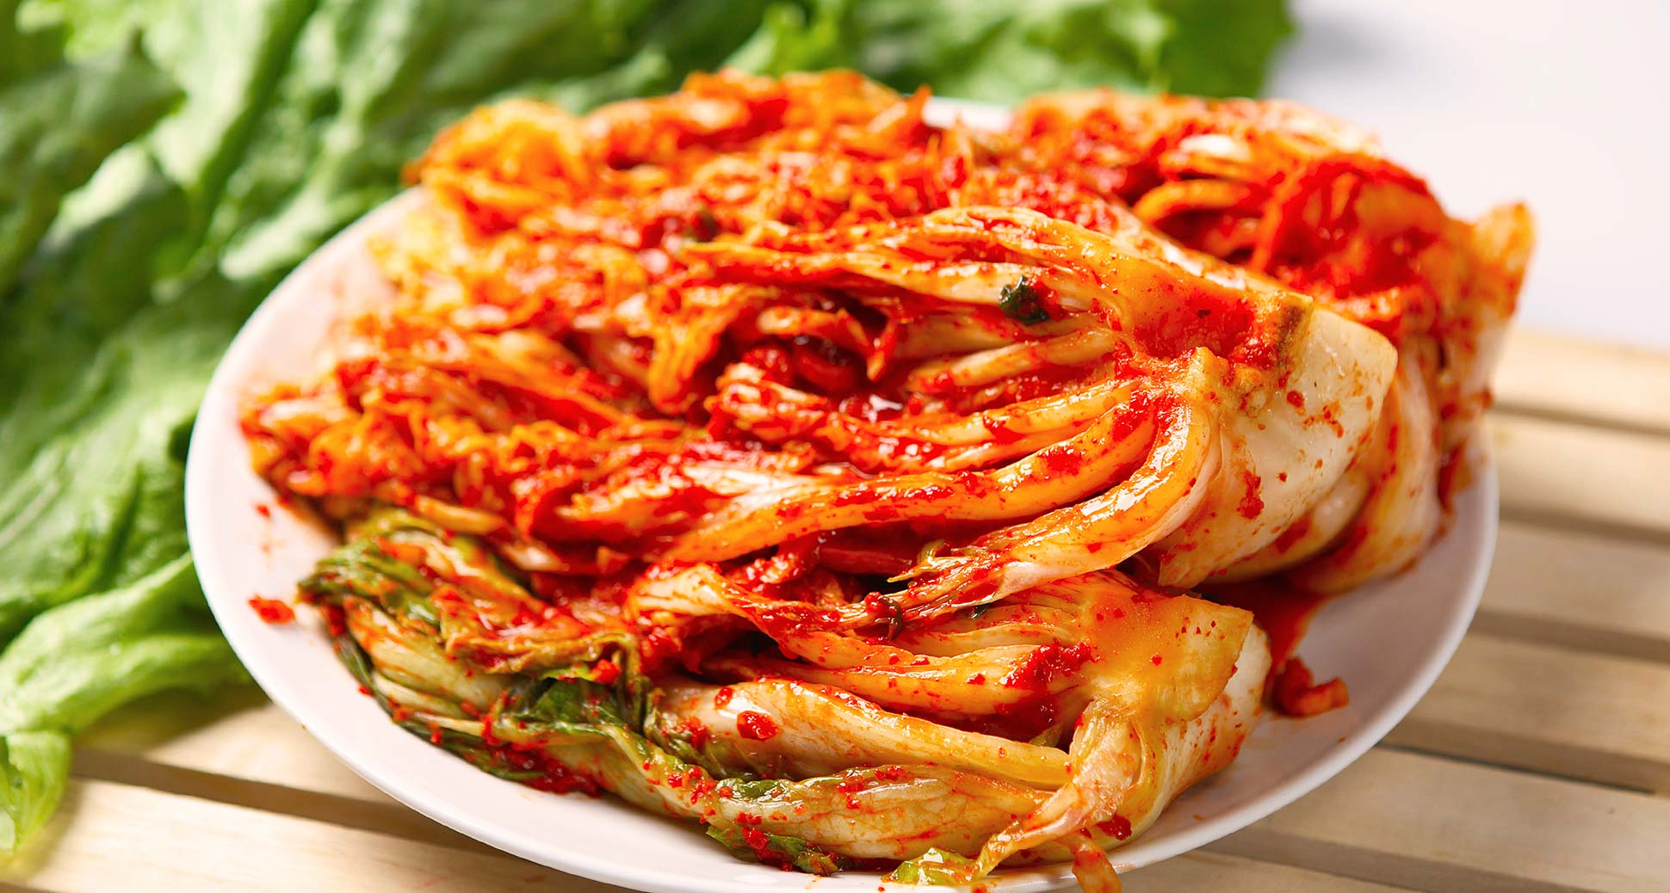
WARM-UP
kimchi

Slide 7
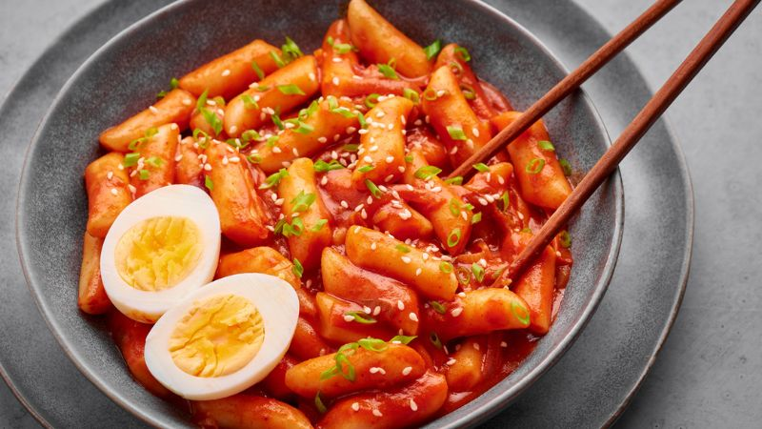
WARM-UP
tteokbokki – spicy rice cakes

Slide 8
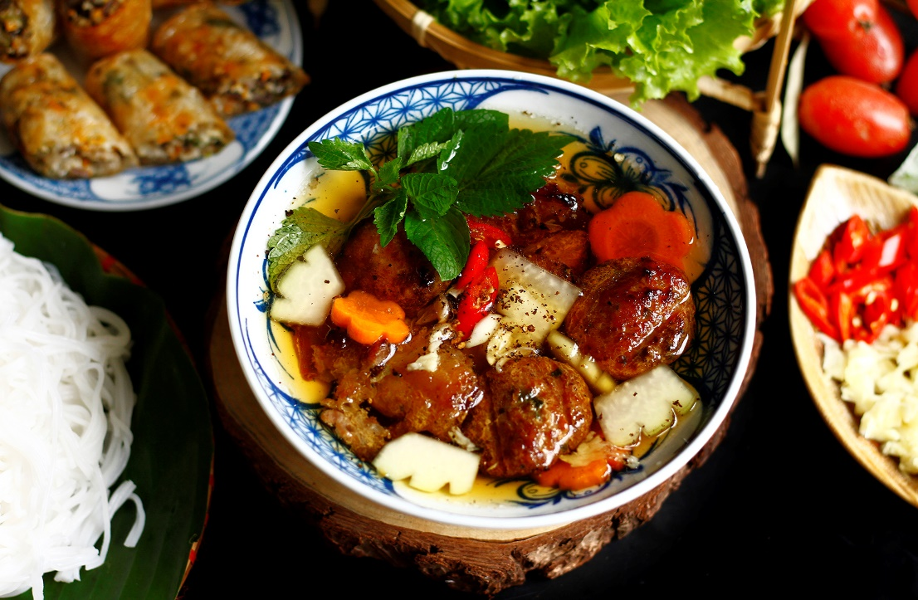
WARM-UP
bun cha – grilled pork meatballs with noodles

Slide 9
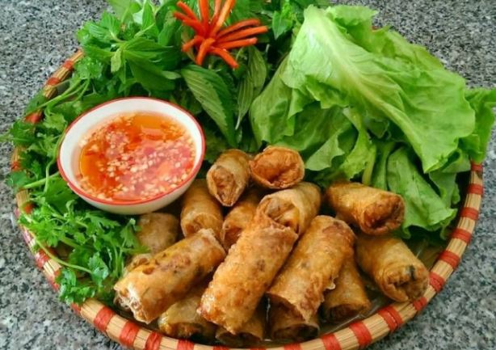
WARM-UP
spring rolls

Slide 10
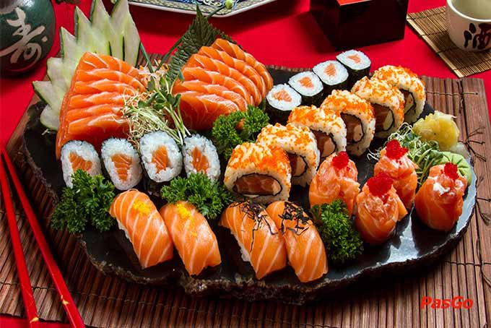
WARM-UP
sushi

Slide 11
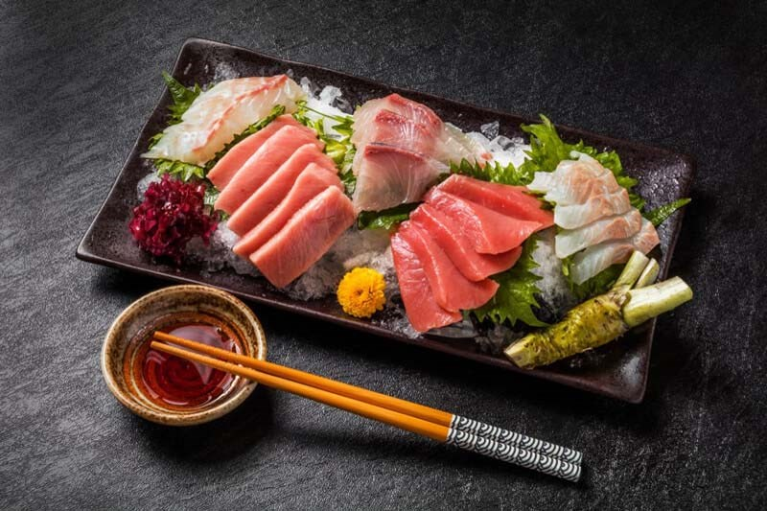
WARM-UP
sashimi

Slide 12


PRESENTATION
cultural diversity (n)
/ˈkʌltʃərəl daɪˈvɜːsəti/
the quality of diverse or different cultures

Slide 13
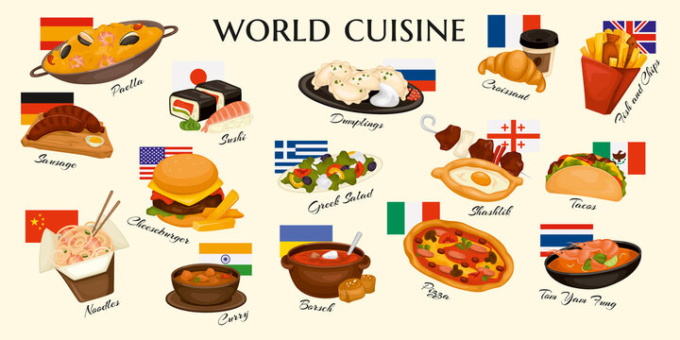

PRESENTATION
cuisine (n)
/kwɪˈziːn/
a style of cooking

Slide 14

PRESENTATION
autograph (n)
/ˈɔːtəɡrɑːf/
a signature (= your name written by yourself), especially of a famous person

Slide 15
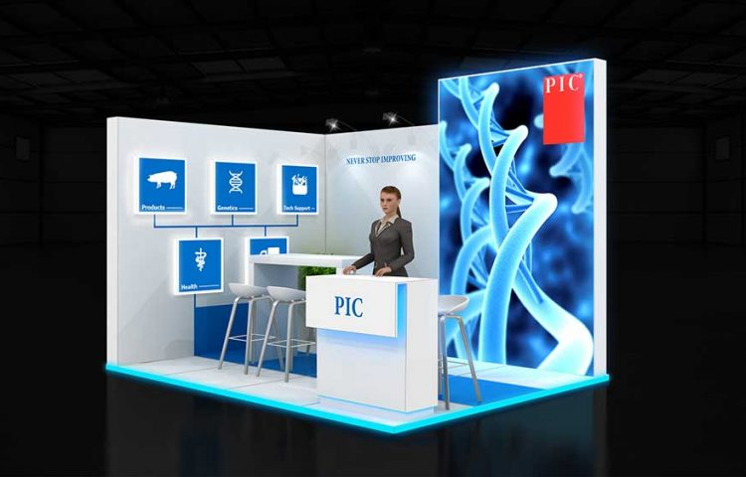
PRESENTATION
booth (n)
/buːð/
a small space like a box that a person can go into

Slide 16
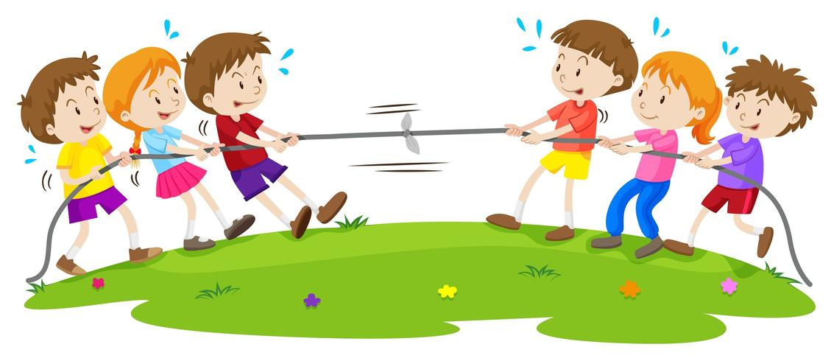
PRESENTATION
tug of war (n)
/ˌtʌɡ əv ˈwɔːr/
a type of sport in which two teams show their strength by pulling against each other at the opposite ends of a rope, and each team tries to pull the other over a line on the ground

Slide 17
PRESENTATION
Form | Pronunciation | Meaning | Vietnamese equivalent
1. cultural diversity (n) | /ˈkʌltʃərəl daɪˈvɜːsəti/ | the quality of diverse or different cultures | sự đa dạng văn hoá
2. cuisine (n) | /kwɪˈziːn/ | a style of cooking | ẩm thực
3. autograph (n) | /ˈɔːtəɡrɑːf/ | a signature (= your name written by yourself), especially of a famous person | chữ kí
4. booth (n) | /buːð/ | a small space like a box that a person can go into | gian hàng
5. tug of war (n) | /ˌtʌɡ əv ˈwɔːr/ | a type of sport in which two teams show their strength by pulling against each other at the opposite ends of a rope, and each team tries to pull the other over a line on the ground | kéo co

Slide 18
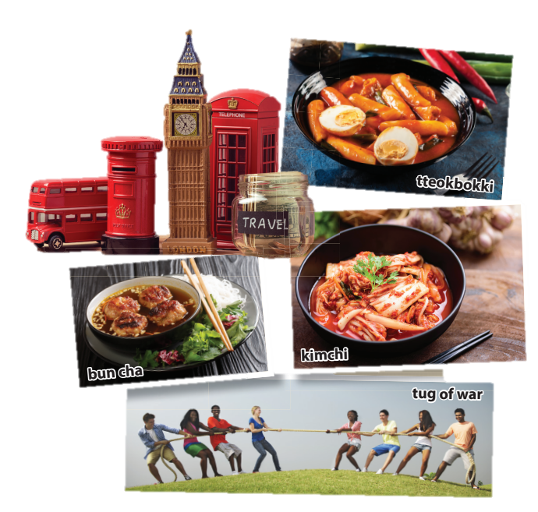
PRACTICE
1
Listen and read.
1. What can you see in the first photo?
2. What does the second picture show?
3. Where can you buy those souvenirs?
4. Who are the speakers?
a bowl of kimchi, bun cha, rice cake
some teenagers playing tug-of-war
England
Nam, Mai and Linda

Slide 19
PRACTICE
2
Read the conversation again and complete the table. Use no more than THREE words for each blank.
Country | Food to try | Things to do or buy
Japan | (1) _________
Korea | kimchi, tteokbokki | meet a K-pop (2) ___________ ________________
Britain | (3) ____________ | buy souvenirs
Viet Nam | spring rolls, (4) _________ | play games (tug of war, bamboo dancing)
sushi
group / singers
and get autographs
fish and chips
bun cha

Slide 20
PRACTICE
3
Find words and a phrase in 1 that have the same or similar meaning to the following words and phrases.
1. variety
2. a style of cooking
3. tasty
4. interesting places
diversity
cuisine
delicious
attractions

Slide 21
PRACTICE
4
Complete the sentences based on the conversation. use the correct article (a, an, the) or ∅ (no article).
1. Nam took Mai and Linda to _____ International Cultural Festival in Ha Noi.
2. Tasting food from different countries is a way to learn about _____ cultural diversity.
3. Nam tells his friends that ____ famous K-pop group will be at the Korean booth.
4. The Vietnamese booth is ____ open booth, and is very big.
the
∅
a
an

Slide 22


PRODUCTION
Design a poster to introduce
the International Cultural Festival

Slide 23
CONSOLIDATION
1
Wrap-up
What have you learnt today?
Some lexical items the topic A multicultural world
Reading for specific information
The article

Slide 24
CONSOLIDATION
2
Homework
Do exercises in the workbook.
Prepare for the project in Lesson 8.

Slide 25
Website: hoclieu.vn
Fanpage: facebook.com/www.tienganhglobalsuccess.vn

