Slide 1


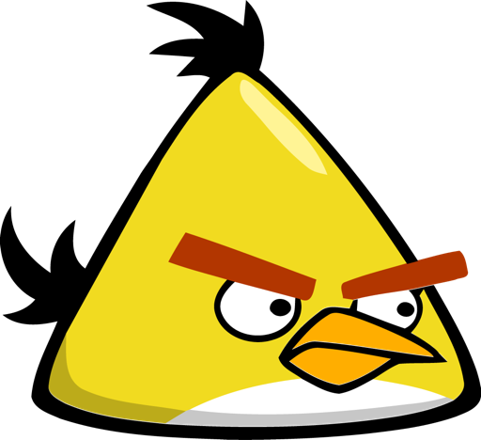

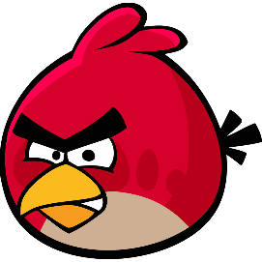

BẮN TRỨNG CÙNG ANGRY BIRDS
PLAY

Slide 2
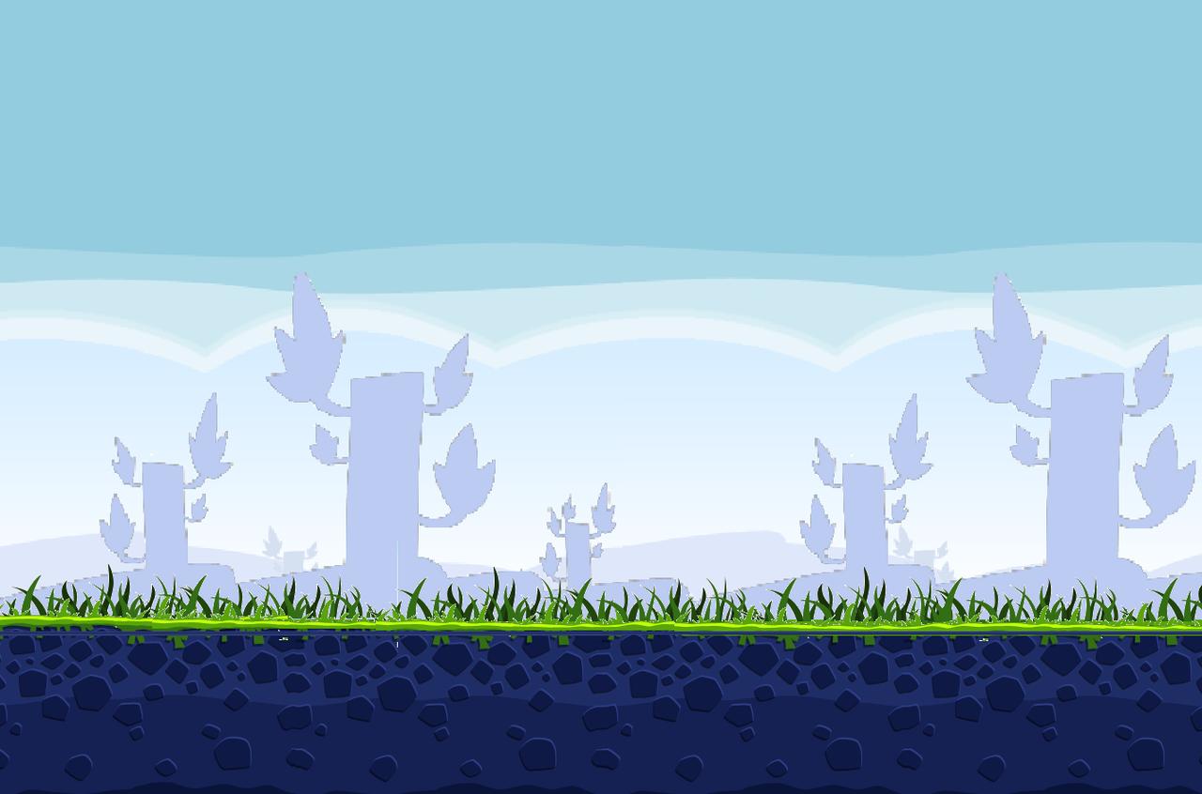
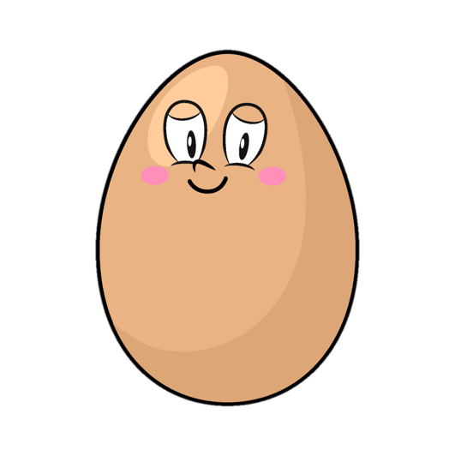
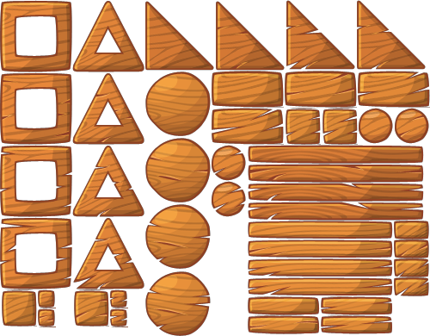



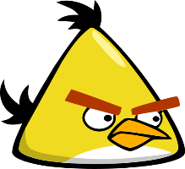
3
1 + 2 =
3
4

Slide 3


7
3 + 4 =
5
7

Slide 4

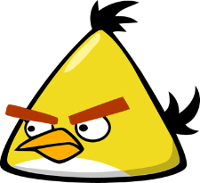
8
1 + 3 + 4 =
6
8

Slide 5

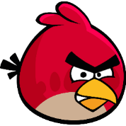
9
2 + 2 + 5 =
9
8

Slide 6
5
8 - 3 =
4
5

Slide 7
5
7 - 2 =
5
4

Slide 8


3
8 - 3 - 2 =
4
3

Slide 9

4
9 - 2 - 3 =
4
5

Slide 10
WELL DONE!!!
END

