Slide 1








UNIT 4.
MY NEIGHBORHOOD

Slide 2








PART 1. THEORY
I. VOCABULARY

Slide 3


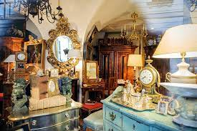
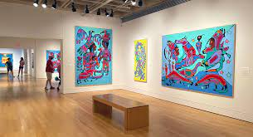

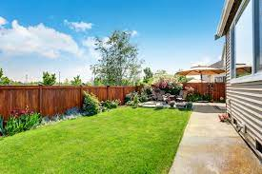
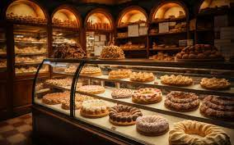


1. antique shop :
2. art gallery :
/ɑːt ‘gælərɪ/
phòng tranh
triển lãm
nghệ thuật
/æn’ti:k ʃɒp/
cửa hàng đồ cổ
3. backyard :
4. bakery :
/’beɪkərɪ/
cửa hàng
bán bánh
/,bæk’jɑːd/
sân sau

Slide 4
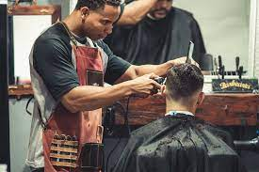
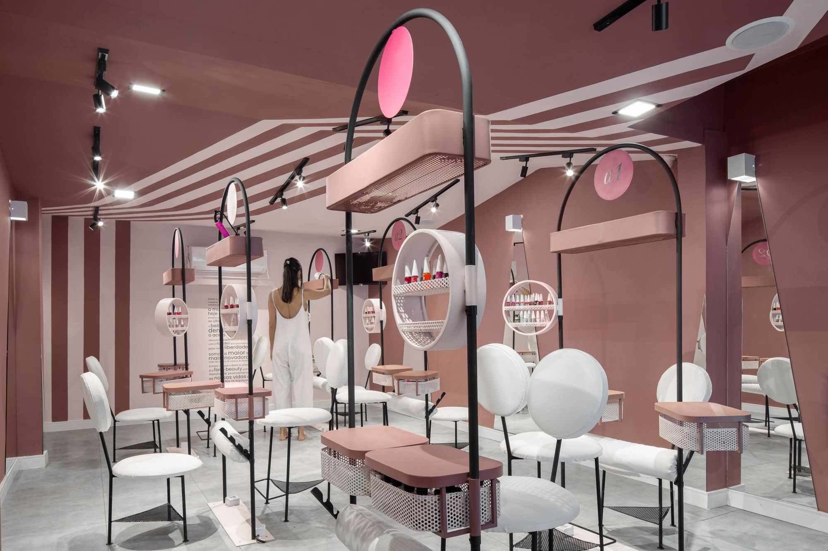
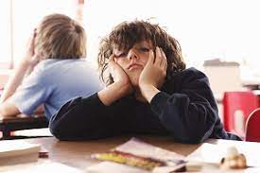
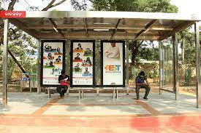
5. barber’s :
6. beauty salon :
/’bju:tɪ ‘sælɒn/
cửa hàng làm đẹp
/’bɑːbə(r)z/
hiệu cắt tóc
7. boring :
8. bus stop :
/'bʌs stɒp/
điểm dừng xe buýt
/’bɔ:rɪη/
buồn chán

Slide 5
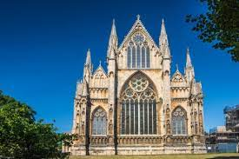
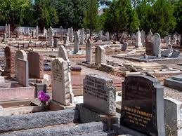
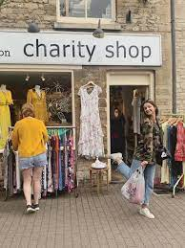
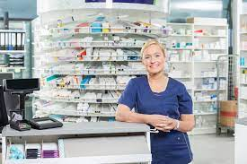
9. cathedral :
10. cemetery:
/'semətrɪ/
nghĩa trang
/’kəθi:drəl/
thánh đường,
giáo đường
11. charity shop :
12. chemist’s/ pharmacy :
/’tʃærətɪ ʃɒp/
cửa hàng từ thiện
/’kemɪsts/ /fɑːməsɪ/
hiệu thuốc

Slide 6
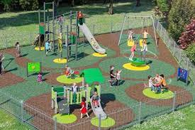
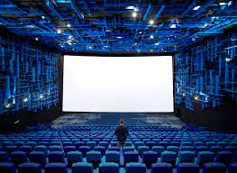
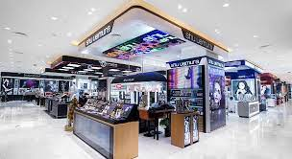
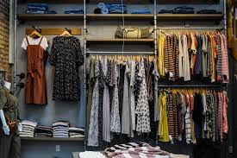
13. children’s playground :
14. cinema :
/’sɪnəmə/
rạp chiếu phim
/’tʃɪldrənz ‘pleɪgraʊnd/
sân chơi trẻ em
15. department store :
16. dress shop :
/dres ʃɒp/
cửa hàng
quần áo
/dɪ’pɑːtmənt stɔ:(r)/
cửa hàng bách hóa

Slide 7
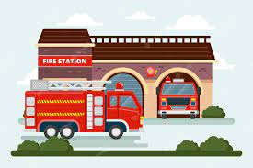
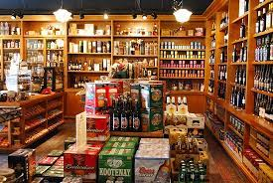
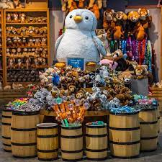
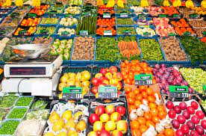
17. fire station :
18. general store:
/’faɪə(r)' steɪʃn/
trạm cứu hỏa
/’dʒenrəl stɔ:(r)/
cửa hàng tạp hóa
19. gift shop :
20. greengrocer's :
/’gri:ngrəʊsə(r)z/
cửa hàng rau quả
/gɪft ʃɒp/
cửa hàng
lưu niệm

Slide 8
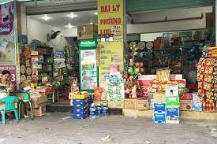
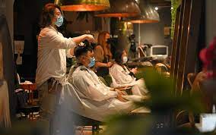

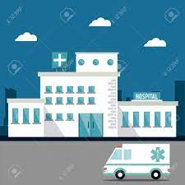
21. grocery :
22. hairdresser’s:
/’grəʊsərɪ/
cửa hàng tạp hóa
/'heədresə(r)z/
hiệu uốn tóc
24. hospital :
/hɒspɪtl/
bệnh viện
23. health centre :
/helθ ‘sentə(r)/
trung tâm y tế

Slide 9
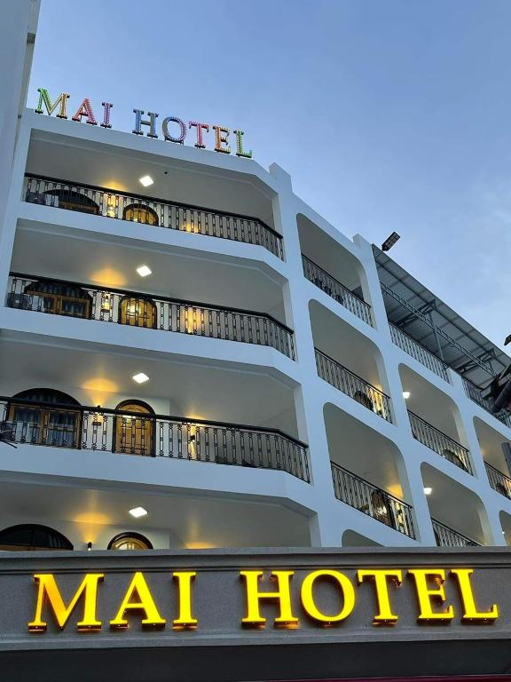
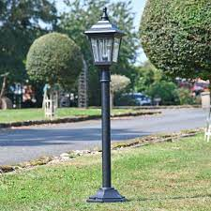
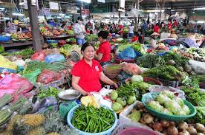
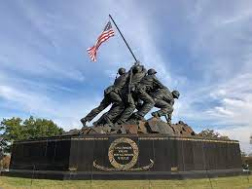
25. hotel :
/həʊ’tel/
khách sạn
26. lamp post :
/læmp pəʊst/
cột đèn đường
27. market :
28. memorial :
/mə’mɔ:rɪəl/
đài tưởng niệm
/’mɑːkɪt/
chợ

Slide 10
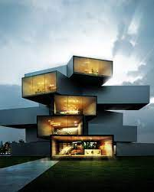
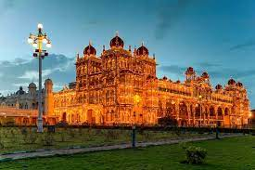
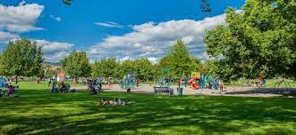
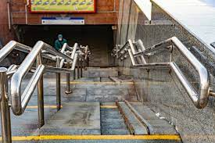
29. modern :
30. palace:
/’pæləs/
cung điện
/’mɒdn/
hiện đại
31. park :
32. pedestrian subway :
/pɑːk/
công viên
/pə’destrɪən ‘sʌbweɪ/
đường hầm đi bộ

Slide 11
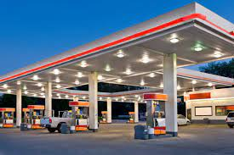
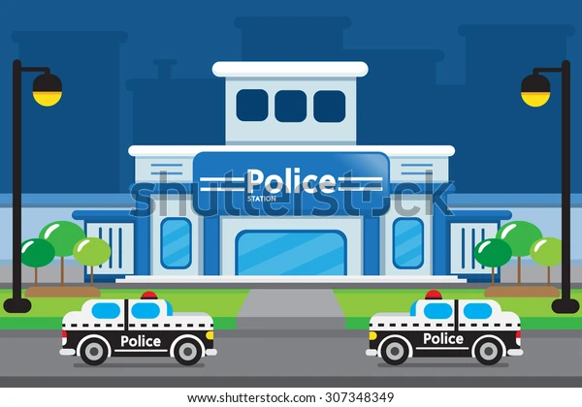
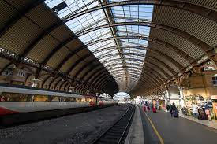
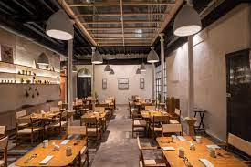
33. petrol station :
34. police station:
/pə’li:s ‘steɪʃn/
đôn cảnh sát
/’petrəl ‘steɪʃn/
trạm xăng
35. railway station :
36. restaurant :
/’restrɒnt/
nhà hàng
/reɪlweɪ ‘steɪʃn/
trạm xe lửa

Slide 12
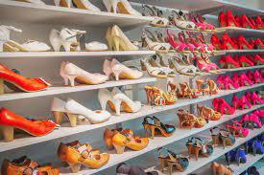
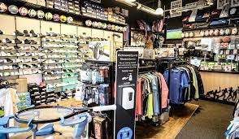
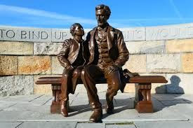
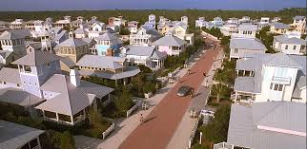
37. shoe shop :
38. sports shop:
/ʃu: ʃɒp/
cửa hàng giầy
/spɔ:t ʃɒp/
cửa hàng đồ
thể thao
39. statue:
40. suburb :
/’sʌbɜ:b/
vùng ngoại ô
/’stætʃu:/
tượng

Slide 13
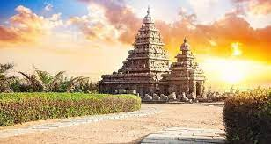
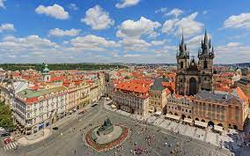
41. temple :
/’templ/
đền, miếu
42. town square :
/taʊn skweə(r)/
quảng trường thành phố

Slide 14
Vocabulary checking
https://wordwall.net/resource/37938926
https://wordwall.net/resource/39018602

Slide 15
Một vài tính từ hay gặp

Slide 16

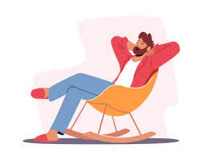

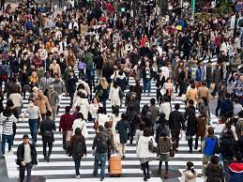
1. cheap :
2. comfortable :
/'kʌmftəbl/
thoải mái
/'tʃi:p/
rẻ
/kən’vi:niənt/
tiện nghi
/kraʊdɪd/
đông đúc
3. convenient :
4. crowded :

Slide 17
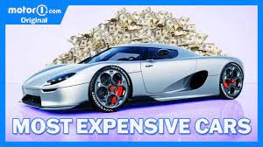

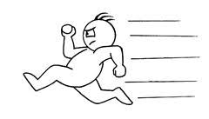
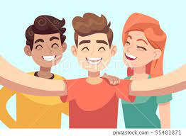
5. expensive :
/ɪk’spensɪv/
đắt
/fæ’tæstɪk/
tuyệt vời,
tuyệt diệu
6. fantastic :
/fɑːst/
nhanh
7. fast :
8. friendly :
/’frendlɪ/
thân thiện

Slide 18
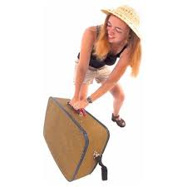
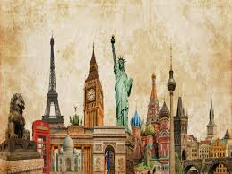
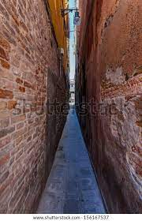
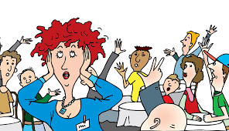
9. heavy :
/’hevɪ/
nặng, (giao thông)
đông đúc
10. historic:
/hɪ’stɒrɪk/
có tính chất
lịch sử
11. narrow:
/’nærəʊ/
hẹp, nhỏ
12. noisy :
/’nɔɪzɪ/
Ồn ào

Slide 19


13. peaceful :
/'pi’sfl/
yên bình
14. polluted :
/pə’lu:tɪd/
ô nhiễm

Slide 20
Vocabulary checking
https://wordwall.net/resource/38280425
Notes:
Choose the find the match template

Slide 21
PART 1. THEORY
II. GRAMMAR

Slide 22






1. Comparative adjectives
a. Form (Câu trúc)
- Với tính từ ngắn
S + be + adj-er + than ...
Ex: Lan is taller than Hoa.
Phong is stronger than Linh.
This car is cheaper than that car.
Summer is hotter than winter.
- Với tính từ dài
S + be + more adj + than ...
Ex: He is more intelligent than me.
This dress is more expensive than that dress.
My cellphone is more modern than her cellphone.
Life in the city is more convenient than life in the countryside.

Slide 23

b. Usage (Cách sử dụng)
Dạng so sánh hơn được sử dụng để so sánh tính chất của 2 người hoặc 2 vật với nhau. Trong tiếng Anh có 2 dạng tính từ so sánh đó là tính từ ngắn và tính từ dài.

Slide 24


Slide 25
Grammar checking
https://www.baamboozle.com/classic/461110
https://www.baamboozle.com/classic/1338901
Notes:
Chơi theo đội.

Slide 26
PART 1. THEORY
III. PHONETICS

Slide 27

c. Chú ý các trường hợp bất quy tắc

Slide 28







 Cách phát âm âm /ɪ/ và /i:/.
a. Âm /ɪ/
Cách phát âm
- Để phát âm âm /ɪ/ ta đưa lưỡi hướng lên trên và ra phía trước, khoảng cách môi trên và dưới hẹp, mở rộng miệng sang 2 bên nhưng hẹp hơn một chút so với âm /i:/.
- Các em hãy tập thực hành phát âm các từ sau:
bin /bɪn/ | begin /bɪ’gɪn/
fish /fɪʃ/ | minute /'mɪnɪt/
him /hɪm/ | dinner /'dɪnər/
gym /gɪm/ | chicken /'tʃɪkn/
six /sɪks/ | fifty /'fɪftɪ/

Slide 29
Cách nhận biết
- Chữ "a” được phát âm là /ɪ/ khi danh từ có hai âm tiết và có tận cùng bằng "age”.
Examples | Transcription | Meaning
village | /'vɪlɪdʒ/ | làng
cottage | /'kɔ:tɪdʒ/ | nhà tranh, lều tranh
shortage | /‘ʃɔ:tɪdʒ/ | tình trạng thiếu hụt
baggage | /'bægɪdʒ/ | hành lý trang bị cầm tay
courage | /’kʌrɪdʒ/ | lòng can đảm

Slide 30
- Chữ "e" được phát âm là /ɪ/ trong tiếp đầu ngữ "be”, "de" và "re”
Examples | Transcription | Meaning
begin | /bɪ'gɪn/ | bắt đầu
become | /bɪ'kʌm/ | trở nên
behave | /bɪ'heɪv/ | cư xử
defrost | /dɪ'frɔ:st/ | làm rã đông, làm tan giá
decide | /dɪ’saɪd/ | quyết định

Slide 31
- Chữ "i" được phát âm là /ɪ/ trong các từ có một âm tiết và tận cùng bằng chữ "i” + phụ âm
Examples | Transcription | Meaning
win | /wɪn/ | chiến thắng
miss | /mɪs/ | nhớ
ship | /ʃɪp/ | thuyền, tàu
bit | /bɪt/ | miếng nhỏ, một mẩu
sit | /sɪt/ | ngồi

Slide 32
- Chữ "ui” được phát âm là /ɪ/
Examples | Transcription | Meaning
build | /bɪld/ | xây dựng
guilt | /gɪlt/ | tội lỗi
guitar | /gɪtɑːr/ | đàn ghi ta
mosquito | /məs’kɪtəʊ/ | con muỗi

Slide 33
b. Âm /i:/
Cách phát âm
Để phát âm âm /i:/, ta đưa lưỡi hướng lên trên và ra phía trước, khoảng cách môi trên và dưới hẹp, mở rộng miệng sang 2 bên. Khi phát âm âm này, miệng hơi bè một chút, giống như đang mỉm cười vậy.
Các em hãy tập thực hành phát âm các từ sau:
sheep /ʃi:p/ see /si:/ bean /bi:n/ eat /i:t/ key/ki:/ | agree /ə'gri:/ complete /kəm'pli:t/ receive /rɪ'si:v/ believe /bɪ'li:v/ Vietnamese /vjetnə'mi:z/

Slide 34
Cách nhận biết
- Chữ "e” thường được phát âm là /i:/ khi từ có tận cùng là phụ âm + e và trong các từ như be, he, she, me,...
Examples | Transcription | Meaning
scene | /si:n/ | phong cảnh
complete | /kəm'pli:t/ | hoàn toàn
Vietnamese | /vjetnə’mi:z/ | người Việt Nam

Slide 35
- Chữ "ea” thường được phát âm là /i:/ khi từ có tận cùng là “ea” hoặc “ea” + một phụ âm
Examples | Transcription | Meaning
tea | /ti:/ | trà
meal | /mi:l/ | bữa ăn
easy | /’i:zɪ/ | dễ dàng
cheap | /tʃi:p/ | rẻ
meat | /mi:t/ | thịt

Slide 36
- Chữ "ee” thường được phát âm là /i:/
Examples | Transcription | Meaning
three | /θri:/ | SỐ 3
see | /si:/ | nhìn, trông, thấy
free | /fri:/ | tự do
heel | /hi:l/ | gót chân
screen | /skri:n/ | màn ảnh

Slide 37
- Chữ "ei" được phát âm là /i:/ khi đi sau âm /s/ hoặc chữ c, s
Examples | Transcription | Meaning
receive | /rɪ'si:v/ | nhận được
ceiling | /’si:lɪη/ | trần nhà
receipt | /rɪ’si:t/ | giấy biên lai
seize | /si:z/ | nắm lẩy, túm lấy

Slide 38
- Chữ "ie” được phát âm là /i:/ khi nó là những nguyên âm ở giữa một chữ
Examples | Transcription | Meaning
grief | /gri:f/ | nỗi lo buồn
chief | /tʃi:f/ | người đứng đầu
believe | /bɪ'li:v/ | tin tưởng
belief | /bɪ'li:f/ | niềm tin, lòng tin

Slide 39
PART 2. LANGUAGE
I. VOCABULARY

Slide 40





Ex 1. Look at the pictures and complete the blanks with the words from the box.

Slide 41

Ex 1. Look at the pictures and complete the blanks with the words from the box.
statue
railway station
memorial
cathedral
palace
petrol station
police station
cemetery

Slide 42

Ex 1. Look at the pictures and complete the blanks with the words from the box.
shoe shop
hairdresser's
lamp post
pedestrian subway
fire station
beauty salon
dress shop
children's playground
gift shop
greengrocer's
sports shop
bakery

Slide 43
Exercise 2. Choose the correct adjectives to complete the sentences.
1. The road is not (wide/ narrow) enough for two cars to pass comfortably.
2. Inside the cathedral, it's (noisy/ peaceful) and quiet.
3. Those shoes are really (cheap/ expensive) – they only cost £25.
4. My house is rather far from my school, so it’s a bit (convenient/ inconvenient).
5. Kids always find Christmas (exciting/ boring). They are always looking forward to Christmas.
6. The air in the countryside is fresh and (polluted/unpolluted).
7. Hoi An is a(n) (old/ modern) town near Da Nang.
8. There are a lot of shops nearby, so the streets are always busy and (noisy/ quiet) during the day.

Slide 44

Exercise 3. Read and do the crossword below.
B U S S T O P
C
I
N
M
A
B
A
K
R
Y
P
R
K
P
A
R
M
A
C
Y
A R T G A L L E R Y E H
E
S
T
A
U
R
A
N
T
M A R E T
C A F E T E R I
H O S P I T L

Slide 45
Exercise 4. Complete the sentences with suitable words from the box.
fast
modern
narrow
expensive
suburb
peaceful
polluted
boring
fantastic
noisy
1. Air in city is more ____________ than air in countryside.
2. This shirt is 40.000. That shirt is 30.000. This shirt is more ____________ than that shirt.
3. Life in countryside is quite ____________.
4. Would you like to live in a ________________apartment or a traditional house?
5. We are going to spend tonight in the mountain. It is going to be very ____________ because there is nothing to play with.
6. My neighbor is having his house rebuilt. It is so ____________ that I cannot focus on anything.
7. This street is so ____________ that heavy traffic usually occurs.
8. Turtles are slow. Rabbits are ____________.
9. My family lives in the ____________ of a big city.
10. Having a villa with a beach view is ____________.

Slide 46
PART 2. LANGUAGE
II. GRAMMAR

Slide 47
Exercise 1. Make the comparative form of the following adjectives.
No. | Adjective | Comparative adjective
1 | narrow
2 | historic
3 | polluted
4 | short
5 | good
6 | boring
7 | peaceful
more narrower
more historic
more polluted
shorter
better
more boring
more peaceful

Slide 48
Exercise 1. Make the comparative form of the following adjectives.
No. | Adjective | Comparative adjective
8 | crowded
9 | bad
10 | modern
11 | fast
12 | cheap
13 | convenient
14 | noisy
15 | heavy
more crowded
worse
more modern
faster
cheaper
more convenient
noisier
heavier

Slide 49
Exercise 2. Complete the sentences with comparative adjectives.
1. My house is (big) ____________ than yours.
2. This flower is (beautiful) _______________ than that one.
3. Buildings are (high) ____________ than houses.
4. Non-smokers usually live (long) ____________ than smokers.
5. A holiday by the sea is (good) ____________ than a holiday in the mountains.
6. It is strange but often a coke is (expensive) _______________ than a beer in my country.
7. Dogs are (intelligent)_________________ than rabbits.
bigger
more beautiful
higher
longer
better
more expensive
more intelligent

Slide 50
Exercise 2. Complete the sentences with comparative adjectives.
8. Lucy is (old) ______________ than Ellie.
9. Russia is far (large) ______________ than UK
10. My Latin class is (boring) __________________ than my English class.
11. In the UK, the streets are generally (narrow) ____________ than in the USA.
12. London is (busy) ____________ than Glasgow.
13. Julie is (quiet) ____________ than her sister.
14. Amanda is (ambitious) ________________ than her classmates.
15. My garden is a lot (colourful) _________________ than this park.
eder
larger
more boring
narrower
busier
quieter
more ambitious
more colourful

Slide 51
Exercise 3. Rewrite the sentence using comparative form,
the first one has been done for you as an example.
0. Hue/small/Hanoi
→ Hue is smaller than Hanoi.
    1. My school/ big/ your school.
    → My school is bigger than your school.
        2. My father/ old/ my mother.
        → My father is elder than my mother.
            3. This ruler/long/that ruler.
            → This ruler is longer than that ruler.
                4. This room/large/my room.
                → This room is larger than my room.
                5. The boys/ strong/ the girls.
                → The boys are stronger than the girls.

Slide 52
Exercise 3. Rewrite the sentence using comparative form,
the first one has been done for you as an example.
6. Everest/ high/ other mountains in the world.
→ Everest is higher than other mountains in the world.
    7. Summer/ hot/ winter.
    → Summer is hotter than winter.
        8. Phuong/good at English/Mai Ly
        → Phuong is better at English than Mai Ly
            9. A dictionary/ thick/ a textbook.
            → A dictionary is thicker than a textbook.
                10. The Great Wall/ long/ Hadrian's Wall.
                → The Great Wall is longer than Hadrian's Wall.

Slide 53
Ex 4. Complete the sentences with the correct forms of the adjectives in brackets. Number 1 is an example for you.
1. Maths is more boring than English, (boring)
2. The French restaurant in our town is _______________ the Italian restaurant. (expensive)
3. Love is _________________ money. (important)
4. Your flat is _____________ mine. (large)
5. Our theater is _____________ our cinema. (big)
6. Iron is _____________ wood. (heavy)
7. My Physics course is _________________ my Math course. (difficult)
more expensive than
more important than
larger than
bigger than
heavier than
more difficult than

Slide 54
Ex 4. Complete the sentences with the correct forms of the adjectives in brackets. Number 1 is an example for you.
8. My mum is _____________ my dad. (busy)
9. My new school is _______________ my old school. (modern)
10. This chair is ___________________ that chair. (comfortable)
11. Museums are _________________ art galleries. (interesting)
12. The market is _____________ the shopping centre. (cheap)
13. The amusement park is _____________ the swimming pool. (noisy)
14. The Nile River is _____________ the Mississippi. (long)
15. A dog is _________________ a cow. (intelligent)
busier than
more modern than
more comfortable than
more interesting than
cheaper than
noisier than
longer than
more intelligent than

Slide 55
Exercise 5. Complete the second sentence so that it means the same as the first sentence, using the adjective in capitals.
1. The first question was easier than the second one. (DIFFICULT)
→ The second question
2. The black coat is smaller than the brown one. (BIG)
→ The brown coat
3. The chair isn’t as comfortable as the sofa. (COMFORTABLE)
→ The sofa
4. Jim’s suitcase was lighter than Jack’s suitcase. (HEAVY)
→ Jack’s suitcase
5. His homework was better than mine. (BAD)
→ My homework
was more difficult than the first one.
is bigger than the black one.
is more comfortable than the chair.
is bigger than the black one.
was more difficult than the first one.

Slide 56
Exercise 5. Complete the second sentence so that it means the same as the first sentence, using the adjective in capitals.
6. The big television is more expensive than the small one. (CHEAP)
→ The small television
7. The Royal Hotel is more old-fashioned than the Holton Hotel. (MODERN)
→ The Holton Hotel
8. The weather yesterday was worse than it is today. (GOOD)
→ The weather today
9. People in the city aren’t as friendly as those in the country. (FRIENDLY)
→ People in the country
10. Life in the city is more interesting than life in the country. (BORING)
→ Life in the country
is cheaper than the big one.
is more modern than the Royal Hotel.
is better than it was yesterday.
are friendlier than those in the city.
more boring than life in the city.

Slide 57
PART 2. LANGUAGE
III. PHONETICS

Slide 58
Exercise 1. Divide the words into two columns: /ɪ/ or /i:/
cheap
cinema
seafood
city
exciting
building
keep
historic
village
beach
peaceful
convenient
busy
street
sheep
slim
evening
different
delicious
think
/i/ | /i:/

Slide 59
Exercise 2. Circle the word that has the underlined part pronounced differently.
1. A. live B. wide C. bicycle D. exciting
2. A. feet B. seat C. near D. team
3. A. busy B. city C. think D. terrible
4. A. great B. heat C. cheek D. peaceful
5. A. historic B. expensive C. office D. finally
6. A. film B. city C. nice D. miss
7. A. big B. wide C. quite D. exciting
8. A. cheap B. sleepy C. near D. peaceful
9. A. heavy B. sea C. team D. street
10. A. noisy B. expensive C. house D. post

Slide 60
PART 3. COMMUNICATION SKILLS
I. LISTENING

Slide 61





Exercise 1. Listen and decide if each statement is True (T) or False (F).  Track 07
1. If you are _________, there are many places for you to go.
2. Besides people, there are many ____________in the city.
3. _________is where you can see art works.
4. If you are hungry, let's have _________at a restaurant.
5. If you don't want to travel around the city, let's take a bus, a taxi or even a _________.
bored
buildings
Gallery
dinner
plane

Slide 62
Exercise 2. Listen again and answer the question.  Track 08
1. Where can you see a movie?
→ At a cinema.
2. What can you see at a museum?
→ An exhibition
3. Where do people buy groceries?
→ At a supermarket
4. What can you buy at a bakery?
→ Bread
5. How many ways to travel around the city are mentioned?
→ Four ways

Slide 63
PART 3. COMMUNICATION SKILLS
II. SPEAKING

Slide 64
Exercise 1. Complete the following conversations with missing words.
Conversation A
Tourist: Excuse me. Can you (1) ____________________ me the (2) ___________ to Ben Thanh Market?
Hoa: Ben Thanh Market? Go straight (3) ___________________.
(4) ___________ the second turning (5) ___________ the right. Ben Thanh Market is on your left.
Tourist: Is there a post office near (6) ___________?
Hoa: Oh, yes. It’s opposite (7) ___________ supermarket.
Tourist: Thank you very much.
Hoa: You’re (8) ___________.
there
way
ahead
Take
on
here
the
welcome

Slide 65
Exercise 1. Complete the following conversations with missing words.
Conversation B
Tourist: Excuse me. Is (1) ___________ a restaurant near here?
Lan: Oh, yes. But it's not very near here. Turn right into Tran Phu Street. (2) ___________ the first turning (3) ___________ the left. You will be on Nguyen Trai Street. The restaurant is (4) ___________ the end of the street.
Tourist: That's so far.
Lan: (5) ___________ do you go there?
Tourist: I walk.
Lan: You should go (6) ___________ taxi.
Tourist: Thank you. Bye.
Lan: Not at all. Bye.
there
Take
on
at
How
by

Slide 66
Exercise 2. Put the conversation in the correct order.
a. How long does it take to get there?
b. Thank you so much.
c. Excuse me! Could you tell me the way to the nearest supermarket, please?
d. Yes. There is a bank opposite the post office.
e. Not at all.
f. Go straight on and turn left at the bookstore. The supermarket will be across the street, next to the post office.
g. It’s just a fifteen-minute walk.
h. Thanks a lot. Is there a bank near the supermarket?
Your answer
c
f
a
g
h
d
b
e
1. _____ | 2. _____ | 3. _____ | 4. _____ | 5. _____ | 6. _____ | 7. _____ | 8. _____

Slide 67
PART 3. COMMUNICATION SKILLS
III. READING

Slide 68
Exercise 1. Read the passage and answer the question.
I live in a house near the sea. It is an old house, about 20 years old, and it is not very large. There are two bedrooms upstairs but no bathroom. The bathroom is downstairs next to the kitchen and there is a living room where there is a lovely old fireplace. There is a garden goes down to the beach and in spring and summer there are flowers everywhere. I live alone with my dog, Boxer but we have many visitors. Many of my friends work in the city, so they often stay with me because they want to relax. I love my house for many reasons: the garden, the flowers in summer, the fire in winter.

Slide 69
Exercise 1. Read the passage and answer the question.
1. Where is the house?
→ It's near the sea.
2. How old is the house?
→ It's about 20 years old.
3. How many bedrooms are there upstairs?
→ There are two bedrooms.
4. Why does the owner of the house have so many visitors?
→ Because they want to relax.
5. Why does the owner love his house?
→ He loves his house for many reasons: the garden, the flowers in summer, the fire in winter.

Slide 70
Exercise 2. Read the passage and decide which statements are true (T) or false (F).
I have a good friend. Her name is Nga. She’s in class 6A. This is her routine. Every morning, Nga gets up at half past six. She washes her face, brushes her teeth and eats a big breakfast. Then she goes to school at seven o’clock. She has lessons from half past seven to half past eleven. At twelve o'clock, she has lunch. In the afternoon, she does the housework. Then she plays volleyball with her friends. In the evening, she does homework. She goes to bed at ten o’clock.

Slide 71
Exercise 2. Read the passage and decide which statements are true (T) or false (F).
Statements | T | F
1. Every morning, Nga gets up at six thirty.
2. She has a quick and small breakfast.
3. She goes to school at half past seven.
4. She has lessons from half past seven to twelve o’clock.
5. In the evening, she does her homework and goes to bed at ten.
T
F
F
F
T

Slide 72
Exercise 3. Read the text and answer the questions.
Mai Anh goes to Nha Trang with her family on holiday. She stays at a hotel on the side of the beach. In the early morning, she goes to the sea and swims for an hour. Then she has breakfast in a canteen on the beach to enjoy fresh air in the morning. In the afternoon, she takes some photos of the sights. She is staying in Nha Trang for four days and takes of a lot of nice photos. She is buying some postcards and souvenirs for her friends. It is an enjoyable holiday because she has a lot of fun.

Slide 73
Exercise 3. Read the text and answer the questions.
1. Where does Mai Anh go on holiday?
→ She goes to Nha Trang on holiday.
2. What does she do in the early morning?
→ In the early morning, she goes to the sea and swims for an hour.
3. What does she do in the afternoon?
→ In the afternoon, she takes some photos of the sights.
4. How long is she staying in Nha Trang?
→ She is staying in Nha Trang for four days.
5. Why is her holiday enjoyable?
→ Because she has a lot of fun.

Slide 74
PART 3. COMMUNICATION SKILLS
IV. WRITING

Slide 75
Exercise 1. Reorder the words or phrases to make meaningful sentences.
1. we/ first/ where/ go/ this morning/ shall?
→ Where shall we go first this morning?
2. the cafeteria/ and/ a cold drink/ let’s/ get/ to/ go.
→ Let's go to the cafeteria and get a cold drink.
3. like/ you/ the countryside/ do/ living/ in?
→ Do you like living in the countryside?
4. neighbourhood/ post office/ in/ there/ your/ a/ is?
→ Is there a post office in your neighborhood?

Slide 76
Exercise 1. Reorder the words or phrases to make meaningful sentences.
5. me/ you/ the way/ could/ the Japanese Bridge/ to/ tell/ please?
→ Could you tell me the way to the Japanese Bridge, please?
6. houses/ are/ there/ historic/ Hoi An/ many/ ancient town/ in.
→ There are many historic houses in Hoi An ancient town.
7. polluted/ smoke/ the air/ is/ with/ factories/ from.
→ The air is polluted with smoke from factories.
8. much/ than/ living in a big city/ expensive/ is/ living in the countryside/ more
→ Living in a big city is much more expensive than living in the countryside.

Slide 77
Exercise 2. Complete the second sentence so that it means the same meaning.
1. Shall we go to the Japanese Covered Bridge first?
→ Let's
2. Helen’s brother is shorter than her.
→ Helen
3. Travelling abroad for a holiday is much more expensive than travelling in your country.
Travelling in your country
4. Country life isn’t as interesting as city life.
→ City life is
5. Would you mind telling me the way to the National Museum?
→ Can
go to the Japanese Covered Bridge first .
is taller than her brother.
for a holiday is much/ a lot cheaper than travelling abroad.
more interesting than country life.
you tell me the way to the National Museum, please?

Slide 78
Exercise 2. Complete the second sentence so that it means the same meaning.
6. The bus stop is in front of the hotel.
→ The hotel
7. Turn left at the first traffic lights.
→ Take
8. The weather yesterday was worse than it is today.
→ The weather today is
9. There are three supermarkets in my town.
→ My town
10. The shopping mall is near the Italian restaurant.
→ The Italian restaurant isn’t
is behind the bus stop.
the left turning at the first traffic lights.
better than it was yesterday.
has three supermarkets.
far from the shopping mall.

Slide 79
Exercise 3. Use the words in brackets to rewrite the sentences without
changing the meaning of the original sentences.
1. How about playing volleyball for a change? (SHALL)
→ Shall we play volleyball for a change?
2. Do you want to go for lunch now? (WOULD)
→ Would you like to go for lunch now?
3. Can you tell me the way to the nearest post office? (HOW)
→ How do I get to the nearest post office?
4. The first question in the test was easier than the second one. (DIFFICULT)
→ The second question in the test was more difficult than the first one.

Slide 80
Exercise 3. Use the words in brackets to rewrite the sentences without
changing the meaning of the original sentences.
5. I expected my exam results to be better. (THAN)
→ My exam results are worse than I expected.
6. The bookstore is at the side of the grocery store. (NEXT)
→ The bookstore is next to the grocery store.
7. Dave doesn’t earn as much money as his wife. (MORE)
→ Dave's wife earns more money than him.
8. Could you close that window, please? (MIND)
→ Would you mind closing that window?

Slide 81





Thank You

