Slide 1
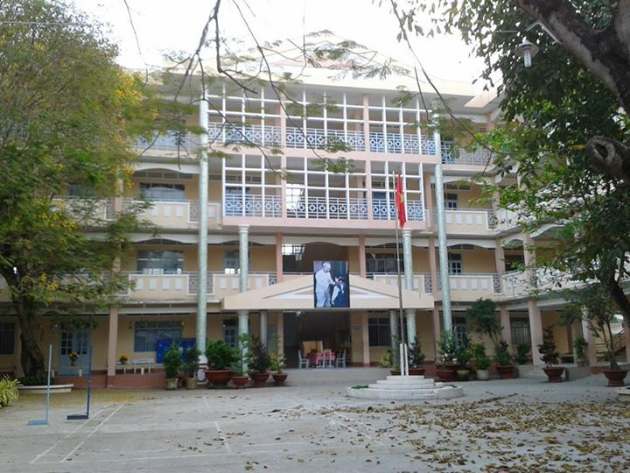
WELCOME TO OUR CLASS

Slide 2

Unit 8 :
ENGLISH SPEAKING COUNTRIES
LESSON 6: SKILL 2

Slide 3
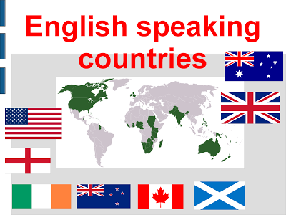
GUESSING GAME
Where is this place?
It is a city in an English speaking country.

Slide 4
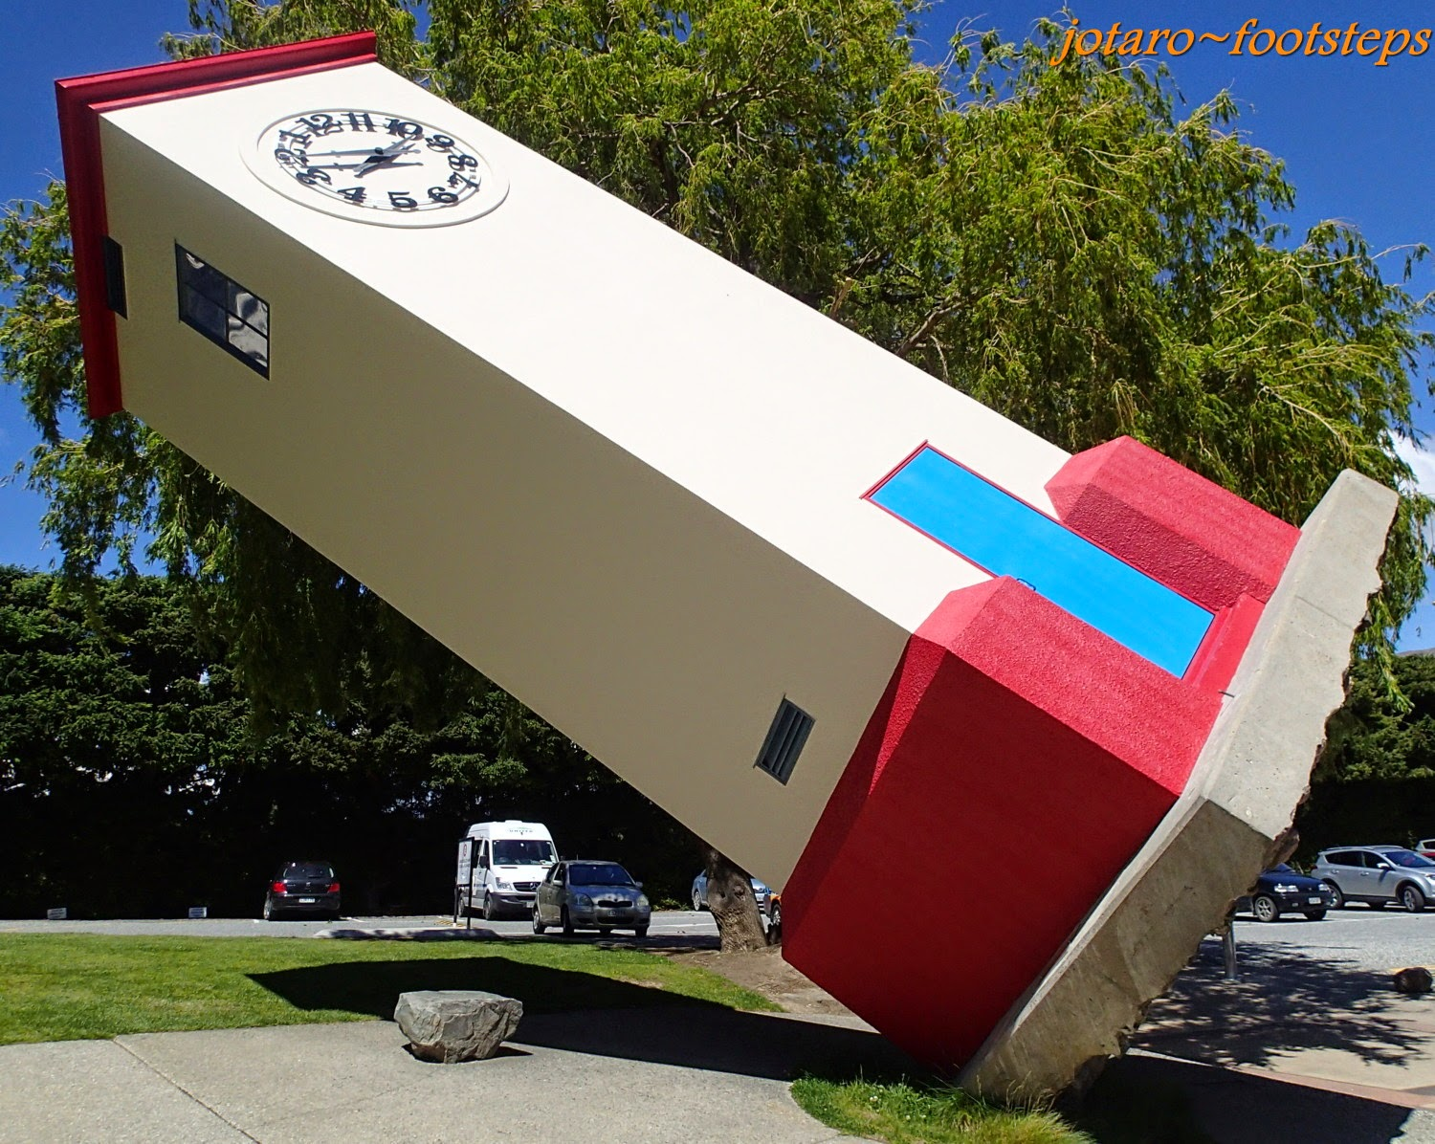
GUESSING GAME
Where is this place?
It has the learning tower

Slide 5
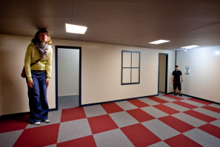
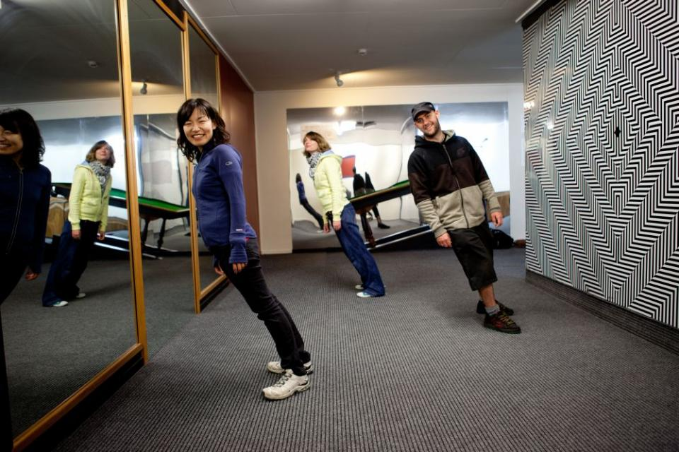
GUESSING GAME
Where is this place?
It has the illusion room

Slide 6
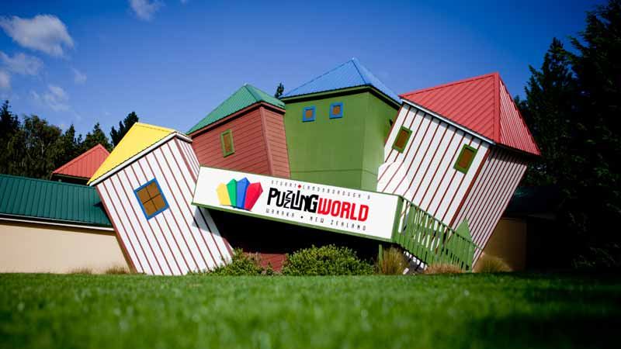
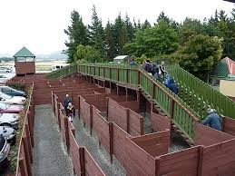
GUESSING GAME
Where is this place?
It has the puzzling world

Slide 7
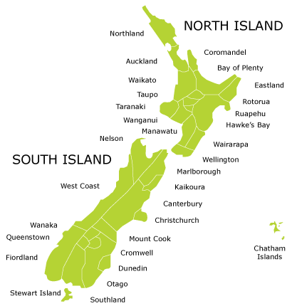

GUESSING GAME
Where is this place?
It is in New Zealand

Slide 8
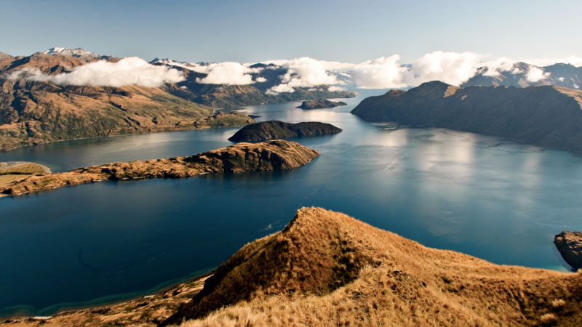
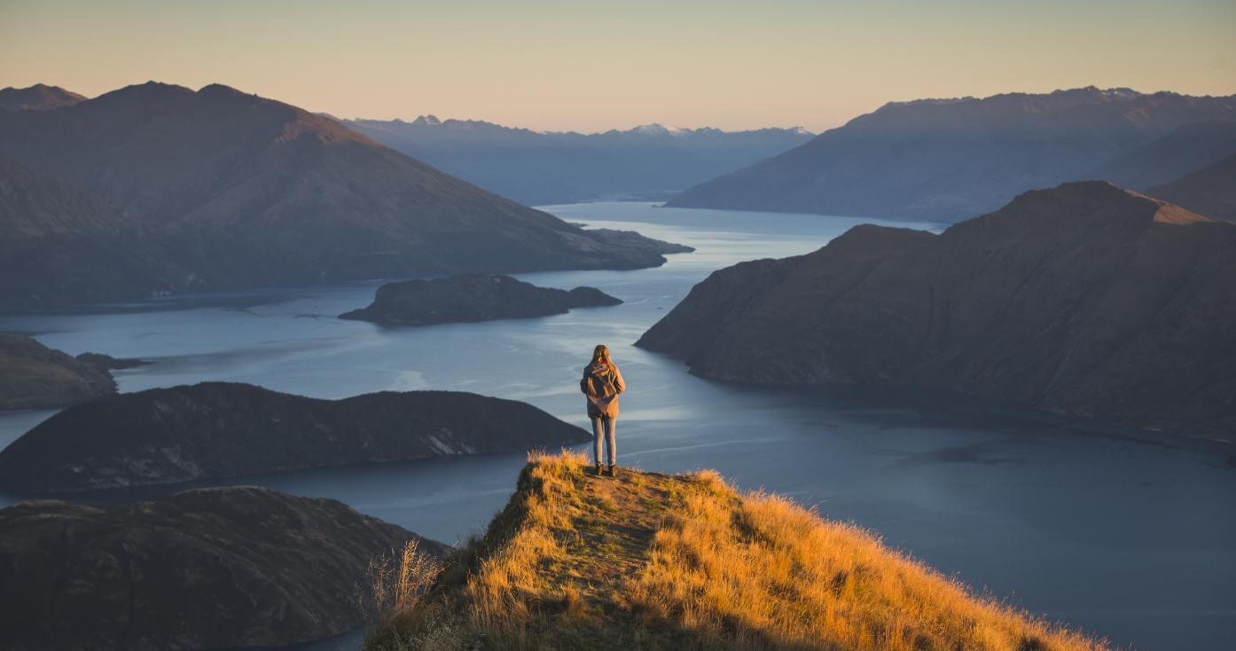
GUESSING GAME
Where is this place?
It has Wanaka lake

Slide 9
It is WANAKA in New Zealand
If you have a chance to visit Wanaka, what will you do?
next

Slide 10
Unit 8 :
ENGLISH SPEAKING COUNTRIES
LESSON 6: SKILL 2

Slide 11
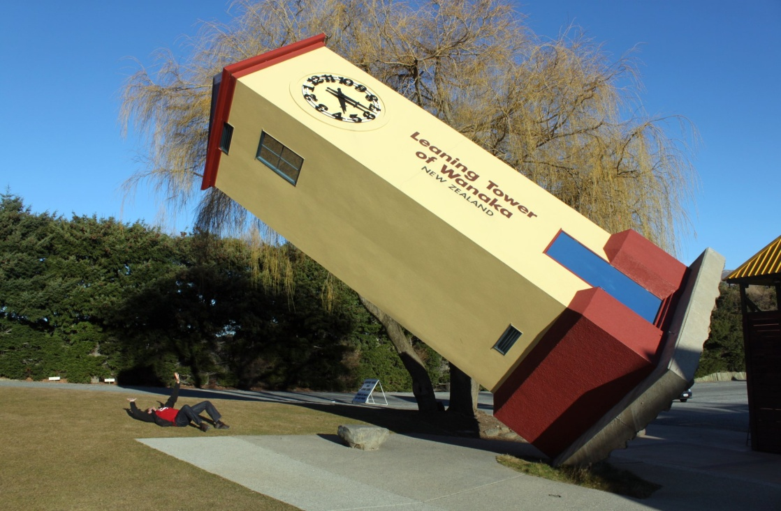
I. Listen
Today, we will take a tour to Wanaka

Slide 12
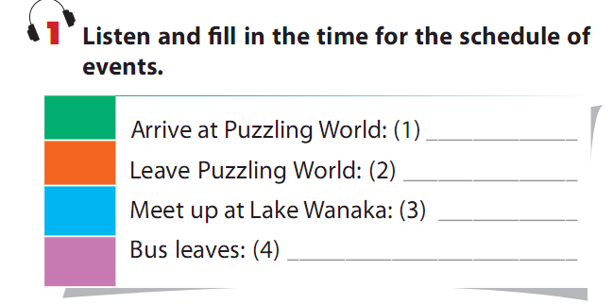

9:30
12:30
4:00
4:15

Slide 13

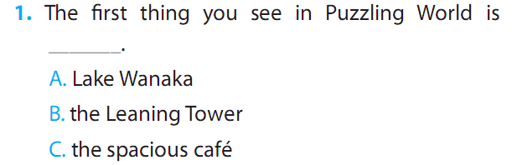
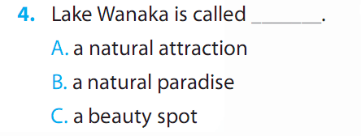
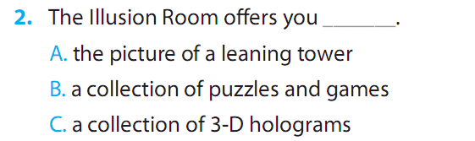
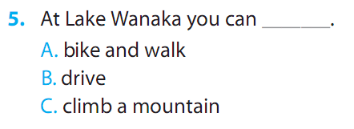
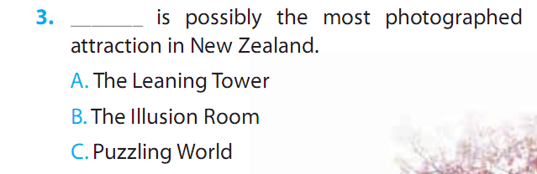

Slide 14
IMAGE THAT you have a chance to visit Washington DC, the capital of the USA
What would you like to do?

Slide 15

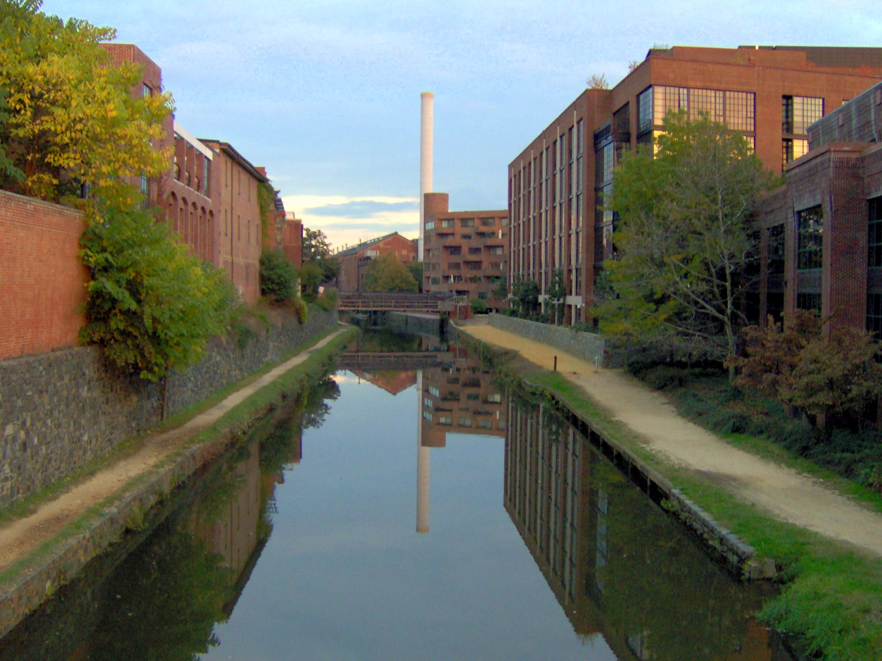
IMAGE THAT you have a chance to visit Washington DC, the capital of the USA

Slide 16

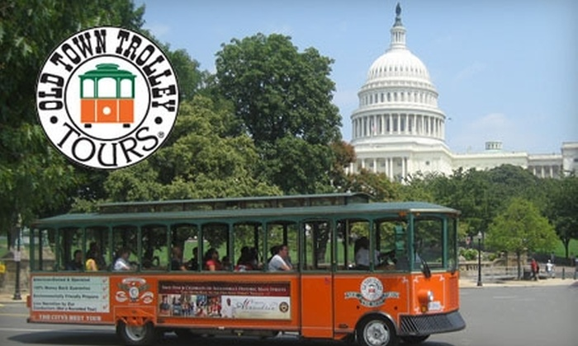
IMAGE THAT you have a chance to visit Washington DC, the capital of the USA

Slide 17

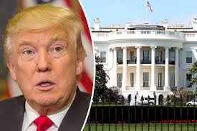
IMAGE THAT you have a chance to visit Washington DC, the capital of the USA

Slide 18
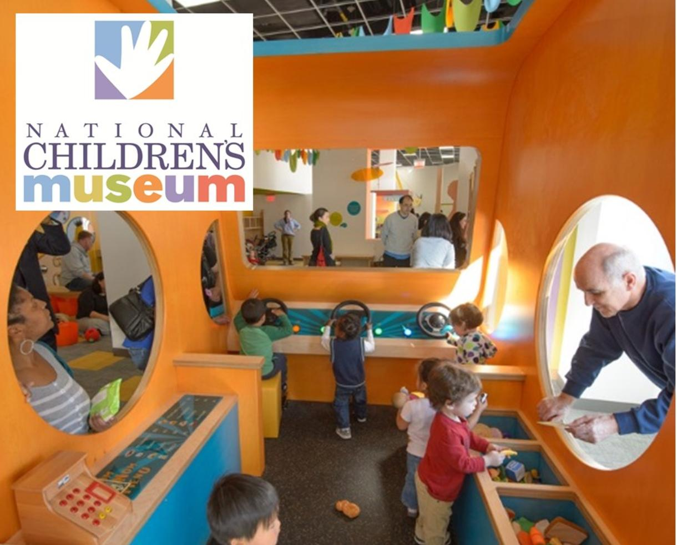
IMAGE THAT you have a chance to visit Washington DC, the capital of the USA

Slide 19
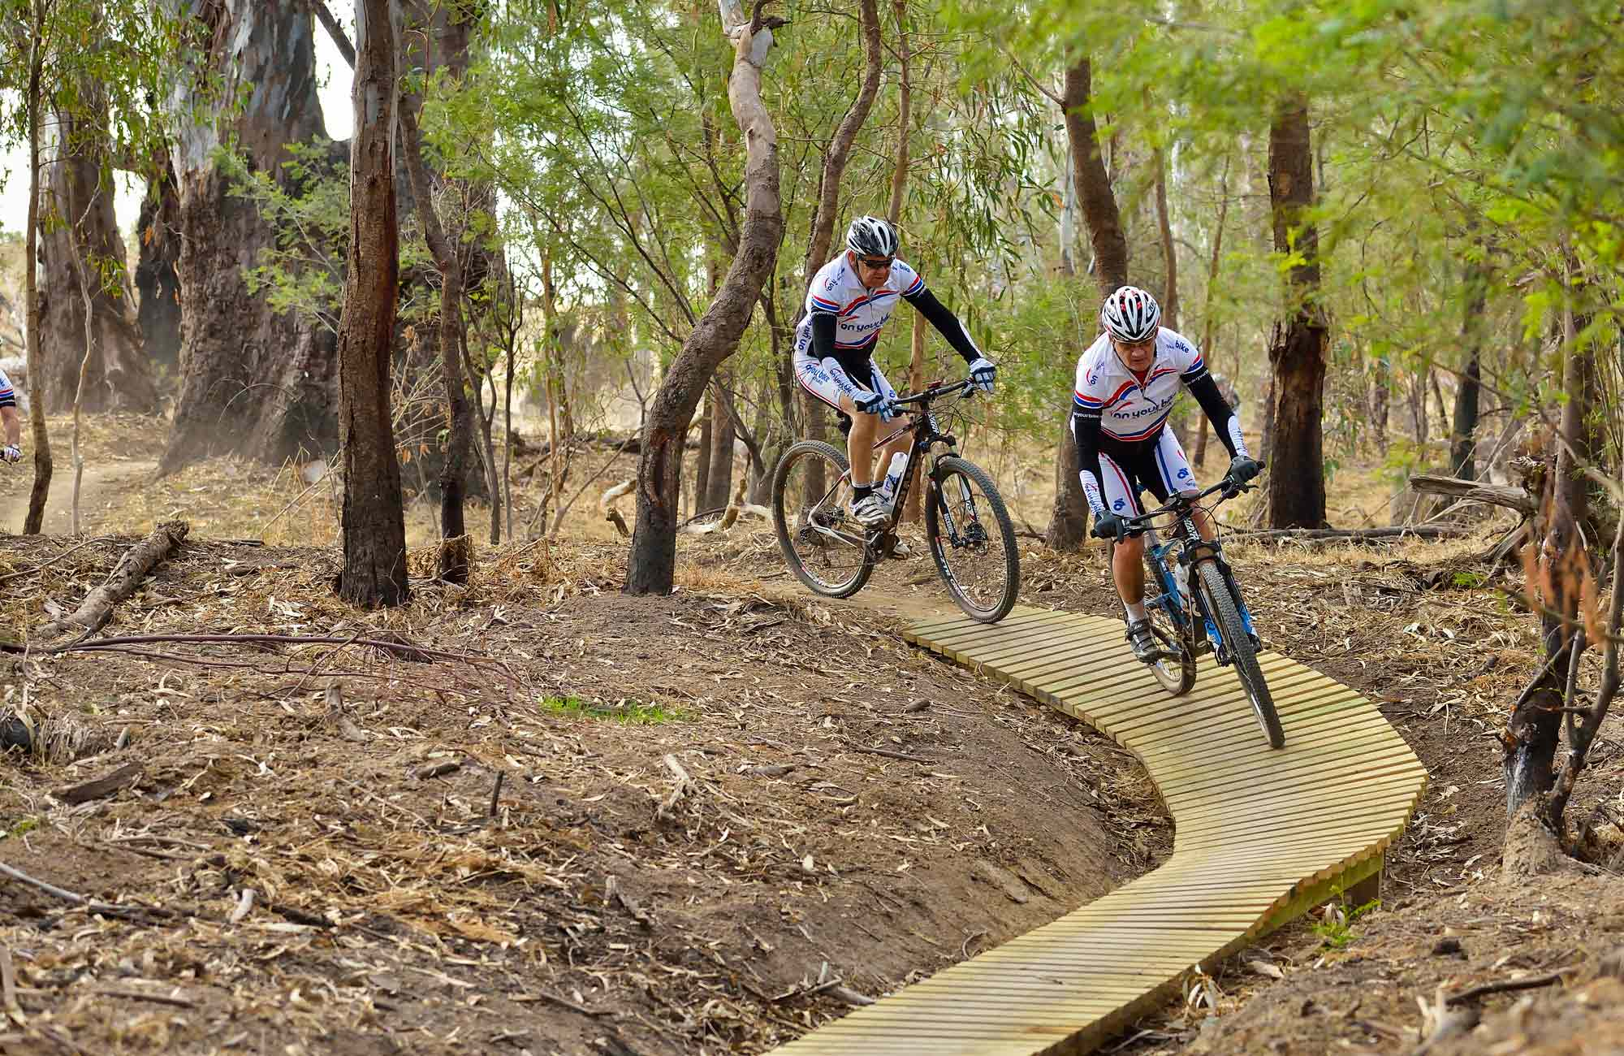
IMAGE THAT you have a chance to visit Washington DC, the capital of the USA

Slide 20
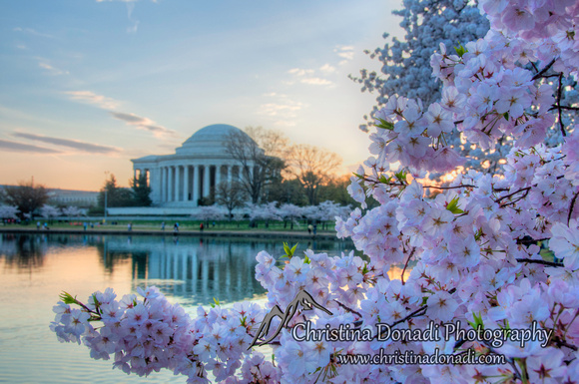
IMAGE THAT you have a chance to visit Washington DC, the capital of the USA

Slide 21
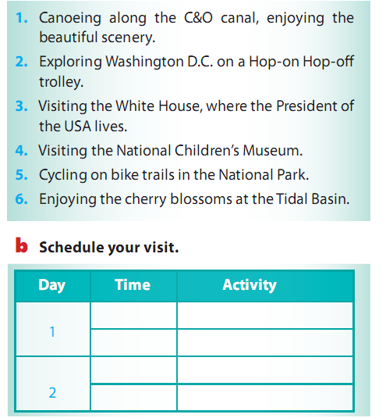

Slide 22
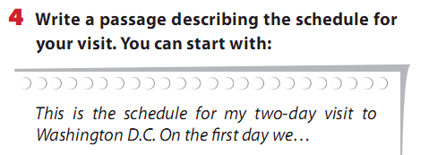
.Then, we…
.On the second day, we…
.In the afternoon, we …

Slide 23
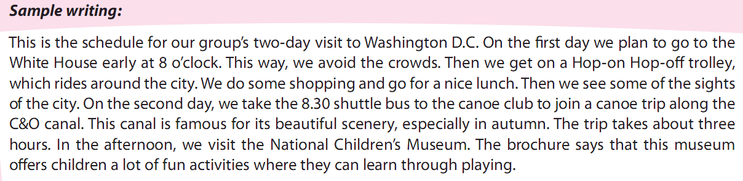

Slide 24
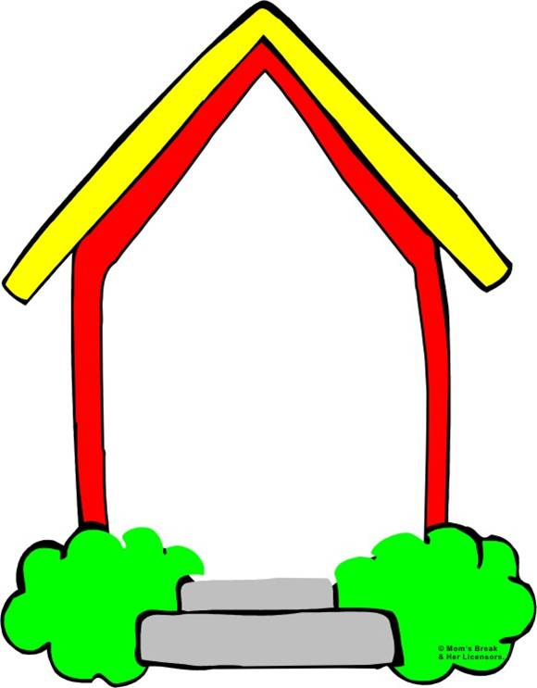

Homework
1. Write your trip to Washington DC by your own.
2. Prepare next lesson.

Slide 25

Thank you for your attendance!

