Slide 1

Unit 9: Houses in the Future
Lesson 3.1: Vocabulary & Listening
Page 76

Slide 2
Lesson Outline
Warm-up
Vocabulary
Listening
Consolidation
Wrap-up

Slide 3
Objectives
By the end of this lesson, students will be able to…
Use the lesson’s vocabulary to talk about life on a space station.
Improve their listening skill (listening for gist and specific information.

Slide 4

WARM-UP

Slide 5
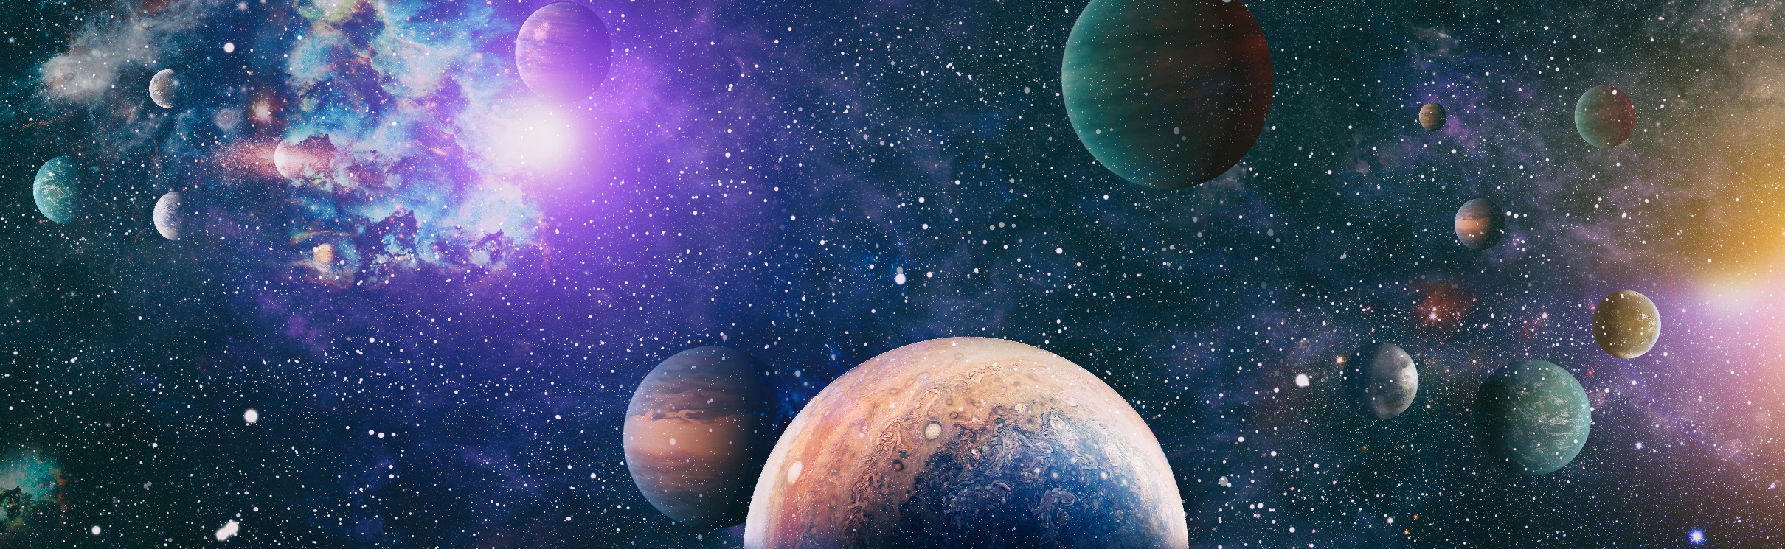
What can you see in the photo?

Slide 6
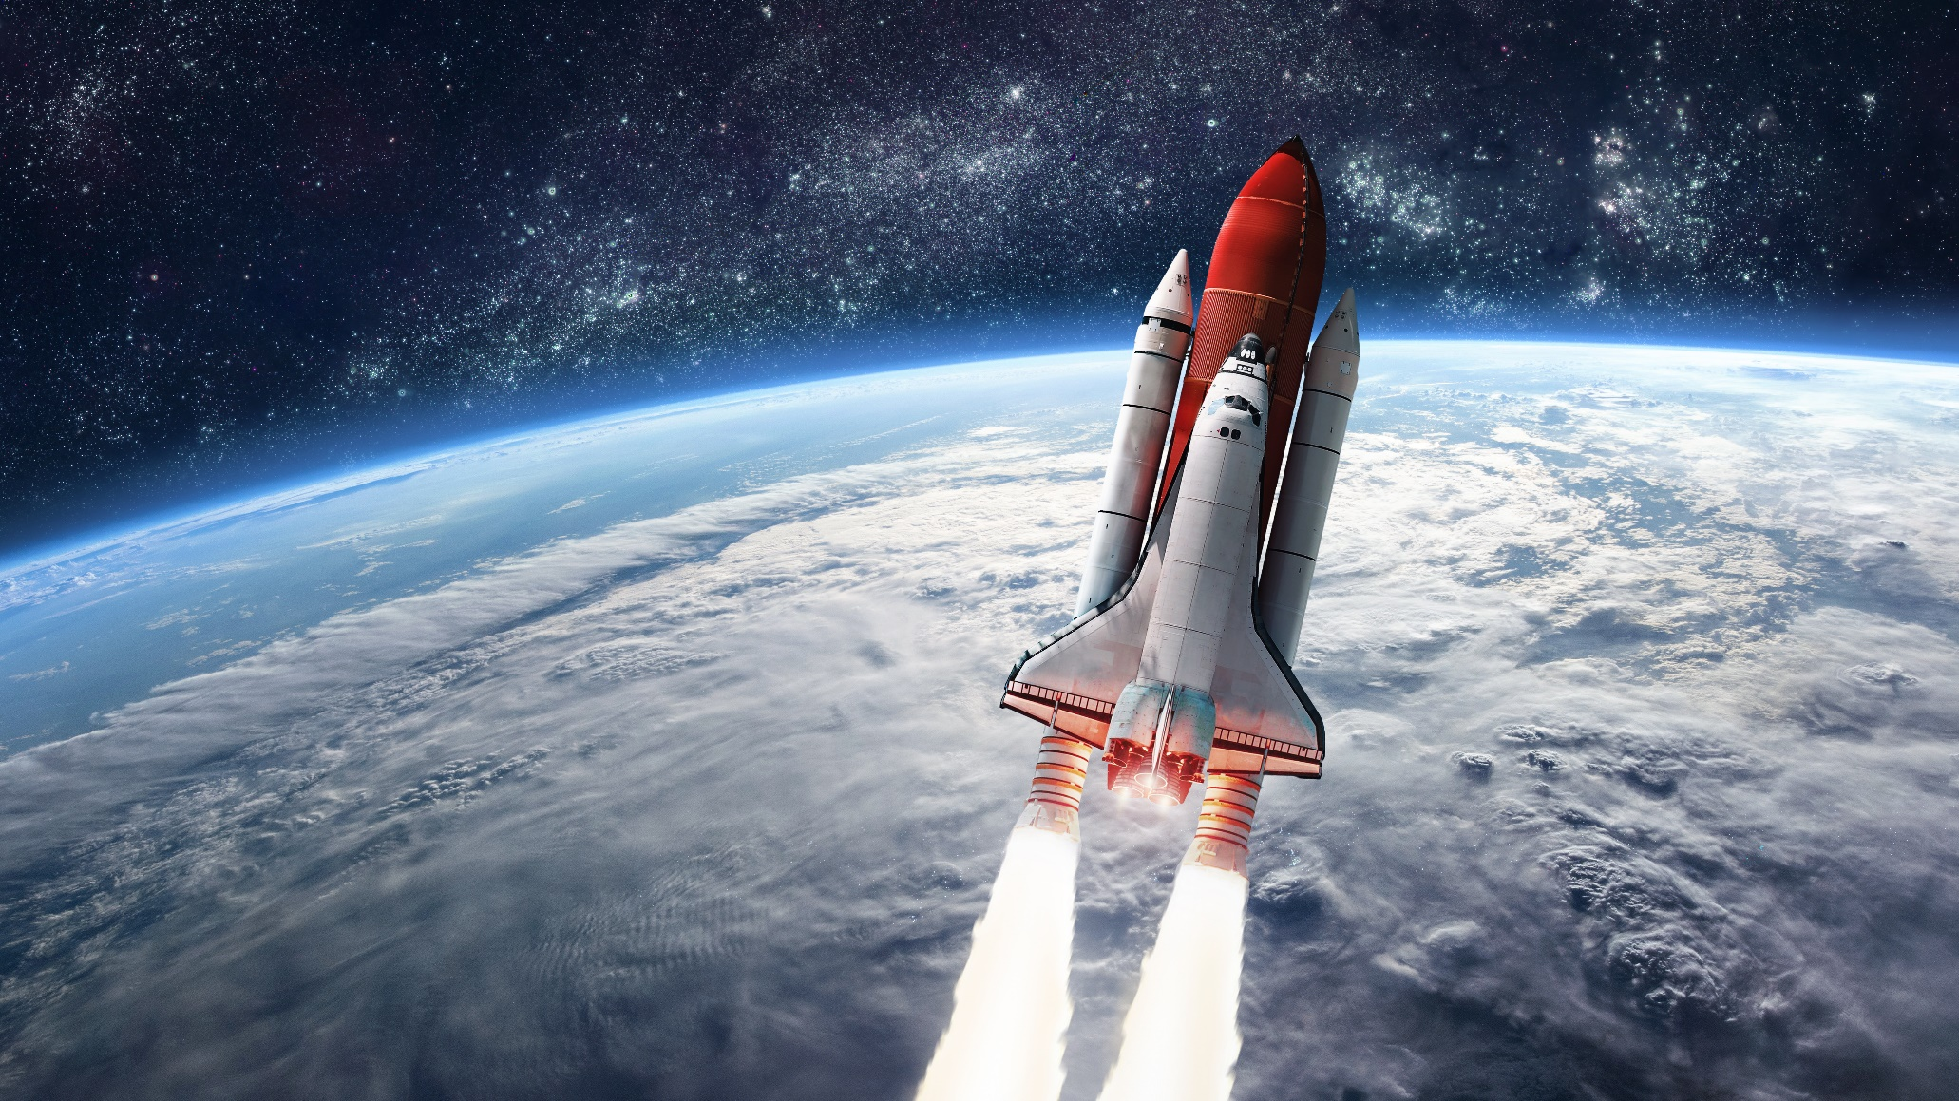
What can you see in the photo?

Slide 7
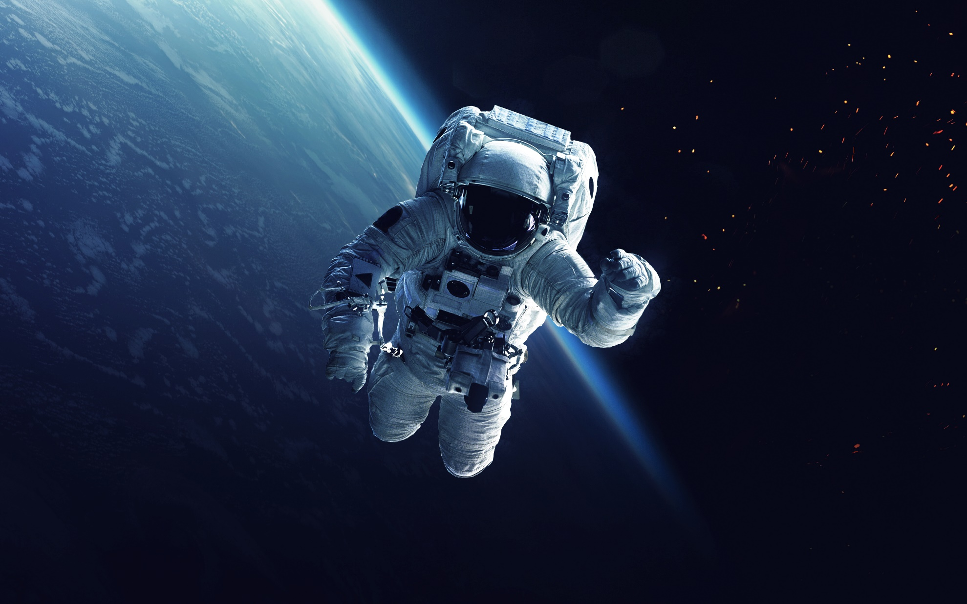
What can you see in the photo?

Slide 8

New words
gravity
lock
float
spacesuit
the Moon
astronaut
space station
the Earth

Slide 9


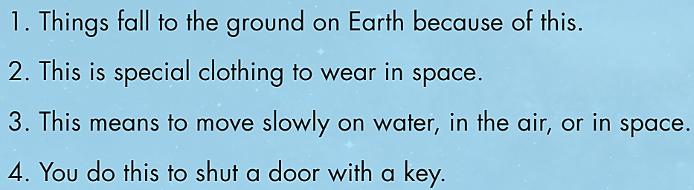
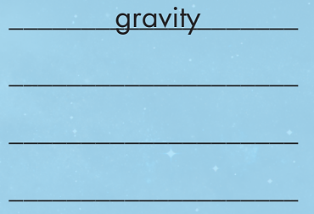
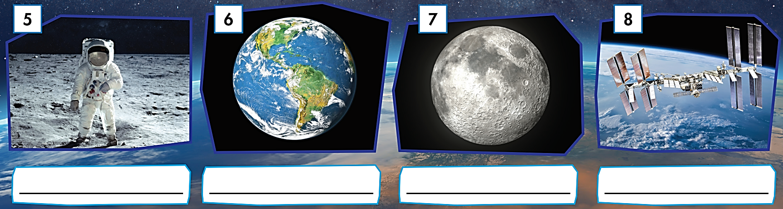
gravity
spacesuit
float
lock
astronaut
the Earth
the Moon
space station

Slide 10

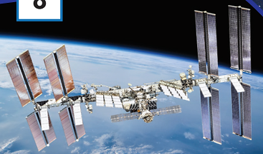

Slide 11
Extra Practice
WB page 54

Slide 12
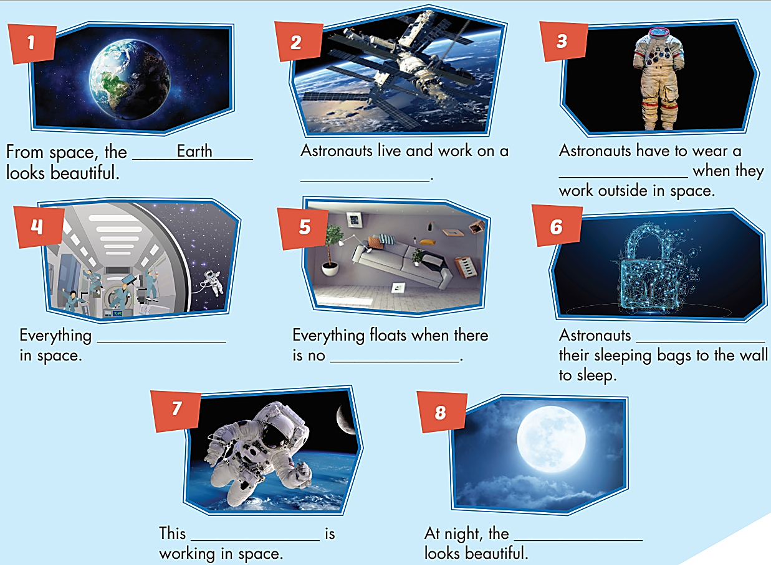


space station
space suit
floats
lock
gravity
astronaut
Moon

Slide 13
Listen and repeat
gravity (n) /ˈgrævəti/ trọng lực
lock (v) /lɑːk/ khóa
float (v) /floʊt/ nổi, lơ lửng
spacesuit (n) /ˈspeɪssuːt/ bộ quần áo vũ trụ
astronaut (n) /ˈæstrənɑːt/ phi hành gia
space station (n) /ˈspeɪs steɪʃən/ trạm không gian







Slide 14

Listening

Slide 15
PAIR WORK
Pre-Listening
- Who lives and works on a space station?
- What do you think they eat, drink, and do in their free time?

Slide 16
While-Listening
"How do you use the toilet?"

Slide 17
While-Listening
1. The first question was from a _____________ from Vietnam.
2. Major Tomkins says the stars, the Moon, and the _____________ look beautiful.
3. Lily is from _____________.
4. Astronauts have to lock their sleeping bags to the wall because there's no _____________ in space.
student
Earth
the USA
gravity

Slide 18







Slide 19
Post-Listening
Listen and look.
Now practice the conversation with a partner.
Interviewer: Hello and welcome to Science World! Our guest is astronaut Major Tomkins.
Major Tomkins: Hi!
Interviewer: Today's questions come from our social media page. Trang, a student from
Vietnam, asks, "What do you do in your free time?“
Major Tomkins: I like to look at the stars, the Moon, and the Earth outside. They're beautiful.
Interviewer: Lily, a student from the USA, wants to know how you sleep.
Major Tomkins: We use sleeping bags. We have to lock them to the wall because there's no
gravity in space!
Interviewer: Interesting. Next, Alex, a student from Russia, asks "How do you use the toilet?“
Major Tomkins: You know, that's actually the question I get asked the most! It's a big
problem...

Slide 20

CONSOLIDATION

Slide 21

PAIR WORK
Do you want to become an astronaut? Why/ Why not?
Is it interesting to live on a space station? Why/ Why not?

Slide 22

WRAP-UP

Slide 23
Today’s lesson
Vocabularies
gravity
lock
float
spacesuit
the Moon
astronaut
space station
the Earth

Slide 24
Homework
Learn by heart vocabularies and make sentences using them.
Do the exercises on page 54, WB
Do the exercises in Tiếng Anh 6 i-Learn Smart World Notebook on page 56
Prepare the next lesson (page 77, SB)
Play the consolidation games in Tiếng Anh 6 i-Learn Smart World DHA App on www.eduhome.com.vn

Slide 25
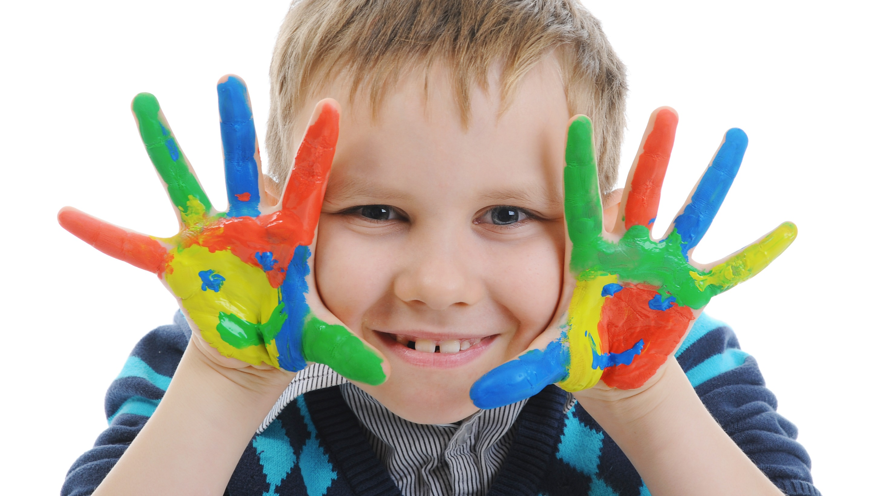
Enjoy your day!

