Slide 1


Slide 2



Unit
6
A VISIT TO A SCHOOL
LESSON 3: A CLOSER LOOK 2
Grammar:
        Prepositions of time
        Prepositions of place
time
place
Unit
HOBBIES

Slide 3

OBJECTIVES
By the end of the lesson, students will be able to use the prepositions of time and place

Slide 4
LESSON 3: A CLOSER LOOK 2
WARM-UP
Game: Simon says
Task 1: Complete the sentences, using suitable prepositions of time.
Task 2: Work in pairs. Ask and answer the questions about your school.
PREPOSITIONS
OF TIME
Task 3: Complete the sentences with at, in or on.
Task 4: Work in pairs. Look at the pictures and answer the questions.
PREPOSITIONS
OF PLACE
Task 5: Complete the passage with at, on, or in. Then discuss in groups which prepositions express time and which ones express place.
FURTHER PRACTICE
CONSOLIDATION
Wrap-up
Homework

Slide 5

LESSON 3: A CLOSER LOOK 2
WARM-UP
Game: Simon says
Aims of the stage:
To activate students’ prior knowledge related to the targeted grammar: prepositions of place
To increase students’ interest

Slide 6
WARM-UP
Put the pen in the pencil case.
Sit on the chair.
Put your ruler on the table.

Slide 7
LESSON 3: A CLOSER LOOK 2
WARM-UP
Game: Simon says
Task 1: Complete the sentences, using suitable prepositions of time.
Task 2: Work in pairs. Ask and answer the questions about your school.
PREPOSITIONS
OF TIME

Slide 8
PREPOSITIONS OF TIME
at | in | on
at six o’clock at noon at break time | in the morning / afternoon / evening in December in 2020 | on Monday on January 18th on Christmas Day
A point of time
A period of time
(longer / shorter than a day)
A day or a part of day

Slide 9
PREPOSITIONS OF TIME
1
Complete the sentences, using suitable prepositions of time.
at
1. In England, schools usually starts ___ 9 a.m. and finish ___ 4 p.m.
2. They built our school a long time ago, maybe ___ 1990.
3. We are going to visit Thang Long Lower Secondary School ___ January.
4. The school year usually begins ___ September 5th every year.
5. The children like playing badminton and football ___ their break time.
at
in
in
on
at

Slide 10
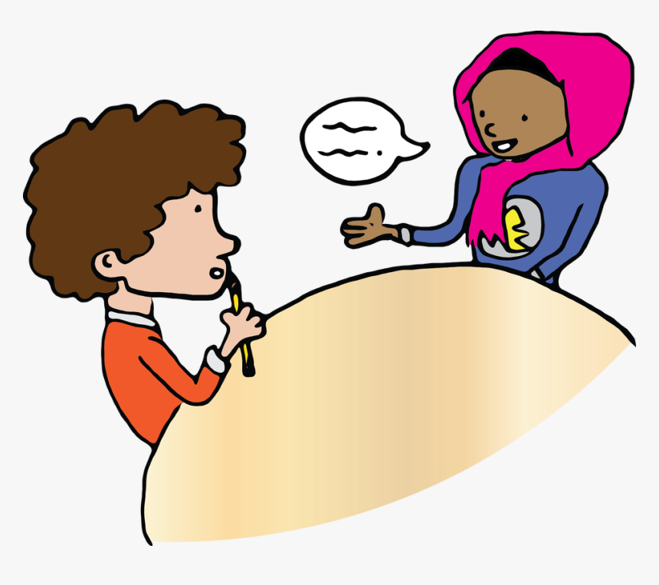
PREPOSITIONS OF TIME
2
Work in pairs. Ask and answer questions about your school.
1. When does your school year start?
2. When do you have English lessons?
3. When do you usually celebrate Teachers’ Day?
4. When are you going to finish the school year?

Slide 11
LESSON 3: A CLOSER LOOK 2
WARM-UP
Game: Simon says
Task 1: Complete the sentences, using suitable prepositions of time.
Task 2: Work in pairs. Ask and answer the questions about your school.
PREPOSITIONS
OF TIME
Task 3: Complete the sentences with at, in or on.
Task 4: Work in pairs. Look at the pictures and answer the questions.
PREPOSITIONS
OF PLACE

Slide 12
PREPOSITIONS OF PLACE
at | in | on
at home at school at work | in the classroom in the school garden in the playground | on the board on the wall on the second floor
A certain point
Inside sth / a place
On the surface of sth

Slide 13
PREPOSITIONS OF PLACE
3
Complete the sentences with at, in or on.
on
1. Her classroom is ___ the third floor of that building.
2. When I’m at school, my parents are ___ work.
3. Look! The students are playing football ___ the classroom.
4. My little sister usually has lunch ___ school.
5. The most beautiful posters are ___ the wall ___ the staffroom.
at
in
at
on
in

Slide 14

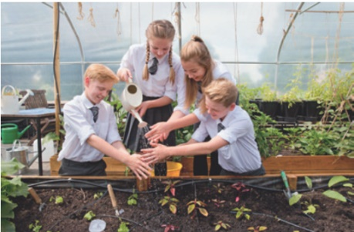

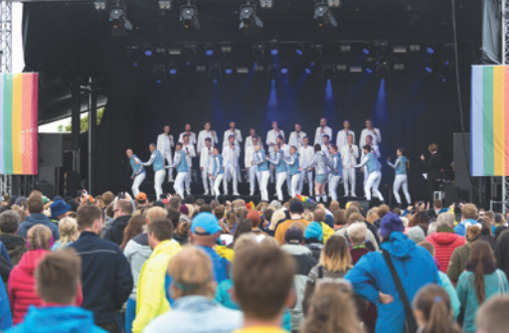
PREPOSITIONS OF PLACE
4
Work in pairs. Look at the pictures and answer the questions.
1. Where does Mrs Hien teach maths?
At school.
2. Where do the students water the flowers?
In the school garden.
3. Where is the boy writing?
On the board.
4. Where do they sing English songs on Teachers’ Day?
On the stage.

Slide 15
LESSON 3: A CLOSER LOOK 2
WARM-UP
Game: Simon says
Task 1: Complete the sentences, using suitable prepositions of time.
Task 2: Work in pairs. Ask and answer the questions about your school.
PREPOSITIONS
OF TIME
Task 3: Complete the sentences with at, in or on.
Task 4: Work in pairs. Look at the pictures and answer the questions.
PREPOSITIONS
OF PLACE
Task 5: Complete the passage with at, on, or in. Then discuss in groups which prepositions express time and which ones express place.
FURTHER PRACTICE

Slide 16
FURTHER PRACTICE
5
Complete the passage with at, on or in. Then discuss in groups which prepositions express time and which ones express place.
in
Tom’s mother is at home, but she is not (1) ___ the kitchen. She usually waters the vegetables in the garden (2) ___ the morning.
Tom’s father is (3) ___ work, but he isn’t in his office at the moment. It is lunch break and he is (4) ___ a travel agent’s, looking at holiday brochures.
Tom is usually at school this time, but he has a bad cold today. He has nothing to do but lying (5) ___ the sofa and looking at the posters (6) ___ the wall.
in
in
in
at
at
at
at
on
on
on
on

Slide 17
LESSON 3: A CLOSER LOOK 2
WARM-UP
Game: Simon says
Task 1: Complete the sentences, using suitable prepositions of time.
Task 2: Work in pairs. Ask and answer the questions about your school.
PREPOSITIONS
OF TIME
Task 3: Complete the sentences with at, in or on.
Task 4: Work in pairs. Look at the pictures and answer the questions.
PREPOSITIONS
OF PLACE
Task 5: Complete the passage with at, on, or in. Then discuss in groups which prepositions express time and which ones express place.
FURTHER PRACTICE
CONSOLIDATION
Wrap-up
Homework

Slide 18
CONSOLIDATION
1
WRAP-UP
Grammar:
      Prepositions of time
      Prepositions of place
time
place

Slide 19

CONSOLIDATION
2
HOMEWORK
Do exercises in the Workbook.
Make sentences using the prepositions of time and place.

Slide 20

Website: hoclieu.vn
Fanpage: facebook.com/www.tienganhglobalsuccess.vn/

