Slide 1

Unit 2: Fit for life
Lesson 2b: Grammar
(Cont.)
Page 33

Slide 2
Lesson Outline
Warm-up
Grammar
Consolidation
Wrap-up

Slide 3
Objectives
By the end of this lesson, students will be able to…
- review: the Past Simple.
- learn and practise regular and irregular verbs.
- ask and answer about what they did last week.

Slide 4

WARM-UP

Slide 5
Write the following verbs in the Past Simple form:
play
cook
come
see
take
ran
played
6. run
7. use
8. have
9. visit
10. watch
cooked
used
came
had
saw
visited
took
watched

Slide 6

It’s time to learn …

Slide 7

Presentation

Slide 8
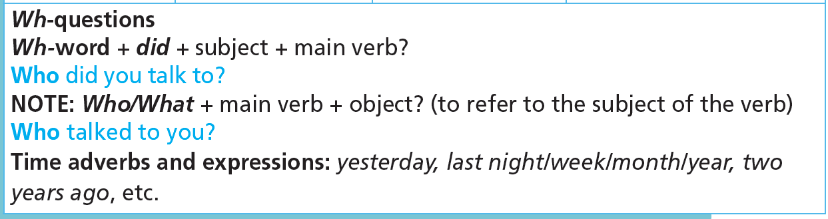

Slide 9
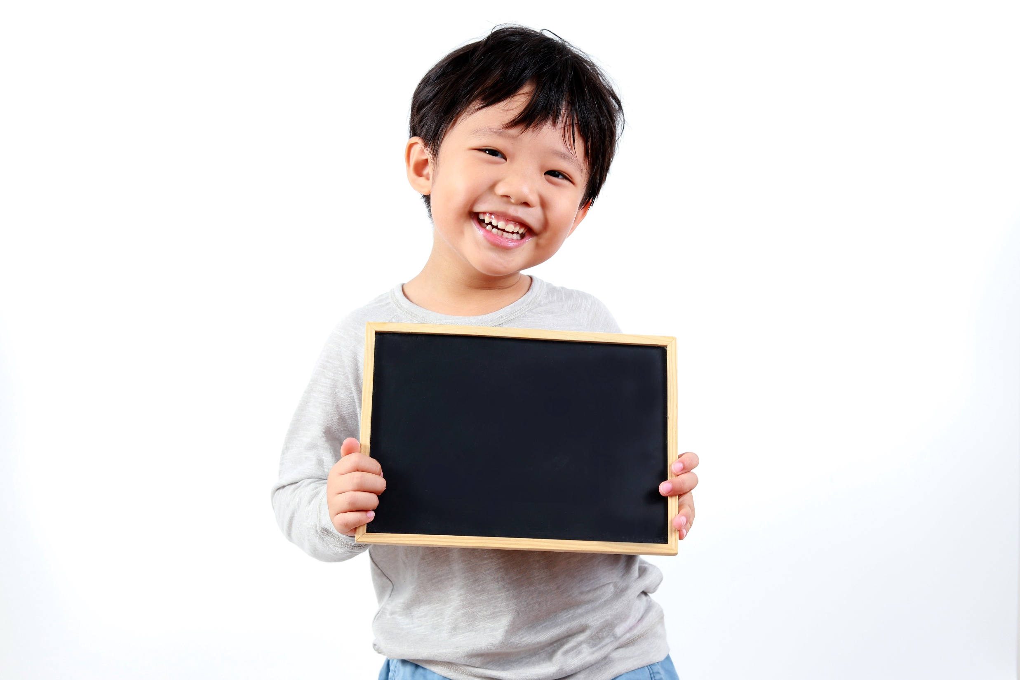
Practice

Slide 10
4. Use the words in brackets to write questions in your notebook as in the example. Read them aloud.
1 She played football yesterday. (What?)
What did she do yesterday?
2 They did yoga in the gym last Friday. (Where?)
3 He went to the stadium on foot last Saturday. (How?)
4 We had basketball practice yesterday afternoon. (When?)
5 Sally went jogging with Mary yesterday morning. (Who?)
Where did they do yoga last Friday?
How did he go to the stadium last Saturday?
When did you have basketball practice?
Who did Sally go jogging with yesterday morning?

Slide 11
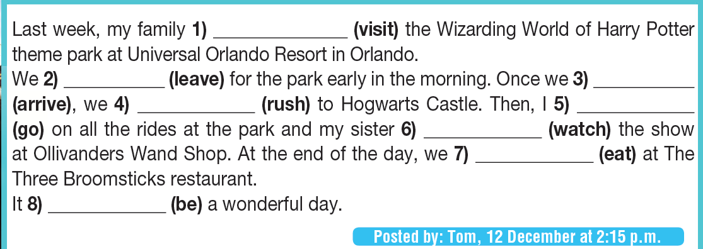
5. Put the verbs in brackets into the Past Simple. Which verbs are regular? Which are irregular?
visited
left
arrived
rushed
went
watched
ate
was
Regular verbs: visited, arrived, rushed, watched
Irregular verbs: left, went, ate, was

Slide 12
6. Form complete questions. Then use the blog in Exercise 5 to answer them.
1 Tom & his family / go / London / last summer
A: Did Tom and his family go to London last summer?
B: No, they didn’t. They went to Orlando.
2 they / visit / Universal Studios
3 Tom’s sister / go / on all the rides at the park
4 they / have / dinner / at their hotel
A: Did they visit Universal Studio?
B: No, they didn’t. They visited Universal Orlando Resort.
A: Did Tom’s sister go on all the rides at the park?
B: No, she didn’t. She watched a show.
A: Did they have dinner at their hotel?
B: No, they didn’t. They ate at the Three Broomsticks restaurant.

Slide 13
More Practice
GB p. 66
28 ★ Complete the dialogue with the Past Simple of the verbs in brackets.
A Hi Liz! 1) ___________ (you/have) a relaxing day yesterday?
B Not really! We 2) ___________ (not/want) to stay at home, so we 3) ___________ (go) to the sports centre.
A What 4) ___________ (you/do) there?
B We 5) ___________ (try) an archery class. It was great! I 6) ___________ (not/shoot) my arrows very straight, but at least I 7) ___________ (not/miss) the target!
A How about your brother?
B He 8) ___________ (be) terrible at first, but at the end of the lesson we 9) _________ (have) a competition and he 10) ___________ (win)!
Did you have
didn’t want
went
did you do
tried
didn’t shoot
didn’t miss
was
had
won

Slide 14
More Practice
GB p. 66
29 a) ★ Complete the text with the Past Simple of the verbs in brackets.
Yoga probably 1) ________ (start) about 5,000 years ago in India, but people 2) ________ (not/call) it ‘yoga’ until thousands of years later. Around 500 B.C.E, a group of people 3) ________ (create) a book called The Gita. The book tells us a lot of things about yoga. The most important yoga book is probably by a man called Patanjali, however. He 4) ________ (write) down a lot of information about yoga in the 2nd century, and we still use his ideas today.
In the 19th century, people from the West 5) __________ (discover) yoga when they 6) ________ (travel) to India. Then in 1883, an Indian man called Swami Vivekananda 7) ________ (visit) Europe and the USA and 8) ________ (talk) about yoga. A lot of people 9) ________ (become) interested in the idea, and some 10) ________ (go) to India to learn more about it.
These days, it’s easy to find yoga classes at community and sports centres all over the world. It’s good for your body and your mind, and everyone can do it.
started
didn’t call
created
wrote
discovered
travelled
visited
talked
became
went

Slide 15

Production

Slide 16
7. Ask and answer questions to find out what your partner did last weekend. Use the phrases in the list and your own ideas.
• play football • watch TV • meet your friends • visit your aunt
• see a film • read a book • go swimming • go to the cinema
A: Did you play football last Saturday?
B: No, I didn’t. I stayed home and did my homework. What about you?
A: I went to the mall to buy some new trainers. Did you visit your aunt on Sunday?
B: Yes, we did. We had lunch together. What did you do?
A: I went to the cinema with my parents.

Slide 17

CONSOLIDATION

Slide 18
Write a paragraph (80 words) about what you did on your latest holiday.
(Where was it? What did you do there? How did you feel?)

Slide 19

WRAP-UP

Slide 20
Today’s lesson
Structures/ Sentence patterns
Past Simple
Regular and irregular verbs

Slide 21
Homework
Review the grammar points and make sentences using them.
Do the exercises in TA 7 Right on WB (page 18)
Prepare the next lesson (page 34 SB)
Complete the grammar notes in TA 7 Right on Notebook (page 13)

Slide 22
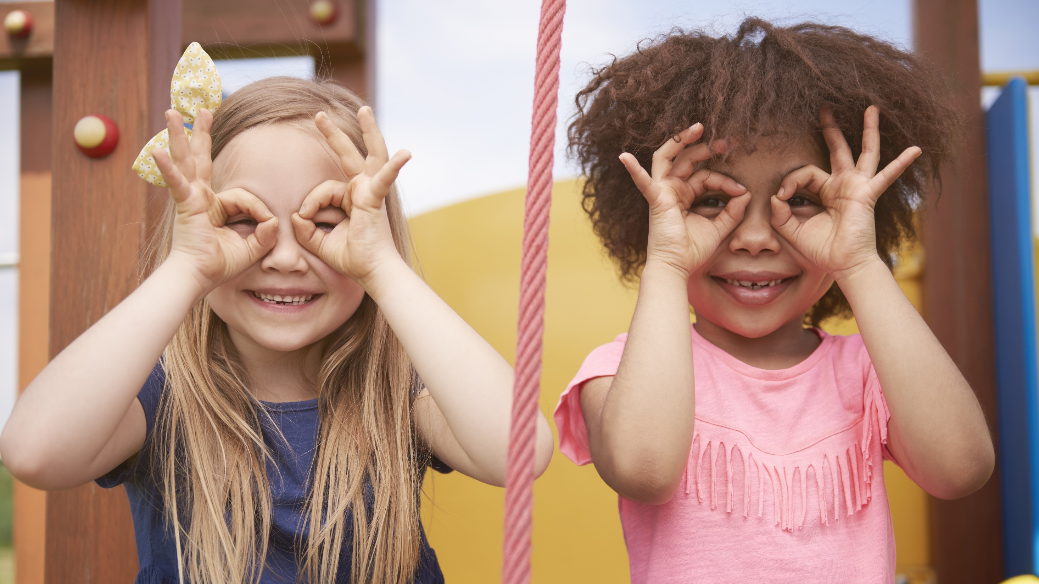
Enjoy your day!

