Slide 1

Unit 1: My World
Progress Check
Page 26

Slide 2
Lesson Outline
Warm-up
Vocabulary
Grammar
Listening
Consolidation
Wrap-up

Slide 3
Objectives
By the end of this lesson, students will be able to…
- test/consolidate vocabulary and grammar learnt throughout the unit.

Slide 4

WARM-UP

Slide 5
Choose the word whose underlined part is pronounced differently from that of the others.
1. A. cook B. look C. good D. school
2. A. curl B. hug C. purse D. surf
3. A. washes B. does C. wishes D. watches
/kʊk/
/lʊk/
/ɡʊd/
/skuːl/
/kɜːl/
/hʌɡ/
/pɜːs/
/sɜːf/
/wɒʃiz/
/dʌz/
/wɪʃiz/
/wɒtʃiz/

Slide 6
Choose the word whose main stress is placed differently from that of the others.
A. funny B. clever C. cheerful D. polite
2. A. uniform B. family C. magazine D. cinema
3. A. moustache B. brother C. pizza D. noodle
/ˈfʌni/
/ˈklevər/
/ˈtʃɪəfəl/
/pəˈlaɪt/
/ˈjuːnɪfɔːm/
/ˈfæməli/
/ˌmæɡəˈziːn/
/ˈsɪnəmə/
/məˈstɑːʃ/
/ˈbrʌðər/
/ˈpiːtsə/
/ˈnuːdəl/

Slide 7
What vocabulary and grammar points you have learnt in this unit?
Vocabulary about appearance, free-time activities & hobbies, characters
Present Simple, Present Continuous

Slide 8

It’s time to learn …

Slide 9
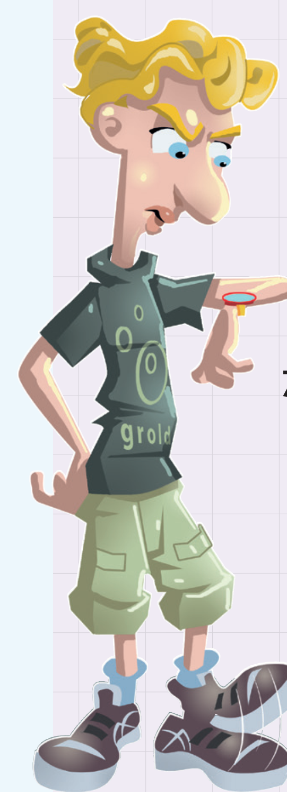
Vocabulary
1 Look at the picture and choose the correct option.
This is Steve. He’s fifteen years old. He 1) tall/long and 2) thin/chubby. He’s got short 3) straight/wavy, 4) black/blond hair, blue eyes, a big nose and full lips. He’s usually 5) bossy/cheerful, but today he’s very 6) impatient/generous because he’s 7) caring/waiting for his friend. He and his best friend Jim always 8) go/play basketball together 9) at/in 6:00 p.m. 10) on/in Wednesday, but Jim is late today.
5) bossy/cheerful, but today he’s very

Slide 10
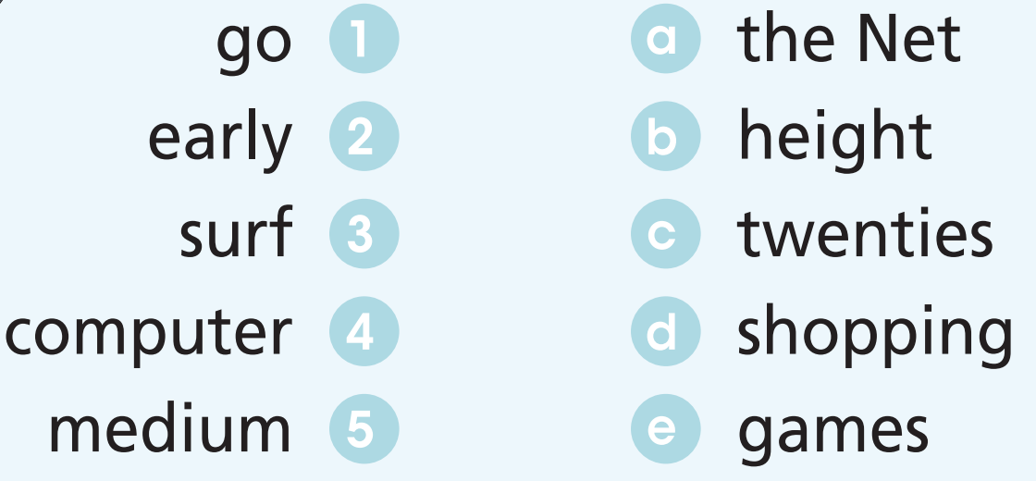
2 Match the words to form phrases.

Slide 11
3 Complete the gaps with , , , and
shake
tap
point
hug
cross
1 In the UK, people _________ their nose to tell somebody to keep something secret.
2 Some people _________ their fingers for luck in the UK.
3 I always _________ my grandma when I see her because I love her very much.
4 It’s polite to _________ hands when you meet someone for the first time.
5 Please don’t _________ at people with your finger.

Slide 12
Grammar
Present Simple and Present Continuous
Write the structures on the board and tell the usages of the Present Simple and the Present Continuous.

Slide 13
 | Present Simple | Present Continuous
Structure | S + V(s/es) S + do/does + not + V-inf Do/Does + S + V-inf? | S + am/is/are + V-ing S + am/is/are + not + V-ing Am/Is/Are + S + V-ing?
Usages | • habits and routines • general states and facts • timetables | actions happening now/around the time of speaking • temporary situations • fixed future arrangements
Common expressions | every day/morning/weekend, often, always, never, on Mondays, once/twice a week/month, etc. | now, at the moment, at present, tonight, these days, etc.

Slide 14
4 Choose the correct option.
action happening now
Kate wears/is wearing a lovely dress today.
Where do you usually go/going on holiday on/in the summer.
What are/do the children playing in the garden?
We don’t/aren’t go to the mall at/on Saturday mornings.
I am never/ never am late for school.
Habit/routine
Adverbs of frequency stand after “to be”

Slide 15
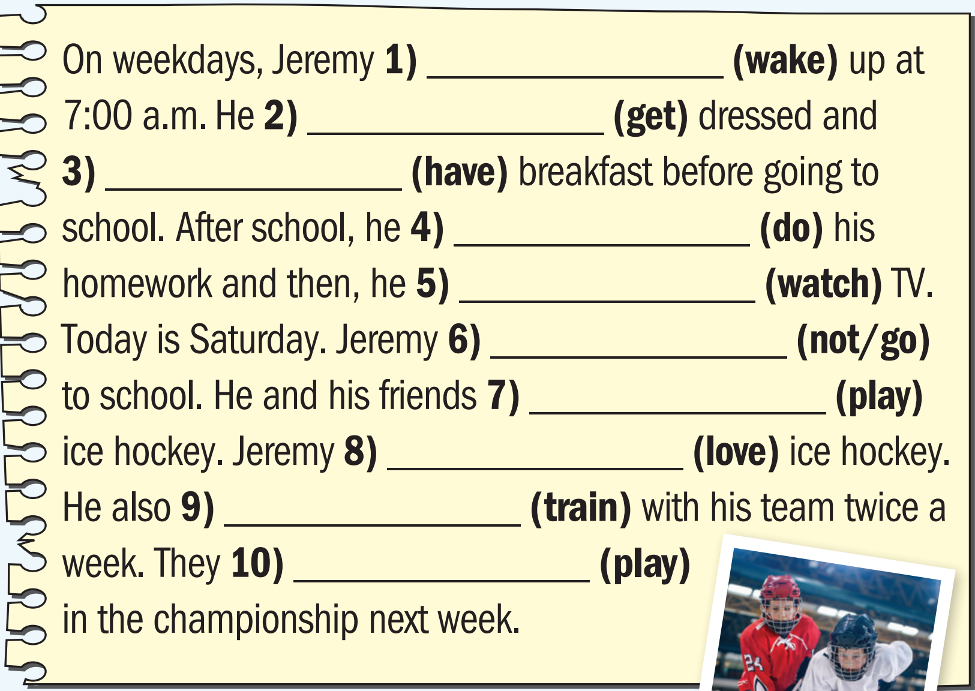
5 Put the verbs in brackets into the Present Simple or the Present Continuous.
Habit/routine
wakes
Habit/routine
gets
Habit/routine
has
does
Habit/routine
watches
Habit/routine
isn’t going
Temporary situation
are playing
loves
Action happening now
trains
General state/fact
are playing
Habit/routine
Fixed future arrangement

Slide 16

Listening

Slide 17
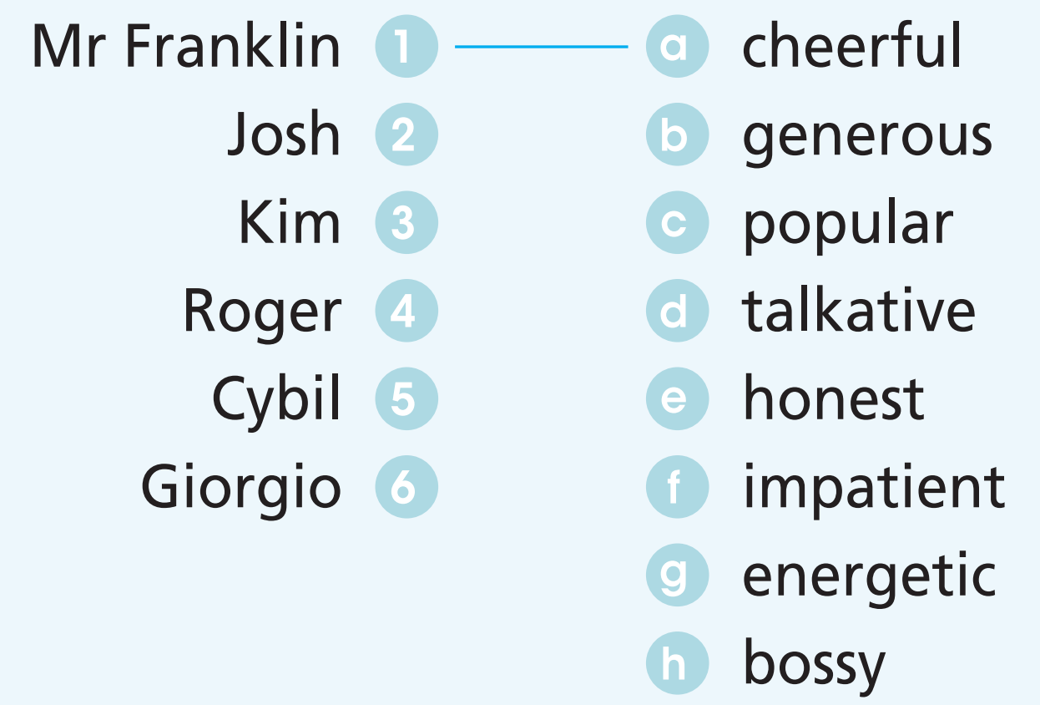
Pre-listening
Read the instruction, underline the key words.
6 Listen and match the people (1-6) to the character adjectives (a-h).
What are you going to do?
=> Listen and match.
What are you going to match?
=> People (1-6) with character adjectives (a-h).

Slide 18

While-listening
Now, listen and match.
6 Listen and match the people (1-6) to the character adjectives (a-h).
What are your answers?

Slide 19
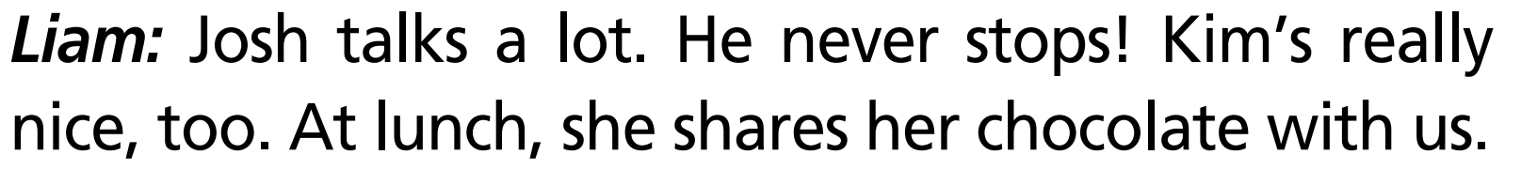
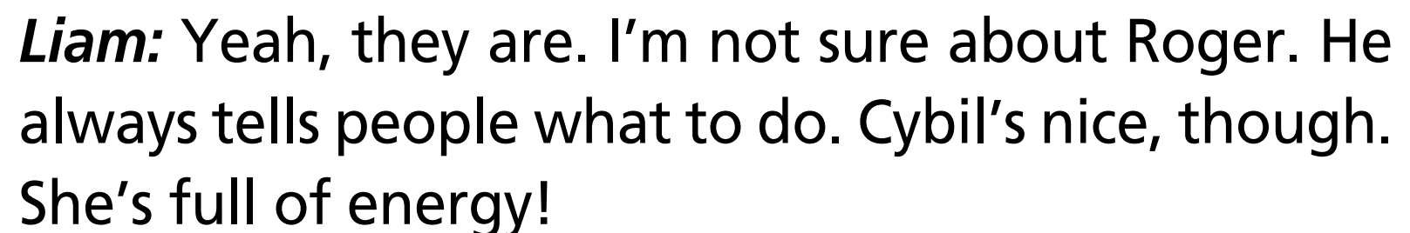

While-listening
Now, listen again and check.
6 Listen and match the people (1-6) to the character adjectives (a-h).

Slide 20
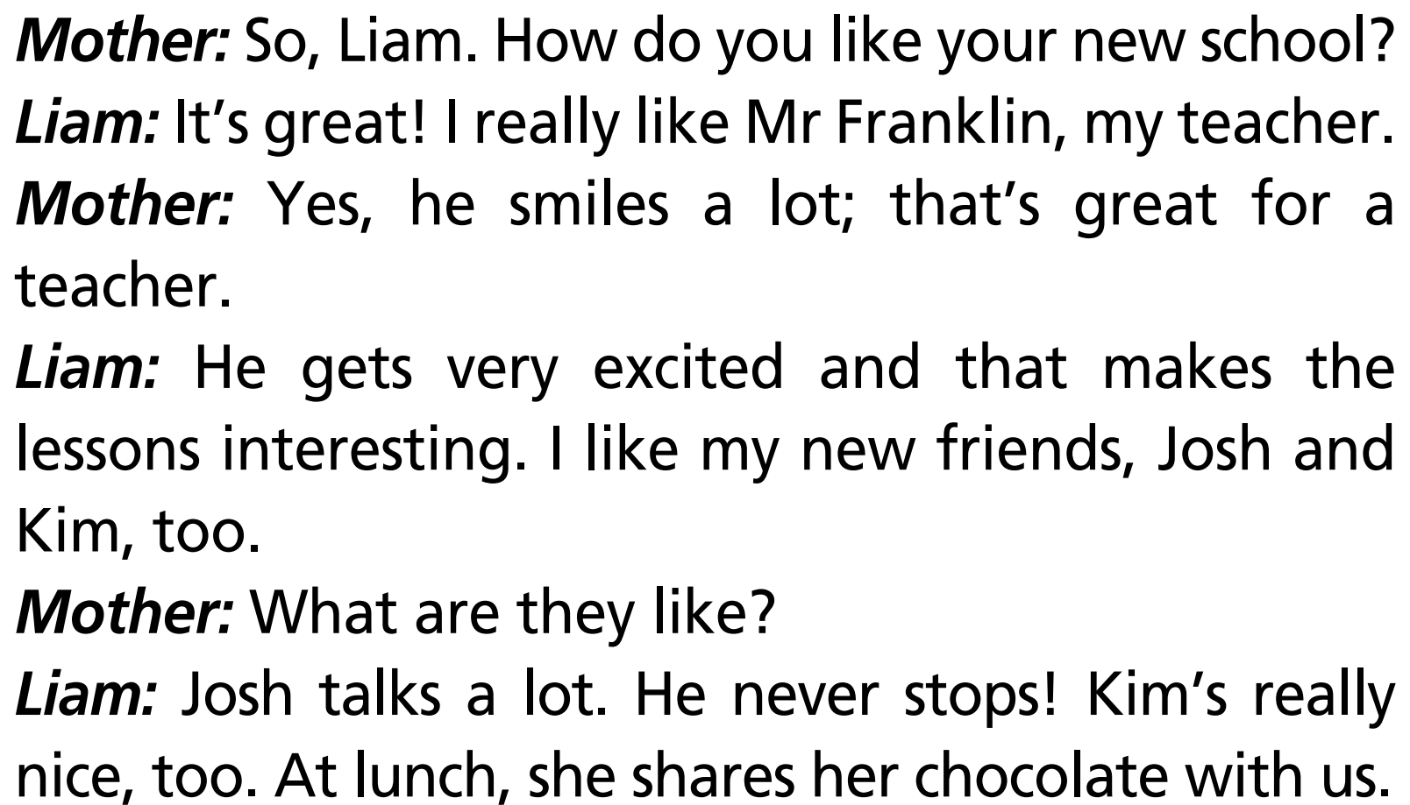
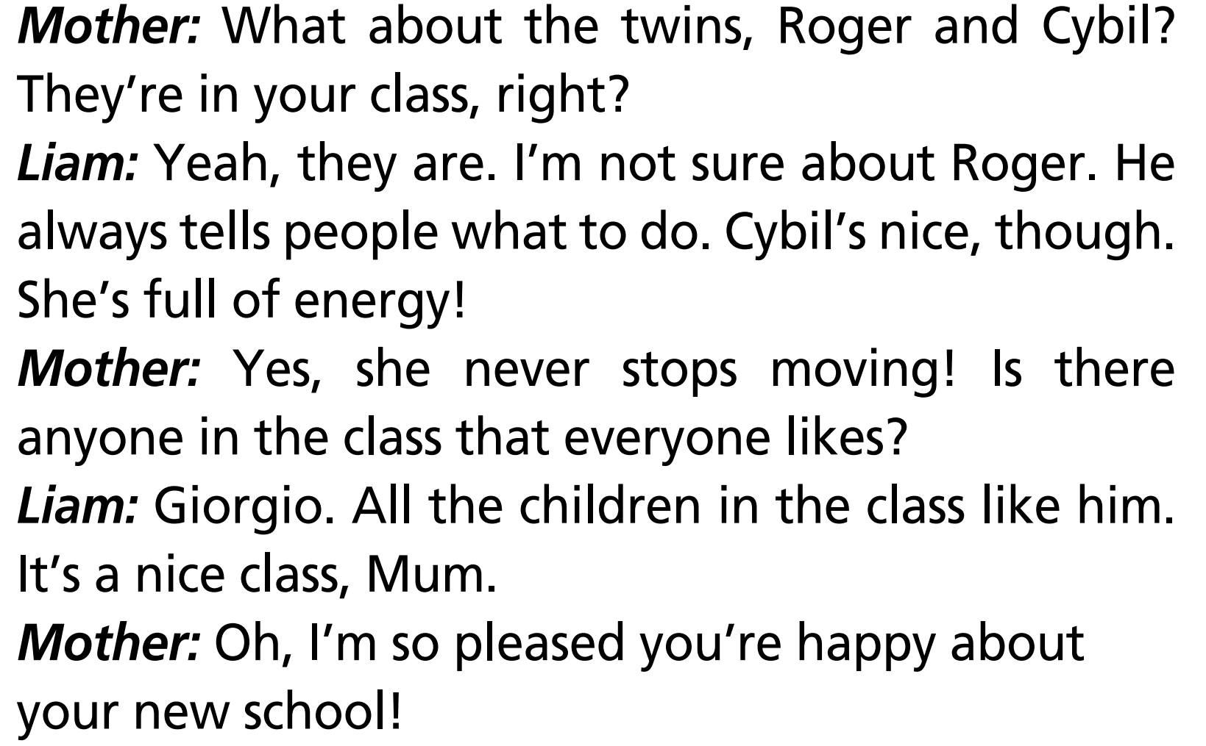
Post-listening
Practise the dialogue in pairs.

Slide 21

CONSOLIDATION

Slide 22
Write a paragraph (60-80 words) to describe your classmates. Use the vocabulary and grammar points you have learnt in this unit.

Slide 23

WRAP-UP

Slide 24
Today’s lesson
Vocabularies
Appearance
Characters
Free-time activities & hobbies
Structures/ Sentence patterns
Present Simple
Present Continuous

Slide 25
Homework
Review the vocabularies and grammar points and make sentences using them.
Prepare the next lesson (page 27 SB)
Do Test 1 of Unit 1 in Bài Tập Bổ Trợ TA 7 Right on
(pages 10 – 13)
Do the Speaking Test – Test 1 of Unit 1 in Bài Tập Bổ Trợ TA 7 Right on (page 74)

Slide 26
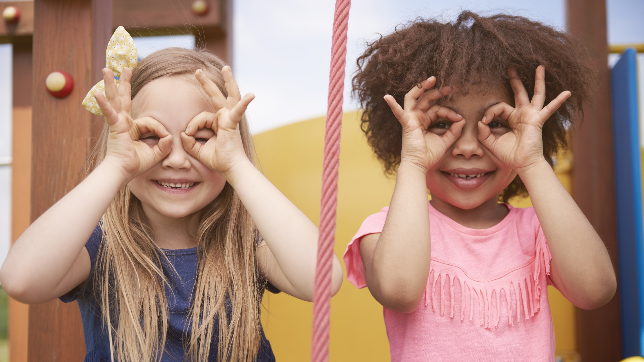
Enjoy your day!

