Slide 1

Unit 2: Every Day
Lesson 2e: Grammar
Page 44

Slide 2
Lesson Outline
Warm-up
Presentation
Practice
Production
Consolidation
Wrap-up

Slide 3
Objectives
By the end of this lesson, students will be able to…
- use adverbs of frequency correctly.

Slide 4

WARM-UP

Slide 5
Choose the word whose main stress is placed differently from that of the others.
1. A. visit B. prepare C. listen D. finish
/ˈvɪzɪt/ /prɪˈpeə/ /ˈlɪsən/ /ˈfɪnɪʃ/
2. A. cinema B. theatre C. department D. restaurant
/ˈsɪnəmə/ /ˈθɪətə/ /dɪˈpɑːtmənt/ /ˈrestrɒnt/
3. A. video B. Saturday C. timetable D. amusement
/ˈvɪdiəʊ/ /ˈsætədeɪ/ /ˈtaɪmteɪbəl/ /əˈmjuːzmənt/

Slide 6
Pair work
Tell your friend when you do these things.
play video games
chat online
watch films
play sports
go to the mall
go bowling
I watch films at the weekend.

Slide 7
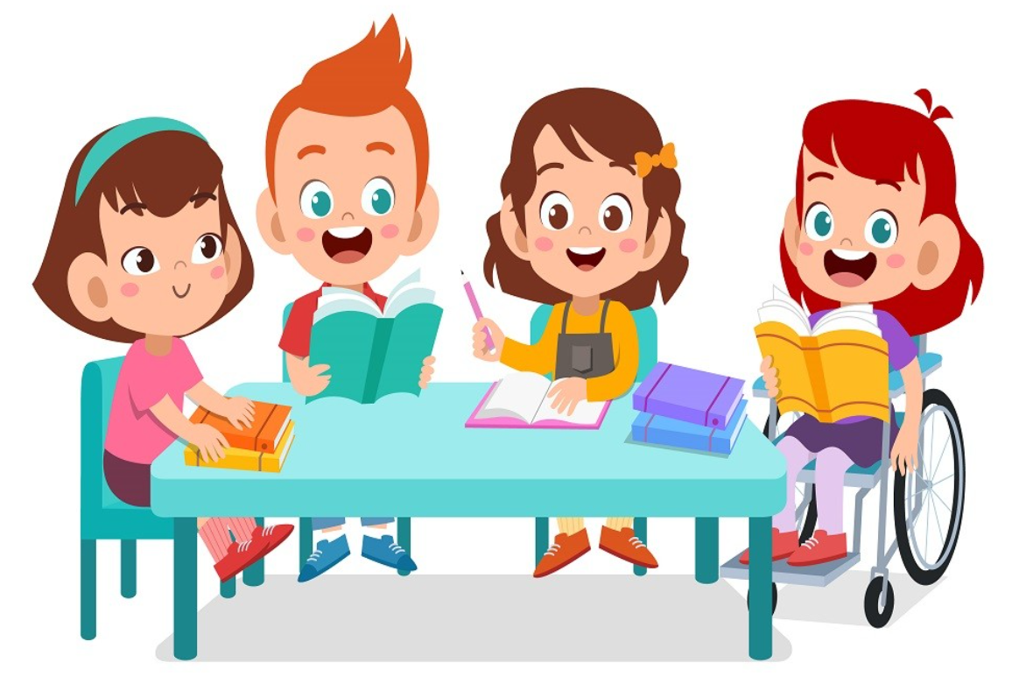
It’s time to learn …

Slide 8
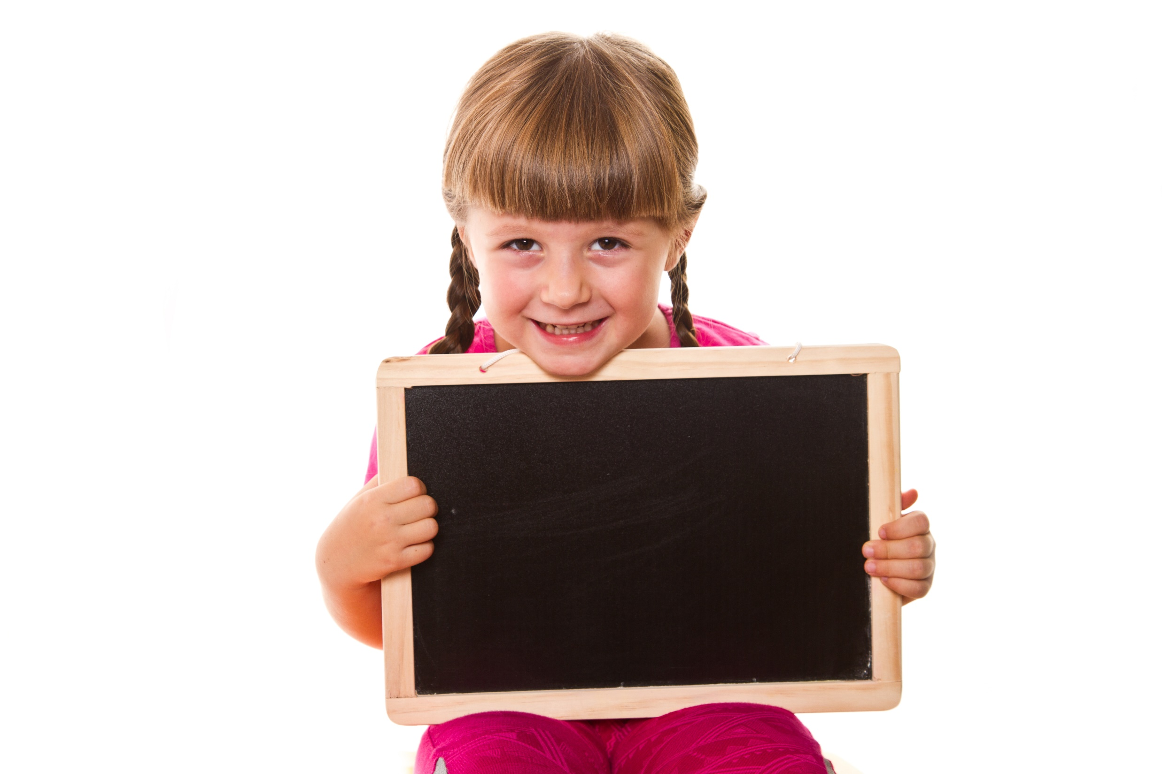
Presentation

Slide 9
Adverbs of frequency: always, usually, often, sometimes, never
 | Mon. | Tue. | Wed. | Thu. | Fri. | Sat. | Sun.
watch TV | ✓ | ✓ | ✓ | ✓ | ✓ | ✓ | ✓
play football | ✓ | ✓ | ✓ | ✓ | ✓
chat online | ✓ |  | ✓ |  | ✓
go shopping |  |  |  |  |  |  | ✓
go bowling | x | x | x | x | x | x | x
I always watch TV in the evening.
I usually play football after school.
I often chat online with friends.
I sometimes go shopping with my mom.
I never go bowling.

Slide 10
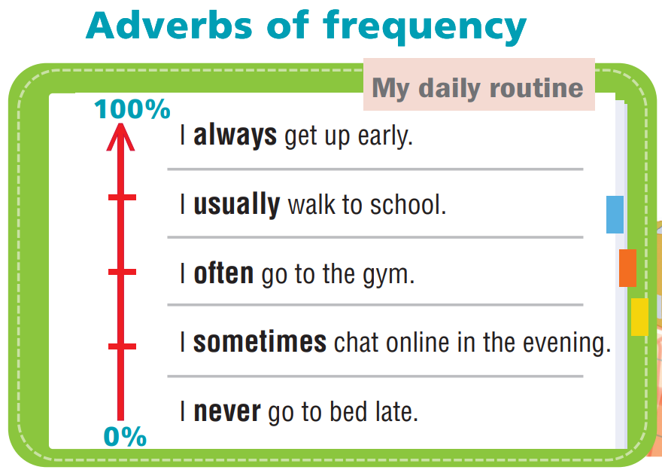
- Adverbs of frequency show how often we do something.
- We put them after the verb to be but before the main verb.
Example:
I always go to school early.
I am never late for school.

Slide 11
Practice

Slide 12
1. Read the theory box. Then write the correct adverb of frequency.
1 John _______________ (100%) walks to school.
2 Helen ______________ (≈25%) watches TV in the evening.
3 They ______________ (≈50%) do their homework after lunch.
4 He is ______________ (0%) late for school.
5 My dad ______________ (≈75%) has lunch at work.
always
sometimes
often
never
usually

Slide 13
2 Put the words in the correct order.
1 always/ early/ is/ for work/ He __________________________________________________
2 She/ late/ sometimes/ is __________________________________________________
3 shower/ He/ in the evening/ usually/ takes/ a __________________________________________________
4 on Sundays/ They/ go/ often/ to the park __________________________________________________
He is always early for work.
She is sometimes late.
He usually takes a shower in the evening.
They often go to the park on Sundays.

Slide 14
2. Rewrite the sentences. Put the adverbs of frequency in the correct place.
1 I get up at 7:00 a.m. (always)
__________________________________________
2 Fran chats online. (sometimes)
__________________________________________
3 Neil plays video games. (usually)
__________________________________________
4 John and Mark have breakfast. (never)
__________________________________________
I always get up at 7:00 a.m.
Fran sometimes chat online.
Neil usually plays video games.
Extra Practise
WB, P. 26
John and Mark never have breakfast.

Slide 15
18 ★ Put the adverbs of frequency in the correct place.
1 Sophie walks to school. (never)
__________________________________________
2 Jenny is late for class. (always)
__________________________________________
3 I play tennis. (often)
__________________________________________
4 My sister goes to the gym. (sometimes)
__________________________________________
5 They go to the cinema on Saturdays. (usually)
__________________________________________
Sophie never walks to school.
Jenny is always late for class.
I often play tennis.
My sister sometimes goes to the gym.
Extra Practise
WB, P. 67
They usually go to the cinema on Saturdays.

Slide 16
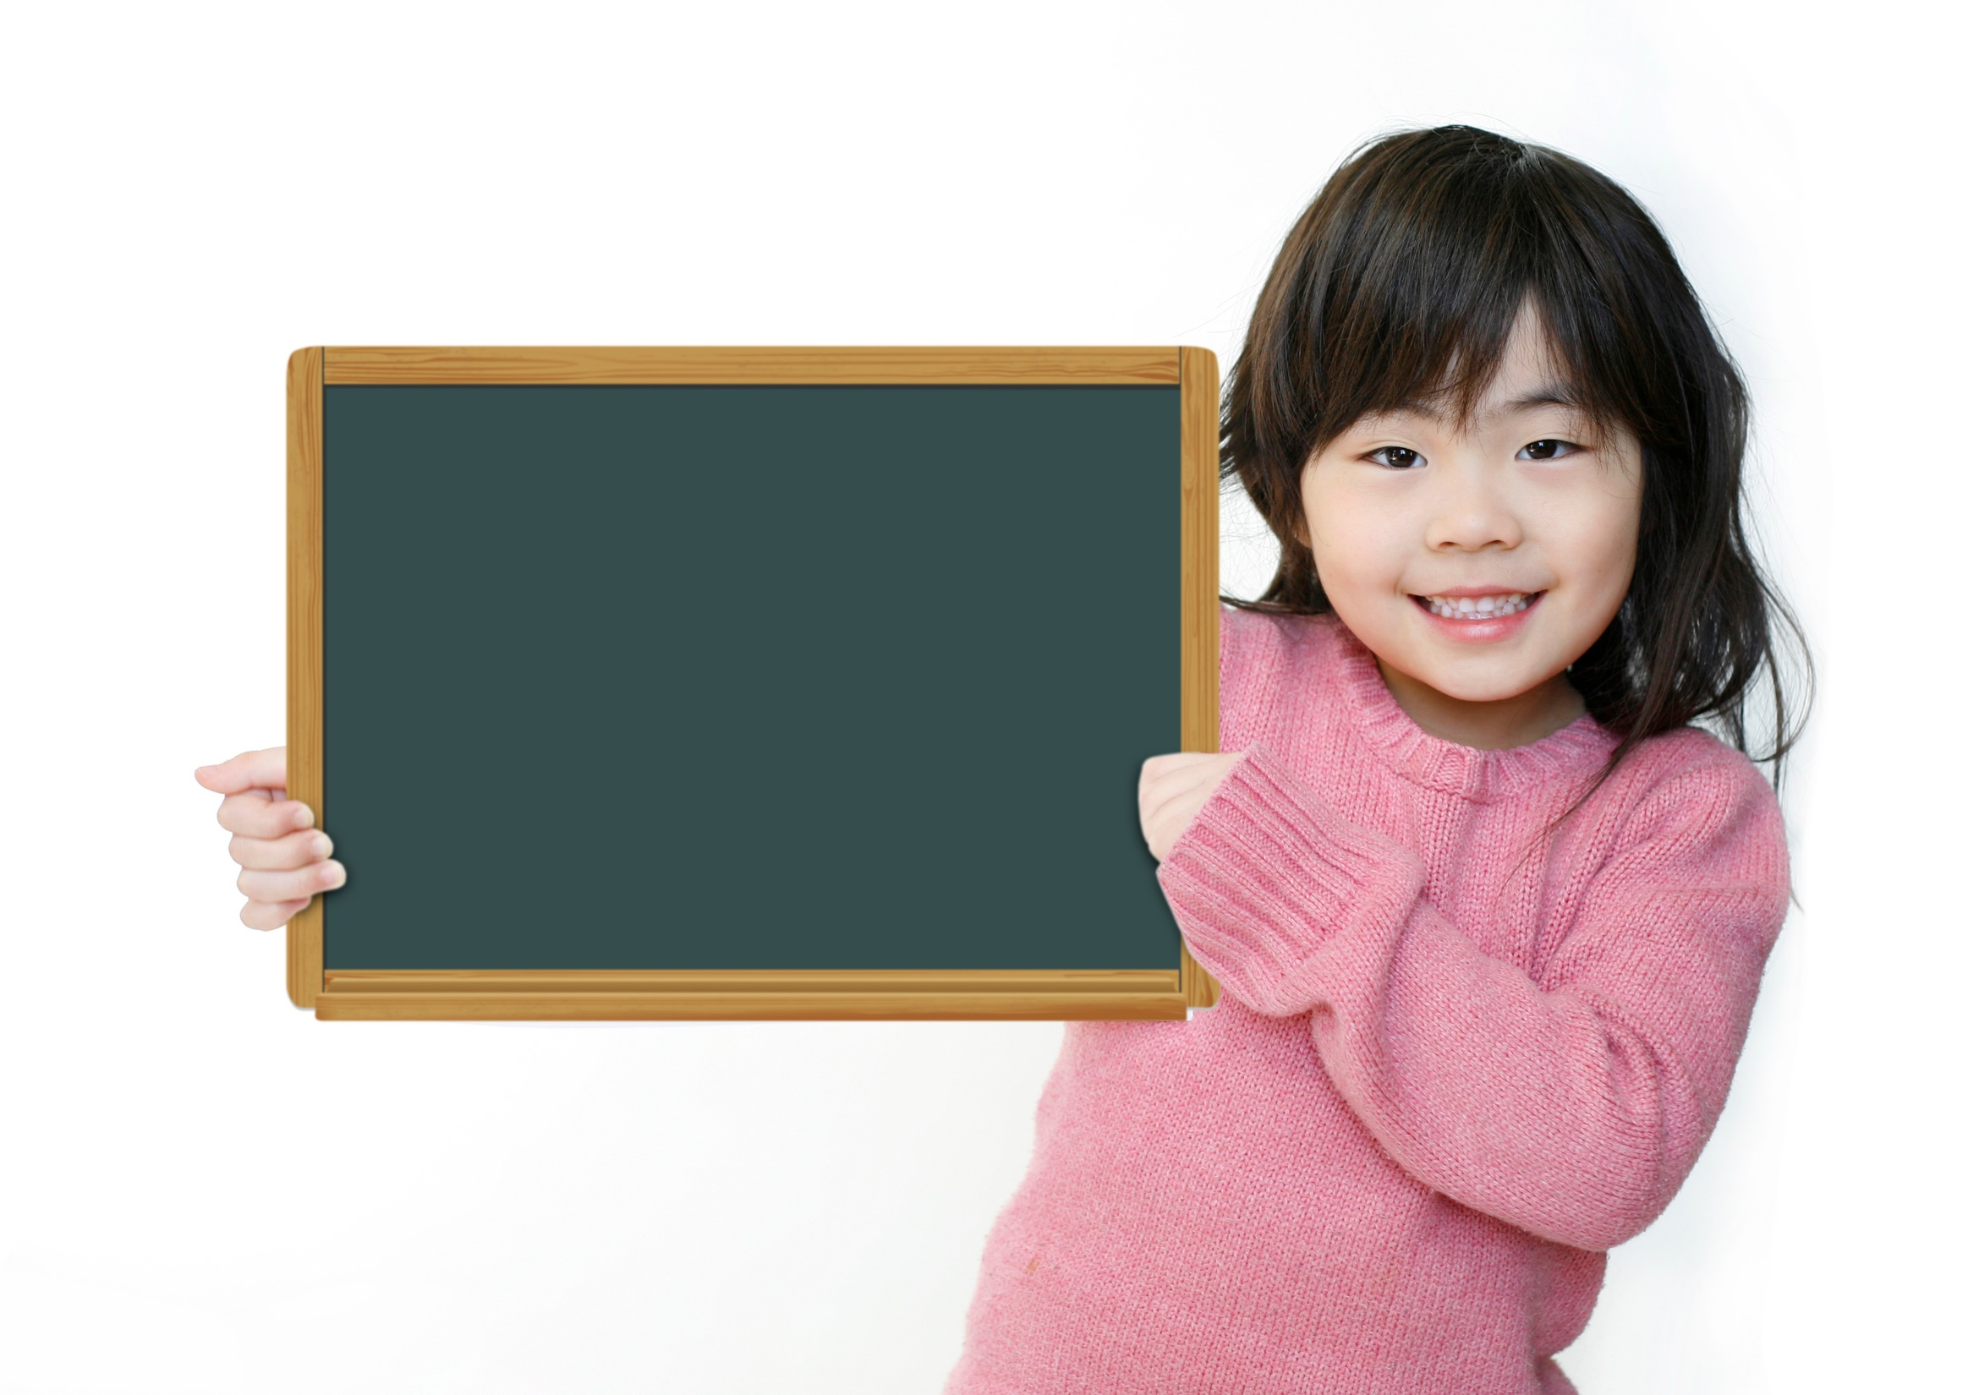
Production

Slide 17
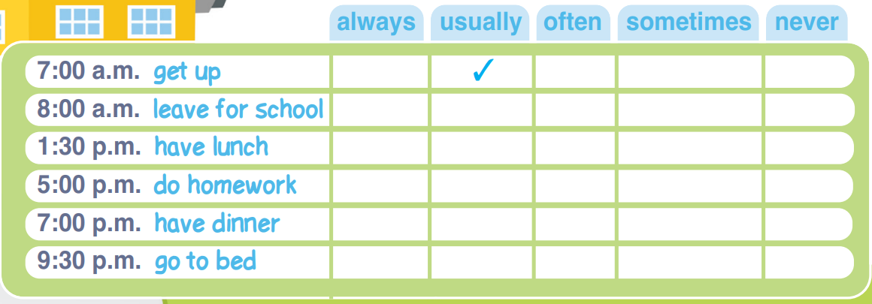
3 Put a tick (✓) in the correct box. Then tell your partner.
I usually get up at 7:00 a.m.

Slide 18
✓
✓
✓
✓
✓
I usually get up at 7:00 a.m.
I always leave for school at 8:00 a.m.
I often have lunch at 1:30 p.m.
I sometimes do my homework at 5:00 p.m.
I never have dinner at 7:00 p.m.
I usually go to bed at 9:30 p.m.

Slide 19
4 Imagine your friend is a famous person. What is his/her daily
routine like?
Steve is a famous actor. He never gets up early. He always has a big breakfast.
Mark is a famous singer. He never goes to school. He always eats lunch in a restaurant. He often goes to the gym in the afternoon. He usually goes to bed late.

Slide 20

CONSOLIDATION

Slide 21
Write five sentences about your routine or free time activities, using adverbs of frequency: always, usually, often, sometimes, never.

Slide 22

WRAP-UP

Slide 23
Today’s lesson
Grammar
Adverbs of frequency
- always
- usually
- often
- sometimes
- never

Slide 24
Homework
Practise making sentences using adverbs of frequency.
Do exercises 1&3 in TA 6 Right on WB (p. 26)
Complete the grammar notes in TA 6 Right on Notebook
(p. 24)
Prepare the next lesson (p. 45 SB)

Slide 25
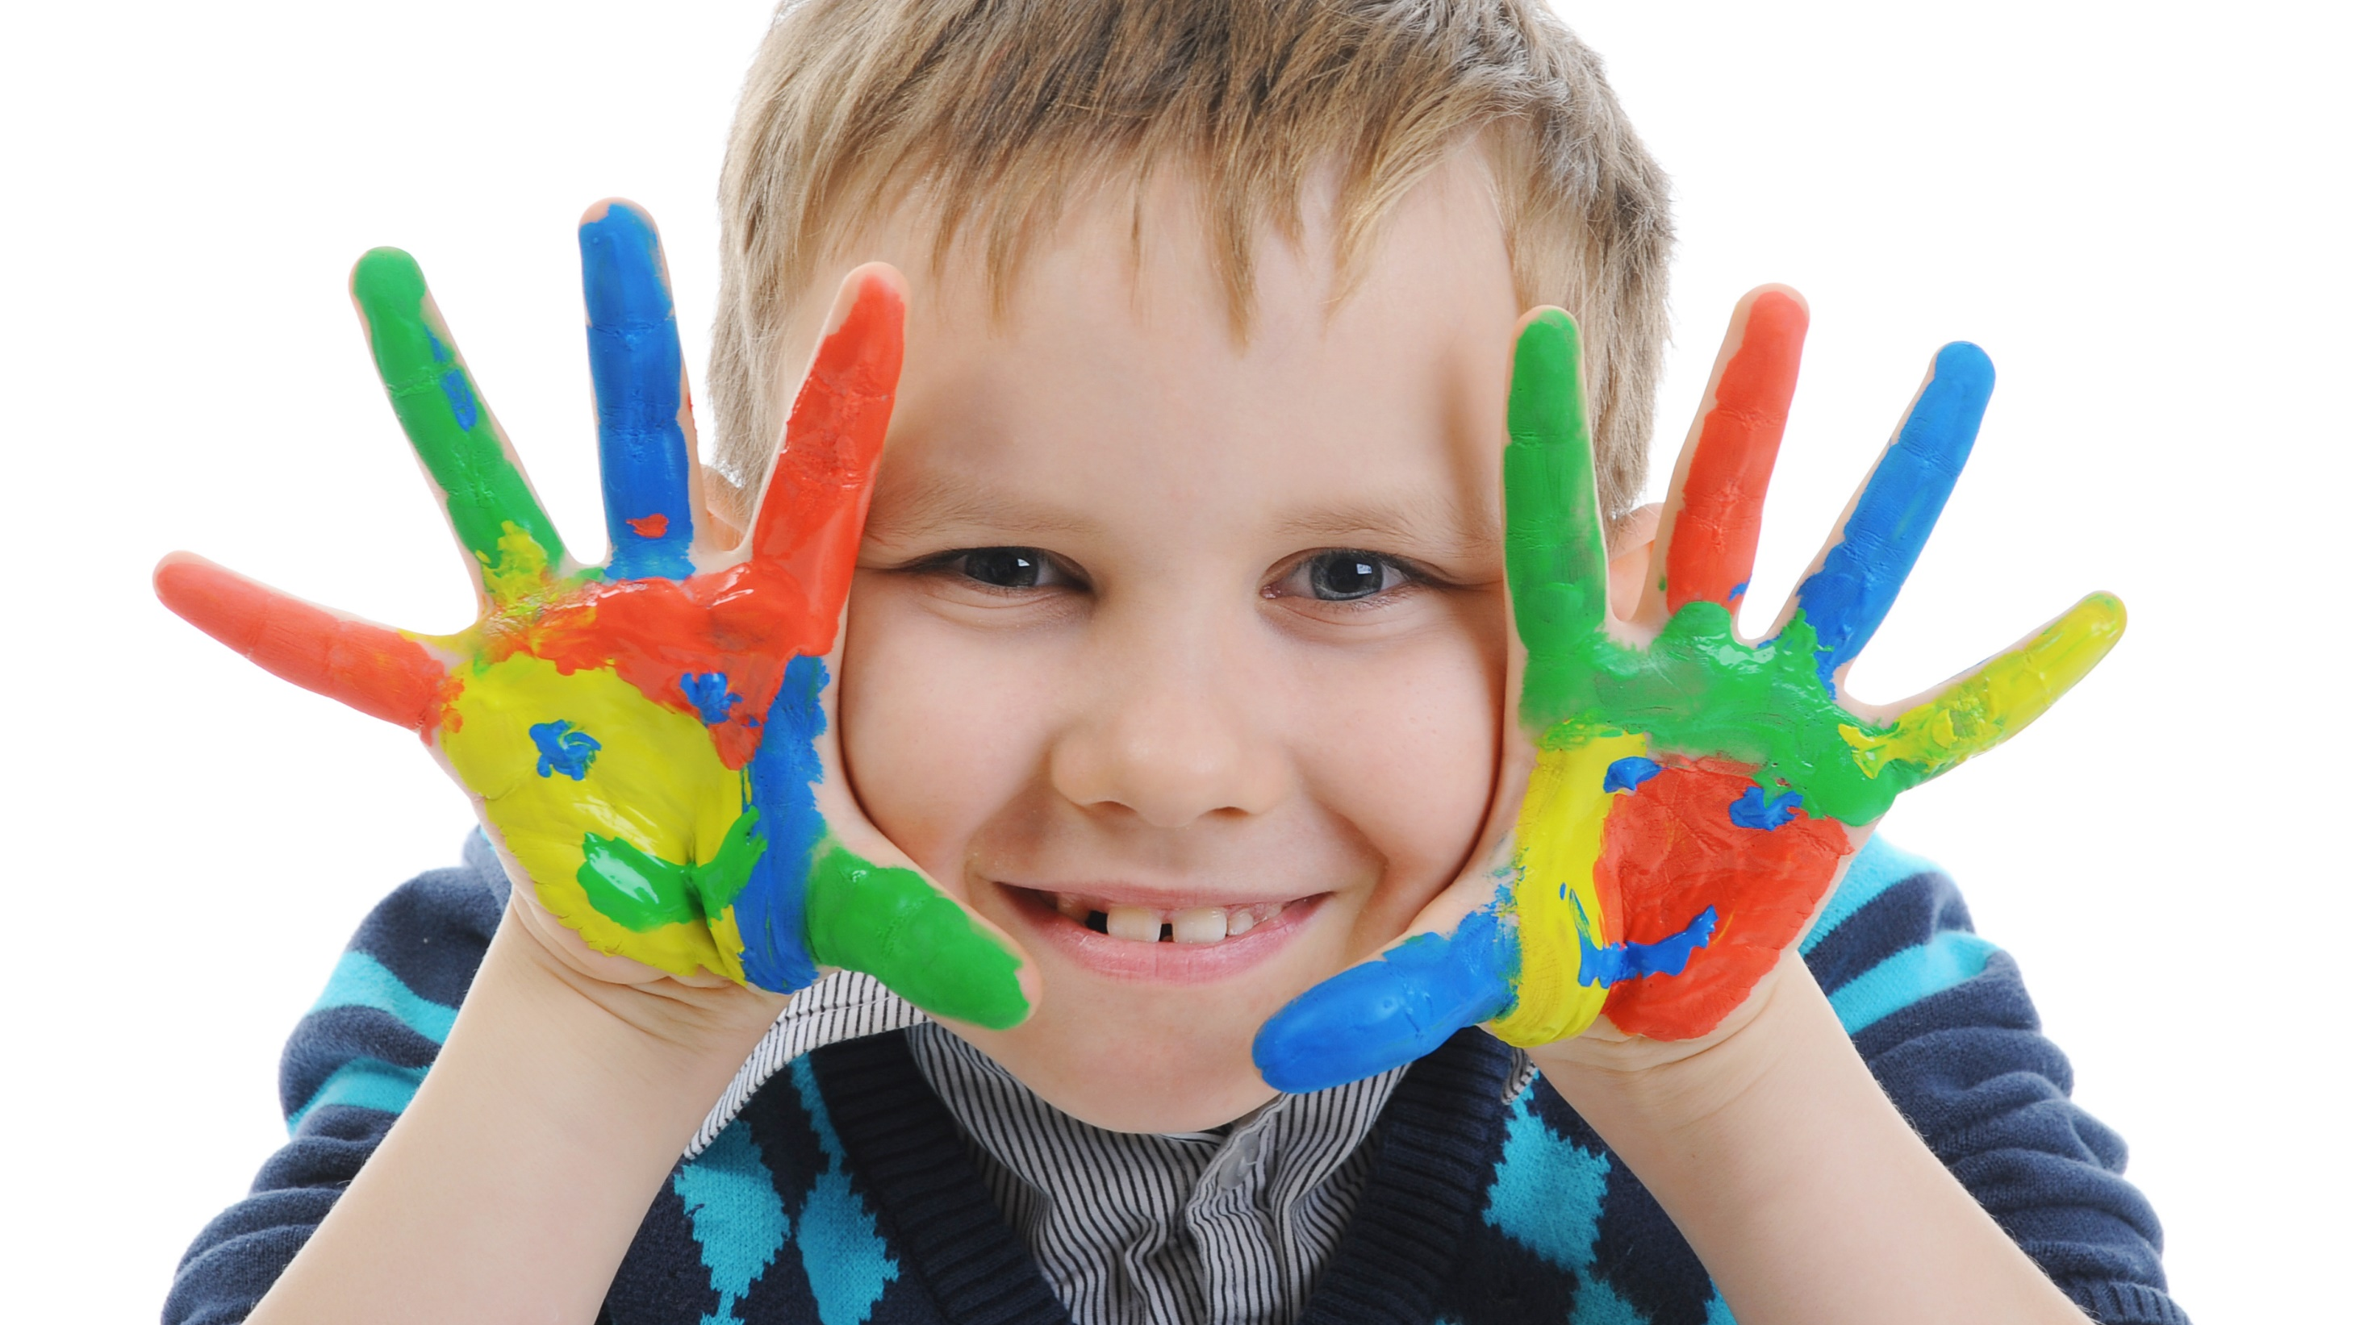
Enjoy your day!

