Slide 1
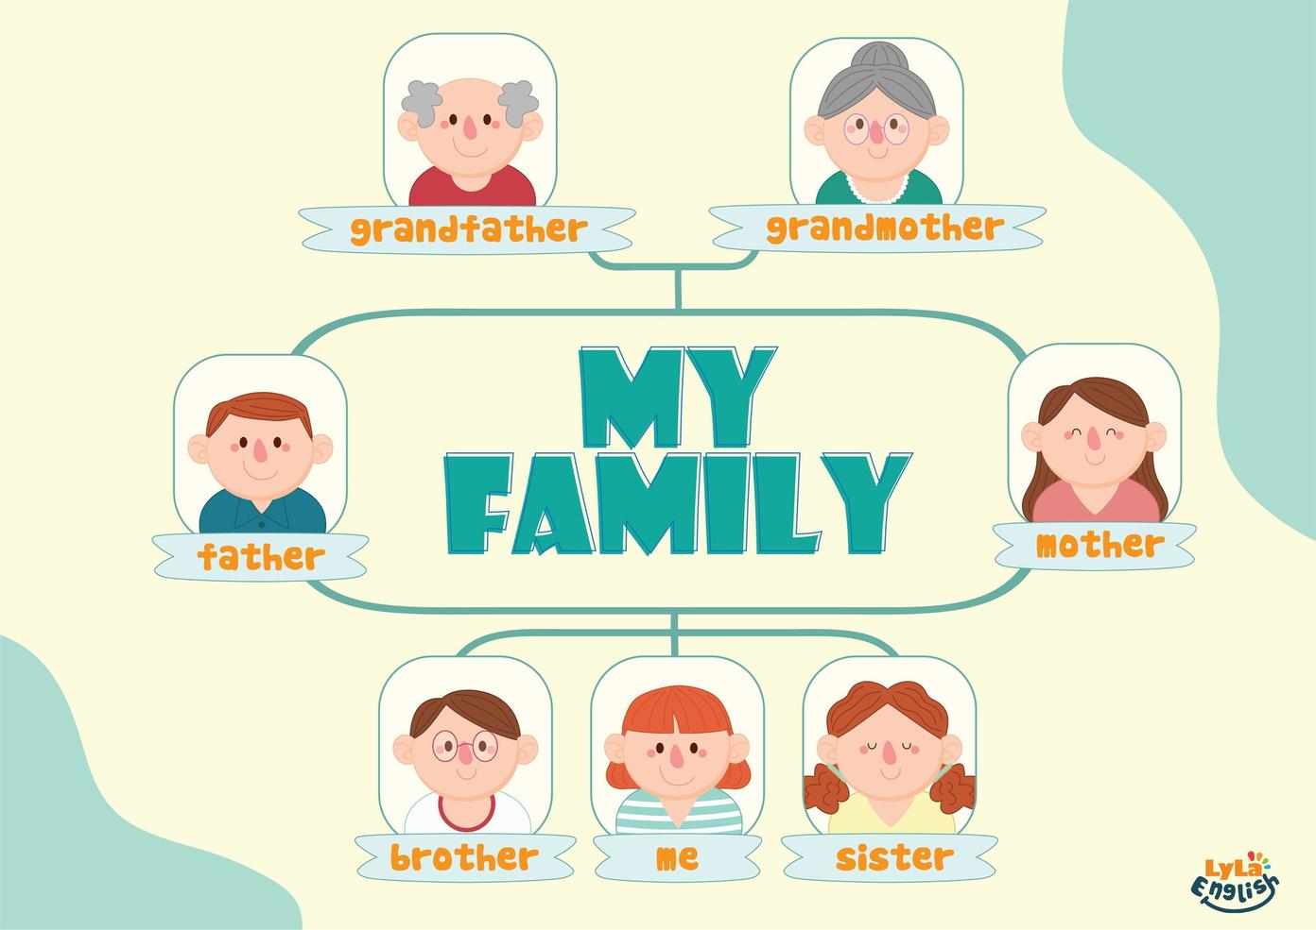



Slide 2
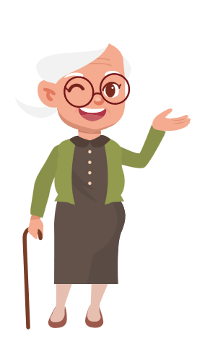

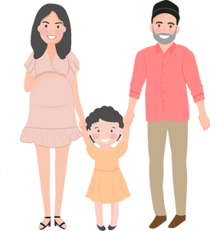
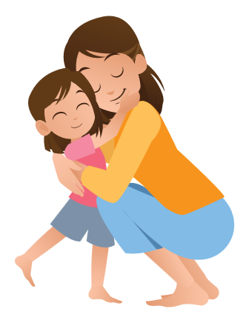
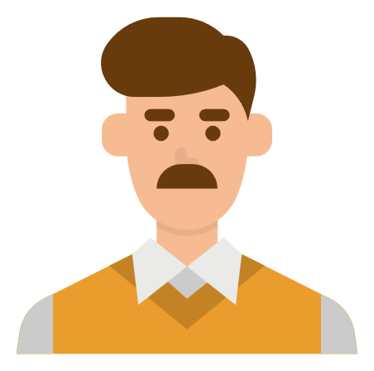
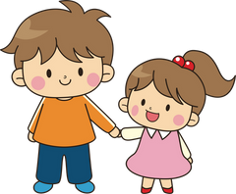
I. QUESTION
1. How many people are there in your family? Who are they? - There are ... people:
2. Who do you love the best in you family? - I love ...
3. What’s your daddy’s name? -My daddy’s name is...
4. What’s your mommy’s/ sister’s /brother’s name?
-My mommy’s/sister’s /brother’s name is...

Slide 3
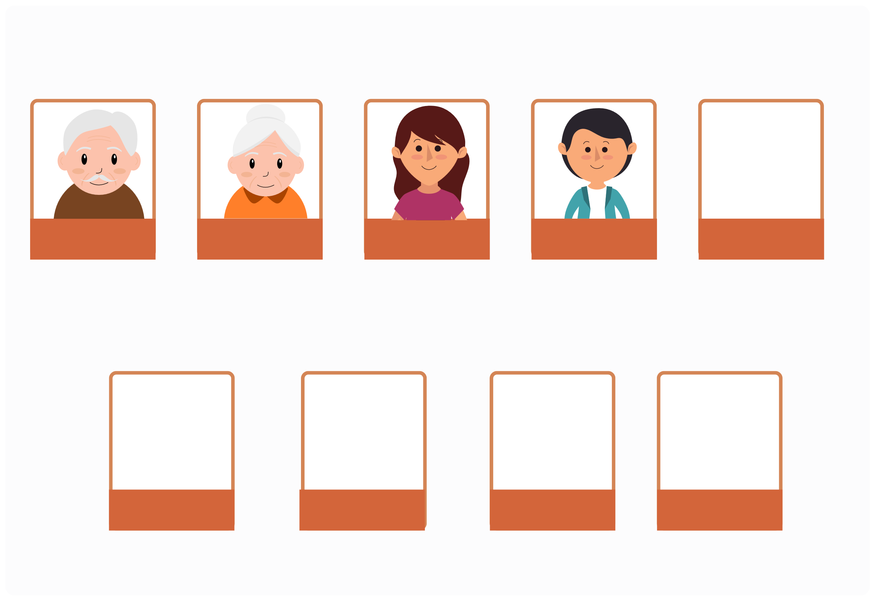
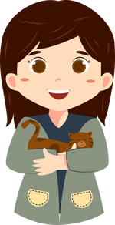
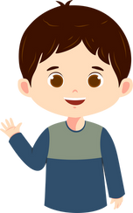
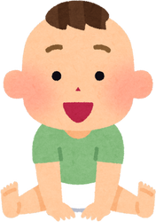
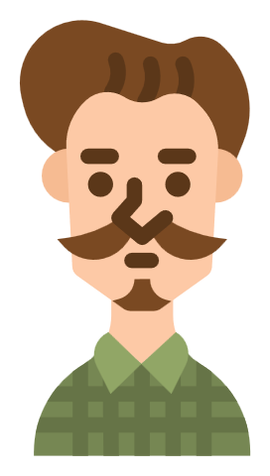
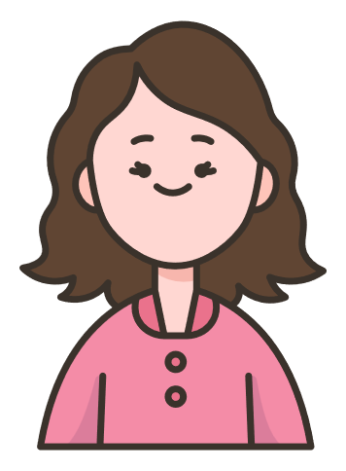
II. VOCABULARY
grandpa
grandma
mommy
daddy
sister
brother
baby
uncle
aunt

Slide 4
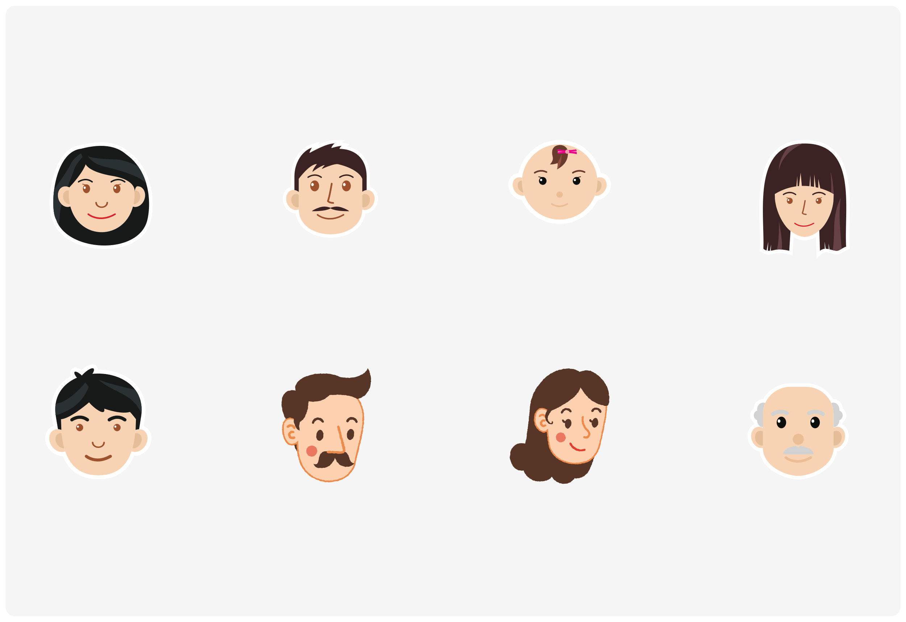
III. EXERCISES:
1.Trace the words:
mommy
daddy
baby
sister
brother
uncle
aunt
grandpa

Slide 5
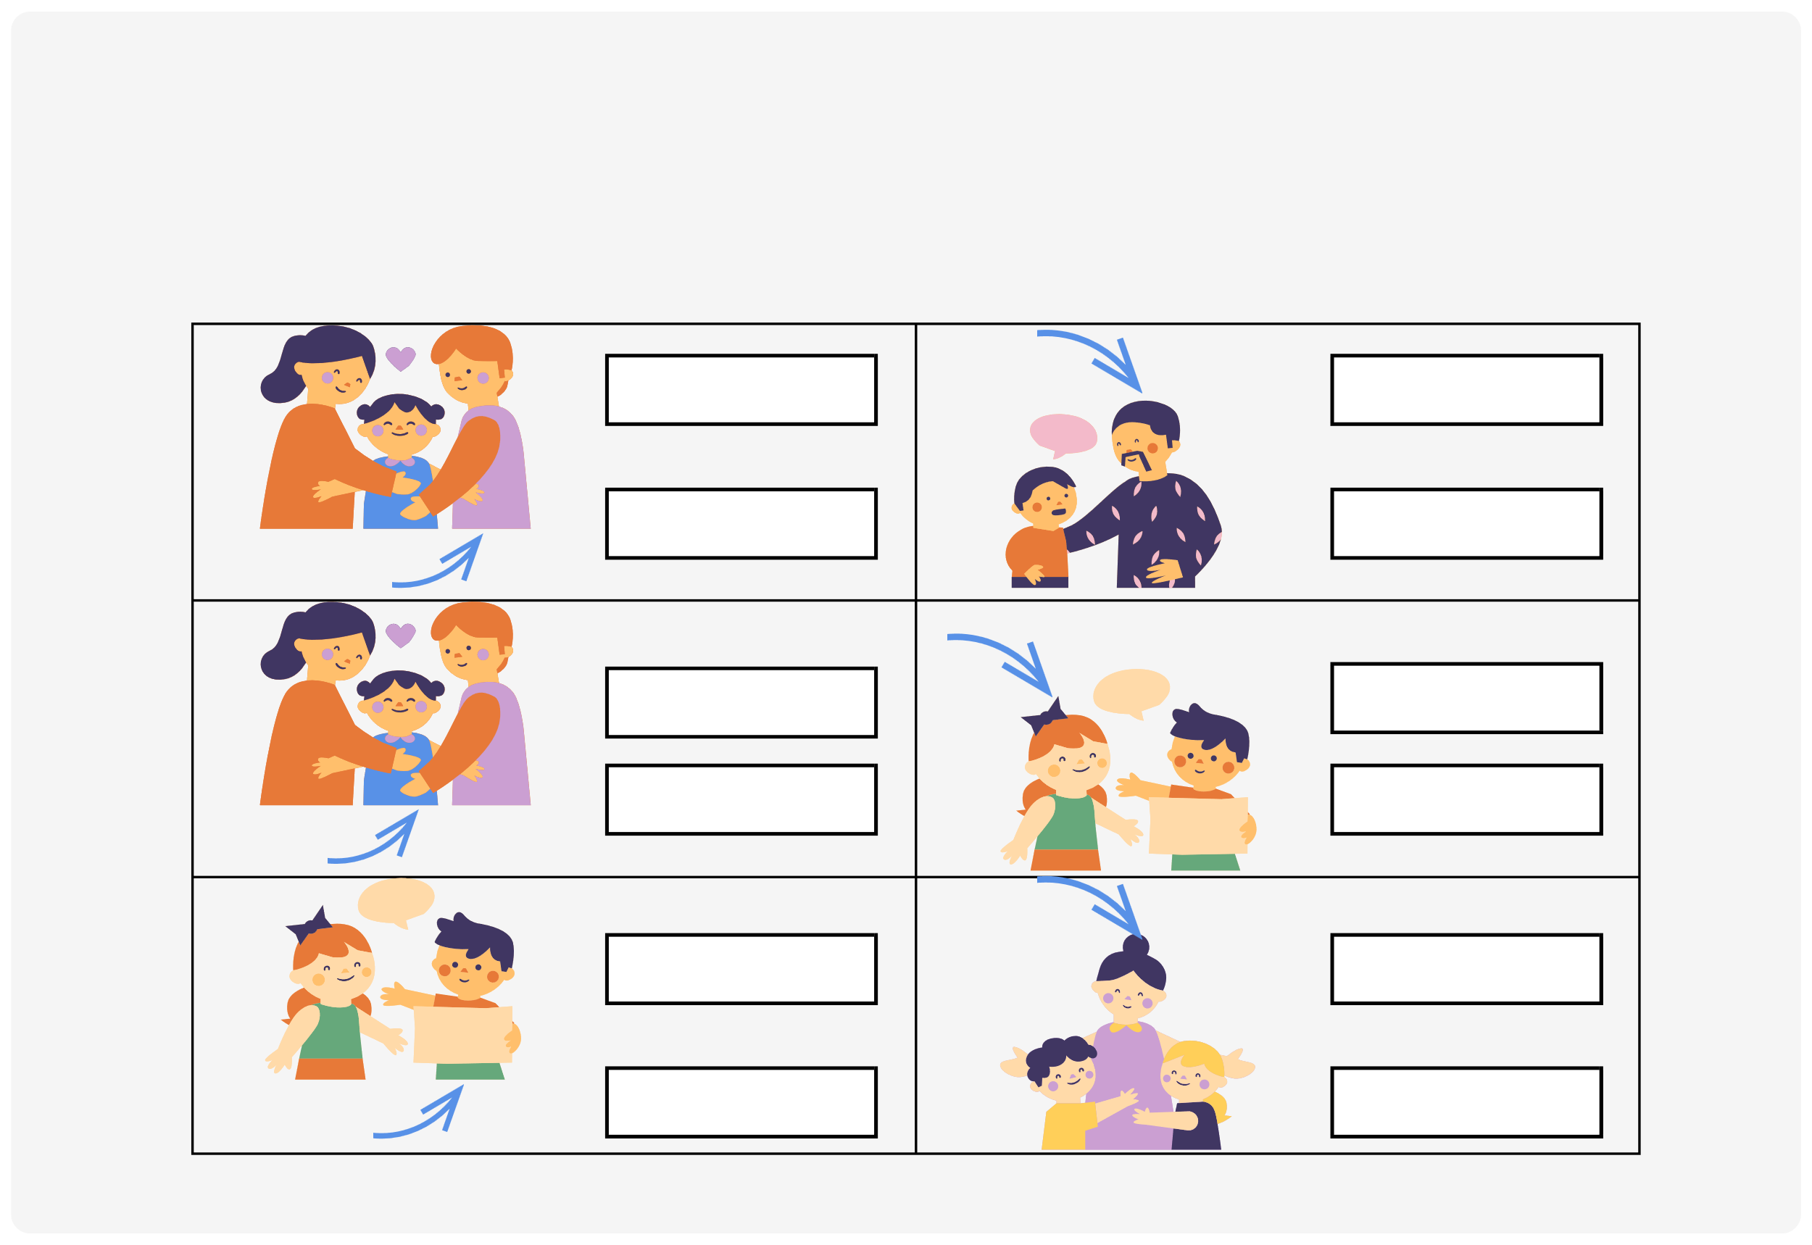
III. EXERCISES:
2. Look at the pictures and circle the correct words:
daddy
grandma
mommy
grandpa
mommy daddy
sister brother
sister
grandma
brother
grandpa

Slide 6

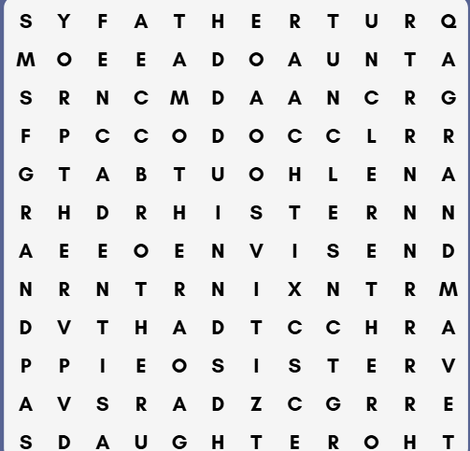
III. EXERCISES:
3. Find the words below:
uncle
aunt
brother
grandma
sister

Slide 7
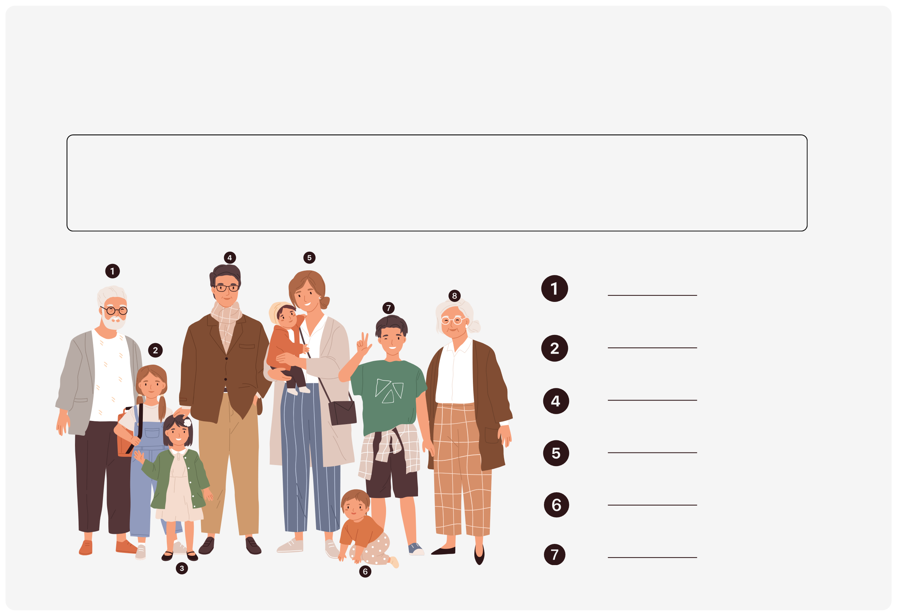
III. EXERCISES:
4.Use the words from the box to label the family members:
daddy
grandpa
sister
baby
brother
mommy
grandma

Slide 8
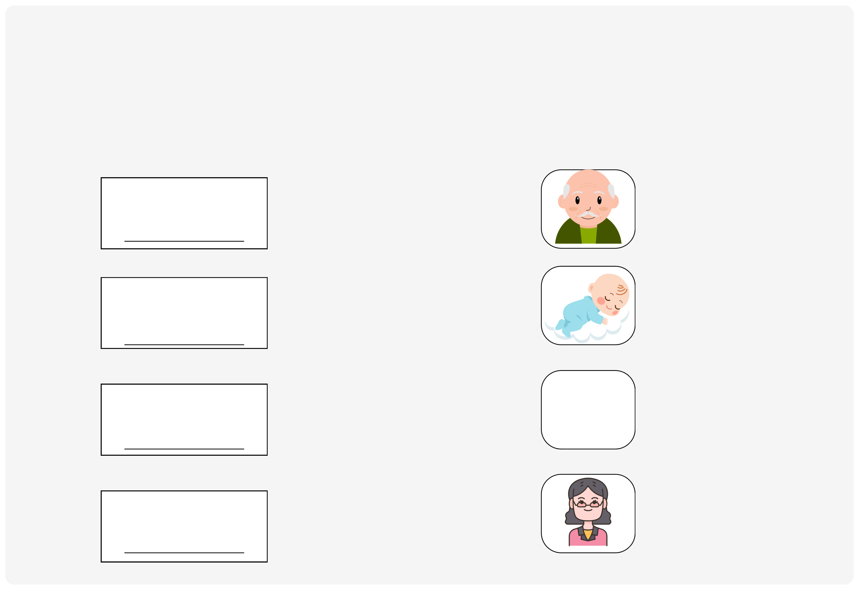
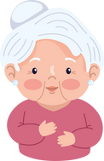
III. EXERCISES:
5. Rearrange the letters below and match the word to the correct picture:
ybab
pagarnd
uant
magarnd

Slide 9
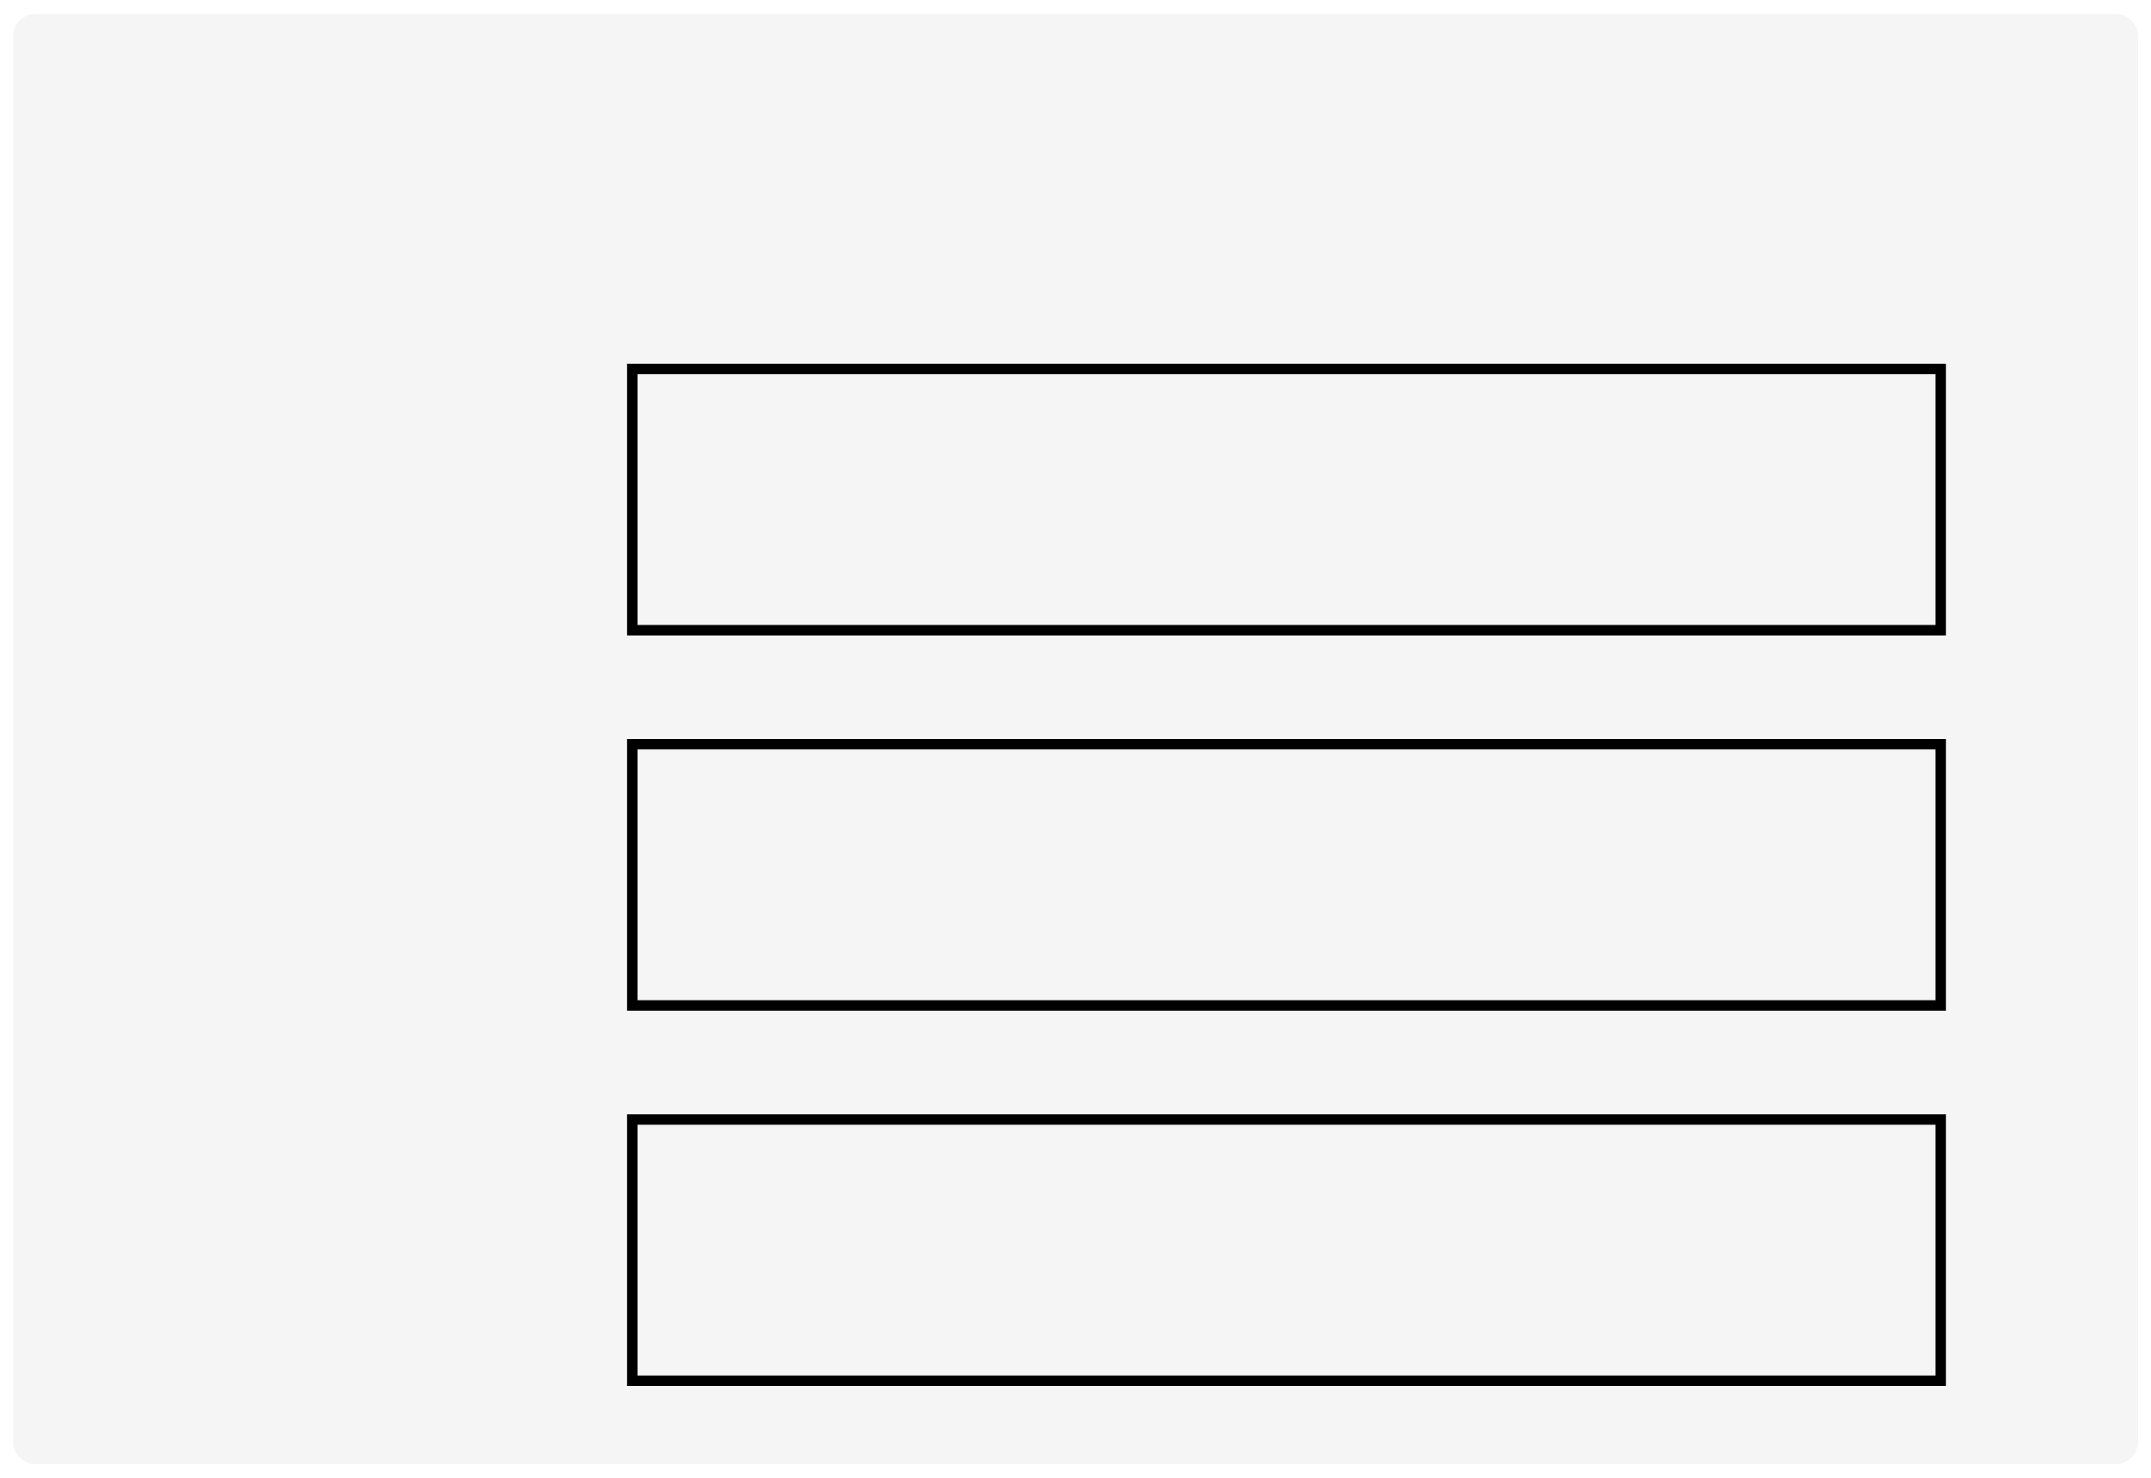
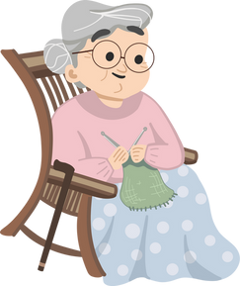
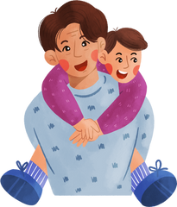

III. EXERCISES:
6. Look at the picture, circle the correct answer:
mommy
grandma
baby
grandpa
uncle
daddy
brother
sister
baby

Slide 10
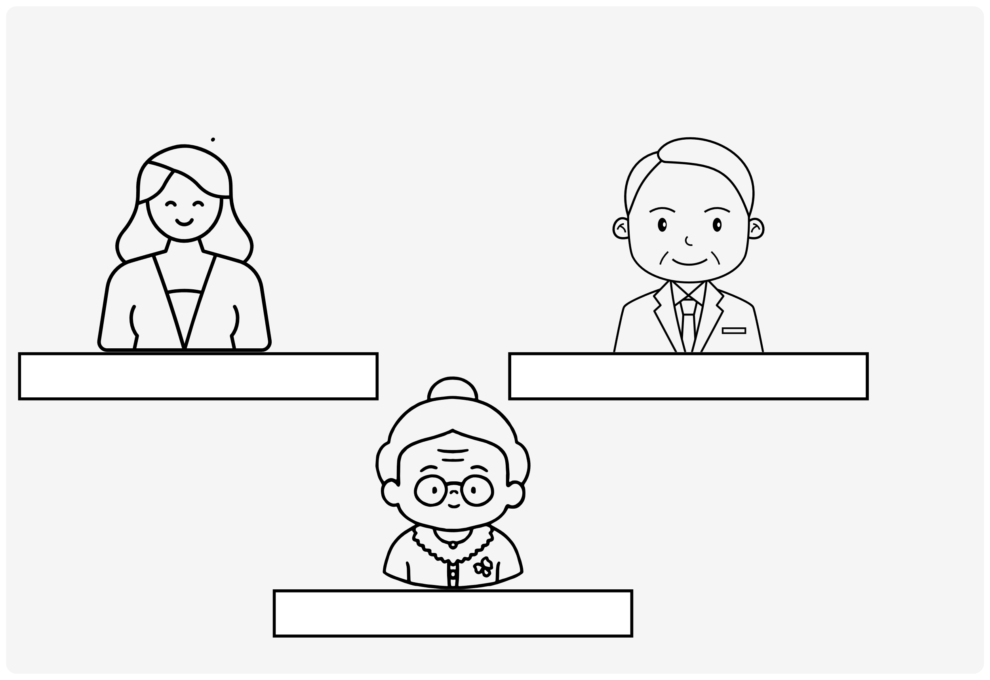
III. EXERCISES:
7. Read and color the picture:
She is my sister.
He is my daddy.
She is my grandma.

Slide 11
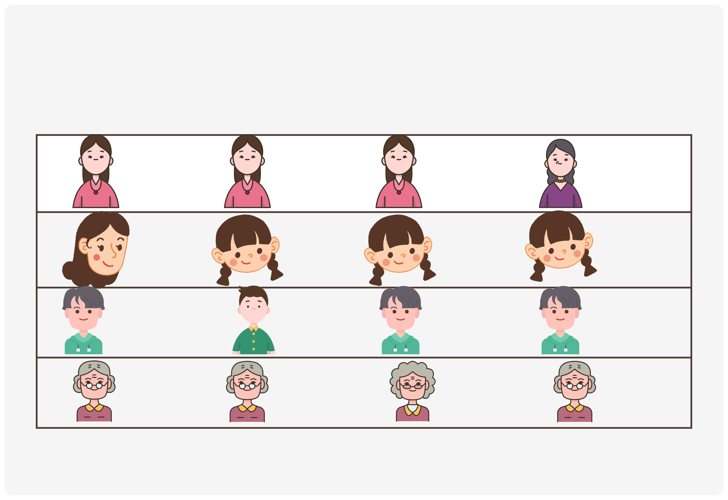
III. EXERCISES:
8. Which picture is different? Circle in that picture:

