Slide 1
C
P
U
1
1.Central Processing Unit
3. an internal storage areas in the computer system
5. a hand-operated input device used to manipulate objects on a computer screen.
7. A hardware to text the words or number
4.a magnetic storage medium for computer systems
2.piece of computer hardware that displays the video and graphics information generated by the computer through the video card.
6.a personal computer that fits on top of a desk.
1
8.a global network connecting millions of computers
2
M
O
N
I
T
O
R
2
3
M
E
M
O
R
Y
3
4
F
L
O
P
P
Y
D
I
S
K
4
M
O
U
S
E
5
5
D
E
S
K
T
O
P
6
6
7
K
E
Y
B
O
A
R
D
7
8
I
N
T
E
R
N
E
T
8

Slide 2
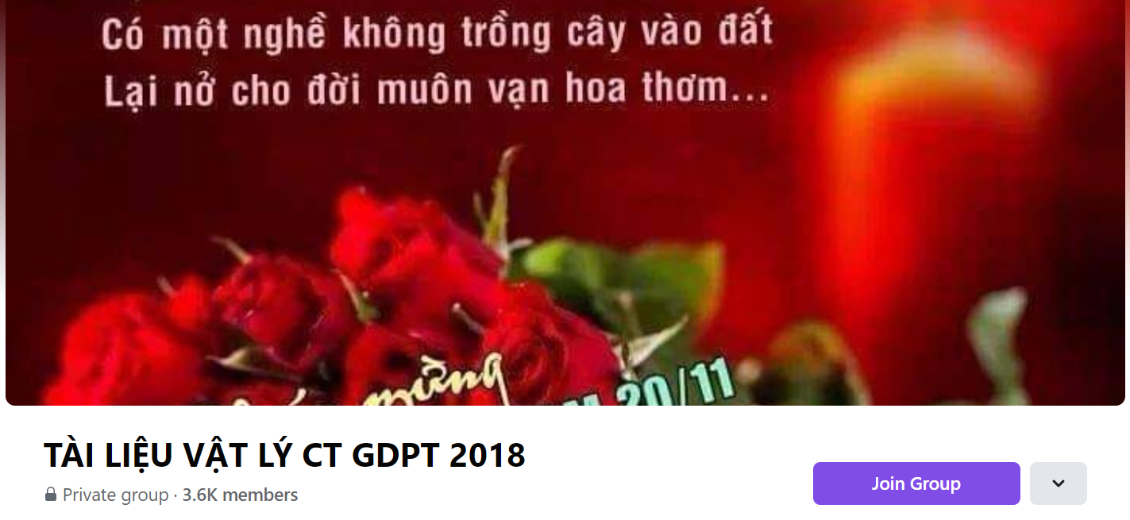
SƯU TẦM: ĐOÀN VĂN DOANH, NAM TRỰC, NAM ĐỊNH
LINK NHÓM DÀNH CHO GV BỘ MÔN VẬT LÝ TRAO ĐỔI TÀI LIỆU VÀ CHUYÊN MÔN CT 2018
https://www.facebook.com/groups/299257004355186

