Slide 1

UNIT 8: ECOLOGY AND THE ENVIRONMENT
Lesson 3.1 – Listening & Reading
Page 70

Slide 2



Lesson 3.1
LESSSON OUTLINE

Slide 3

By the end of this lesson,
students will be able to:
- practice listening and reading for gist and specific information.
- get ideas and vocabulary related to environmental problems and ways to solve them
- be familiar with problem and solution essay.

Slide 4



Slide 5

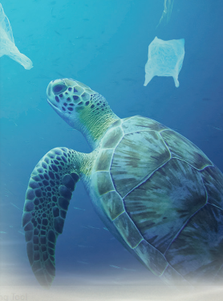
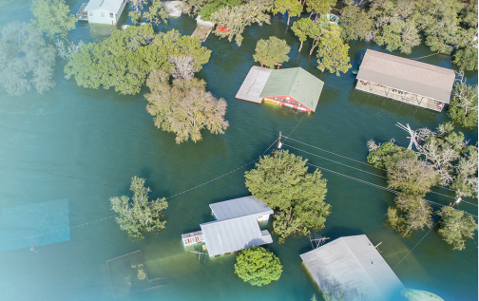
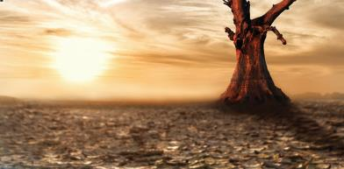
Work in pairs - Discuss
What environment problems can you see in the pictures?
Do you have these problems where you live?
What other problems are there in your hometown?

Slide 6



Slide 7

Pre - Listening
a. Listen to a lecture about climate change. What is discussed in the lecture?
1. The causes and effects of climate change
2. The causes of and solutions to climate change

Slide 8


While- Listening
a. Listen to a lecture about climate change. What is discussed in the lecture?
1. The causes and effects of climate change
2. The causes of and solutions to climate change

Slide 9
Pre - Listening
b. Now, listen and answer the questions?
1. How much has the global temperature increased since 1880?
2. When did the Little Ice Age begin?
3. What will happen in the future?
a. cold winters b. deadly storms and floods
4. Which human activity is the main cause of climate change?
5. What helps reduce CO₂ and flooding?

Slide 10
While - Listening
b. Now, listen and answer the questions?
How much has the global temperature increased since 1880?
2. When did the Little Ice Age begin?
3. What will happen in the future?
a. cold winters b. deadly storms and floods
4. Which human activity is the main cause of climate change?
5. What helps reduce CO₂ and flooding?
By about one degree Celsius
In the fourteenth century
Burning fuel
Forests

Slide 11
Audio Scripts
So, you've probably heard about climate change. But what changes are happening? The Earth has become warmer by about one degree Celsius since 1880. Why should we care about a one-degree difference? In the past, when the temperature dropped by one to two degrees, the Earth was put into the Little Ice Age, which lasted from the fourteenth to the mid-nineteenth century. Europe and North America experienced years of long winters leading to poor crops and people dying of hunger. So, as temperature increases, ice is melting faster, and sea levels are rising. In the future, some places will face more deadly storms and floods while other places will experience more heat waves and wildfires. Most scientists agree that the cause of climate change is because of human activity. Burning fuel, which produces greenhouse gases, for electricity and transportation is the main cause. These gases trap the sun's heat. Cutting down forests also contributes to global warming because trees help reduce the amount of carbon dioxide. CO2 is the most common greenhouse gas. Forests also trap water during heavy rainfall and slow down speed of water flowing into rivers. This helps to reduce flooding. So, what should we do? First,…

Slide 12
Cause (n/v) nguyên nhân/ gây ra
Effect (n) hậu quả
Temperature (n) nhiệt độ
Drop (v) giảm/ rớt
Experience (v) trải qua
Lead (v) dẫn đến
Crop (v) thu hoạch ( mùa vụ)
Dying of hunger (np) chết (vì) đói
Face (v) đối mặt
Increase (v) tăng
Produce (v) sản xuất,
Contribute (v) góp phần
Global warming (v) hiên tương nóng lên của địa cầu
Greenhouse effect (np) hiệu ứng nhà kính
New words/ key words from the listening

Slide 13

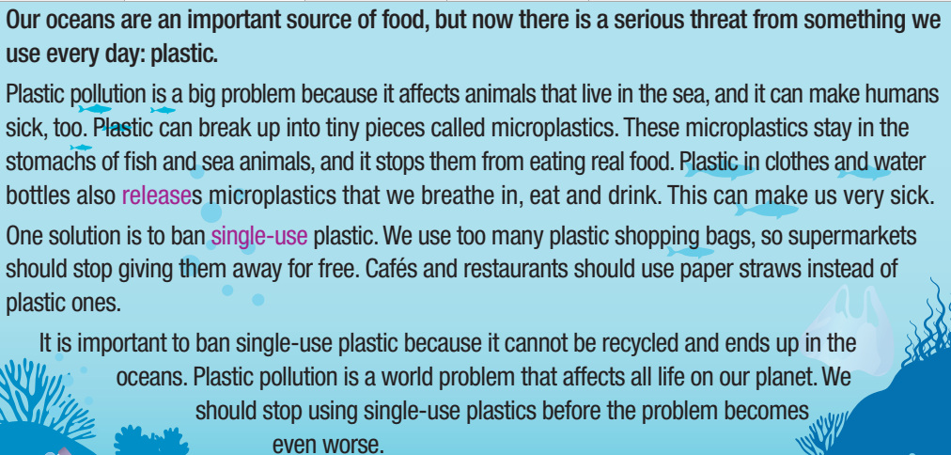
Read and choose the best tittle for Jane’s essay
How plastic harms fish
Why we should stop using single – use plastic
Pre & While- Reading
Notes:
Taken from TA 10 i-Learn Smart World WB, page 44

Slide 14
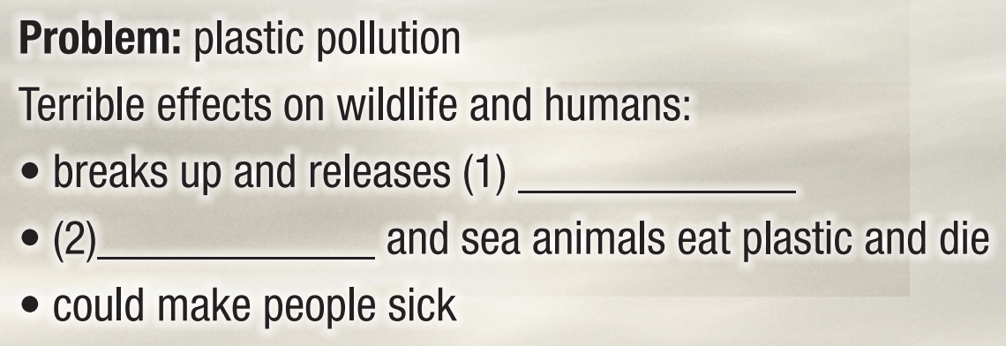
b. Now, read and complete the notes. Write one word only for each blank
While - Reading
microplastics
fish

Slide 15
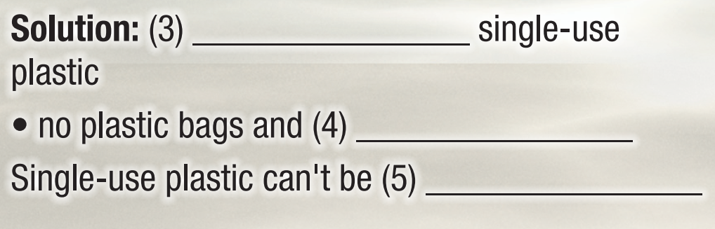
b. Now, read and complete the notes. Write one word only for each blank
While - Reading
ban
straws
recycled

Slide 16

Post- Reading
c. In pairs
Which idea is better:
stop giving away plastic bags or use paper straws?
Why?

Slide 17
Key ideas from the Reading
Problem: Plastic pollution affects all life on our planet
- affects animals (that live in the sea)
- make humans sick
Suggested solutions:
- ban single-use plastic/stop using single-use plastics
- use paper straws instead of plastic ones

Slide 18

Consolidation

Slide 19
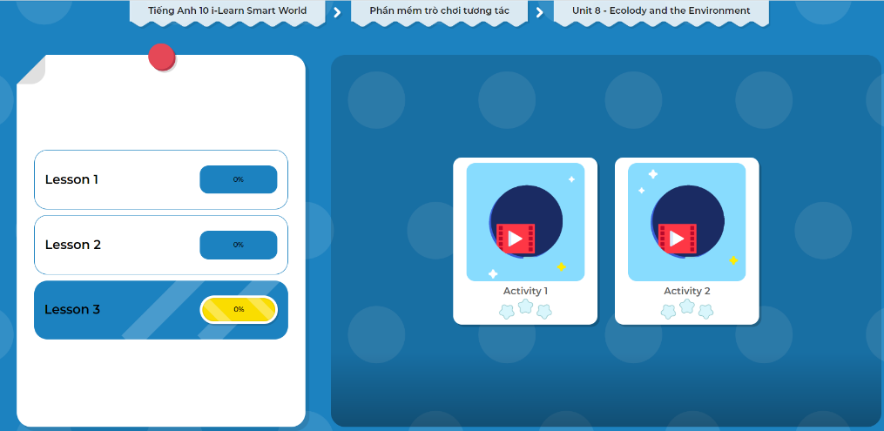
LET’S PLAY!
Click here to play the game!

Slide 20
Wrap-up
Today’s lesson
Key words and ideas for the Writing related to the topic: Environmental problems and ways to solve them
(Cause, Effect, Temperature, Drop, Experience, Lead, Crop, Dying of hunger, Face, Increase, Produce, Contribute, Global warming Greenhouse effect, Plastic pollution )

Slide 21
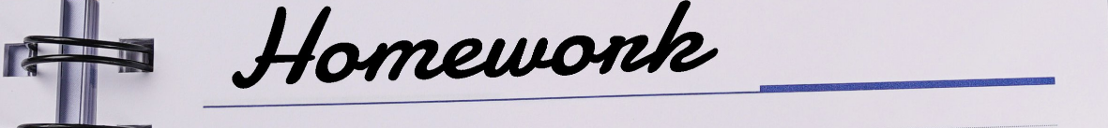
- Do exercise in workbook on page 48.
- Prepare the next lesson: Lesson 3.2 – Writing, (page 71).
Practice vocabulary in the Tiếng Anh 10 i-Learn Smart World DHA Notebook (page 48)
Play the consolidation games in Tiếng Anh 10 i-Learn Smart World DHA App on www.eduhome.com.vn

