Slide 1

Unit 3: All about food
Overview
Pages 52 & 53

Slide 2
Lesson Outline
Warm-up
Vocabulary
Speaking
Consolidation
Wrap-up

Slide 3
Objectives
By the end of this lesson, students will be able to…
learn vocabulary about food.
talk about the food they like or don’t like.

Slide 4

WARM-UP

Slide 5
Pair work
List the foods or drinks you know.
Foods
cake
banana
chicken
ice cream
apple
fish
Drink
water
milk
coke
tea
juice

Slide 6

It’s time to learn …

Slide 7

Presentation

Slide 8
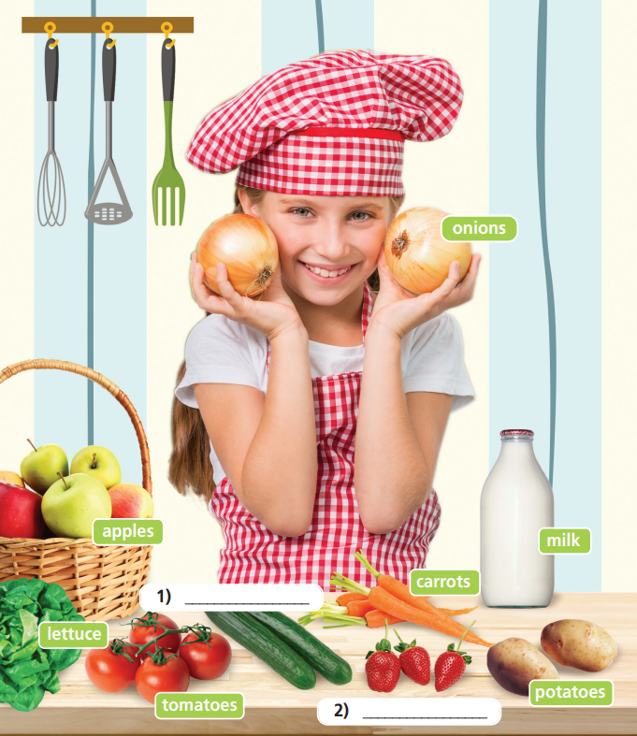
Label the numbered pictures with words in the box.
• biscuits
• pasta
• fruit juice
• meat
• cucumbers
• strawberries
• salt
cucumbers
strawberries

Slide 9
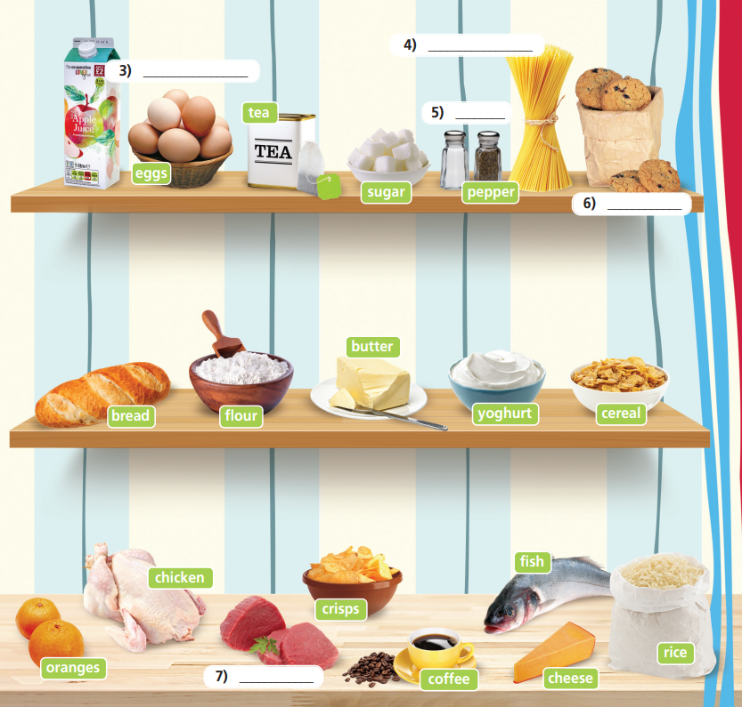
salt
fruit juice
• biscuits
• pasta
• fruit juice
• meat
• cucumbers
• strawberries
• salt
pasta
biscuits
meat

Slide 10

onions (n) /ˈʌnjənz/: hành tây
apples (n) /ˈæpəlz/: táo
lettuce (n) /ˈletɪs/: rau diếp
tomatoes (n) /təˈmɑːtəʊz/: cà chua
cucumbers (n) /ˈkjuːkʌmbəz/: dưa leo, dưa chuột
carrots (n) /ˈkærəts/: cà rốt
potatoes (n) /pəˈteɪtəʊz/: khoai tây
strawberries (n) /ˈstrɔːbəriz/: dâu tây
milk (n) /mɪlk/: sữa
Notes:
Select the words that might be new to your students. Ignore/ go through quickly those which are familiar to them.

Slide 11
fruit juice (n) /fruːt dʒuːs/: nước trái cây
eggs (n) /eɡz/: trứng
tea (n) /tiː/: trà
sugar (n) /ˈʃʊɡə/: đường
pasta (n) /ˈpæstə/: mì ống
salt (n) /sɒlt/: muối
pepper (n) /ˈpepər/: tiêu
Notes:
Select the words that might be new to your students. Ignore/ go through quickly those which are familiar to them.

Slide 12
biscuits (n) /ˈbɪskɪts/: bánh quy
bread (n) /bred/: bánh mì
flour (n) /flaʊə/: bột mì
butter (n) /ˈbʌtə/: bơ
yoghurt (n) /ˈjɒɡət/: sữa chua
cereal (n) /ˈsɪəriəl/: ngũ cốc
oranges (n) /ˈɒrɪndʒ/: cam
Notes:
Select the words that might be new to your students. Ignore/ go through quickly those which are familiar to them.

Slide 13
chicken (n) /ˈtʃɪkɪn/: thịt gà
meat (n) /miːt/: thịt
crisps (n) /krɪsps/: snack khoai tây
coffee (n) /ˈkɒfi/: cà phê
fish (n) /fɪʃ/: cá
cheese (n) /tʃiːz/: phô mai
rice (n) /raɪs/: cơm
Notes:
Select the words that might be new to your students. Ignore/ go through quickly those which are familiar to them.

Slide 14
2 List the food/drinks under the headings: Grain – Vegetables – Fruit – Dairy products – Animal products – Others
Grain | Vegetables | Fruit
pasta
flour
cereal
rice
bread
lettuce
cucumbers
tomatoes
carrots
potatoes
apples
strawberries
oranges

Slide 15
Dairy products | Animal products | Others
milk
butter
yoghurt
cheese
eggs
chicken
meat
fish
fruit juice, tea
sugar, salt
pepper
biscuits
crisps
coffee

Slide 16
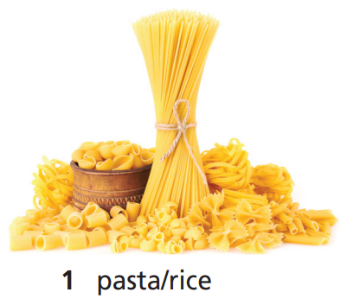
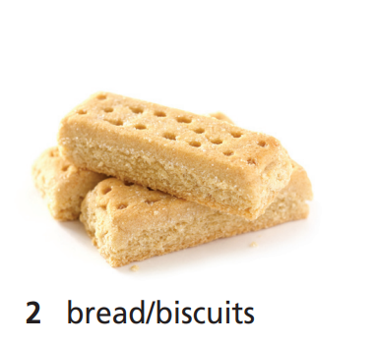
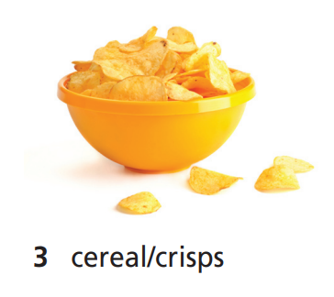
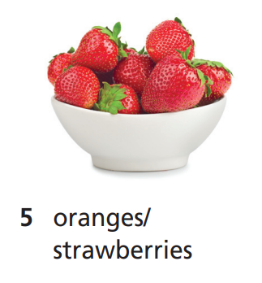
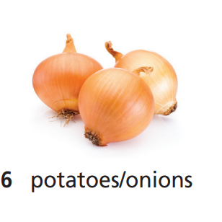
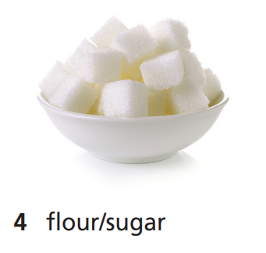
Circle the correct word.

Slide 17

Practice

Slide 18





Expressing likes/dislikes
love/like/hate + V-ing
I love eating cereal and eggs.
I really like drinking milk.
I quite like eating fish.
I don’t like eating yoghurt very much.
I hate drinking coffee.

Slide 19
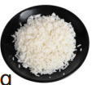



Put the words in the correct order.
1 don’t like/ /John and I/very/much/eating
___________________________________________
2 hate/Scott and I/ /eating
___________________________________________
3 Pat and I/like/really/ /drinking
___________________________________________
4 don’t like/very much/eating/ /I
___________________________________________
John and I don’t like eating rice very much.
Scott and I hate eating eggs.
Pat and I really like drinking tea.
I don’t like eating cheese very much.

Slide 20
Speaking
Tell your friend what you like and don’t like eating/drinking.
I love eating cheese.
I really like eating pasta and rice.
I quite like eating fish and eggs.
I don't like
drinking milk very much.
I hate eating cucumbers.

Slide 21

Production

Slide 22
PAIRWORK
Ask and answer about what you eat for breakfast / lunch / dinner.
What do you eat for breakfast?
I eat bread and egg for breakfast.

Slide 23

CONSOLIDATION

Slide 24
Write five sentences (about 50 words) about what you love / really like / quite like / not like / hate eating.

Slide 25

WRAP-UP

Slide 26
Today’s lesson
Vocabularies
Food
Speaking
Expressing like/dislike

Slide 27
Homework
Practise the vocabularies and make sentences with them.
Do exercise 1 in TA 6 Right on WB (p. 28)
Do the exercises in TA 6 Right on Notebook (pp. 26&27)
Prepare the next lesson (p. 54 SB)

Slide 28

Enjoy your day!

