Slide 1


Slide 2

Unit
10
1
Unit
FAMILY LIFE
ECOTOURISM
LESSON 4
SPEAKING
How to become an ecotourist

Slide 3

Unit
1
1
FAMILY LIFE
Family Life
Unit
OBJECTIVES
Talk about how to become an ecotourist

Slide 4
LESSON 4
SPEAKING
WARM-UP
Matching game
Task 1: Match each verb on the left with a phrase on the right.
CONTROLED PRACTICE
Task 2: Discuss which of the things in Task 1 we should or should not do to become ecotourists.
LESS-CONTROLED PRACTICE
Task 3: Talk about what tourists should or should not do if they are on an ecotour to a tourist attraction in your local area.
FREE PRACTICE
Task 4: Share your ideas with the whole class. Vote for the best ideas.
CONSOLIDATION
Wrap-up
Homework

Slide 5
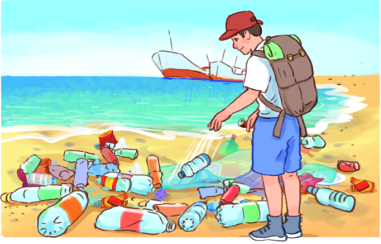
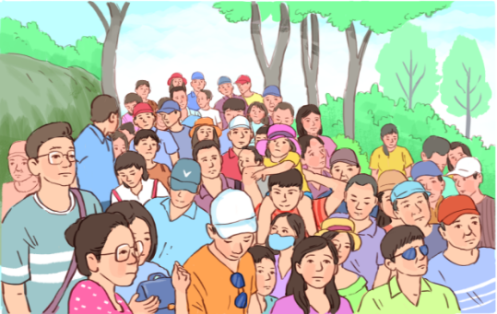
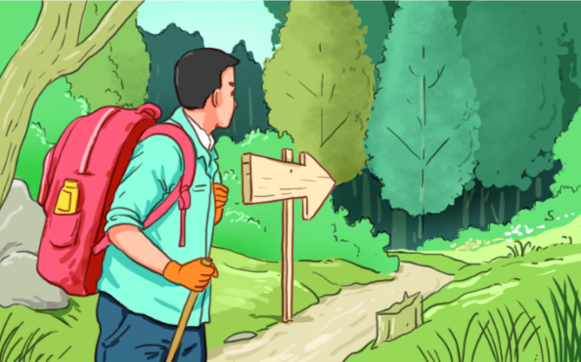
WARM-UP
1
Match each verb with a phrase. Use the pictures to help you.
1. litter
2. avoid
3. follow
c. on the beach or the street
d. crowded places
a. walking paths and trails

Slide 6
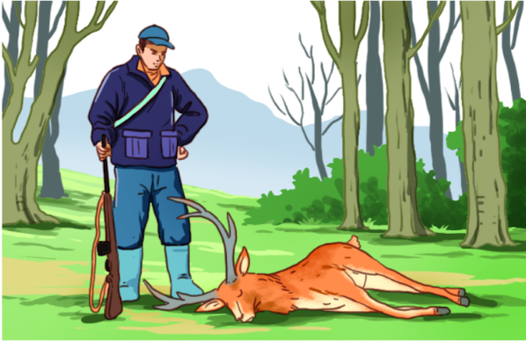
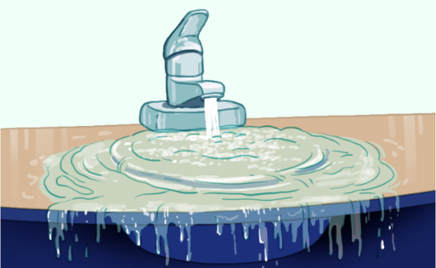
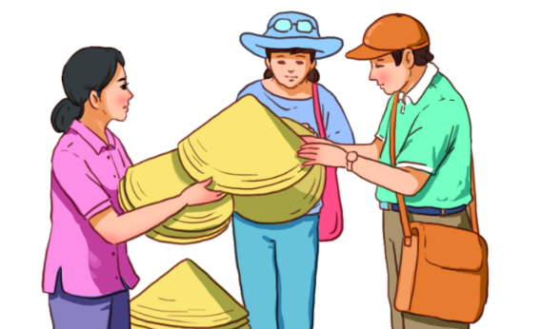
WARM-UP
1
Match each verb with a phrase. Use the pictures to help you.
4. hunt
5. waste
6. buy
b. wild animals
f. water and electricity
e. locally made souvenirs

Slide 7
LESSON 4
SPEAKING
WARM-UP
Matching game
Task 1: Match each verb on the left with a phrase on the right.
CONTROLED PRACTICE
Task 2: Discuss which of the things in Task 1 we should or should not do to become ecotourists.

Slide 8
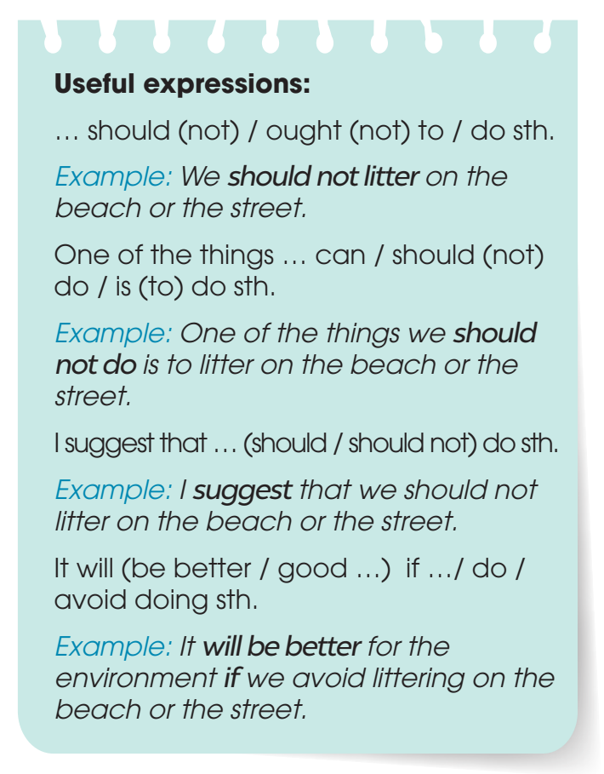

PRE-SPEAKING
2
Work in pairs. discuss which of the things in Task 1 we should or should not do to become ecotourists. Use the expressions below to help you.

Slide 9
LESSON 4
SPEAKING
WARM-UP
Matching game
Task 1: Match each verb on the left with a phrase on the right.
CONTROLED PRACTICE
Task 2: Discuss which of the things in Task 1 we should or should not do to become ecotourists.
LESS-CONTROLED PRACTICE
Task 3: Talk about what tourists should or should not do if they are on an ecotour to a tourist attraction in your local area.

Slide 10
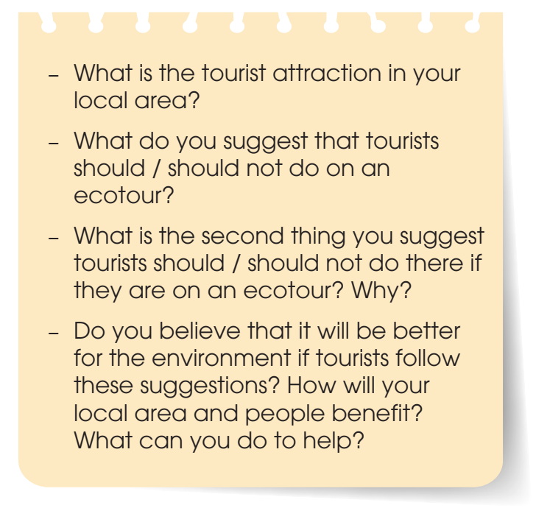

WHILE-SPEAKING
3
Work in groups. Talk about what tourists should or should not do if they are on an ecotour to a tourist attraction in your local area. Use the discussion questions below to help you.

Slide 11
LESSON 4
SPEAKING
WARM-UP
Matching game
Task 1: Match each verb on the left with a phrase on the right.
CONTROLED PRACTICE
Task 2: Discuss which of the things in Task 1 we should or should not do to become ecotourists.
LESS-CONTROLED PRACTICE
Task 3: Talk about what tourists should or should not do if they are on an ecotour to a tourist attraction in your local area.
FREE PRACTICE
Task 4: Share your ideas with the whole class. Vote for the best ideas.

Slide 12

POST-SPEAKING
4
Share your ideas with the whole class. Vote for the best ideas.

Slide 13
LESSON 4
SPEAKING
WARM-UP
Matching game
Task 1: Match each verb on the left with a phrase on the right.
CONTROLED PRACTICE
Task 2: Discuss which of the things in Task 1 we should or should not do to become ecotourists.
LESS-CONTROLED PRACTICE
Task 3: Talk about what tourists should or should not do if they are on an ecotour to a tourist attraction in your local area.
FREE PRACTICE
Task 4: Share your ideas with the whole class. Vote for the best ideas.
CONSOLIDATION
Wrap-up
Homework

Slide 14
CONSOLIDATION
1
Wrap-up
Talk about how to become an ecotourist

Slide 15
CONSOLIDATION
2
Homework
Prepare for the next lesson: Unit 10 – Listening
2. Do exercises in the workbook

Slide 16

Website: hoclieu.vn
Fanpage: facebook.com/tienganhglobalsuccess.vn/

