Slide 1


Travelling with Doraemon
By Huyen Trang

Slide 2

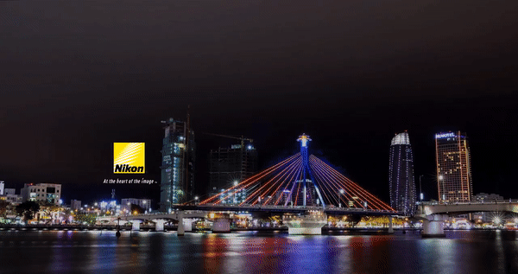





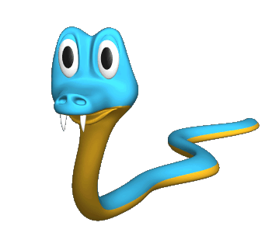
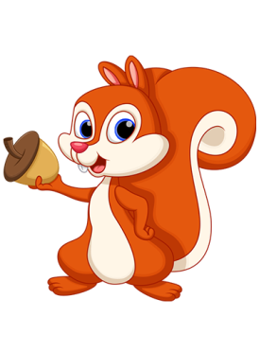
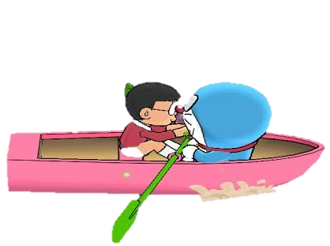

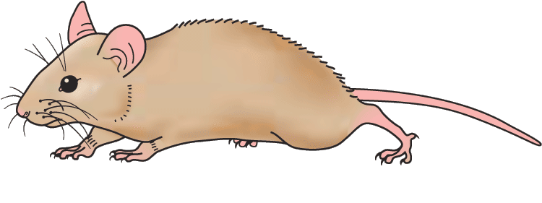
Han River bridge
Danang Vietnam
Question
A.
B.
A. wrong
B. right

Slide 3

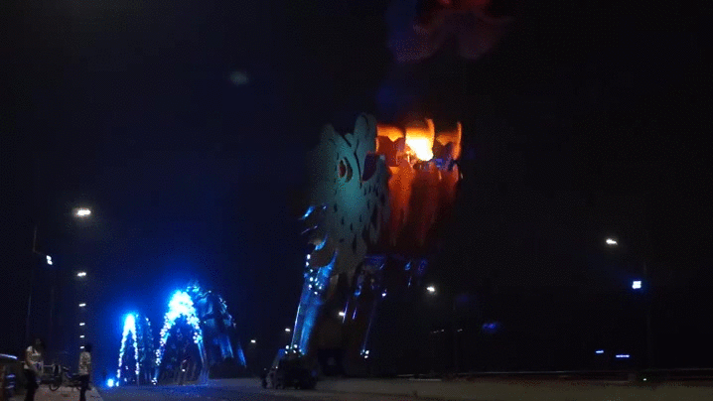

Question
A.
B.
Dragon bridge
Danang Vietnam
A. right
B. wrong

Slide 4

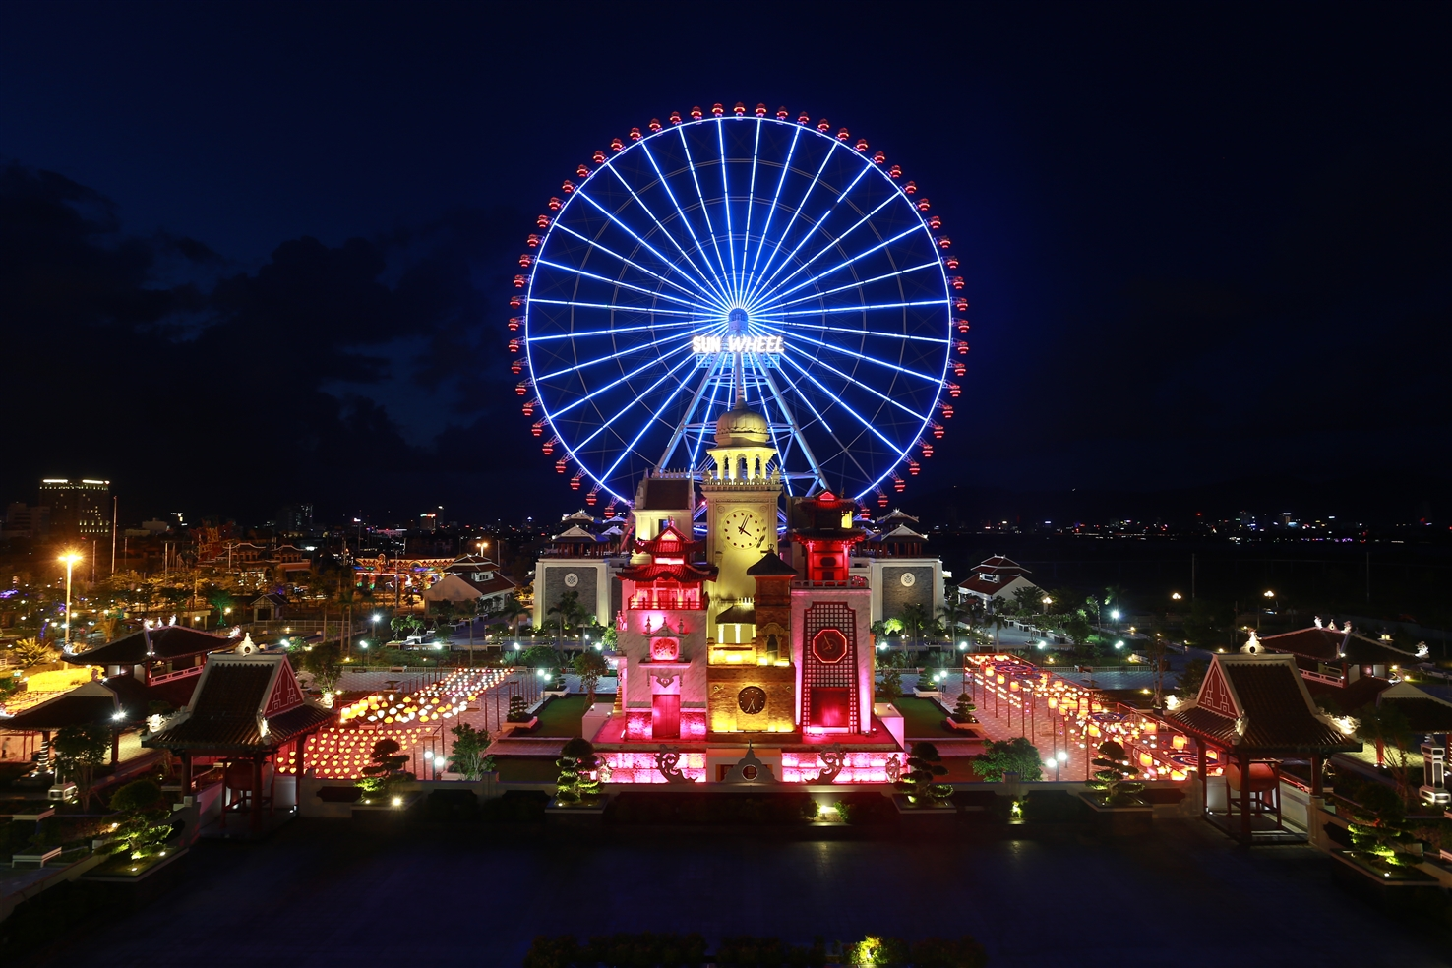


Question
A.
B.
Asia Park
Danang Vietnam
A. right
B. wrong

Slide 5

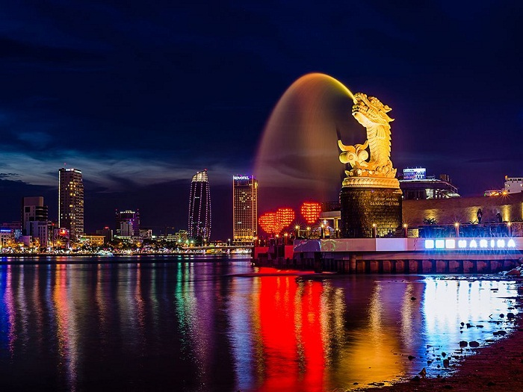


Love bridge
Danang Vietnam
Question
A.
B.
A. wrong
B. right

