Slide 1
Warmly welcome all the teachers to class 6D!

Slide 2
Traffic signs

Slide 3
Unit 4
MY NEIGHBOURHOOD
Lesson 4: COMMUNICATION
(P. 43)

Slide 4
turn right
turn left
go straight
take the first turning on the right
take the second turning on the left
next to
behind
opposite

Slide 5
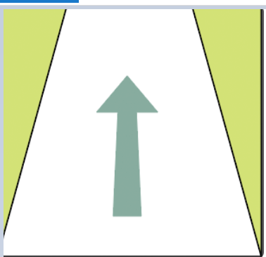
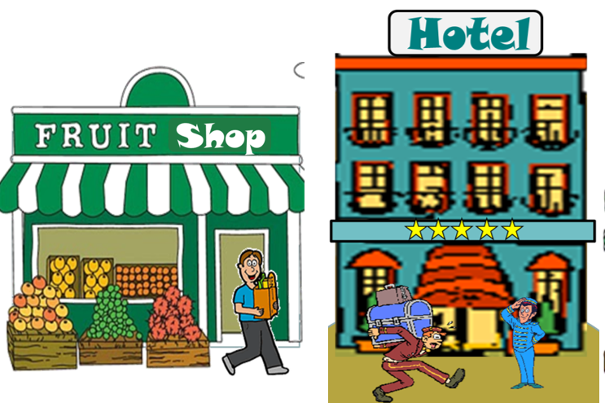
Match these following directions and prepositions with the diagrams below
turn right
go straight
take the first turning on the right
next to
turn left
behind
take the second turning on the left
opposite
1
2
3
4
5
6

Slide 6
Listen and read the conversations.
A: Excuse me. Could you tell me the way to the cinema, please?
B: Go along this street. It’s on your left.
A: Excuse me. Where’s the nearest post office, please?
B: Go out of the station. Take the first turning on the right.
Notes:
Slide này không đúng.

Slide 7
Listen and read the conversations.
A: Excuse me. Could you tell me the way to the cinema, please?
B: Go along this street. It’s on your left.
=> Could you tell me the way to ............. please?
A: Excuse me. Where’s the nearest post office, please?
B: Go out of the station. Take the first turning on the right.
=> Where’s the nearest .............please?
Notes:
Slide này không đúng.

Slide 8
Thanh Dat Company
Duy Anh Company
Ninh Giang
Secondary School
Photocopy Store
Quynh Anh Shop
Ninh Giang
Primary School
YOU ARE HERE
S1: Excuse me. Could you tell me the way to Ninh Giang Secondary School, please?
S2:Go straight and take the second turning on the left. It’s on your left

Slide 9
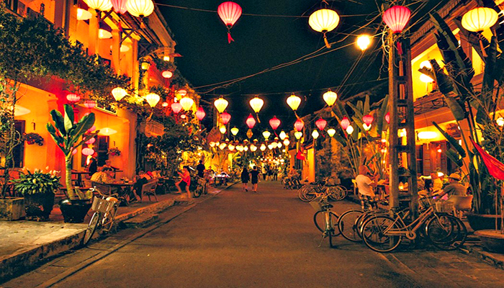
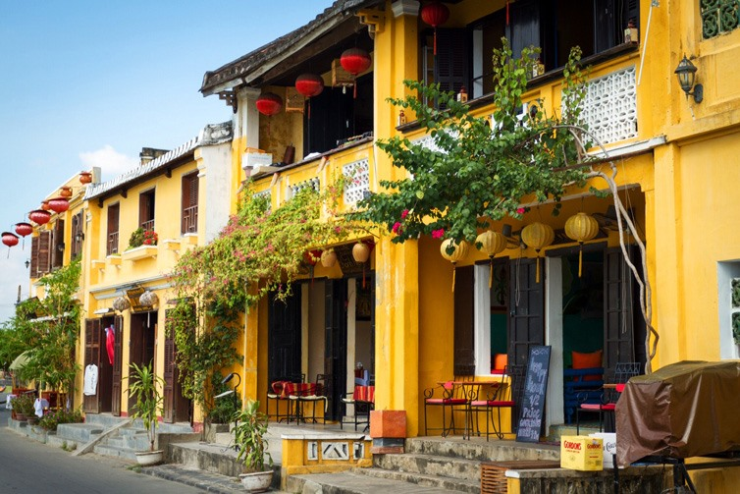

Slide 10
Nick is listening to an audio guide to Hoi An. Listen and fill the blanks.
Let’s start our tour in Hoi An. We are in Tran Phu Street now. First, go to Ong Pagoda. To get there, go (1) along the street for five minutes. It’s on your left. Next, go to the Museum of Sa Huynh Culture. Take the (2) turning on your left. Turn (3) and it’s on your right. Finally, go to Hoa Nhap Workshop to buy some presents. Turn left and then right. It’s (4) Tan Ky House.
straight
second
right
next to
Notes:
City landmarks phải ở trên mục 3

Slide 11
Look at the map below and create an audio guide for Ninh Binh attractions.
Remember to:
give directions to at least three different places;
use first, then, after that and finally to link your directions.
4
3
2
1

Slide 12
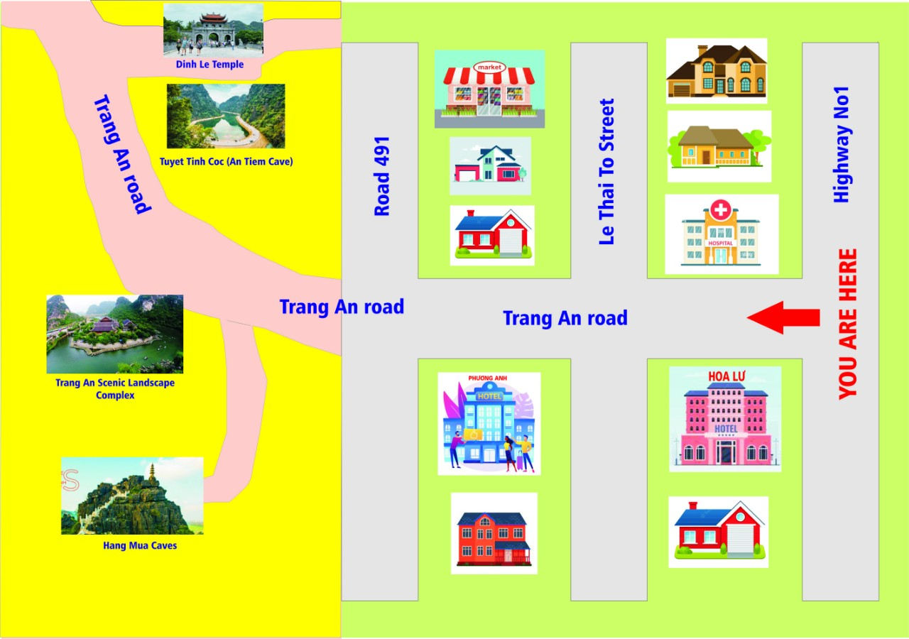
4
3
2
1
Let’s start our tour in Ninh Binh attractions. We are in Highway No1 now.
- First, (1) go to Hang Mua Caves. To get there, we go straight along..........
- Then, (2) ……… Trang An Scenic Landscape Complex...................
- Next, (3) go to Tuyet Tinh Coc, go out of Trang An..............
- Finally (4) to get to Dinh Le Temple, .....................

Slide 13
CONSOLIDATION
WRAP- UP
In this lesson, we have learnt about:
- asking for and giving directions
- creating an audio guide

Slide 14
HOMEWORK
Practice asking for and giving directions.
Prepare: SKILLS 1 (P. 44)

