Slide 1

UNIT 2: ENTERTAINMENT & LEISURE
Lesson 1.2 – Grammar
Page 13

Slide 2



Lesson .
LESSSON OUTLINE
Consolidation

Slide 3

By the end of this lesson,
students will be able to:
use gerunds to talk about hobbies and general things
we like/don't like.
talk about the activity they like the most and the
activity they don't like.
write sentences about what they like/don’t like using
certain verbs with gerunds.

Slide 4



Slide 5

Work in pairs.
YOUR WEEKEND
What do you like doing on weekends?
And what do you hate doing? Why not?

Slide 6



Slide 7

Presentation

Slide 8








Slide 9
GERUNDS
A gerund is a noun made from a verb by adding -ing. (gerund= verb + ing)
Now, listen and make the gerund for each verb phrase:
VERB PHRASE | GERUND
see a movie
do homework
hang out with friends
go to a party
play the guitar
sing
seeing a movie
doing homework
hanging out with friends
going to a party
playing the guitar
singing

Slide 10
GERUNDS
We can use certain verbs (e.g. like) with gerunds:
like enjoy love
can't stand don't mind hate
Look and read the sentences:
She loves going for a bike ride on the weekends.
They hate playing board games.
He doesn't like cooking.
What do you like doing on the weekends?
Do you enjoy doing aerobics?
We can use gerunds to talk about hobbies and general
things we like/don't like.
I like playing soccer.
I hate washing dishes.

Slide 11
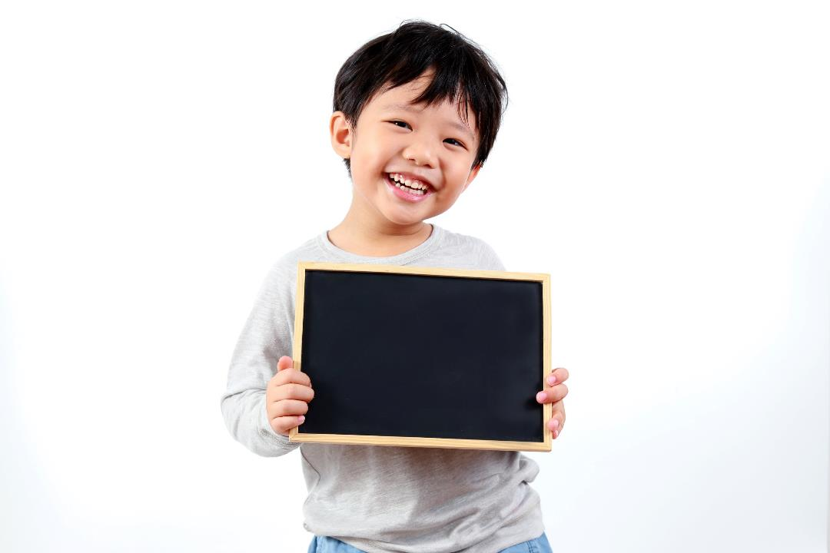
Practice

Slide 12
b. Fill in the blanks using gerunds.
1. She ____________________ (like/do) karate, but she ____________________
(not/like/watch) it.
2. He ____________________ (not mind/help) his mom with the shopping.
3. She ____________________ (enjoy/hang) out with her friends on Sundays.
4. Andy ___________________ (hate/do) crossword puzzles. He thinks it's boring.
5. My sister ____________________ (not stand/do) aerobics.
6. I ____________________ (not/like/go) running, but I ____________________
(love/go) for a bike ride.
7. I ____________________ (enjoy/play) tennis after school.
8. She ____________________ (not stand/listen) to loud music.
likes doing karate
doesn’t like watching
doesn’t mind helping
enjoys hanging
hates doing
can’t stand doing
don’t like going
love going
enjoy playing
can’t stand listening

Slide 13
c. Look at the prompts and write full sentences. Use gerunds.
1. I/love/sing/karaoke __________________________________________________
2. I/like/play computer games/after school __________________________________________________
3. I/not enjoy/dance __________________________________________________
4. I/can’t stand/play/board games __________________________________________________
5. I/like/sleep late/weekends ___________________________________________________
I love singing karaoke.
I like playing computer games after school.
I don’t enjoy dancing.
I can’t stand playing board games.
I like sleeping late on the weekends.

Slide 14
Extra Practice, WB page 9.
Write the sentences using the prompts.
1. You/like/go for a bike ride?
_____________________________________________
2. She/can't stand/do aerobics.
_____________________________________________
3. Mike/enjoy/play role-playing games/weekends/his friends.
_____________________________________________
4. She/not mind/go running/but/she/hate/go running/after/it/rain.
_____________________________________________
5. Betty/really like/do karate.
_____________________________________________
6. I/not like/it/at first/but/I/love/go canoeing/now.
_____________________________________________
Do you like going for a bike ride?
She can’t stand doing aerobics.
Mike enjoys playing role-playing games with his friends on the weekends.
She doesn’t mind going running but she hates going running after it rains.
Betty really likes doing karate.
I don’t like going canoeing at first but I love it now.

Slide 15
Extra Practice, WB page 9.
Unscramble the sentences.
1. lake./love/We/the/going/and/sunset/canoeing/the/in/seeing/ the/ over/evenings
2. them/mind/for/rest/The/chores/if/day./boys/the/let/role-playing/ don't/doing/you/the/play/games/the/of
3. they/sports/The/want/aerobics./like/doing/don't/any/but/
children/to/play/really
4. humid./I/when/it's/ride/stand/bike/going/a/and/can't/for/hot
5. doesn't/ask/you./with/like/going/go/, so/really/running/ to/ don’t/ her/She
6. because/more/most/challenging./doing/puzzles/Sunday/enjoys/the/
newspaper's/crossword/He/they're
7. likes/the/He/karate/in/to/neighborhood./his/teaching/children

Slide 16
Extra Practice, WB page 9.
Unscramble the sentences.
1. lake./love/We/the/going/and/sunset/canoeing/the/in/seeing/ the/over/evenings
_____________________________________________________
2. them/mind/for/rest/The/chores/if/day./boys/the/let/role -playing/ don't/doing/you/the/play/games/the/of
_____________________________________________________
_____________________________________________________
3. they/sports/The/want/aerobics./like/doing/don't/any/but/
children/to/play/really
_____________________________________________________
_____________________________________________________
We love going canoeing in the evenings and seeing the sunset over the lake.
The boys don't mind doing the chores if you let them play
role-playing games for the rest of the day.
The children don't want to play any sports, but they really like doing aerobics.

Slide 17
Extra Practice, WB page 9.
4. humid./I/when/it's/ride/stand/bike/going/a/and/can't/for/hot
_____________________________________________________________
5. doesn't/ask/you./with/like/going/go/,so/really/running/to/don't/her/She
_____________________________________________________________
6. because/more/most/challenging./doing/puzzles/Sunday/enjoys/the/ newspaper's/crossword/He/they're
_____________________________________________________________
_____________________________________________________________
7. likes/the/He/karate/in/to/neighborhood./his/teaching/children
_____________________________________________________________
I can't stand going for a bike ride when it's hot and humid.
She really doesn't like going running, so don't ask her to go with you.
He enjoys doing the newspaper's Sunday crossword puzzles most because they're more challenging.
He likes teaching karate to the children in his neighborhood.

Slide 18

Production

Slide 19


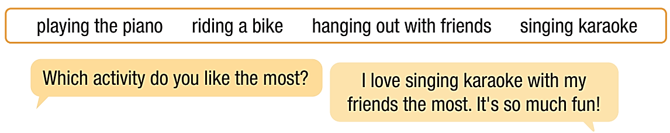
d. In pairs: Talk about the activity that you like the most and the
activity that you don't like and say why. Use the words from the box.

Slide 20

Consolidation

Slide 21
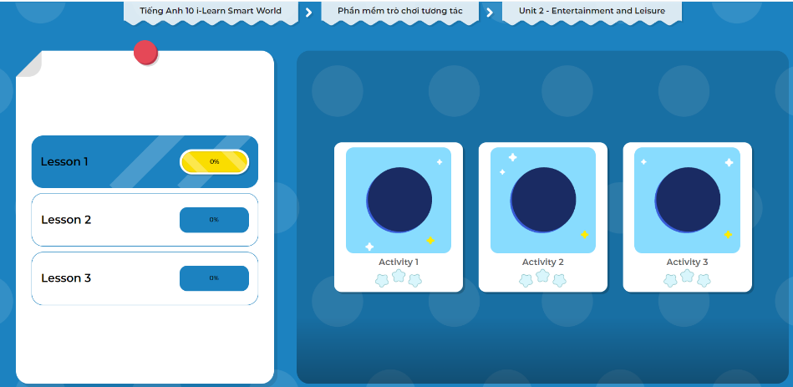
LET’S PLAY!
Click here to play the games.

Slide 22

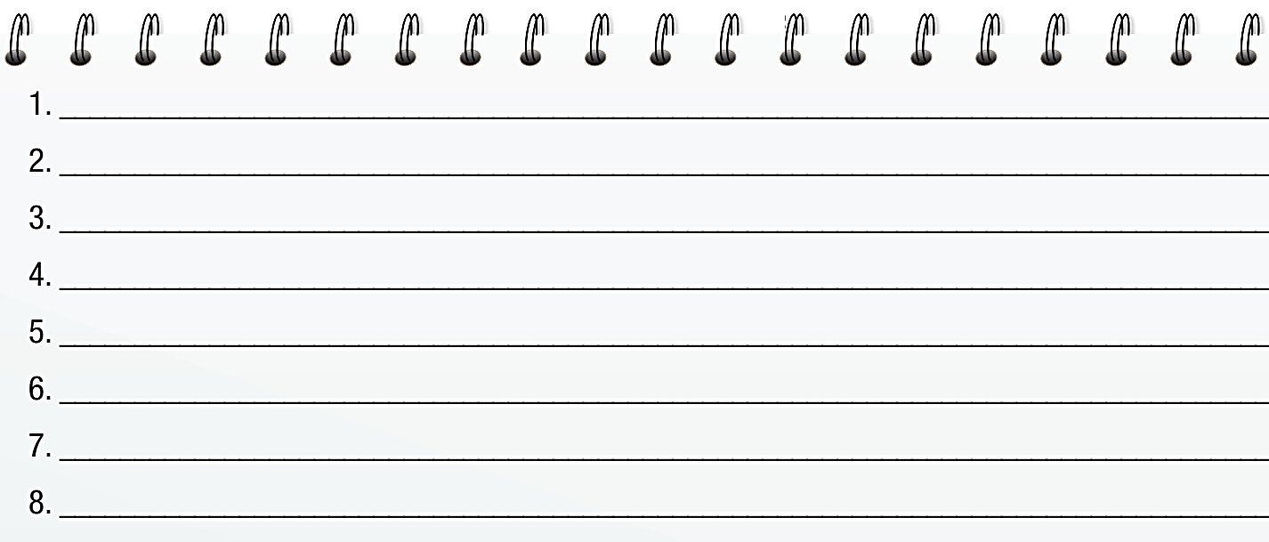
Write sentences with the verbs and phrases
in the box using your own ideas.

Slide 23
Today’s lesson
Wrap-up
Grammar: verbs with gerunds.
Speaking: activities you like most/ don’t like.
Writing: hobbies and general things using gerunds and your own ideas.

Slide 24
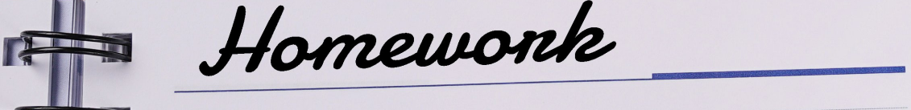
Complete the grammar notes in Tiếng Anh 10 i-Learn Smart World Notebook on page 9.
Prepare the next lesson on page 14, SB.
Play the consolidation games in Tiếng Anh 10 i-Learn Smart World DHA App on www.eduhome.com.vn

Slide 25

Have a nice day!

