Slide 1





)
)
)
)
English 6 – Semester 2
)
)
)
UNIT 7. TELEVISION
)
)
)
)
)
)
)
)
)
)
)

Slide 2

)
)
)
)
)
)
PART 1. THEORY
)
)
)
)
)
)
I. VOCABULARY
)
)
)
)
)
)

Slide 3
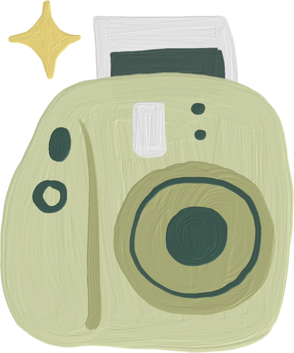
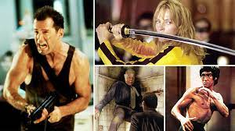
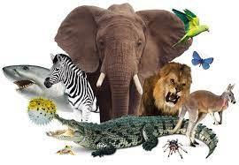



)
2. animal (n):
1. action film (n):
)
/'ækʃn fɪlm/
phim hành động
/'ænɪml/
động vật
)
)
)
)
)
)
)
)
)
3. animals programme (n) :
/'ænɪmlz 'prəʊgræm/
chương trình thế giới động vật
)
)
)
)
)
)
)

Slide 4

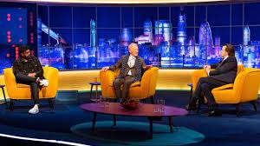


)
4. channel (n):
5. chat show (n):
)
/'tʃænl/
kênh truyền hình
/tʃæt ʃəʊ/
chương trình tán gẫu
)
)
)
)
)
)
)
)
6. comedy (n):
7. documentary (n):
)
/'kɒmədɪ/
kịch vui, hài kịch
/.dɒkju'mentrɪ/
phim tài liệu
)
)
)
)
)
)
)

Slide 5
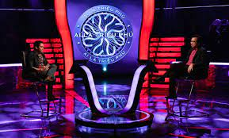
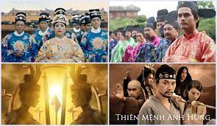
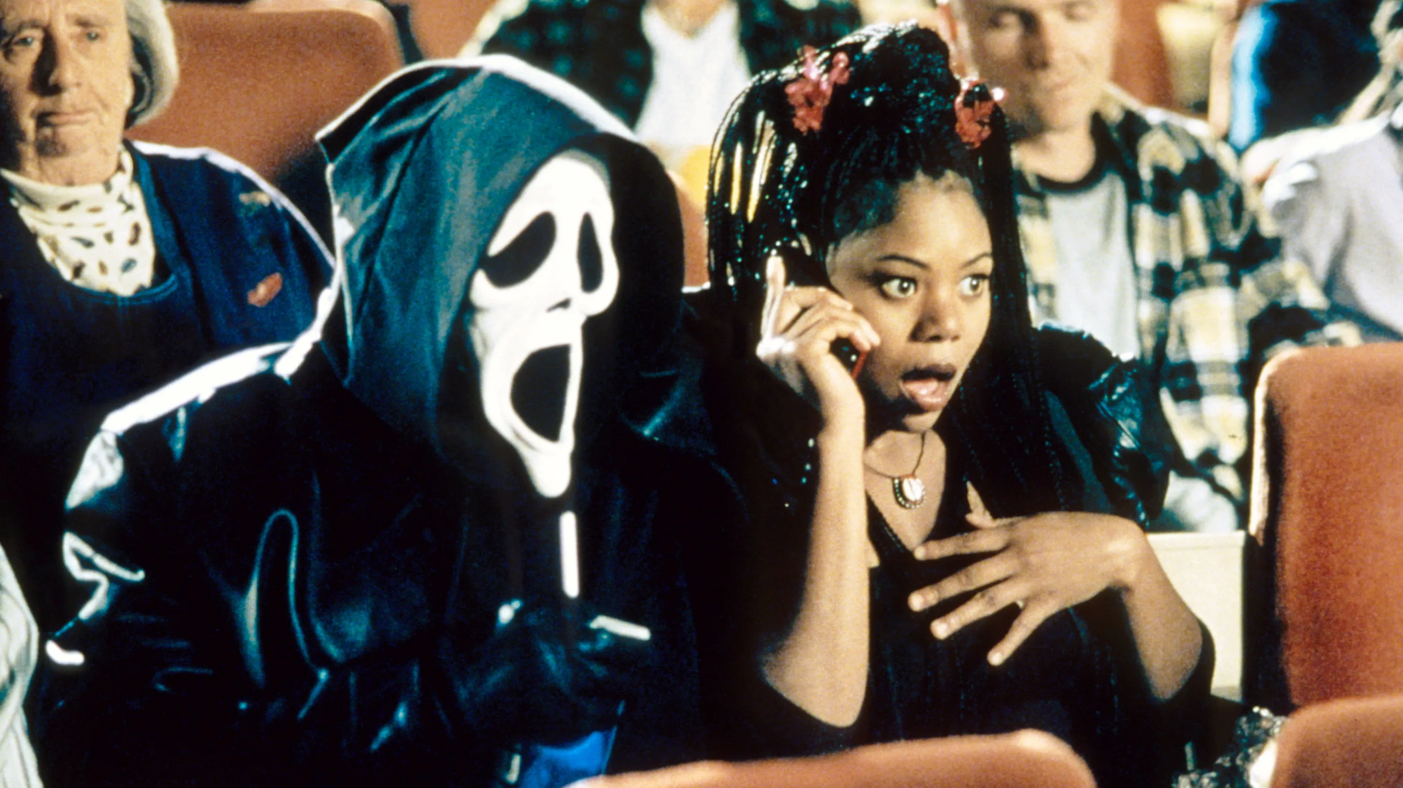
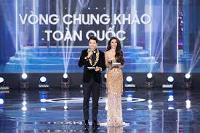
)
8. game show (n):
9. historical drama (n):
)
/geɪm ʃəʊ/
trò chơi
truyền hình
/hɪ'stɒrɪkl 'drɑ:mə/
phim, kịch lịch sử
)
)
)
)
)
)
)
)
10. horror film (n):
11. MC (n):
)
/'hɒrər fɪlm/
phim kinh dị
/,em 'si:/
người dẫn
chương trình
)
)
)
)
)
)
)

Slide 6
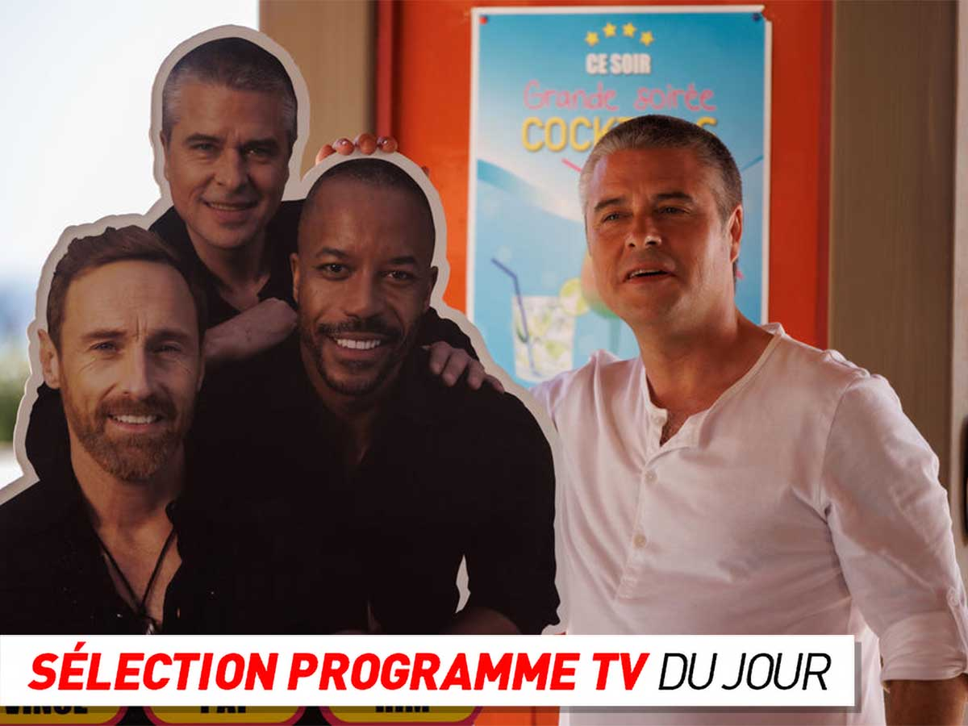
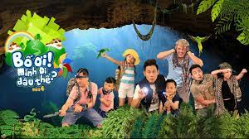
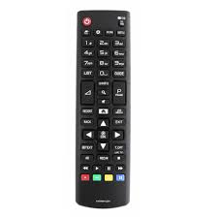
)
12. programme (n):
13. reality show (n):
)
/'prəʊgræm/
chương trình
/rɪ'ælətɪ ʃəʊ/
chương trình
truyền hình
thực tế
)
)
)
)
)
)
)
)
)
14. remote control (n):
)
/rɪ'məʊt kən'trəʊl/
điều khiển
)
)
)
)
)
)

Slide 7


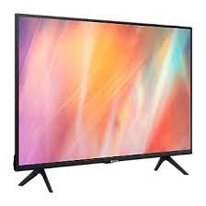
)
15. romantic comedy (n):
)
/rəʊ'mæntɪk 'kɒmədɪ/
phim lãng mạn hài
)
)
)
)
)
)
)
)
16. soap opera (n):
17. television (n):
)
/səʊp 'ɒprə/
phim dài tập
/'telɪvɪʒn/
ti vi
)
)
)
)
)
)
)

Slide 8
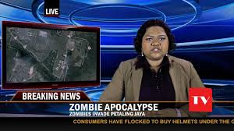
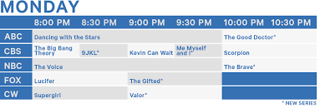
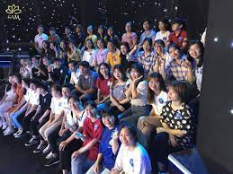
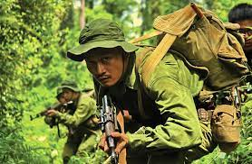
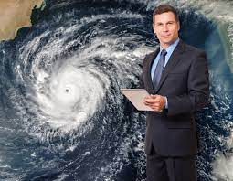
18. the news (n):
19. TV schedule (n):
)
/ðə nju:z/
bản tin
thời sự
/,ti:'vi: 'skedʒu:l/
lịch phát sóng
)
)
)
)
)
)
)
)
)
21. war film (n):
22. weatherman (n):
20. viewer (n):
)
/'weðəmæn/
người đọc tin
dự báo thời tiết
)
/vju:ər/
khán giả
/wɔ:r fɪlm/
phim chiến tranh
)
)
)
)
)
)

Slide 9

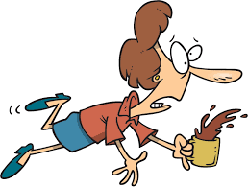
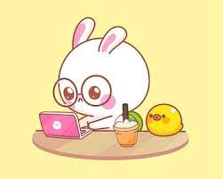
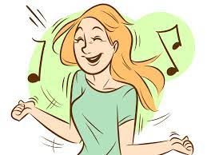
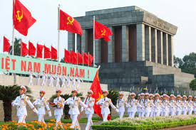
Một số từ khác
)
3. local (adj):
1. clumsy (adj):
2. cute (adj):
)
/ləʊkl/
mang tính
địa phương
)
/'klʌmzɪ/
hậu đậu
/kju:t/
dễ thương
)
)
)
)
)
)
)
)
4. national (adj):
5. entertain (v):
)
/'næʃnəl/
mang tính quốc gia
/.entə'teɪn/
giải trí
)
)
)
)
)
)

Slide 10
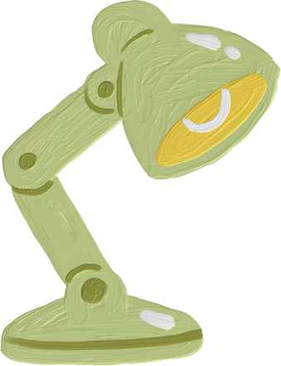
)
)
)
Vocabulary checking
)
)
)
)
)
)
https://wordwall.net/resource/26999139
)
)
)
)
https://wordwall.net/resource/21789470
)
)
)
)
)

Slide 11
)
)
)
)
)
)
PART 1. THEORY
)
)
)
)
)
)
II. GRAMMAR
)
)
)
)
)
)

Slide 12


1. WH-QUESTION
)
)
)
“Who" hoặc “What": câu hỏi chủ ngữ
Đây là câu hỏi dùng khi muốn biết chủ ngữ hay chủ thê’ của hành động.
Who, What + V...?
Example
- Who opened the door last night? (Ai đã mở cửa tôi qua?)
James opened the door last night. (James đã mở cửa tối qua.)
- What happened last night? (Có chuyện gì xảy ra tối qua?)
A car accident happened last night. (Một tai nạn xe hơi đã xảy ra tối qua.)
)
)
)
)
)
)
)
)
)
)
)
)
)
)
)

Slide 13
1. WH-QUESTION
)
)
)
b. “Whom" hoặc “What": câu hỏi tân ngữ
Đây là câu hỏi dùng khi muốn biết tân ngữ hay đối tượng tác động của hành động.
Whom, What + do, does, did + S + V?
Example
- What did George buy at the store? (George đã mua gì ở cửa hàng?)
George bought a packet of buiscuit at the store. (George đã mua một gói bánh quy ở cửa hàng.)
)
)
)
)
)
)
)
)
)
)
)
)
)
)
)

Slide 14
1. WH-QUESTION
)
)
)
c. When, Where, How, Why, How many, How often: câu hỏi trạng ngữ
Đây là câu hỏi dùng khi muốn biết thời gian, nơi chốn, cách thức, lý do, số lượng, tần suất của hành động.
When, Where, How, Why, How many, How often + do, does, did + S + V?
Example
- When did you come to the UK? (Bạn tới Anh khi nào?)
I came to the UK last week. (Tớ tới Anh tuần trước?)
Where did you go last night? (Bạn đi đâu tối qua?)
I went to my grandparents’ house. (Tối qua tớ tới nhà ông bà.)
)
)
)
)
)
)
)
)
)
)
)
)
)
)
)

Slide 15
1. WH-QUESTION
)
)
)
How did you come to the UK? (Bạn đến Anh bằng cách nào?)
I came to the UK by plane. (Tớ đến Anh bằng máy bay.)
- Why did you come to the UK? (Tại sao bạn tới Anh?)
I came to the UK to visit my relatives. (Tớ tới Anh để thăm họ hàng.)
Because I want to visit my relatives. (Vì tớ muốn thăm họ hàng.)
- How many books do you have? Bạn có bao nhiêu cuốn sách?
I have three books. (Tớ có ba cuốn.)
- How often do you visit your grandparents? (Bạn đến thăm ông bà bao lâu một lần?)
I visit my grandparents twice a month. (Tớ đến thăm ông bà 2 lần 1 tháng.
)
)
)
)
)
)
)
)
)
)
)
)
)
)
)

Slide 16
)
)
)
Grammar checking
)
)
)
)
)
)
https://wordwall.net/resource/29667110
)
)
)
)
)
https://quizizz.com/join/quiz/6513c73e433a0023b8039854/start?studentShare=true
)
)
)
)

Slide 17
2. CONJUNCTION
)
)
AND: và | She is a good and loyal wife.
OR: hoặc | Hurry up, or you will be late.
BUT: nhưng | He is intelligent but very lazy.
SO: nên | He is a good teacher; so, he is very popular with students.
AFTER: sau khi | A man should take a little rest, after he has worked hard.
BEFORE: trước khi | Don’t count your chickens before they are hatched.
UNTIL: cho tới khi | People do not know the value of health until they lose it.
WHEN: khi | He was shocked when I told him.
TO: để | I go to the library to borrow books.
BECAUSE: bởi vì | We could not pass the test because we didn’t learn hard.
ALTHOUGH: mặc dù | Although it rained hard, I went out with her.
WHILE: trong khi | Don’t sing while you work.
)
)
)
)
)
)
)
)
)
)
)
)
)
)
)
)

Slide 18
)
)
)
Grammar checking
)
)
)
)
)
)
https://wordwall.net/resource/34161089
)
)
)
)
https://quizizz.com/join/quiz/6513c86ab833e92b512fa787/start?studentShare=true
)
)
)
)
)

Slide 19
)
)
)
)
)
)
PART 1. THEORY
)
)
)
)
)
)
III. PHONETICS
)
)
)
)
)
)

Slide 20

1. Âm /θ/
)
a. Cách phát âm âm /θ/
Âm /θ/ là một phụ âm vô thanh, khi phát âm ầm này, ta đặt đầu lưỡi vào giữa răng cửa trên và răng cửa dưới. Tiếp đó, hãy đẩy luồng hơi qua khe giữa đầu lưỡi và răng cửa trên. Vì âm /θ/ là phụ âm vô thanh nên khi phát âm ầm này, dây thanh không rung.
Các em tập thực hành phát âm các từ sau:
)
)
)
)
)
)
)
)
)
)
)
)
thief /θi:f/ thin /θɪn/ three /θri:/ | mouth /maʊθ/ north /nɔ:rθ/ thousand /’ θaʊznd/ thirsty /'θɜ:rstɪ/ | theatre /'θi:ətər/ author /ɔ:θər/ everything /'evrɪθɪη/
)
)
)
)
)

Slide 21
1. Âm /θ/
)
b. Dấu hiệu nhận biết
* “th” được phát âm là / θ /:
- Khi nó đứng đầu hay cuối của từ
)
)
)
)
)
)
Examples | Transcription | Meaning
think | /θɪηk/ | nghĩ, suy nghĩ
thing | /θɪη/ | đỗ vật
month | /mʌnθ/ | tháng
path | /pɑ:θ/ | lối đi, đường nhỏ
truth | /tru:θ/ | sự thật
bath | /bɑ:θ/ | tắm
)
)
)
)
)
)
)
)
)
)
)

Slide 22
1. Âm /θ/
)
b. Dấu hiệu nhận biết
* “th” được phát âm là / θ /:
- Khi nó đứng đầu hay cuối của từ
)
)
)
)
)
)
Examples | Transcription | Meaning
think | /θɪηk/ | nghĩ, suy nghĩ
thing | /θɪη/ | đỗ vật
month | /mʌnθ/ | tháng
path | /pɑ:θ/ | lối đi, đường nhỏ
truth | /tru:θ/ | sự thật
bath | /bɑ:θ/ | tắm
)
)
)
)
)
)
)
)
)
)
)

Slide 23
1. Âm /θ/
)
)
b. Dấu hiệu nhận biết
* “th” được phát âm là / θ /:
- Khi “th” chỉ số thứ tự:
)
)
)
)
)
)
Examples | Transcription | Meaning
fourth | /fɔ:θ/ | số thứ 4
fifth | /fɪfθ/ | số thứ 5
sixth | /sɪksθ/ | số thứ 6
)
)
)
)
)
)
)
)
)
Lưu ý: trong các trường hợp khác “th” còn được phát ầm là /ð/
)

Slide 24
2. Âm /ð/
)
a. Cách phát âm âm /ð/
Âm /ð/ là một phụ âm hữu thanh. Khi phát âm âm này, ta đặt đầu lưỡi vào giữa răng cửa trên và răng cửa dưới. Sau đó ta đẩy luồng hơi thoát ra ngoài qua khe giữa đầu lưỡi và răng cửa trên. Vì ầm /ð/ là phụ âm hữu thanh nên khi phát âm âm này, dây thanh rung lên.
Các em tập thực hành phát âm các từ sau:
)
)
)
)
)
)
)
)
)
)
)
this /ðɪs/ than /ðæn/ their /ðər/ bathe /beɪð/ breathe /bri:ð/ | without /wi'ðaʊt/ father /'fɑ:ðər/ weather /'weðər/ together /tə'geðər/ clothing /’kləuðiη/
)
)
)
)
)
)

Slide 25
)
)
)
)
)
PART 2. LANGUAGE
)
)
)
)
)
)
)
I. VOCABULARY
)
)
)
)
)
)

Slide 26

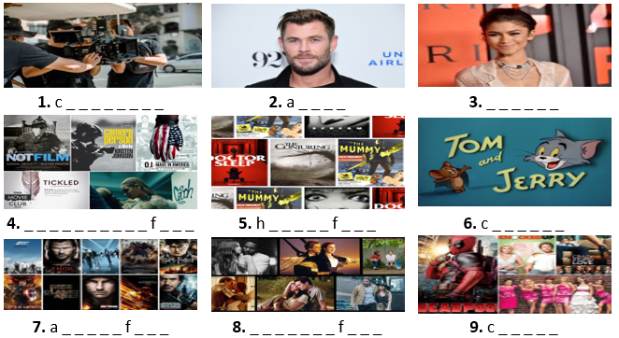
Exercise 1. Look at the photos and write the correct words. The first letter is a hint for you.
)
)
)
)
)
)
ameraman
ctor
actress
)
)
)
)
)
)
)
)
documentary ilm
orror ilm
artoon
)
)
)
)
ction ilm
romantic ilm
omedy

Slide 27
Exercise 2. Choose the word from the box for each description below.
cartoon
quiz show
educational programme
sitcom
game show
documentary
MC
)
)
news headlines
weather forecast
drama
comedy
animal programme
)
)
1. _____________: an amusing play or film with a happy ending.
2. _____________: a regular comedy programme on television that shows the same characters in different funny situations.
3. _____________: a television programme where people get points by answering questions or doing things.
4. _____________: a film or a radio or television programme giving facts about something.
5. _____________: a play for the theatre, television or radio.
6. _____________________: a television programme to give the description of the weather for the next few days.
7. _____________: a competition on TV in which people try to answer questions to test their knowledge.
8. ____________________: a television programme telling us about the life of birds, elephants, tigers, lions, and so on.
9. _______________________: a television programme for schools, and students.
10. _____________: the important items of news read on television.
11. _____________: a person who introduces guests at the right time at an important event.
12. _____________: a programme that tells a story by using moving pictures.
)
)
)
)
)
)
)
)
)
)
)
)
)
)

Slide 28
Exercise 3. Give the correct form of the word in brackets.
)
)
adventurous
1. For the more __________________ tourists, there are trips into the mountains with a local guide. (ADVENTURE)
2. She completed her formal __________________ in 1995. (EDUCATE)
3. She is an experienced English teacher. I always find her talks so informative and __________________. (ENTERTAIN)
4. I was really embarrassed, but then I saw the ______________ side of it. (FUN)
5. ____________, they organize youth clubs and support for the unemployed. (LOCAL)
6. The government announced plans to ___________________ the public transport system. (NATION)
)
)
)
)
education
)
)
)
)
entertaining
)
)
funny
)
)
Locally
)
)
)
)
nationalize

Slide 29
Exercise 4. Complete the sentences with suitable adjectives from the box.
entertaining
popular
cute
funny
)
boring
clumsy
national
educational
)
1. This is a very _____________ television programme. Millions of people watch it every week.
2. It was a really _____________ film. It made US laugh all the time!
3. Donald Duck is so _____________! I really love him.
4. VTV is the _____________ television broadcaster of Vietnam.
5. Channels like Discovery offer _____________ programmes that can increase our knowledge.
6. That’s the third glass you’ve broken this week - you’re so _____________!
7. This programme is _____________ - shall I turn over to BBC?
8. I found this youtube channel both informative and _____________.
)
)
)
)
)
)
)
)
)
)
)
)
)
)
)
)

Slide 30
Exercise 5. Complete the sentences with suitable words/ phrases from the box.
channel
remote control
comedy
animal programme
TV schedule
)
)
national
soap opera
game show
weather forecast
educational
)
)
1. ____________________ is a programme about animals’ life.
2. VTV3 is a _____________ channel.
3. The programme about the weather is called __________________.
4. Who wants to be a millionaire? is a very famous _____________.
5. One versus one hundred is a game show which is both _____________ and entertaining.
6. Could you give me the ________________? I want to change this channel.
7. My mother loves Indian films, so her favourite _____________ is TodayTV.
8. If you want to have fun, let’s watch _____________.
9. Where can I check the _____________?
10. _____________ is a kind of film that consists of many episodes.
)
)
)
)
)
)
)
)
)
)
)
)
)
)

Slide 31
Exercise 6. Choose the correct answers.
)
)
1. ‘Why are you laughing so hard?’ - I am watching a _____________. It’s really funny!’
A. drama B. news C. comedy D. romance
2. Did you watch the _____________ about the history of India?
A. documentary B. sitcom C. news D. game
3. Who wants to be a millionaire? is a kind of _____________.
A. music programmes B. game shows C. talk shows D. reality shows
4. I love _____________. Tom and Jerry are my favourite characters.
A. romances B. comedies C. documentaries D. cartoons
5. Grandma watches her favourite _____________ every day. She never misses any episodes.
A. cartoon B. series C. news D. weather forecast
6. Where is the _____________? I’d like to change the channel.
A. remote control B. volume button C. TV programme D. schedule
7. Could you turn up the, please? I cant hear that singer very well.
A. channel B. programme C. volume D. television
)
)
)
)
)
)
)
)
)
)
)
)
)
)
)
)

Slide 32
Exercise 6. Choose the correct answers.
8. Let’s take a look at the weather _____________ now!
A. forecast B. presentation C. broadcast D. programme
9. Did you see the Prime Minister on the 10 o’clock _____________ last night?
A. drama B. sitcom C. news D. cartoon
10. Jill Newman was a(n) _____________ on News at Ten.
A. MC B. newsreader C. host D. interviewer
11. _____________ is a programme about important events.
A. A documentary B. A game show C. TV news D. The weather forecast
12. For many people, film programme is a good source of _____________.
A. entertainer B. entertaining C. entertainment D. entertain
13. One of the most famous _____________ is “Who wants to be a millionaire?”
A. chat show B. fashion shows C. game shows D. reality TV programmes
14. I am doing my homework. _____________ the TV please!
A. Turn off B. Turn up C. Turn on D. Turn over
15. The children who attend that kindergarten will receive a good _____________.
A. educate B. education C. educator D. educational
)
)
)
)
)
)
)
)
)
)
)
)
)
)
)
)
)
)

Slide 33
)
)
)
)
)
PART 2. LANGUAGE
)
)
)
)
)
)
)
II. GRAMMAR
)
)
)
)
)
)

Slide 34
Exercise 1. Complete the sentences with suitable question words.
)
)
1. _____________ did you live last year? - In London.
2. _____________ lessons do you have today? - Five.
3. _____________ is that man at the door? - My uncle.
4. _____________ do you go to the Music Club? - At six o’clock.
5. _____________ did you feel yesterday? - Awful.
6. _____________ is your sister? - Seven years old.
7. _____________ will the concert start? - At 8 p.m.
8. _____________ is playing with the dog? - My friend, Tom.
9. _____________ are you going shopping with? - Rosy and Nana.
10. _____________ nationality are you? - American.
Where
)
)
How many
)
)
Who
)
)
What time
)
)
How
)
)
How old
)
What time
)
)
Who
)
Whom
)
)
What

Slide 35
Exercise 1. Complete the sentences with suitable question words.
)
11. _____________ books should I buy? - 20.
12. _____________ are you crying? - Because I have lost my key.
13. _____________ is the T-shirt? - 40.000 VND.
14. _____________ class are you and Minh in? - 6C.
15. _____________ sports do you like? - Basketball.
16. _____________ do you go to the bookshop? - To buy some new magazines.
17. _____________ do you visit your grandparents? - Once a month.
18. _____________ do you get to Ho Chi Minh City? - By car.
19. _____________ is the kitten? - In the cage.
20. _____________ are you going to meet? - My pen pal.
)
How many
)
)
Why
)
)
How much
)
What
)
)
What
)
Why
)
)
)
)
How often
)
)
How
)
)
Where
Who

Slide 36
Exercise 2. Write questions for the underlined parts.
)
1. Paul will have six lessons tomorrow.
→ How many lessons will Paul have tomorrow?
2. They are going to the stadium after school.
→ Where are they going after school?
3. Mona plans to buy a new mobile next month.
→ When does Mona plan to buy a new mobile?
4. They are watching TV at 7 o’clock in the evening.
→ What are they doing at 7 o’clock in the evening?
5. Ben is meeting his friends at the railway station tonight.
→ Where is Ben meeting his friends tonight?
6. Helen has got a license to drive her new car.
→ What has Helen got to drive her new car?
7. They will spend their vacation in Spain next year.
→ Where will they spend their vacation next year?
8. Kate is afraid of sitting in the dark room.
→ What is Kate afraid of?
)
)
)
)
)
)
)
)
)
)
)
)
)
)
)
)
)

Slide 37
Exercise 2. Write questions for the underlined parts.
)
9. Tom breaks the window in the classroom because he is careless.
→ Why does Tom break the window in the classroom?
10. We usually have lunch in the garden.
→ Where do you usually have lunch?
11. I usually have a shower at 7 a.m.
→ When/ What time do you usually have a shower?
12. I am going to the post office because I need some stamps.
→ Why are you going to the post office?
13. My brother looks tall and quite thin.
→ What does your brother look like?
14. I am going to the cinema tonight.
→ What are you going to do tonight?
15. She is going shopping with Lucy.
→ Whom is she going shopping with?
)
)
)
)
)
)
)
)
)
)
)
)
)
)
)
)
)

Slide 38
Exercise 3. Fill in the blank with the conjunctions in the box.
and
or
because
)
so
but
although
)
and
1. Read over your answers ______________ correct all mistakes before you hand them in.
2. ______________ Jim doesn’t like this game show, he watches it almost every Friday.
3. Nadia doesn’t like to drive, ______________ she takes the bus everywhere.
4. He is very rich, ______________ he doesn’t spend a lot of money.
5. To get from Vancouver to Victoria, you can fly ______________ you can ride the ferry.
6. Thomas was really hungry this morning ______________ he didn’t eat breakfast.
7. I have a lot of homework to do, ______________ I can’t go to the cinema with you.
8. The waiter was not very nice, ______________ the food was delicious.
9. We enjoyed the film ______________ it had a sad ending.
10. She went to see a doctor ______________ her back was painful.
)
)
)
Although
)
)
)
so
)
but
)
or
)
)
because
)
)
so
)
)
but
)
)
although
because

Slide 39
Exercise 4. Match the sentence halves, writing the answer in each blank.
)
)
1. looked for the key, | A. and had to stay at home.
2. My friends were ill | B. because I studied very hard.
3. I got good marks on the test | C. so we couldn’t be home by eleven.
4. The film started at ten, | D. so I couldn’t buy anything.
5. She likes you a lot | E. but I just couldn’t find it.
6. I lost my money, | F. because she thinks you are very intelligent.
)
)
)
)
)
)
)
)
)
)
)
)
Your answer:
)
)
)
E
A
B
C
F
D
)
1. | 2. | 3. | 4. | 5. | 6.

Slide 40
Exercise 5. Join each pair of sentences, using the word in brackets.
)
)
1. James missed the bus. He was late for school. (because)
→ James was late for school because he missed the bus.
2. Keep the food covered. The files will contaminate it. (or)
→ Keep the food covered, or the flies will contaminate it.
3. Linda has a guitar. She plays it very well. (and)
→ Linda has a guitar and she plays it very well.
4. I need to study hard. I can get a good score on the test. (so)
→ I need to study hard, so I can get a good score on the test.
5. She seemed a friendly person. I didn’t like her. (although)
→ Although she seemed a friendly person, I didn't like her.
6. The food looks delicious. It tastes horrible. (but)
→ The food looks delicious, but it tastes horrible.
7. Mark fell. The floor was wet. (because)
→ Mark fell because the floor was wet.
8. Mary took a part-time job. She needed some money. (so)
→ Mary needed some money, so she took a part-time job.
)
)
)
)
)
)
)
)
)
)
)
)
)
)
)
)

Slide 41
Exercise 6. Choose the best option to complete the sentence.
)
)
1. Fruit tastes good ___________ it’s healthy for your body.
A. but B. and C. so D. or
2. I want to buy a new jacket, ___________ I don’t have enough money.
A. and B. so C. but D. because
3. Linda is going to make a cake, ___________ she needs some eggs and flour.
A. so B. but C. and D. or
4. We went for a walk ___________ it was raining heavily.
A. because B. although C. therefore D. however
5. We can go to the pool ___________ we can go horse-riding, whichever you prefer?
A. or B. but C. and D. so
)
)
)
)
)
)
)
)
)
)
)
)
)
)
)
)

Slide 42
Exercise 6. Choose the best option to complete the sentence.
)
)
6. John likes funny movies ___________ he doesn’t like scary movies.
A. and B. or C. so D. but
7. I’d like to see that Korean band ___________ their music is pretty cool.
A. although B. so C. because D. but
8. I still cry at the end ___________ I’ve seen this movie several times.
A. and B. although C. because D. so
9. You must hurry ___________ you will miss your train.
A. so B. but C. and D. or
10. His chocolate was too hot, ___________ he put some cold milk in it.
A. so B. but C. because D. although
)
)
)
)
)
)
)
)
)
)
)
)
)
)
)
)

Slide 43
)
)
)
)
)
PART 2. LANGUAGE
)
)
)
)
)
)
)
III. PHONETICS
)
)
)
)
)
)

Slide 44
Exercise 1. Choose the word whose underlined part is pronounced differently from that of the others in each group.
)
)
)
)
1. A. thirsty | B. both | C. Thanksgiving | D. there
2. A. weather | B. through | C. warmth | D. tooth
3. A. than | B. their | C. earth | D. then
4. A. birthday | B. although | C. thing | D. theatre
5. A. anything | B. neither | C. than | D. feather
6. A. think | B. thank | C. theatre | D. there
7. A. mother | B. through | C. leather | D. either
8. A. them | B. they | C. something | D. this
9. A. thirty | B. though | C. fifth | D. thanks
10. A. everything | B. brother | C. theory | D. both
)
)
)
)
)
)
)
)
)
)
)
)
)
)

Slide 45
Exercise 2. Choose the word from the box for each description below.
Thursday
third
healthy
feather
clothing
think
)
)
them
mother
thought
there
those
)
)
smooth
weather
)
they
)
anything
brother
month
birthday
bathtub
another
)
)
/θ/ | /ð/
)
)
)
)
)
)
)
)
)
)

Slide 46
)
)
)
PART 3.
COMMUNICATION SKILLS
)
)
)
)
)
)
)
)
)
)
)
I. LISTENING
)
)
)
)

Slide 47
Exercise 1. Choose the correct answer.  Track 01
)
1. The show is.
A. at 7:30 on channel 7 B. at 7:00 on channel 5 C. at 7:30 on channel 7
2. The man doesn’t want to watch the reality show because he
A. isn’t interested in the show’s theme.
B. wants to go swimming instead
C. watched the same program last week
3. How does the man feel about watching Star Wars on TV?
A. He’d like to watch it if he had more time.
B. He wouldn’t mind seeing it again.
C. He'd prefer to watch something else
4. After the home improvement show, the man feels that.
A. he will be able to get a better job
B. his wife will want him to fix everything
C. he won’t be able to play golf
5. What does the couple decide to watch?
A. a TV drama B. a talk show C. a sports event
)
)
)
)
)
)
)
)
)
)
)
)
)
)
)
)
)

Slide 48
Exercise 2. Listen again and answer the question.  Track 02
)
1. What do people do in reality shows?
→ They do crazy things.
2. Which animal is the documentary about?
→ It is about the life of panda bears.
3. Which films has the boy watched zillion times?
→ He has watched Star Wars zillion times.
4. Why does the girl think the boy should watch home improvement show about fixing anything around the house?
→ Because they do have a few things that he could repair in the bathroom.
5. What sports event is on TV at that time?
→ It is a basketball game.
)
)
)
)
)
)
)
)
)
)
)
)
)
)
)
)
)

Slide 49
)
)
)
PART 3.
COMMUNICATION SKILLS
)
)
)
)
)
)
)
)
)
)
)
II. SPEAKING
)
)
)
)

Slide 50
Exercise 1. Match the questions with the answers.
)
)
1. What is the name of your favourite TV programme? | A. Because they are colourful and funny.
2. Why do you like the programme? | B. Its Steven Spielberg.
3. How many hours a day do you watch? | C. In California, USA.
4. What time is the cartoon on? | D. In 1926.
5. Who is the director of the film? | E. Because it is very exciting.
6. What channel is the film on? | F. Twice a week, usually at weekend.
7. Why do you like cartoons? | G. About two hours a day.
8. When did John Logie Baird make the first TV set? | H. It’s the Science programme.
9. How often do you watch football on TV? | I. It’s on VTV3.
10. Where is Hollywood? | J. It’s at 7:30 p.m.
)
)
)
)
)
)
)
)
)
)
)
)
)
)
Your answer:
)
)
H
E
G
J
B
I
A
D
F
C
1. | 2. | 3. | 4. | 5. | 6. | 7. | 8. | 9. | 10.

Slide 51
Exercise 2. Complete the conversation with the sentences from the box.
)
)
A. Don’t you watch any other channel?
D. How many hours do you watch TV every day?
)
E. Which is your favourite TV channel?
)
B. Why do you watch television?
C. What is your opinion about cartoon films?
F. On weekends, I may watch for two hours or more.
)
)
James: (1) ____________________________________________________
Hugo: Mostly for one hour. (2) ________________________________________
James: (3) ____________________________________________________
Hugo: I watch it for information and entertainment.
James: (4) __________________________________________________
Hugo: I like to watch the sports channel ESPN.
James: (5) ________________________________________________
Hugo: I also watch Discovery, History and some news channels.
James: (6) ___________________________________________
Hugo: Most of the cartoon movies refresh our mind.
)
)
)
)
)
)
)
)
)
)
)
)
1. D 2. F 3. B 4. E 5. A 6. C

Slide 52
)
)
)
PART 3.
COMMUNICATION SKILLS
)
)
)
)
)
)
)
)
)
)
)
III. READING
)
)
)
)

Slide 53
Ex 1. Read the following text and decide which answer best fits each numbered blank.
)
)
TELEVISION
Television is one of man’s most important (1) ___________ of communication. It brings (2) ___________ and sounds from around the world into millions of homes. A person with a television (3) ___________ can sit in his house and watch the President (4) ___________ a speech or visit a foreign country. He can see a war being fought and watch statesmen try to bring about peace. (5) ___________ television, home viewers can see and learn about people, places and things in faraway lands. TV even takes its viewers out of this world. It brings them coverage of Americas astronauts as the astronauts explore outer (6) ___________.
In addition to all these things, television brings its viewers a steady stream programs that are (7) ______ to entertain. In fact, TV provides many more entertainment programs than any other kind. The programs include action-packed dramas, light comedies, sporting (8) _______, and motion pictures.
)
)
)
)
)
)
)
)
)
)
)
)
)
)
)
)

Slide 54
Ex 1. Read the following text and decide which answer best fits each numbered blank.
)
)
1. A. procedure | B. manner | C. means | D. technology
2. A. pictures | B. photos | C. images | D. painting
3. A. desk | B. bench | C. chair | D. set
4. A. make | B. say | C. read | D. compose
5. A. By | B. Because of | C. Through | D. In
6. A. home | B. space | C. sky | D. atmosphere
7. A. built up | B. worked | C. designed | D. painted
8. A. happenings | B. events | C. occurrences | D. meeting
)
)
)
)
)
)
)
)
)
)
)
)
)
)
)
)

Slide 55
Exercise 2. Read the following text and choose option A, B, C or D.
)
)
The television set is an indispensable house item today. It now takes up its familiar place as the local point of the living room. The television set is one of the best ways to get the latest news and to watch films.
The television set was not only fully electronic when it was first invented. Its screen actually has a small motor and a small lamp. When the motor and the lamp were turned on, they worked together to give out a reddish orange picture. The picture was blurry and it was only about the size of a business card.
It was only in 1953 in Europe when many people first started owning a television set. They bought a television set for the sole purpose of watching coronation of Queen Elizabeth II in London. Only a few thousand people were allowed into Westminster Abbey. However, live coverage allowed millions of people around the world to watch the coronation.
Another significant event was the moon landing in 1969. Again, millions of people around the worlds watched as Neil Armstrong walked on the Moon and planted an American flag where to serve as a reminder of the accomplishment of the crew. This time the event was broadcast in colour. The programme was much more realistic than previous ones.
)
)
)
)
)
)
)
)
)
)
)
)
)
)
)
)

Slide 56
Exercise 2. Read the following text and choose option A, B, C or D.
)
)
1. Many people need the television set today as it.
A. allows them to watch the coronation of Queen Elizabeth II
B. enables them to find out what is happening around the world.
C. is an electronic item.
D. let them see things in colour.
2. Television sets in the past
A. were not so clear B. were very bulky
C. ran on electricity D. showed pictures that were full coloured
3. Why do you think the sales of television set rocketed in Europe in 1953?
A. Television sets became more affordable.
B. people wanted to watch the moon landing.
C. People wanted to watch the crowning of the Queen.
D. People wanted to watch live coverage of events around the world.
4. People around the world watched Neil Armstrong in 1969.
A. travel to the moon B. sit on the moon
C. put a flag on the moon D. take the American flag away from the moon.
)
)
)
)
)
)
)
)
)
)
)
)
)
)
)
)

Slide 57
Exercise 3. Read and do the tasks followed.
Stuart
There’s a lot of good stuff on TV, so I watch something most days of the week. It’s the easiest thing to do when I get home from school and I’m too tired to go out or read a book. I watch quite a lot of documentaries and the news, because I like to know what’s happening in the world, and I’m also a big fan of reality shows like Big Brother.
In Big Brother, they get real people together in a house for a few weeks, and because the house is full of cameras you can watch how they behave. Sometimes the people are celebrities. As a viewer, you can decide which of the people you don’t like, and then vote to evict them from of the house -1 love that!
Patricia
Most of the time I’m too busy to watch TV, and anyway, there’s so much rubbish on these days. Apart from the news - which I find interesting, it’s difficult to find anything intelligent on any of the channels.
What I really hate are those reality shows, like the one where they put people in a house for a few weeks and then film how they behave, as if they were animals in a zoo. From the little I’ve seen, it seems the people who make these programmes ' always put some really ignorant or selfish people in the house, and then expect the viewers to find their behaviour entertaining. I find it depressing.
)
)
)
)
)
)
)
)
)
)
)
)
)
)
)
)
)
)

Slide 58
a. Decide which person likes to do each of these actions.
)
)
- spend much time watching TV
- find reality shows depressing
)
- too busy to watch TV
- find reality show interesting
)
- watch documentaries and news
- hate Big Brothers
)
)
- just watch news
- love Big Brothers
)
)
Stuart | Patricia
)
)
)
)
)
)
)
)
)
)

Slide 59
b. Answer the question
)
)
1. Why does not Stuart go out or read books?
→ Because he is too tired.
2. What programmes does Stuart watch lots of?
→ He watches lots of documentaries and the news.
3. What can you do as a viewer of Big Brother?
→ I can decide which of the people I don't like, and then vote to evict them from of the house.
4. Why does not Patricia watch much TV?
→ Because she is too busy to watch TV, and anyway there's so much rubbish on these days.
5. What do people do when they take part in Big Brothers?
→ They are put in a house for a few weeks and they are filmed how they behave.
6. What does Patricia think about the people who make Big Brothers?
→ She thinks they always put some really ignorant or selfish people in the house, and then expect the viewers to find their behaviour entertaining.
)
)
)
)
)
)
)
)
)
)
)
)
)
)
)
)

Slide 60
)
)
)
PART 3.
COMMUNICATION SKILLS
)
)
)
)
)
)
)
)
)
)
)
IV. WRITING
)
)
)
)

Slide 61
Ex 1. Combine the two sentences using "because, so, but, although", and "and".
)
)
1. Tom is sleeping. You can’t speak to him at the moment.
→ Tom is sleeping, so you can't speak to him at the moment.
2. My father wanted me to be a doctor. I didn’t.
→ My father wanted me to be a doctor but I didn't.
3. Mai didn’t understand the lesson. She couldn’t do the homework.
→ Mai didn't understand the lesson, so she couldn't do the homework.
4. A bee flew into the room this morning. It stung me.
→ A bee flew into the room this morning and it stung me.
5. They put video cameras in shops. They want to stop people from stealing things.
→ They put video cameras in shops because they want to stop people from stealing things.
6. Peter could speak Spanish and French. He couldn’t write them.
→ Peter could speak Spanish and French but he couldn't write them.
7. We went to the cinema. The museum closed early.
→ We went to the cinema because the museum closed early.
8. They like watching TV. They spend three hours watching it every day.
→ They like watching TV and they spend three hours watching it every day.
)
)
)
)
)
)
)
)
)
)
)
)
)
)
)
)

Slide 62
Exercise 2. Rearrange the given words or phrases to make meaningful sentences.
)
1. information/ TV/ useful/ us/ with/ provides.
→ TV provides us with useful information.
2. the children/ are not/ Many programmes/ good/ on TV/ for.
→ Many programmes on TV are not good for the children.
3. game shows/ watch/ on TV/ time/ enough/ don’t/ have/ We/ interesting/ to.
→ We don't have enough time to watch interesting game shows on TV.
4. Geography/ difficult/ is/ Learning/ but/ interesting.
→ Learning Geography is difficult but interesting.
5. difficult/ are/ quite/ she’s/ but/ finishing/ exercises/ The/ very/ well/ them.
→ The exercises are quite difficult but she's finishing them very well.
6. home/ went/I/ so/ tired/ was/I / early.
→ I was tired so I went home early.
7. office/ left/was/ it/ although/ raining/ the/ we/ hard.
→ We left the office although it was raining hard.
8. was/ bread/ of/ hungry/ a lot/I/ but/ very/ still/ ate.
→ I ate a lot of bread but I was still very hungry.
)
)
)
)
)
)
)
)
)
)
)
)
)
)
)
)
)

Slide 63
Exercise 3. Write questions for the underlined parts of the following sentences.
)
)
1. My father is in the garden right now.
→ Where is your father right now?
2. Mr. Brown is staying at Duy Tan hotel.
→ Where is Mr. Brown staying?
3. I rode my motorbike to the company.
→ How did you go to the company?
4. The students are having lunch in the school canteen.
→ What are the students doing in the school canteen?
5. My mother left for work at 6:45 a.m.
→ What time did your mother leave for work?
6. He stayed at home because it rained heavily yesterday morning.
→ Why did he stay at home yesterday morning?
7. He went to the cinema with his classmates.
→ Whom did he go to the cinema with?
8. My teacher is doing an experiment in the laboratory.
→ Who is doing an experiment in the laboratory?
)
)
)
)
)
)
)
)
)
)
)
)
)
)
)
)

Slide 64

)
)
)
Thank You
And
See you again
)
)
)
)
)
)
)
)
)
)
)
)
)
)
)

