Slide 1

Unit 5: Sports and hobbies
P.E. Lesson 4.2
Page 78

Slide 2
Lesson Outline
Warm-up
Reading
Listening
Consolidation
Wrap-up

Slide 3
Objectives
By the end of this lesson, students will be able to talk about what they can use in some sports, what they can / can’t do, using
Vocabulary: hand, arm, foot/feet, leg, head, body
Structure:
I use my legs and feet in soccer.
I can kick the ball in soccer.
I can't kick the ball in basketball.

Slide 4

WARM UP

Slide 5


Play

Slide 6






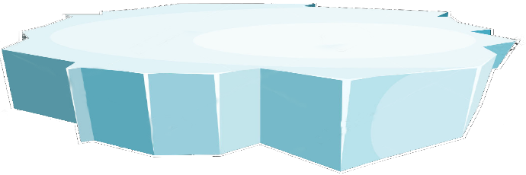









Choose 1 penguin.
Double click to open
end

Slide 7



arm
A: đầu | B: cánh tay
C: cơ thể | D: bàn tay
B
BACK

Slide 8

I use __ hands and arms in volleyball.
A: your | B: can’t
C: use | D: my
D
BACK

Slide 9
📢
A: đầu | B: cánh tay
C: cơ thể | D: bàn tay
A
BACK

Slide 10
hand
A: đầu | B: cánh tay
C: cơ thể | D: bàn tay
D
BACK

Slide 11
I __ my legs and feet in soccer
A: can | B: can’t
C: use | D: kick
C
BACK

Slide 12
f_et (đôi bàn chân)
A: o | B: a
C: e | D: i
C
BACK

Slide 13

Lost turn
☹
Back

Slide 14
📢
A: body | B: hand
C: arm | D: foot
A
BACK

Slide 15
I can kick __ in soccer.
A: the ball | B: can’t
C: use | D: arm
A
BACK

Slide 16

It’s time to learn …

Slide 17

Reading

Slide 18



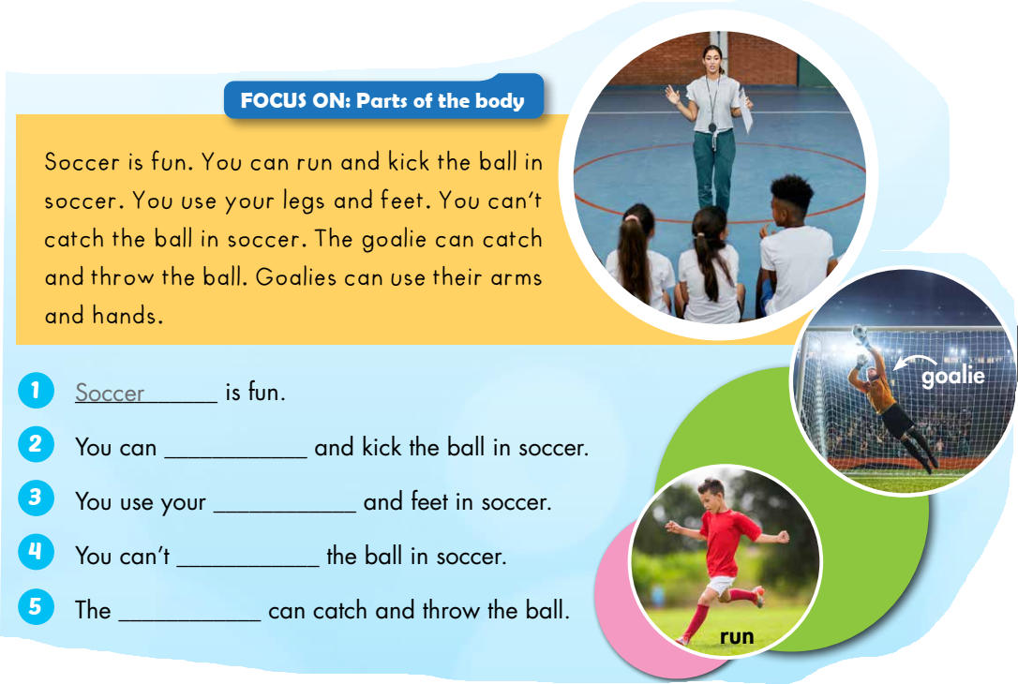
run
legs
catch
goalie

Slide 19

Listening

Slide 20

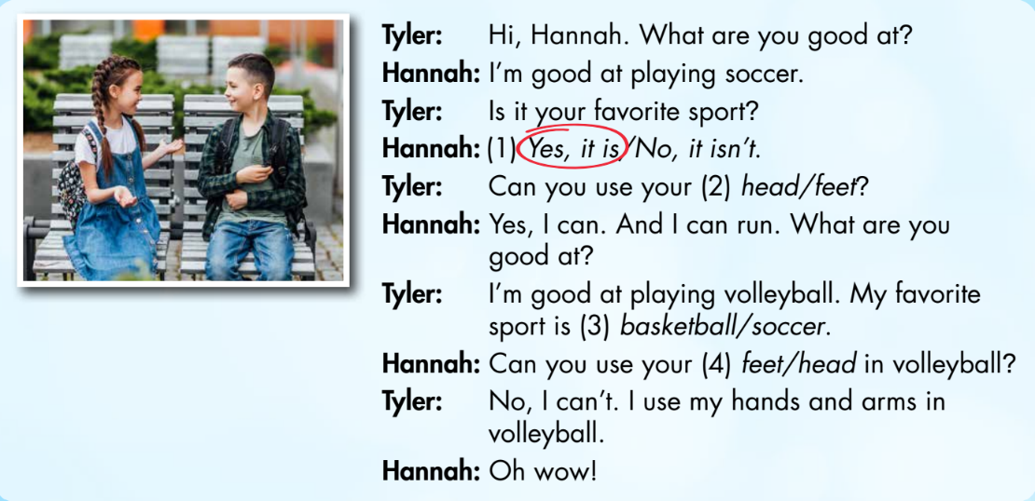
• Who are talking?
• What are they talking about?

Slide 21


Slide 22

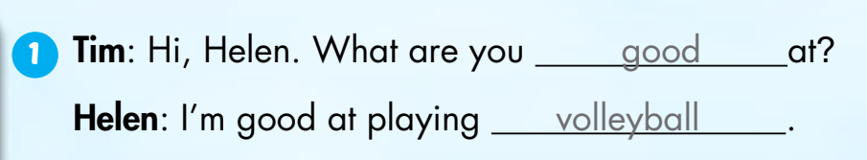

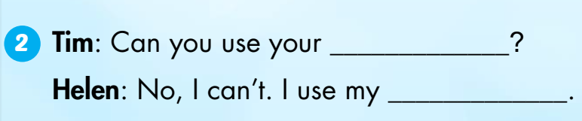
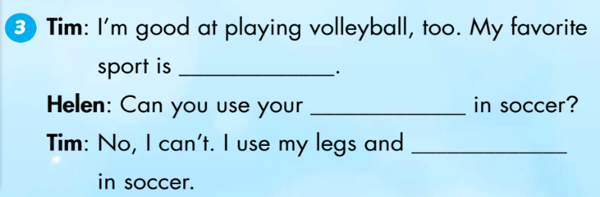
Extra Practice
WB, page 55.
Click on the text box to hear the sound
feet
hands.
soccer
hands
feet

Slide 23

Production

Slide 24

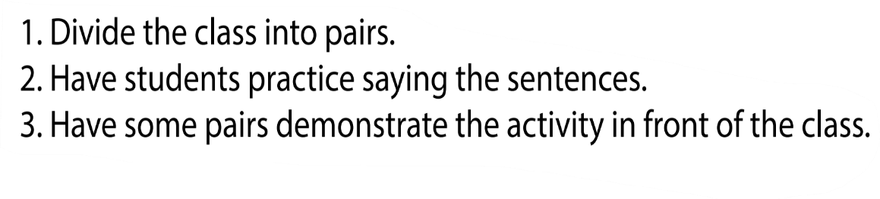


Can you use your feet in volleyball?
No, I can't. I use my hands and arms in volleyball.

Slide 25
FIND SOMEONE WHO

Slide 26


Student A ask “Can you use … in …?” for the suggested words.
Listen the student B's answer and write the student B's name in the "Name" column (different names).

Slide 27
Students draw the following chart in notebooks.
Example:
Student A: Can you use your hands in soccer?
Student B: No, I can’t. I use my legs in soccer.
Sports | Parts of the body | NAME
 | legs
 | arms
 | foot/feet
 | hands
 | head
soccer
B

Slide 28

CONSOLIDATION

Slide 29
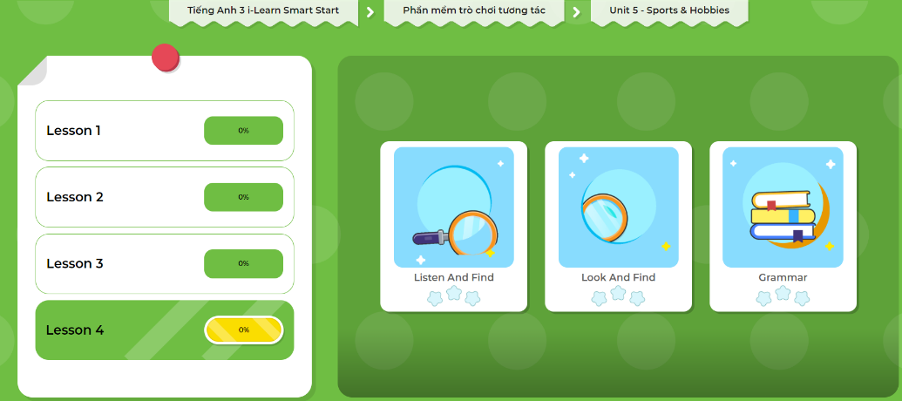
LET’S PLAY!
Click here to play the games.

Slide 30

WRAP-UP

Slide 31












Hide and seek

Slide 32









Start
I ___ my hands in soccer.
play
can
can’t
use
Time up
Correct

Slide 33
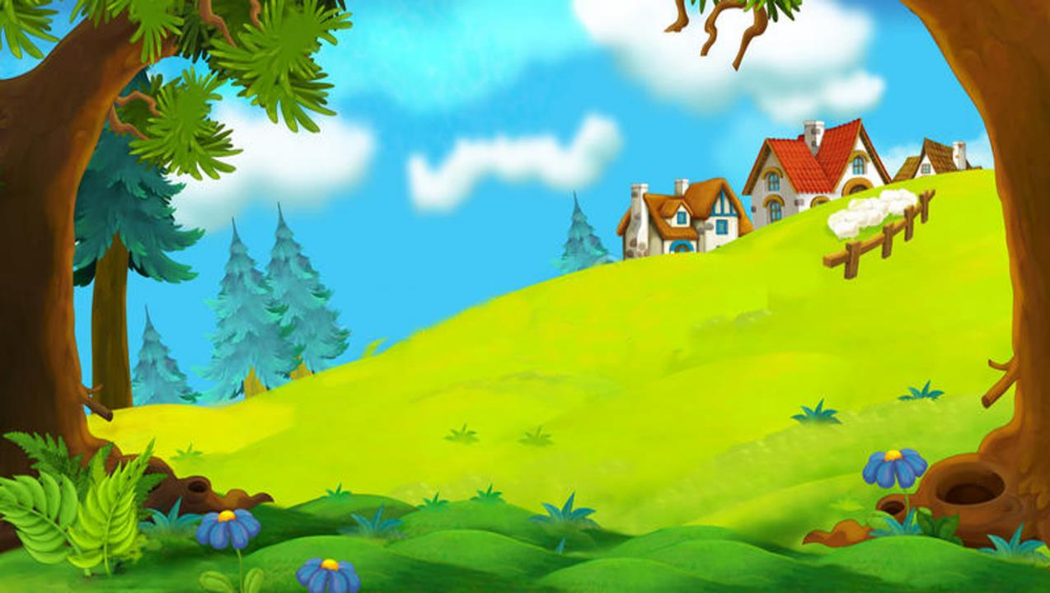



Start
I use ___ hands and arms in
volleyball.
my
your
play
can
Time up
Good job

Slide 34
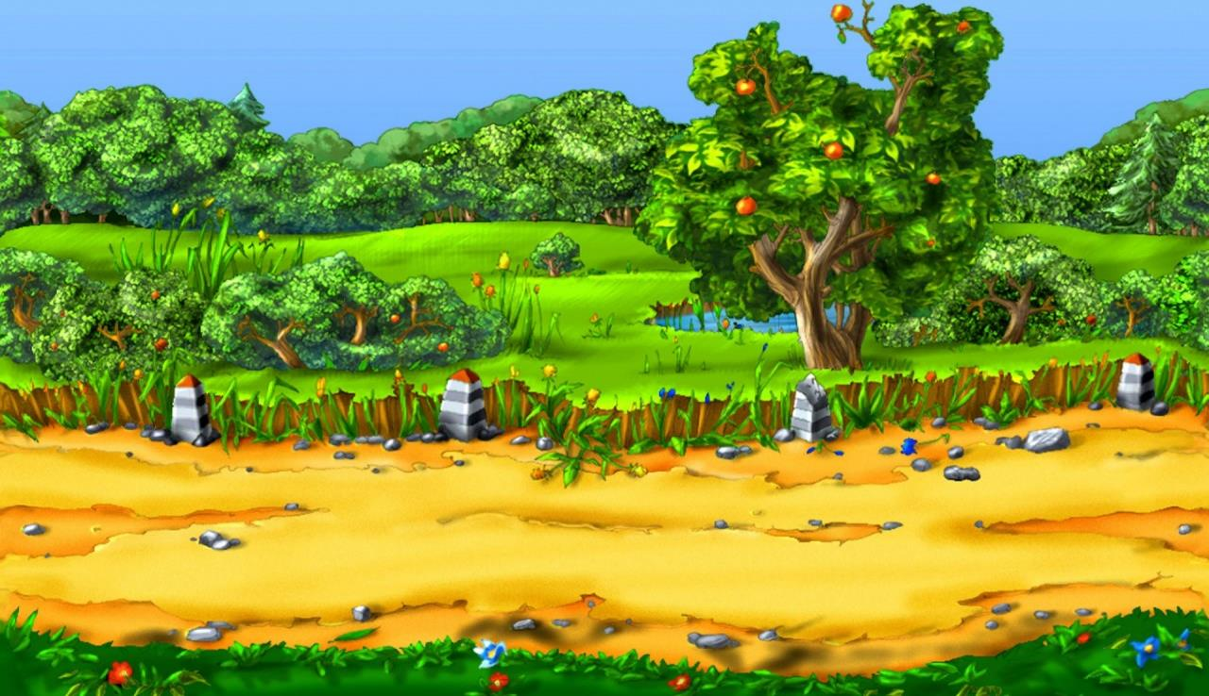

Start
My ____ sport is soccer.
name
use
favorite
playing
Time up
Very good

Slide 35


Start
I ___ kick the ball in basketball.
you can
can’t
use
play
Time up
Good job

Slide 36

Start
You use your arms and hands
___ basketball.
at
on
and
in
Time up
Excellent

Slide 37
Start
Basketball is _____.
fun
use
play
kick
Time up
Good job

Slide 38


Start
I can kick ____ in basketball.
play
the ball
ball
hands
Time up
Very good

Slide 39

Start
you/Can/ volleyball?/ use/ in/ your feet
END
Can use feet in volleyball?
Can you use your feet in volleyball?
Can you use in feet volleyball?
Can use you feet in volleyball?
Time up
Very good

Slide 40
Today’s lesson
Vocabularies
hand
arm
foot/feet
leg, head
body
Structures/ Sentence patterns
I use my legs and feet in soccer.
I can kick the ball in soccer.
I can't kick the ball in basketball.

Slide 41
Lesson 3
Homework
Practice vocabularies and structure. Make sentences using them.
Do the exercises in Tiếng Anh 3 i-Learn Smart Start Workbook (page 55)
Do the exercises in Tiếng Anh 3 i-Learn Smart Start Notebook (page 37)
Play the consolidation games in Tiếng Anh 3 i-Learn Smart Start DHA App on www.eduhome.com.vn
Prepare the next lesson (page 79)

Slide 42

Have a nice day!

