Slide 1

UNIT 5: GENDER EQUALITY
Lesson 1 – Pronunciation and Speaking
Page 40

Slide 2



Lesson 1.1
LESSSON OUTLINE
Consolidation

Slide 3

By the end of this lesson,
students will be able to:
- know and apply how to use falling intonation in a WH-question.
- give opinions, agreement or disagreement about the changes in gender equality and show surprise in their talks.

Slide 4



Slide 5

Work in pairs.
Choose the word whose main stress is placed
differently from the others.
A. allow B.provide C. support D. listen
2. A. inspire B. damage C. answer D. follow
3. A. homeless B. peaceful C. grateful D. alike
/əˈlaʊ/
/prəˈvaɪd/
/səˈpɔ:rt/
/ˈlɪsən/
/ɪnˈspaɪr/
/ˈdæmɪdʒ/
/ˈænsə/
/ˈfɑ:loʊ/
/ˈhoʊmləs/
/ˈpi:sfəl/
/ˈɡreɪtfəl/
/əˈlaɪk/

Slide 6
Work in pairs.
Choose the word whose underlined part is
pronounced differently from that of the other words.
A. gender B. women C. sentence D. letter
2. A. employer B. government C. property D. manager
3. A. starts B. makes C. posts D. calls
/ˈdʒendə/
/ˈwɪmɪn/
/ˈsentəns/
/ˈletə/
/ɪmˈplɔɪər/
/ˈɡʌvənmənt/
/ˈprɒpəti/
/ˈmænədʒə/
/stɑ:rts/
/meɪks/
/poʊsts/
/kɑ:lz/

Slide 7
Make a list of questions with the words provided
he/ here/ How/ come/ did?
What/ job/ is/ your?
When/ was/ started/ she/ she/ old/ How/ to/ work?
What kind of questions are these?
Do we raise or lower our voice at the end of these questions?

Slide 8

Pronunciation

Slide 9
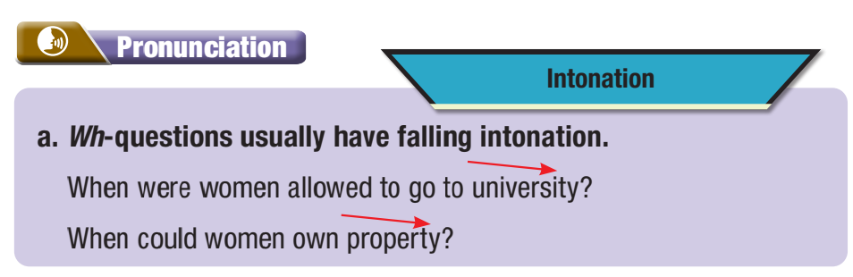

b. Listen to the sentence and focus on how the intonation goes down.
When did women win the right to vote?

Slide 10
c. Listen and cross out the sentence with the wrong intonation.
What was America like?
How old was she when she started to work?
d. Read the sentences with the correct intonation to a partner.

Slide 11



Talk about Canada and Australia, using the prompts. Remember to show surprise.

Slide 12
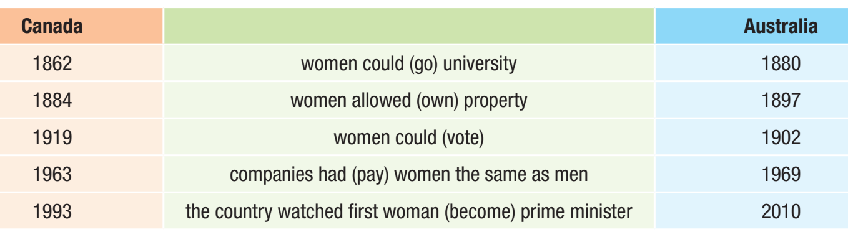

Slide 13



Slide 14

a. You’re discussing the most important moments in the history of gender equality. In pairs: Look at the moments in the table and choose the best reason for each one. Rank the moments from 1-4 (most important to least important).

Slide 15
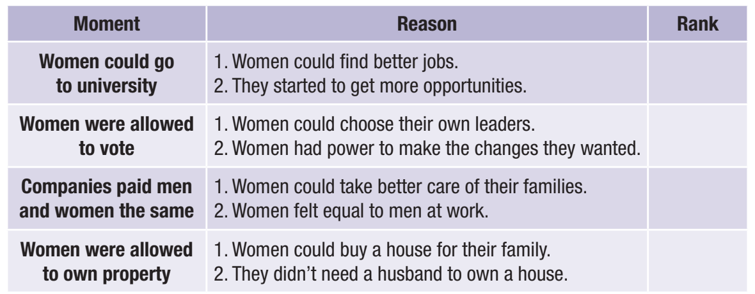
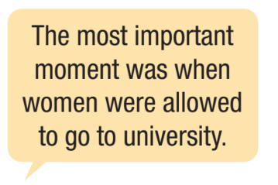
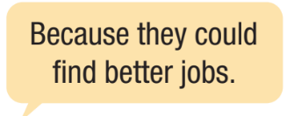

1

Slide 17
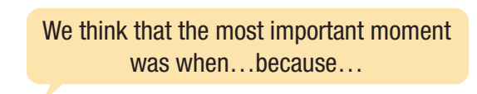


b. Now, compare your choices with another pair. Did you agree on the most important changes? Can you think of any changes that still need to happen?

Slide 18

Consolidation

Slide 19

Now, write a short paragraph (about 80-100 words) about one change you think women will have in the future and give reasons for this change.
I think women can _______ in the future.
There are some reasons for this change.
Firstly, __________________________
Secondly, ________________________
Finally, __________________________

Slide 20
Consolidation
Today’s lesson
Pronunciation: Falling intonation in WH-questions
Speaking: Give opinions, agreement, and disagreement so someone and give reasons.

Slide 21

Practice falling intonations in WH-questions.
Prepare the next lesson - Vocabulary and Reading on page 41 in SB.
Review the vocabularies and grammar points in the unit.
Play the consolidation games in Tiếng Anh 10 i-Learn Smart World DHA App on www.eduhome.com.vn

Slide 22

Have a nice day!

