Slide 1


Slide 2
Unit
6
Preserving our heritage
Unit
FAMILY LIFE
LESSON 6
WRITING
A leaflet about ways to preserve Trang An Scenic Landscape Complex

Slide 3
LESSON 6
WRITING
WARM-UP
Guess the item
Task 1. Put the problems that Trang An Scenic Landscape Complex may face and the possible solutions in the correct blanks.
PRE-WRITING
Task 2. Write a leaflet about the problems that Trang An may face and the possible solutions to them.
WHILE-WRITING
POST-WRITING
Tips to compose a leaflet
Wrap-up
Homework
CONSOLIDATION

Slide 4



WARM-UP
GUESS THE ITEMS
leaflet (booklet or pamphlet)
a printed sheet of paper or a few printed pages that are given free to advertise or give information about something

Slide 5
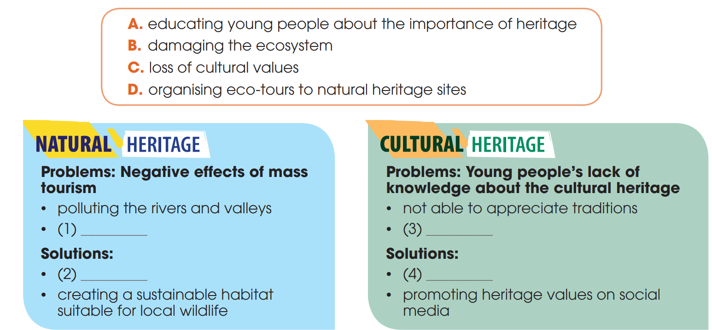
PRE-WRITING
1
Work in pairs. Put the problems that Trang An Scenic Landscape Complex may face and the possible solutions in the correct blanks
B
C
D
A

Slide 6
PRE-WRITING
Useful expressions
To talk about problems and consequences | To talk about solutions
+ … causes …. + … leads to …. + … results in … + As a result, … + As a consequence, … + Consequently, … | + It is necessary to … + It is recommended that … + This problem can be solved if … + To deal with this problem, we should … + It is advisable / vital/ crucial to … + It is urgent to …

Slide 7
WHILE-WRITING
2
Write a leaflet about the problems that Trang An may face and the possible solutions to them. Use the ideas in Task 1 and the outline below to help you.
PREVERVE OUR HERITAGE – PRESERVE TRANG AN LANDSCAPE COMPLEX
Trang An (Ninh Binh Province) was the first site in Viet Nam to be recognised by UNESCO as a mixed World Heritage Site in 2014. It is famous for its natural beauty and rich biodiversity. To preserve its beauty, we need to identify what problems Trang An may face and find ways for preserving it.
PRESERVING NATURE
Trang An is affected by mass tourism. This kind of tourism can pollute rivers and valley. It can also damage the ecosystem because of the large number of visitors.
To preserve Trang An, it is necessary to organize eco-tours to the heritage sites. We should also create a sustainable habitat for wildlife on the heritage site.
PRESERVING CULTURE
Another problem is young people’s lack of knowledge about our cultural heritage. As a result, they are not be able to appreciate our traditions.
This problem can be solved if schools teach the importance of heritage. Our heritage values should also be promoted on social media so that they reach wider audiences.

Slide 8
POST-WRITING
4
Fill in the blank with suitable words in the box to create a list of tips in designing a leaflet.
1. Brand (1)__________ and Logo
2. Make it (2) ___________: The Purpose of the Leaflet
3. (3) __________ is the Leaflet For?
4. Speak (4) _________ to People
5. The Right Spacing
6. Eye-Catching, (5) _________ Imagery
7. The Power of Persuasion
8. Call to (6) __________
colours
different
different who directly colours actions useful
Who
directly
useful
actions

Slide 9
CONSOLIDATION
1
Wrap-up
What have you learnt today?
How to write a leafletl
Apply structures to talk about prpoblems and solutions.

Slide 10
CONSOLIDATION
2
Homework
Do exercises in the workbook.
Prepare for Lesson 7 - Unit 6.

Slide 11

Website: hoclieu.vn
Fanpage: facebook.com/sachmem.vn/

