Slide 1

Unit 2: Every Day
Lesson 2b: Grammar
Page 41

Slide 2
Lesson Outline
Warm-up
Presentation
Practice
Production
Consolidation
Wrap-up

Slide 3
Objectives
By the end of this lesson, students will be able to…
know negative form of the Present Simple tense.
use preposition of time in, on, at correctly.

Slide 4

WARM-UP

Slide 5




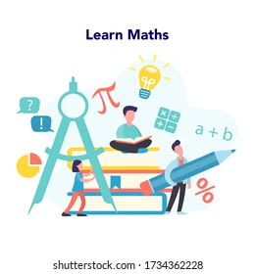
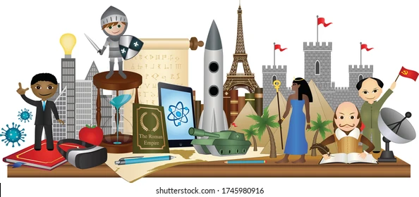
Name these school subjects and tell your friend what subjects you like.
English
Science
Music
Geography
Maths
History

Slide 6

It’s time to learn …

Slide 7

Presentation

Slide 8
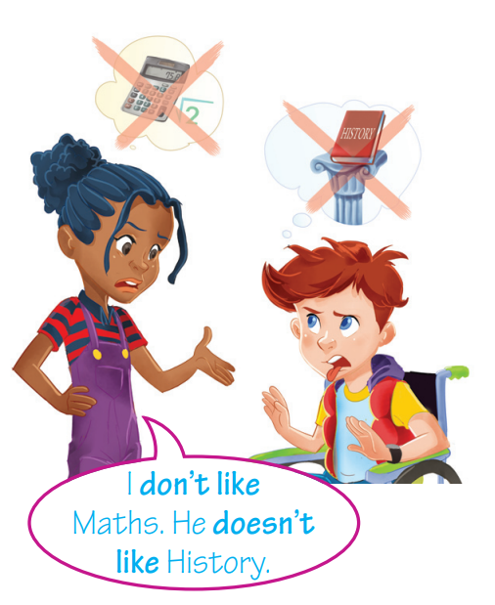
FORMATION
Present Simple tense
Negative
singular | I/You
 | He/She/It
plural | We/You/ They
do not like
don’t like
does not like
doesn’t like
do not like
don’t like

Slide 9
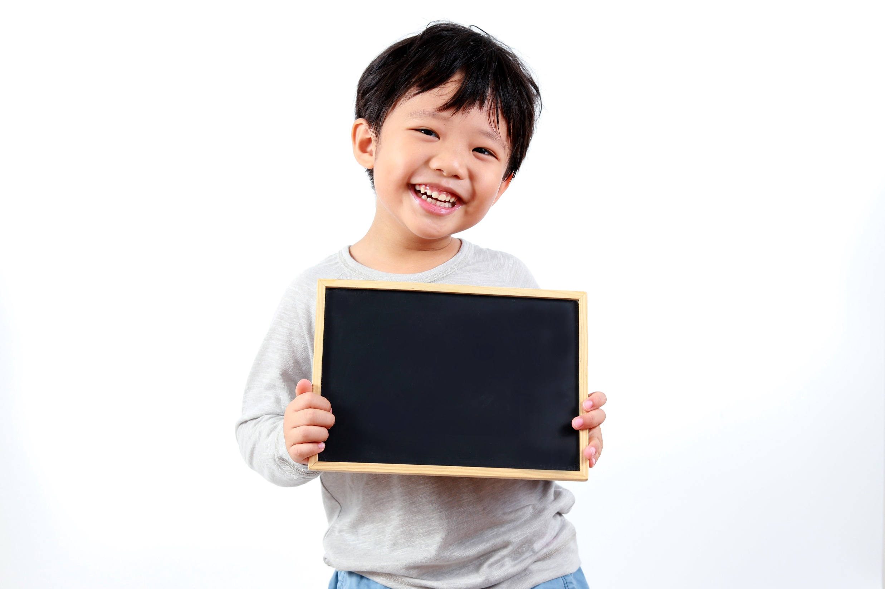
Practice

Slide 10
2 ★★ Fill in the gaps with don’t or doesn’t.
1 Sean ____________ play video games.
2 We ____________ walk to school.
3 Louisa ____________ have dinner at 8:00.
4 You ____________ wash the dog on Friday.
5 Nigel and Boris ___________ speak Spanish.
doesn’t
don’t
doesn’t
don’t
don’t
Extra Practise
WB, P. 23

Slide 11
4 Read the theory box. Complete the sentences using the verbs in the list in the negative form.
• go • have • like • start • prepare
1 Chris _____________ Music.
2 They _____________ dinner at 4:00 p.m.
3 Lessons ___________ at 8:00 p.m.
4 He __________ to school on Saturdays.
5 My mum _____________ lunch for us. We have lunch at school.
doesn’t like
don’t have
don’t start
doesn’t go
doesn’t prepare

Slide 12
3 ★★ Put the verbs in brackets into the Present Simple.
1 Julia _____________ (brush) her teeth in the morning.
2 The children ____ (do) their homework after school.
3 George _____________ (not/have) lunch at school.
4 We ____ (go) to bed at 9:30 p.m.
5 They ____________ (not/play) tennis.
brushes
do
doesn’t have
go
don’t play
Extra Practice
WB, P. 23

Slide 13
16 ★★ Put the verbs in brackets into the Present Simple.
Hi Laura,
My name 1) _________ (be) Sue. I am 11 years old and I 2) _________ (live) in York, UK. I 3) _________________ (have got) one brother. My brother is very good at sport. He 4) _________ (play) in the school basketball team. They 5) _________ (practise) every afternoon. I 6) ________________ (not/like) sport. I 7) _________ (draw) well and I also 8) _________ (play) the guitar. I really 9) _________ (enjoy) it but I 10) ____________ (not/be) very good at it. What about you? 11) ________ ____________________ (you/have got) any brothers or sisters? What 12) __________________________ (you/do) in your free time?
Write back and tell me.
Sue
is
live
have got
plays
practise
don’t like
draw
play
enjoy
am not
Have
you got
do you do
Extra Practise
WB, P. 66

Slide 14
Production

Slide 15
5. What do/don’t you do on Sundays? Use the phrases in the list to write sentences. Tell your partner.
• have breakfast at 8:00
• have lunch with my family at 12:00
• prepare dinner
• eat at a restaurant
• go to the cinema
• play football in the park
• meet my friends
Example:
On Sundays, I don’t have breakfast at 8:00. I have breakfast at 9:00

Slide 16
Prepositions of time

Slide 17
Complete the sentences with in, on, at.
Students don’t go to school ____ Sunday.
My mother always gets up ___ 6:00 a.m.
at
on
What do you do ____ the evening?
in

Slide 18
Prepositions of time (at, on, in)
At | On | In
time: at 7 o’clock
holidays: at Easter,
at Christmas
in the expressions:
at noon, at the
weekend, at night
days: on Monday,
on New Year’s Day
dates: on 2nd August
part of a particular
day: on Friday night
months: in January
seasons: in the winter/ spring/summer/autumn
in the expressions:
in the morning/afternoon/ evening, in an hour, in a minute, in a week/month/ year/few days

Slide 19
6 Fill in the gaps with at, on or in.
1 He doesn’t get up ______ 8:00 ______ the morning.
2 I haven’t got a music lesson ______ Thursdays.
3 We can meet ______ the afternoon.
4 We don’t visit our grandparents ______ Sunday mornings.
5 The children finish lessons ______ 3:00 p.m.
at
in
on
in
on
at

Slide 20
Circle the correct item.
1 My family and I go to the park on / at Saturdays.
2 Bob and Susanna have dinner outside in / at the summer.
3 I go to the cinema in / on Friday nights.
4 Maria’s birthday is on / in May 3rd.
5 We go on holiday on / in June.

Slide 21
PAIR WORK
Tell your friend what you do …
in the evening / in summer
at the weekend / at Christmas
on Monday morning / New Year’s Day
I usually watch TV in the evening.
I always get up early on Monday morning.

Slide 22

CONSOLIDATION

Slide 23
Write six sentences (three in affirmative and three in negative form) about what you do and what you don’t do at the weekend, using prepositions of time (in, on, at) correctly.

Slide 24

WRAP-UP

Slide 25
Today’s lesson
Grammar
Present Simple tense (negative)
Prepositions of time (in, on, at)

Slide 26
Homework
Practise speaking and writing sentences, using the Present Simple tense and prepositions of time (in, on, at).
Redo exercises 5&6 in TA 6 Right on WB (p. 23)
Complete the grammar notes in TA 6 Right on Notebook (p. 22)
Prepare the next lesson (p. 42 SB)

Slide 27
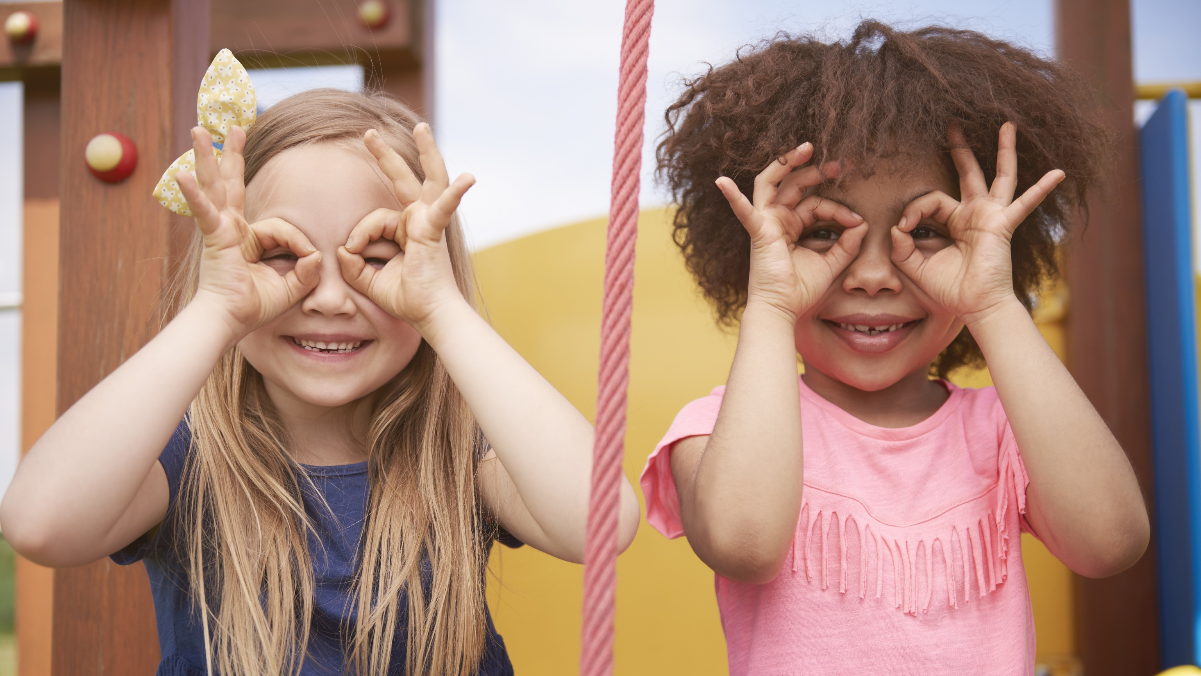
Enjoy your day!

