Slide 1

Unit 2: Every Day
Lesson 2f: Skills
Page 46

Slide 2
Lesson Outline
Warm-up
Pre - reading
While - reading
Post - reading
Consolidation
Wrap-up

Slide 3
Objectives
By the end of this lesson, students will be able to…
read fact file.
practise reading skills (reading for specific information).

Slide 4

WARM-UP

Slide 5
PAIRWORK
Tell your friend about your idol.
Who’s your favourite singer/actor/sports star?
What do you know about him/her?

Slide 6

It’s time to learn …

Slide 7

Pre-reading

Slide 8
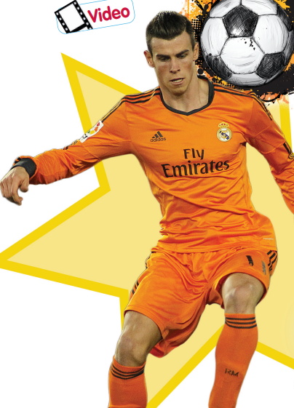
Look at the picture and answer the questions:
What’s his name?
His name is Gareth Bale.
How old is he?
He’s 33 years old.
Where is he from?
He’s from Wales.
What does he do?
He’s a footballer.

Slide 9
Find these words and underline them. Can you guess their meanings?
nickname training twice filed wizard charity
Gareth Bale is a great footballer. He usually gets up early at 7:00 a.m. and goes to the gym. After that, he takes a shower and then he eats breakfast. At 9:00 a.m., Gareth goes to football practice. Gareth always has a lunch break at about half past one and then continues training. He has Spanish lessons twice a week.
On the field, Gareth often scores goals. His nickname is ‘the Welsh Wizard’. Gareth is tall and runs very fast.
When Gareth doesn’t have training or a match, he plays computer games and watches DVDs or sports matches on TV. He plays golf, too. He also helps different charities that help children. His family is very important to him and he likes spending time with them.

Slide 10

Vocabulary
Listen and repeat. Click on each word to hear the sound.
• nickname (n) /ˈnɪkneɪm/: biệt danh
• training (n) /ˈtreɪnɪŋ/: việc tập luyện
• twice (adv) /twaɪs/: hai lần
• field (n) /fiːld/: sân bóng
• wizard (n) /ˈwɪzəd/: phù thủy
• charity (n) /ˈtʃærəti/: tổ chức từ thiện

Slide 11
Vocabulary
Practise saying them. Focus on the word stress.
• nickname (n) /ˈnɪkneɪm/: biệt danh
• training (n) /ˈtreɪnɪŋ/: việc tập luyện
• twice (adv) /twaɪs/: hai lần
• field (n) /fiːld/: sân bóng
• wizard (n) /ˈwɪzəd/: phù thủy
• charity (n) /ˈtʃærəti/: tổ chức từ thiện

Slide 12
Vocabulary
Make sentences using these words.
• nickname (n) /ˈnɪkneɪm/: biệt danh
• training (n) /ˈtreɪnɪŋ/: việc tập luyện
• twice (adv) /twaɪs/: hai lần
• field (n) /fiːld/: sân bóng
• wizard (n) /ˈwɪzəd/: phù thủy
• charity (n) /ˈtʃærəti/: tổ chức từ thiện

Slide 13
While-reading

Slide 14

1. Look at the picture. Say three things you think Gareth Bale does every day. Listen, read and check.
I think he plays football every day. He probably goes to the gym every day, too. In his free time, maybe he plays computer games.

Slide 15
Gareth Bale is a great footballer. He usually gets up early at 7:00 a.m. and goes to the gym. After that, he takes a shower and then he eats breakfast. At 9:00 a.m., Gareth goes to football practice. Gareth always has a lunch break at about half past one and then continues training. He has Spanish lessons twice a week.
On the field, Gareth often scores goals. His nickname is ‘the Welsh Wizard’. Gareth is tall and runs very fast.
When Gareth doesn’t have training or a match, he plays computer games and watches DVDs or sports matches on TV. He plays golf, too. He also helps different charities that help children. His family is very important to him and he likes spending time with them.

Slide 16
2 Read the text. Match phrases (1-3) to phrases (a-c) to make sentences.
Gareth Bale is a great footballer.
Gareth Bale is 1
His birthday is 2
Gareth runs 3
a very fast.
b a footballer.
c on 16th July.
Date of birth: 16th July, 1989
Gareth is tall and runs very fast.

Slide 17
Read and underline the key words and guess the type of missing word.
1. Gareth goes to football practice _________________
2. People call him ________________
3. In his free time, he _________________
4. He likes spending time ______________
adverb
noun
verb
noun / V-ing

Slide 18
3. Complete the sentences.
At 9:00 a.m., Gareth goes to football practice.
1 Gareth goes to football practice
2 People call him
3 In his free time, he
4 He likes spending time
at 9:00 a.m.
the Welsh Wizard.
His nickname is ‘the Welsh Wizard’.
When Gareth doesn’t have training or a match, he plays computer games and watches DVDs or sports matches on TV. He plays golf, too.
plays computer games, watches DVDs or sports matches on TV and plays golf.
His family is very important to him and he likes spending time with them.
with his family.

Slide 19
Read the text again and write TRUE or FALSE.
Read the sentences and underline key words.
Gareth takes a shower before going to the gym.
He has lunch at 1:30 p.m.
He goes to Spanish classes two times a week.
Gareth is short, but he runs very fast.
He does charities to help children.
Extra Practice

Slide 20
Read the text again and write TRUE or FALSE.
Gareth takes a shower before going to the gym.
He has lunch at 1:30 p.m.
He goes to Spanish classes two times a week.
Gareth is short, but he runs very fast.
He does charities to help children.
He usually gets up early at 7:00 a.m. and goes to the gym. After that, he takes a shower…
F
T
Gareth always has a lunch break at about half past one
T
He has Spanish lessons twice a week.
F
Gareth is tall and runs very fast.
He also helps different charities
that help children.
T

Slide 21
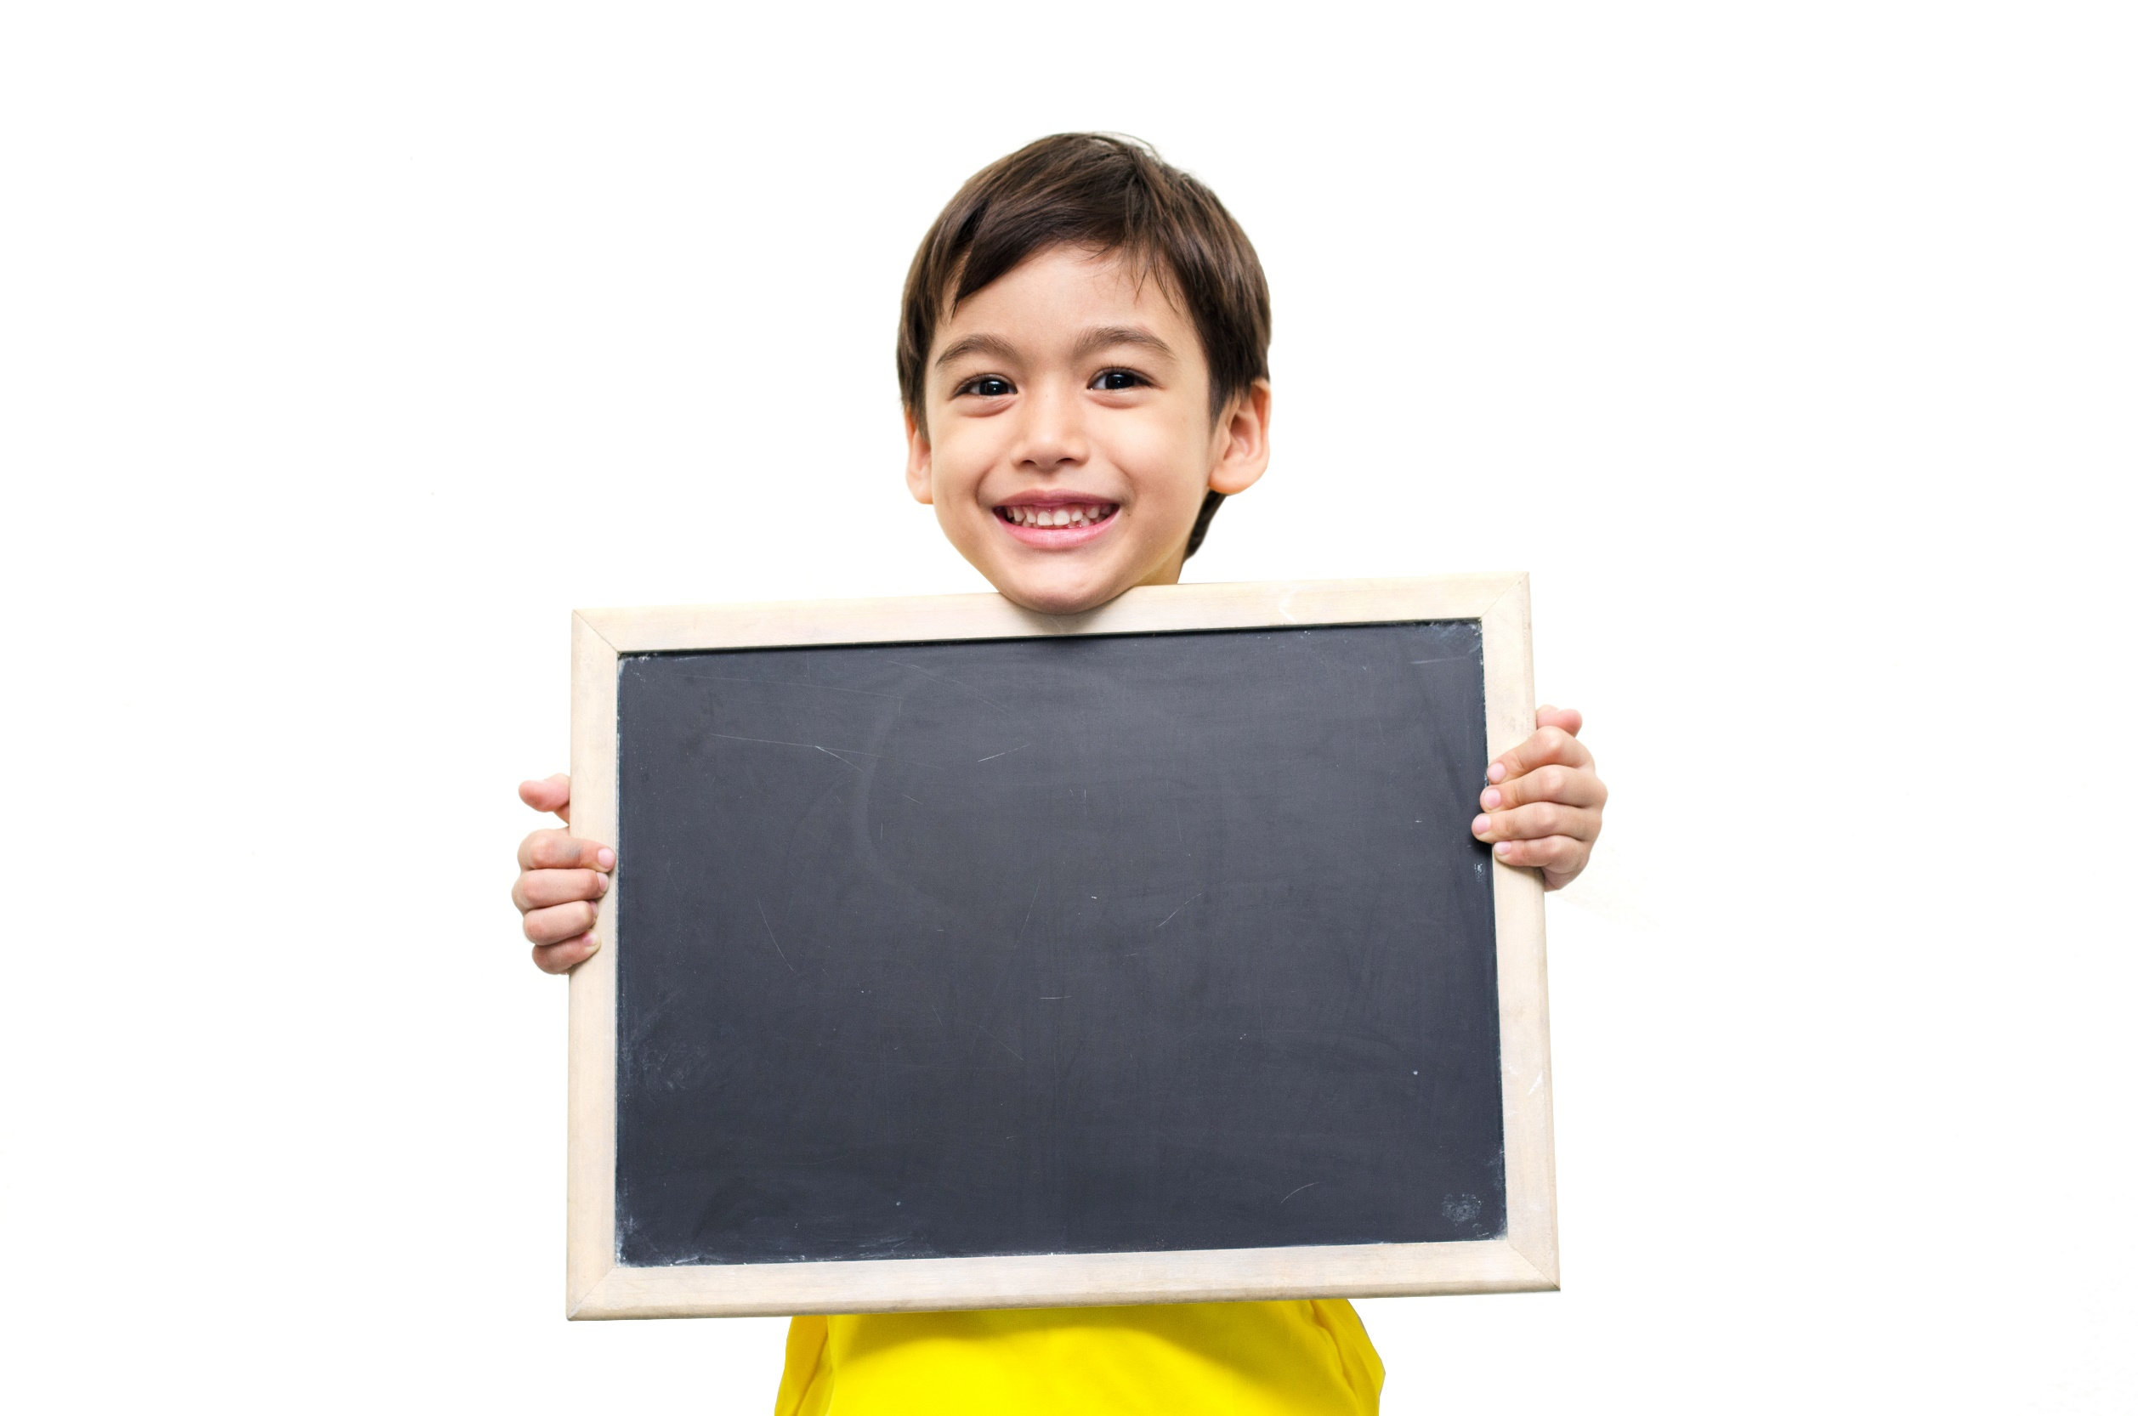
Post-reading

Slide 22
Pair work
Tell your friend what you remember about Gareth Bale by completing these sentences.
He’s a ………..
He’s from …………
His birthday is ………………
He goes to ……………. everyday.
People call him ……………..
He ……………..in his free time.
He ………………to help children.
He likes ………………….

Slide 23

CONSOLIDATION

Slide 24
Write a summary (5 sentences) about Gareth Bale, using the information in the text you have read.

Slide 25

WRAP-UP

Slide 26
Today’s lesson
Vocabularies
• nickname
• training
• twice
• field
• wizard
• charity
Reading
Read a text about Gareth Bale.

Slide 27
Homework
Practise making sentences using the vocabularies.
Do the exercises in TA 6 Right on WB (p. 27)
Prepare the next lesson (p. 47 SB)

Slide 28
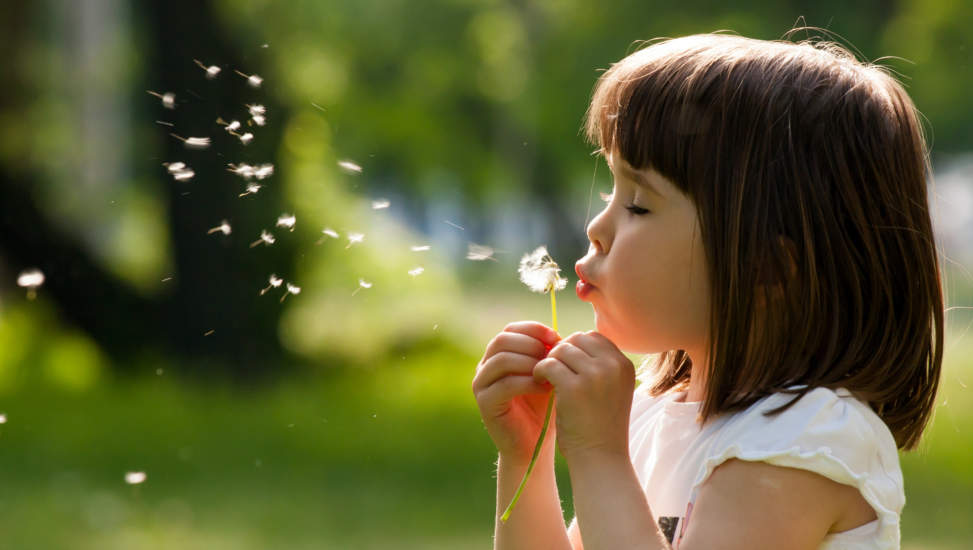
Enjoy your day!

