Slide 2



REVIEW 1
( UNITS 1 – 2 – 3)
Pronunciation
Vocabulary
Grammar

Slide 3


Pronunciation
Choose the word whose underlined part is pronounced differently.
Write the names of school things and furniture in the house which begin with /b/ and /p/.

Slide 4


Choose the word whose underlined part is pronounced differently.
1.
A.
ears
B.
eyes
C.
lips
2.
A.
cat
B.
father
C.
calm
3.
A.
lights
B.
pencils
C.
lamps
4.
A.
notebooks
B.
rules
C.
rooms
5.
A.
brother
B.
homework
C.
mother

Slide 5

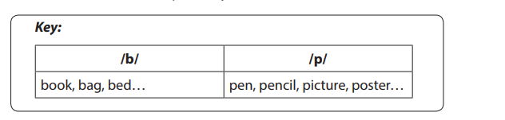
Write the names of school things and furniture in the house which begin with /b/ and /p/.
/b/: book,
/p/: pen,

Slide 6


Vocabulary
Complete the words.
Solve the crossword puzzle.

Slide 7
Complete the words.
English
sports
1.
English
sports
E l
4.
s r
homework
badminton
2.
homework
badminton
h w
5.
b m n
lunch
3.
lunch
l h
Now write the words in the correct group.
play | do | have | study
sports
homework
lunch
English
badminton

Slide 8
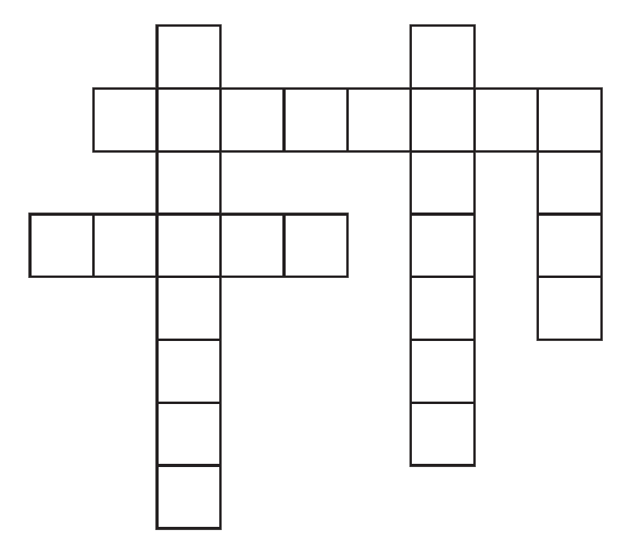
Solve the crossword puzzle.
DOWN
1
2
1.
She likes to meet new people.
She’s .
4
3
2.
People cook meals in this room.
4.
5
You hear with them.
ACROSS
3.
He’s good at drawing.
He’s very .
5.
It’s a side of the face, below the eyes.

Slide 9
1
2
f
r
i
e
n
d
l
y
k
i
t
c
h
e
n
4
c e a t v
e
a
r
s
3
5
c h e k

Slide 10


Grammar
Look at the picture of a classroom. Choose the best answer A, B, or C.
Complete the sentences with the present simple or the present continuous form of the verbs in brackets.

Slide 11
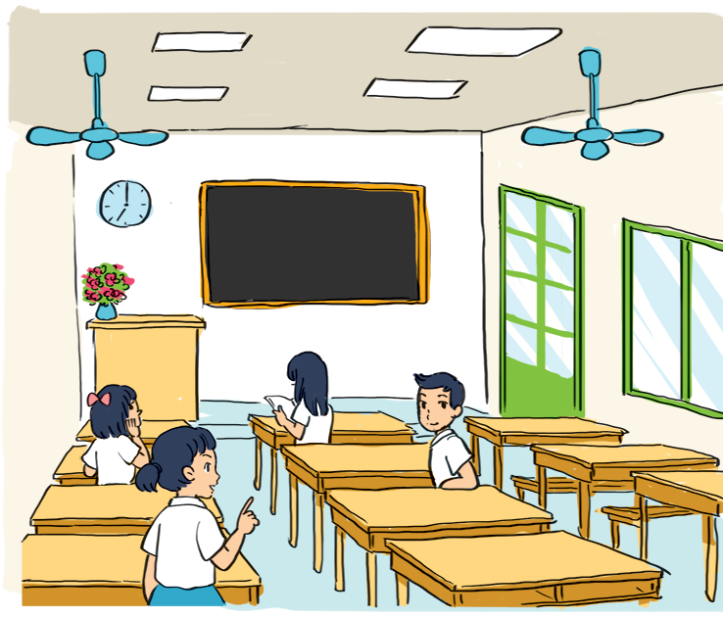
Look at the picture of a classroom. Choose the best answer A, B, or C.

Slide 12
1.
There is a blackboard and a clock the wall.
A.
in
B.
on
C.
behind

Slide 13
2.
A vase of flowers is on the desk.
A.
teacher’s
B.
teachers
C.
teacher’

Slide 14
3.
A boy and these girls are the classroom.
A.
in
B.
on
C.
in front of

Slide 15
4.
The window is the big door.
A.
behind
B.
next to
C.
under

Slide 16
5.
A girl her book now.
A.
B.
reading
C.
is reading
reads
5.
A girl her book now.
A.
reads
B.
reading
C.
is reading

Slide 17
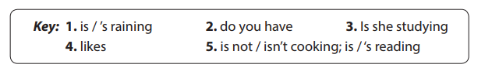
Complete the sentences with the present simple or the present continuous form of the verbs in brackets.
is / ‘s reading.
We can’t go out now. It (rain)
.
1.
is / ‘s raining.
you (have) breakfast every day?
do
you have breakfast every day?
2.
What time
you (have) breakfast every day?
-
- No, she isn’t
3.
she (study) studying English now?
she (study) English now?
Is
she (study) English now?
4.
My dog (like)
likes my bed very much.
my bed very much.
now. She (read)
is not / isn‘t cooking
now.
5.
now.
My mother (not cook)
a book.
She (read) a book.
She (read) is / ‘s reading a book.

Slide 18







