Slide 1

Unit 3: Music and Arts
Lesson 3.1: Listening & Reading
Page 26

Slide 2



Lesson 3.1
LESSSON OUTLINE
Consolidation

Slide 3

By the end of this lesson, students will be able to…
- talk about favorite movies.
practice listening and reading for main ideas and specific information.
be well-prepared for the writing section in the next lesson.

Slide 4

WARM UP

Slide 5


Work in pairs.
What are different types of movies you like to watch? Why?

Slide 6
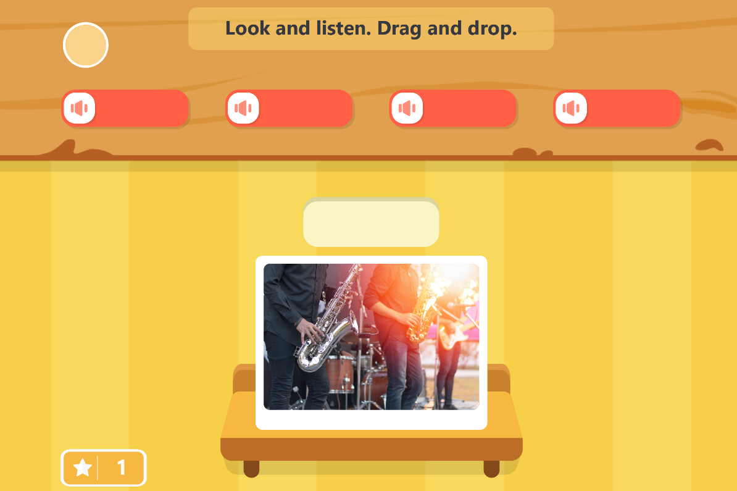
Play the games. Click the picture below.

Slide 7


It’s listening time….

Slide 8
Pre – listening
a. Match the vocabulary to the meaning.
VOCABULARY | MEANING
conclusion | a very famous, successful, and important person, especially a performer such as a musician, an actor, or a sport player
plot | The place a film is recorded or performed
star | the last part of something
setting | The story of a book, film, play, etc.

Slide 9
Pre - listening
b. Underline the key words and fill in the blanks using the words below.
conclusion plot star setting
1. The main character or actor is called the ______________.
2. The ______________ is the place/time the movie happens.
3. The story the movie tells is called the ______________.
4. The ______________ gives your overall feelings.

Slide 10

While - listening
Listen to an English teacher and check your answers.
☞ FIRST TIME
1. The main character or actor is called the ______________.
2. The ______________ is the place/time the movie happens.
3. The story the movie tells is called the ______________.
4. The ______________ gives your overall feelings.
star
setting
plot
conclusion

Slide 11
While - listening
Now listen again and check.  SECOND TIME
Next, write about the main character or star of the movie.
For example, the star is Brad Pitt.
Next, write about the main character or star of the movie.
For example, the star is Brad Pitt.
setting
1. The main character or actor is called the ______________.
2. The ______________ is the place/time the movie happens.
star
Next, write about the main character or star of the movie.
For example, the star is Brad Pitt.
Next, write about the main character or star of the movie.
For example, the star is Brad Pitt.
3. The story the movie tells is called the ______________.
conclusion
4. The ______________ gives your overall feelings.
plot

Slide 12
Pre - listening
Read the instruction quickly. Underline the key words in the questions and options. What are we going to do?
Listen and circle the correct answers
b. Now, listen and circle the correct answers.
1. When should you say what kind of movie it is?
at the start/in the middle
2. What does the teacher say you shouldn’t tell?
the ending/the surprise
3. What else does the teacher say to write about?
music and costumes/who would like the movie

Slide 13
While - listening
Now listen and circle the correct answers.  FIRST TIME
1. When should you say what kind of movie it is?
at the start/in the middle
2. What does the teacher say you shouldn’t tell?
the ending/the surprise
3. What else does the teacher say to write about?
music and costumes/who would like the movie

Slide 14
While - listening
Now listen again and check.  SECOND TIME
1. When should you say what kind of movie it is?
at the start/in the middle
2. What does the teacher say you shouldn’t tell?
the ending/the surprise
3. What else does the teacher say to write about?
music and costumes/who would like the movie

Slide 15
While - listening
Now listen again and check.  THIRD TIME
First, start with the movie name, and what type of movie it is.
Say what the movie is about, but don’t tell the ending
1. When should you say what kind of movie it is?
at the start/in the middle
3. What else does the teacher say to write about?
music and costumes /
who would like the movie
First, start with the movie name, and what type of movie it is.
2. What does the teacher say you shouldn’t tell?
the ending/the surprise

Slide 16

Post - listening
Work in pairs.
Talk about a movie you like.

Slide 17
Track 34
Teacher: OK, class, today we are going to write about movies we like. First, start with the movie name, and what type of movie it is. Next, write about the main character or star of the movie. For example, the star is Brad Pitt. After that, write where the movie takes place. This is the setting. For example, you can say, the movie is set in America. After that, tell the main parts of the story. This is called the plot. Say what the movie is about, but don’t tell the ending. Then, you should describe some good or bad parts of the movie. At the end, you should give your overall feelings and who would enjoy the movie. This is called the conclusion.
Scripts

Slide 18


It’s reading time….

Slide 19

Pre - reading
Read the instruction quickly. Underline the key words. What are we going to do?
Read and choose the best title.

Slide 20
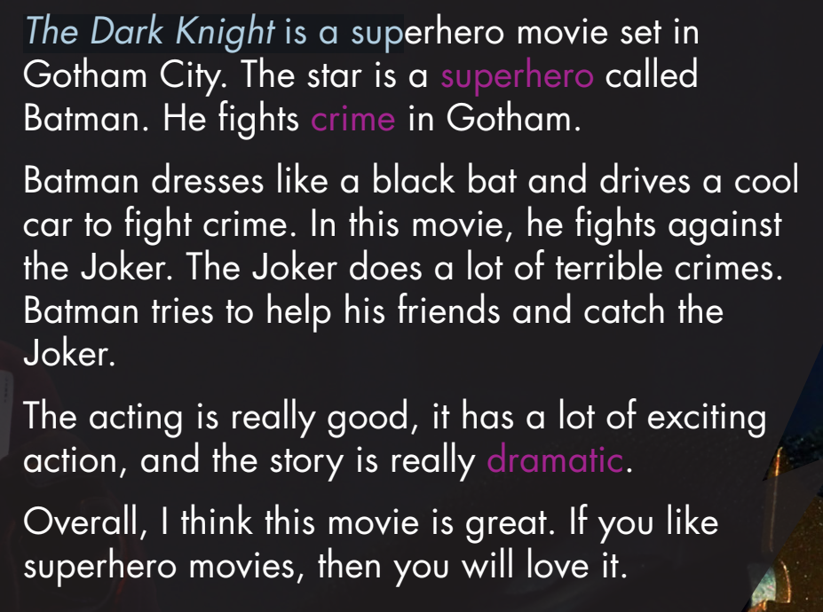
Pre - reading
Look at the topic sentence and guess.

Slide 21
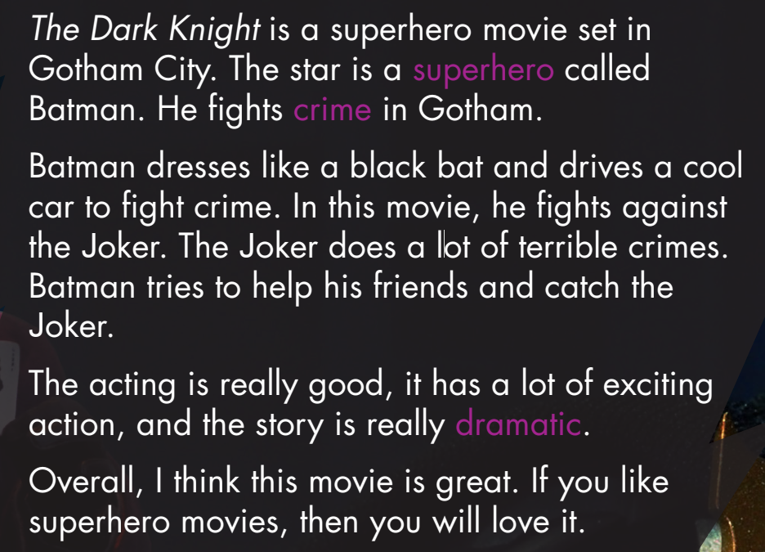
Skim the text. Underline the key words/phrases. Choose the best title.
While - reading
1. The Dark Knight – an action-packed crime drama

Slide 22
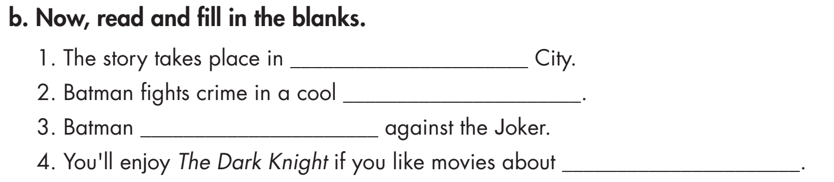
Pre - reading
Read the instruction quickly. Underline the key words. What are we going to do?
Read and fill in the blanks.

Slide 23
Pre - reading
Read the sentences. Underline the key words. Scan the text and answer the questions.

Slide 24
Pre - reading
Read the sentences. Guess the type of words (a verb, a noun, an adjectives, an adverb, etc.,… missing in each statement.
a name of a city
a noun
a verb
a noun

Slide 25
1. The story takes place in ______________________ City.
Gotham
While - reading

Slide 26
car
2. Batman fights crime in a cool __________.
While - reading

Slide 27
fights
While - reading
3. Batman _______________ against the Joker.

Slide 28
superheroes
4. You'll enjoy The Dark Knight if you like movies about______________.
While - reading

Slide 29
Post - reading
Work in pairs.
Would you like to watch this movie? Why (not)?

Slide 30

CONSOLIDATION

Slide 31

Work in pairs.
Talk about a movie star you like. Say why you like him / her!

Slide 32

WRAP-UP

Slide 33
Today’s lesson
Listening:
- Listen for gist and comprehension.
Reading:
- Skim and scan for general and specific information.

Slide 34
Homework
Do the exercises on page 18 WB.
Do the exercises in Tiếng Anh 7 i-Learn Smart World Notebook on page 18
Prepare the next lesson (page 27 SB)
Play the consolidation games in Tiếng Anh 7 i-Learn Smart World DHA App on www.eduhome.com.vn

Slide 35

Lesson 3
Stay positive and have a nice day!

