Slide 2


Unit
9
CITIES OF THE WORLD
LESSON 5: SKILLS 1
1

Slide 3
LESSON 5: SKILLS 1
LESSON 1: GETTING STARTED
Guess the country
WARM-UP
Reading
Task 1: Work in groups. Look at the postcard and discuss.
Task 2: Read the postcard and answer the questions.
Task 3: Read the text and match the places with the things they have.
READING
Speaking
Task 4: Work in groups. Choose a city you know. Discuss and answer the questions below.
Task 5: Share the information you have collected in 4 with your class.
SPEAKING
CONSOLIDATION
Wrap-up
Homework

Slide 4
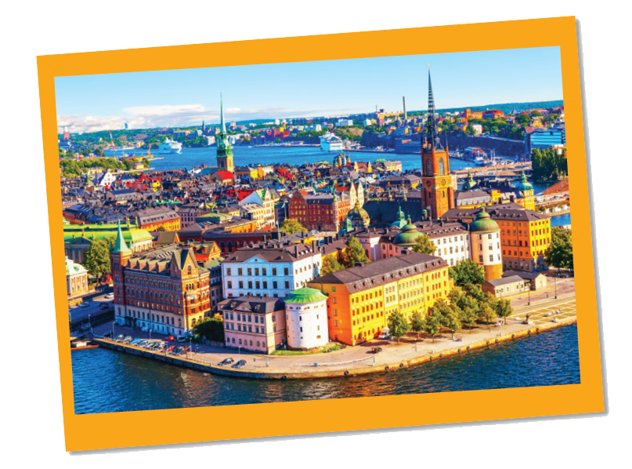
WARM-UP
Where
is it?
Sweden

Slide 5

Reading
Love from Sweden

Slide 6


PRESENTATION
postcard (n)
/ˈpəʊstkɑːrd/
bưu thiếp

Slide 7
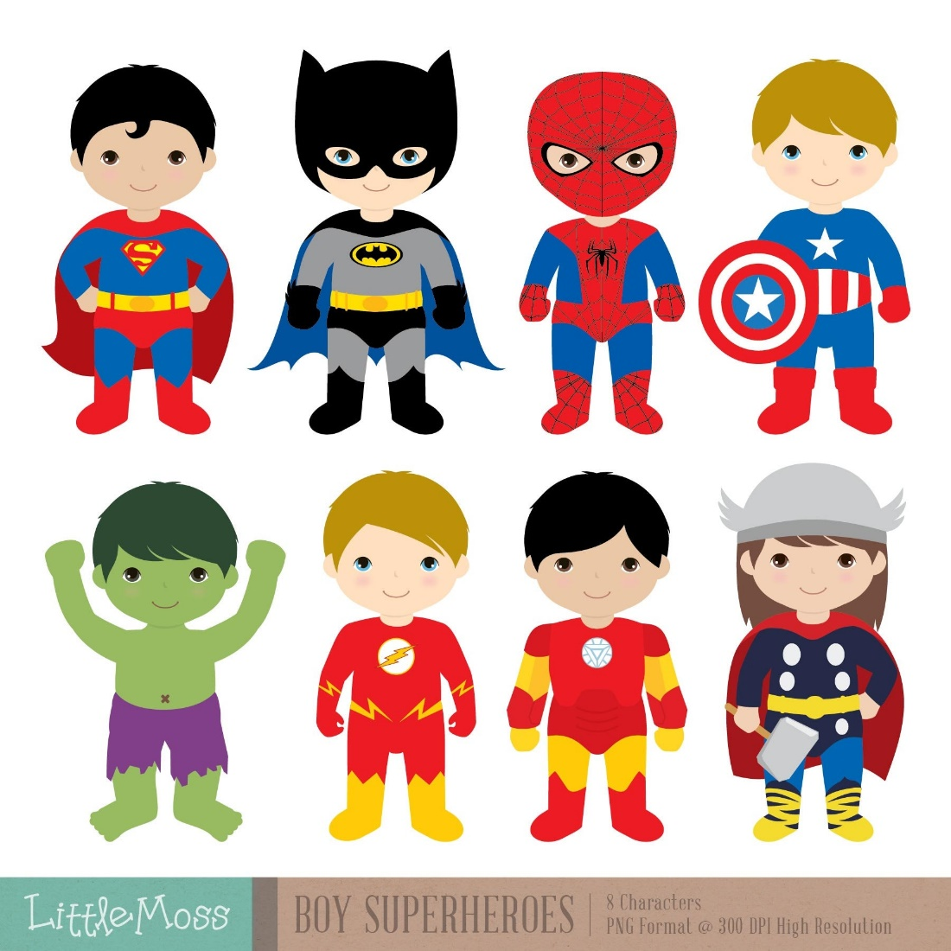
PRESENTATION
fantastic (adj)
/fænˈtæstɪk/
phi thường, vô cùng to lớn, tuyệt vời

Slide 8

PRESENTATION
perfect (adj)
/ˈpɜː(r)fekt/
hoàn hảo

Slide 9
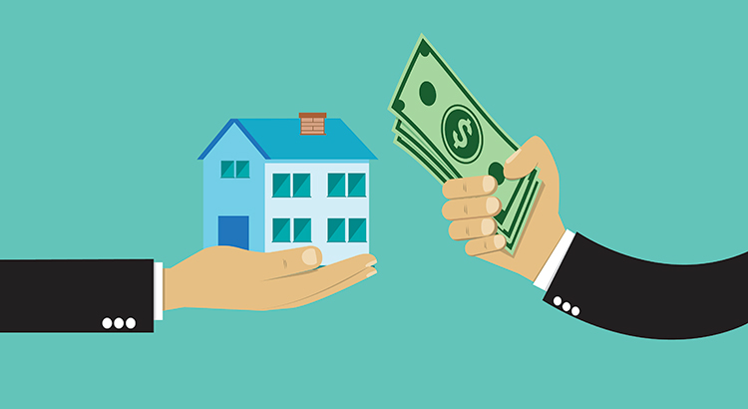
PRESENTATION
rent (v)
/rent/
thuê, mướn

Slide 10
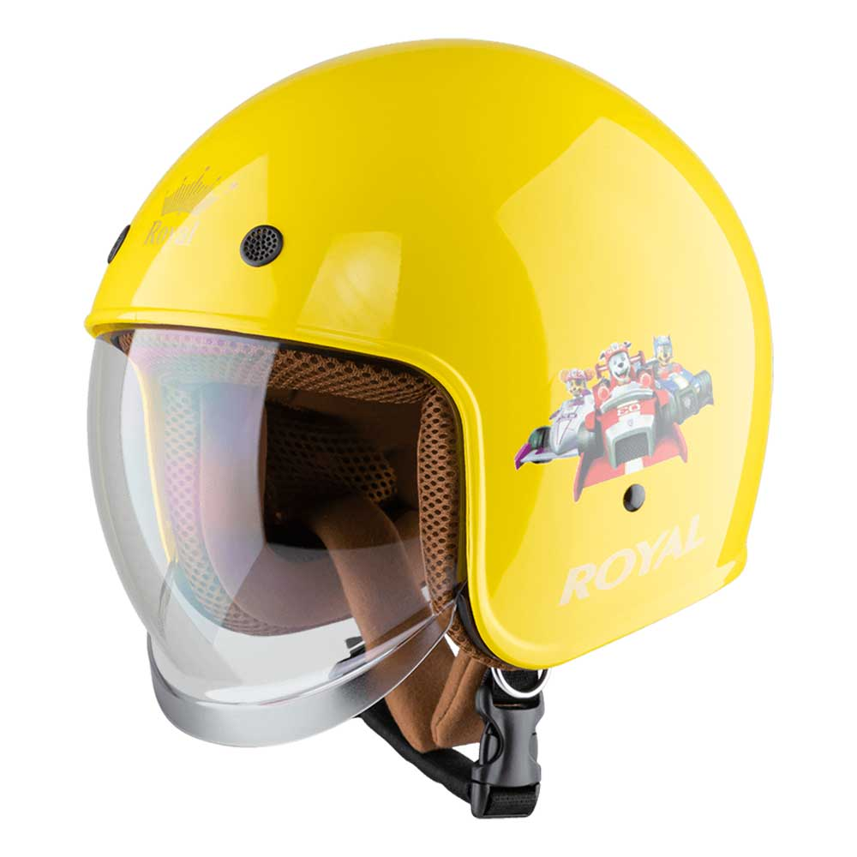
PRESENTATION
helmet (n)
/ˈhelmɪt/
mũ bảo hiểm

Slide 11
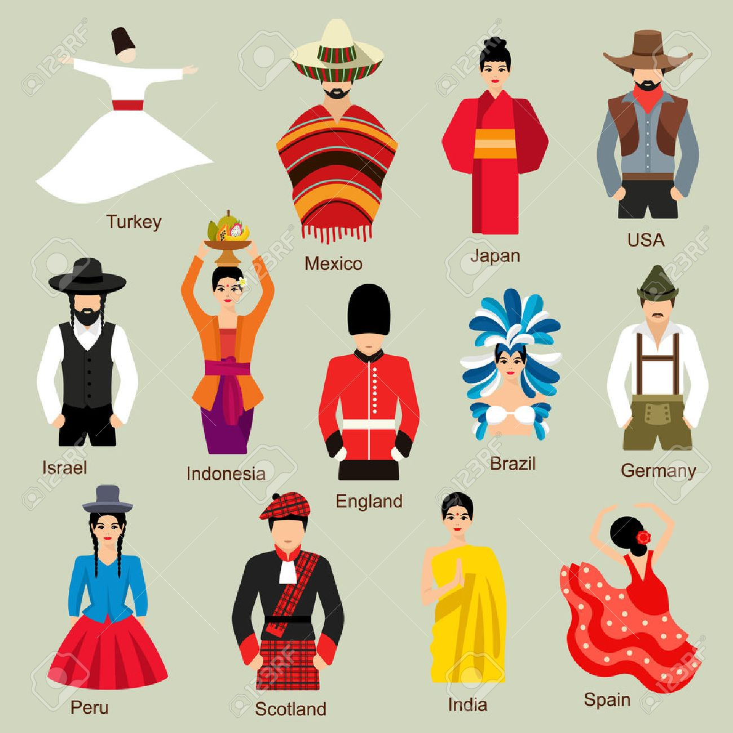
PRESENTATION
traditional (n)
/trəˈdɪʃənl/
thuộc về truyền thống

Slide 12
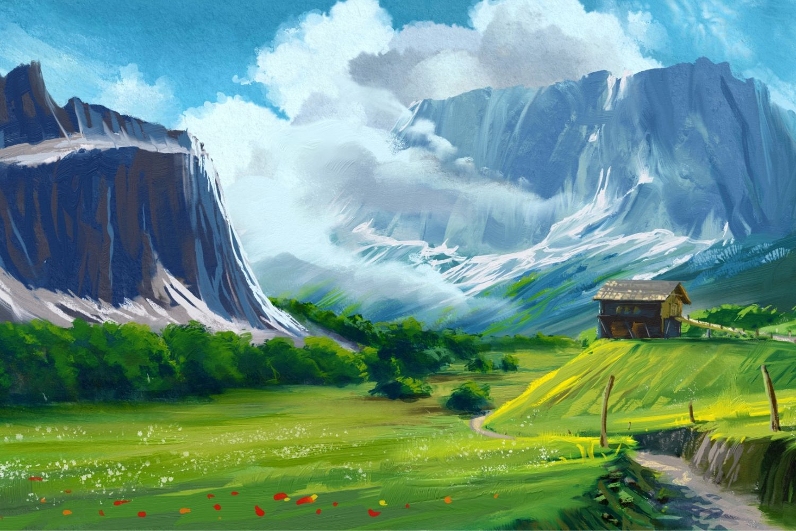
PRESENTATION
landscape (n)
/ˈlændskeɪp/
phong cảnh

Slide 13
READING
Form | Pronunciation | Vietnamese equivalent
1. Postcard (n) | /ˈpəʊstkɑːrd/ | bưu thiếp
2. fantastic (adj) | /fænˈtæstɪk/ | phi thường, vô cùng to lớn, tuyệt vời
3. perfect (adj) | /ˈpɜːrfɪkt/ | hoàn hảo
4. rent (v) | /rent/ | thuê, mướn
5. helmet (n) | /ˈhelmɪt/ | mũ bảo hiểm
6. traditional (adj) | /trəˈdɪʃənl/ | thuộc về truyền thống
7. landscape (n) | /ˈlændskeɪp/ | phong cảnh

Slide 14
READING
1
Work in groups. Look at the postcard and discuss.
1. When do people write a postcard?
2. What do they often write on a postcard?

Slide 15
READING
2
Read the postcard and answer the questions.
1.
This postcard is about in Stockholm.
B.
a holiday
C.
landscapes
To: Grandpa & Grandma
Hoan Kiem, Ha Noi, Viet Nam
A.
the weather
2.
Guests can in the hotel.
A.
exercise
B.
cycle
C.
See Swedish art
3.
Mai and her parents rented bikes to .
A.
cycle around the hotel
B.
C.
go shopping
visit the old town
4.
“Fika” is a .
A.
traditional café
B.
palace
C.
coffee break

Slide 16

SUGGEST
September 6
Dear Grandpa and Grandma,
Stockholm is fantastic!
Its weather is perfect, sunny all the time! Our hotel is good. It has a swimming pool and a gym. It offers delicious breakfast. Yesterday Mum, Dad and I rented three bikes and cycled to the Old Town. My parents wore their helmets and I wore mine. We visited the Royal Palace first. What a beautiful place! Mum loved it. She said, “Swedish art is amazing.” After that, we had “fika”, a coffee break, in a traditional café. Everything is so wonderful!
Wish you were here!
Love,
Mai

Slide 17
SUGGEST
September 6
Dear Grandpa and Grandma,
Stockholm is fantastic!
Its weather is perfect, sunny all the time! Our hotel is good. It has a swimming pool and a gym. It offers delicious breakfast. Yesterday Mum, Dad and I rented three bikes and cycled to the Old Town. My parents wore their helmets and I wore mine. We visited the Royal Palace first. What a beautiful place! Mum loved it. She said, “Swedish art is amazing.” After that, we had “fika”, a coffee break, in a traditional café. Everything is so wonderful!
Wish you were here!
Love,
Mai

Slide 18
SUGGEST
September 6
Dear Grandpa and Grandma,
Stockholm is fantastic!
Its weather is perfect, sunny all the time! Our hotel is good. It has a swimming pool and a gym. It offers delicious breakfast. Yesterday Mum, Dad and I rented three bikes and cycled to the Old Town. My parents wore their helmets and I wore mine. We visited the Royal Palace first. What a beautiful place! Mum loved it. She said, “Swedish art is amazing.” After that, we had “fika”, a coffee break, in a traditional café. Everything is so wonderful!
Wish you were here!
Love,
Mai

Slide 19
SUGGEST
September 6
Dear Grandpa and Grandma,
Stockholm is fantastic!
Its weather is perfect, sunny all the time! Our hotel is good. It has a swimming pool and a gym. It offers delicious breakfast. Yesterday Mum, Dad and I rented three bikes and cycled to the Old Town. My parents wore their helmets and I wore mine. We visited the Royal Palace first. What a beautiful place! Mum loved it. She said, “Swedish art is amazing.” After that, we had “fika”, a coffee break, in a traditional café. Everything is so wonderful!
Wish you were here!
Love,
Mai

Slide 20
READING
3
Read the text and match the places with the things they have.
a.
the Royal Palace
1.
The hotel in Stockholm
b.
delicious breakfast
c.
Swimming pool
2.
The Old Town
d.
‘fika’
e.
Swedish art

Slide 21
READING
3
Read the text and match the places with the things they have.
b.
delicious breakfast
c.
Swimming pool
a.
the Royal Palace
d.
‘fika’
Swedish art
e.
1.
The hotel in Stockholm
2.
The Old Town
b.
delicious breakfast
a.
the Royal Palace
c.
Swimming pool
d..
‘fika’
e.
Swedish art

Slide 22
SUGGEST
September 6
Dear Grandpa and Grandma,
Stockholm is fantastic!
Its weather is perfect, sunny all the time! Our hotel is good. It has a swimming pool and a gym. It offers delicious breakfast. Yesterday Mum, Dad and I rented three bikes and cycled to the Old Town. My parents wore their helmets and I wore mine. We visited the Royal Palace first. What a beautiful place! Mum loved it. She said, “Swedish art is amazing.” After that, we had “fika”, a coffee break, in a traditional café. Everything is so wonderful!
Wish you were here!
Love,
Mai

Slide 23
SUGGEST
September 6
Dear Grandpa and Grandma,
Stockholm is fantastic!
Its weather is perfect, sunny all the time! Our hotel is good. It has a swimming pool and a gym. It offers delicious breakfast. Yesterday Mum, Dad and I rented three bikes and cycled to the Old Town. My parents wore their helmets and I wore mine. We visited the Royal Palace first. What a beautiful place! Mum loved it. She said, “Swedish art is amazing.” After that, we had “fika”, a coffee break, in a traditional café. Everything is so wonderful!
Wish you were here!
Love,
Mai

Slide 24
Speaking

Slide 25
Speaking
4
Work in groups. Choose a city you know. Discuss and answer the questions below.
What city is it?
What is it like? (the weather, the food…)
What can you see and do there?
How do you feel about it?

Slide 26
Speaking
5
Share the information you have collected in 4 with your class.
You may start your talk with:
We’re going to tell you about …

Slide 27

CONSOLIDATION
1
Wrap-up
What have we learnt in this lesson?
Read for specific information about Sweden
Talk about a city;

Slide 28

CONSOLIDATION
2
Homework
Search for information about Bangkok (the weather, the people, the food, landmarks,…).

Slide 29






Website: hoclieu.vn
Fanpage: facebook.com/www.tienganhglobalsuccess.vn/

