Slide 1

UNIT 1: FAMILY LIFE
Lesson 1.3 – Pronunciation & Speaking
Page 6

Slide 2




Lesson .
LESSSON OUTLINE
Consolidation

Slide 3

By the end of this lesson,
students will be able to:
pronounce the sound changes “How often”.
talk as well as write questions and answers about doing household chores.

Slide 4



Slide 5

Work in pairs.
Choose the word whose main stress is placed
differently from the others.
A. cupboard B. dishes C. bedroom D. cartoon
2. A. vacuum B. conclusion C. tradition D. container
3. A. furniture B. equipment C. performance D. reminder
/ˈkʌbəd/
/ˈdɪʃiz/
/ˈbedru:m/
/kɑ:rˈtu:n/
/ˈ vækju:m/
/kənˈklu:ʒən/
/trəˈdɪʃən/
/kənˈteɪnə/
/ˈfɜ:nɪtʃər/
/ɪˈkwɪpmənt/
/pəˈfɔ:rməns/
/rɪˈmaɪndə/

Slide 6
Work in pairs.
Choose the word whose underlined part is
pronounced differently from that of the other words.
A. room B. floor C. food D. loop
2. A. dust B. mud C. bush D. bulb
3. A. tidy B. living C. dinner D. thinking
/ru:m/
/flɔ:r/
/fu:d/
/luːp/
/dʌst/
/mʌd/
/bʊʃ/
/bʌlb/
/ˈtaɪdi/
/ˈlɪvɪŋ/
/ˈdɪnər/
/ˈθɪŋkɪŋ/

Slide 7

Look at each picture, say the household chore.

Slide 8
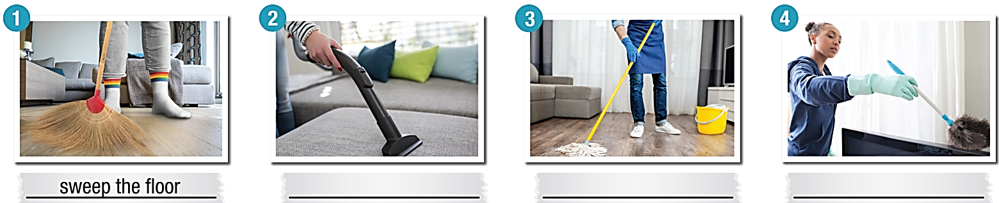
sweep the floor
vacuum the sofa
_______________________
Notes:
Please, click on each phrase to hear the sound

Slide 9
mop the living room
dust the furniture
Notes:
Please, click on each phrase to hear the sound

Slide 10

tidy my room
put away the clothes

Slide 11
wash/do the dishes
clean the bathroom

Slide 12



Slide 13



How often do you vacuum the living room floor?


Slide 14
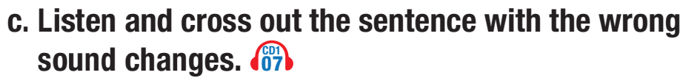


1. How often does he tidy his bedroom?
2. How often do you dust the furniture?


Wrong. Because there is no connected speech.

Slide 15

How often do you vacuum the living room floor?

How often does he tidy his bedroom?
How often do you dust the furniture?



Slide 16
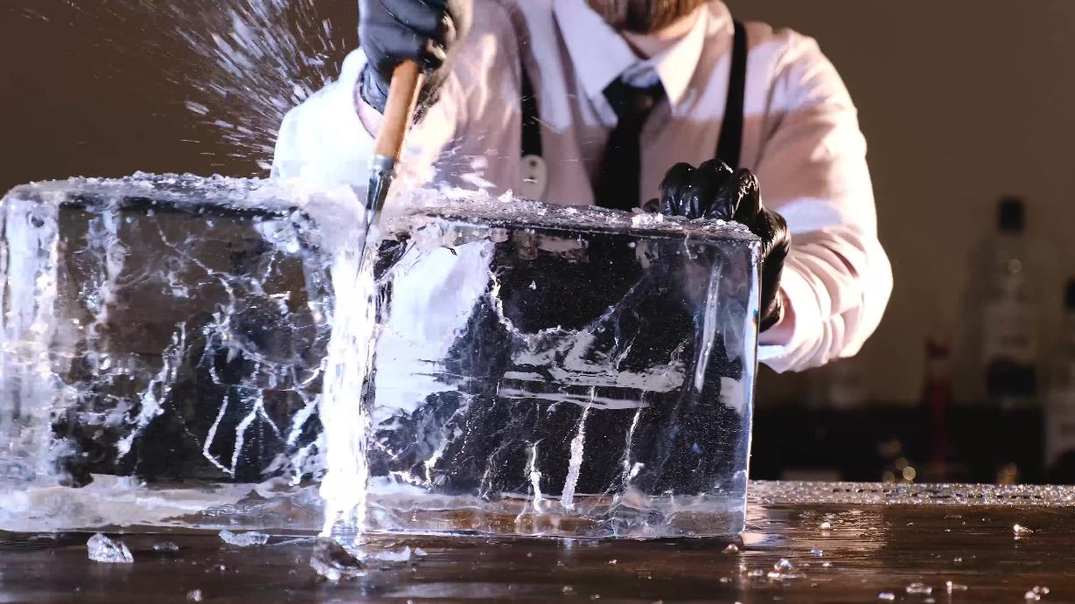


Slide 17




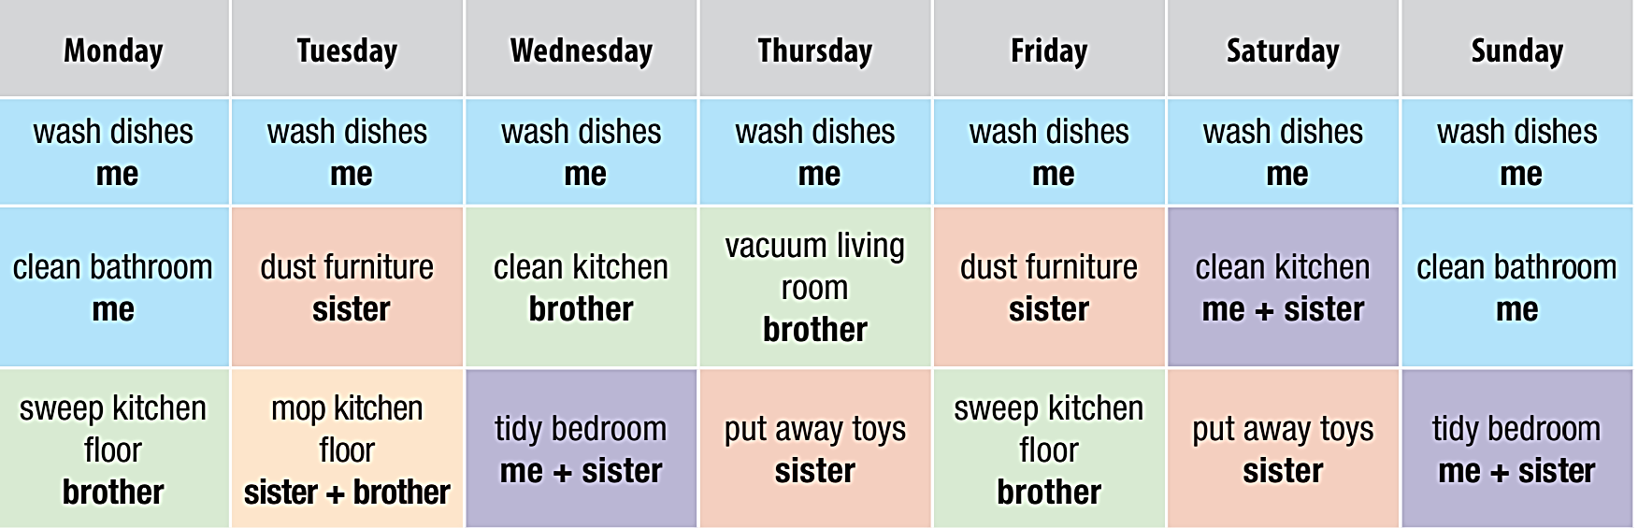
Use the table below to ask your partner what chores they or their family members do, then ask how often they do them. Swap roles and repeat.

Slide 18


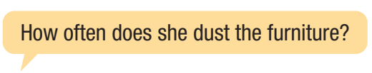
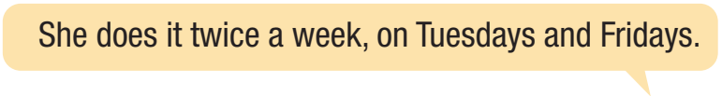


Slide 19



Slide 20

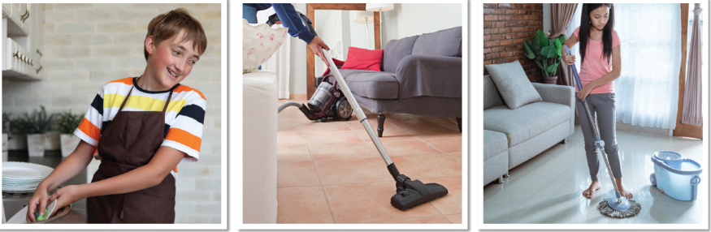
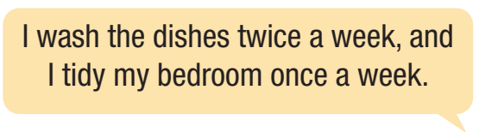

a. You are talking to a friend about who does the chores in your house. Look at the list of chores and think about who does each and how often. In pairs: Ask your partner about the chores in their house.
mop the bathroom
sweep the kitchen
dust the furniture
tidy the bedroom
put clothes away
wash the dishes
vacuum the living room

Slide 21

vacuum the living room
mop the bathroom
sweep the kitchen
dust the furniture
tidy the bedroom
put clothes away
wash the dishes

Slide 22



Slide 23

Consolidation

Slide 24
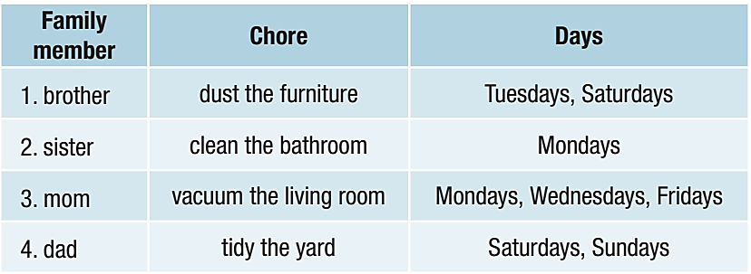
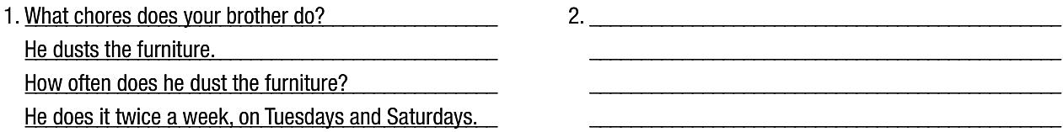

Slide 25
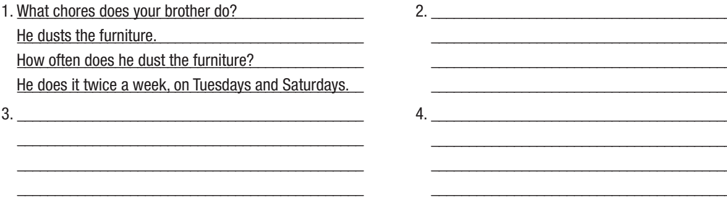

Slide 26
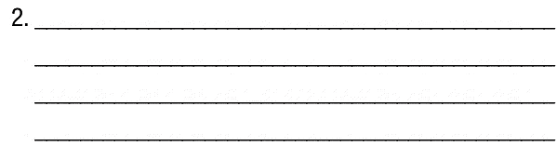
What chores does your sister do?
She cleans the bathroom.
How often does she clean the bathroom?
She does it once a week, on Mondays.

Slide 27
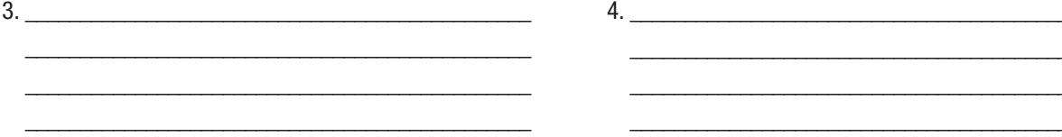
What chores does your mom do?
What chores does your dad do?
She vacuums the living room.
He tidies the yard.
How often does she vacuum the living room?
How often does he tidy the yard?
She does it 3 times a week, on Mondays, Wednesdays, and Fridays.
He does it twice a week, on the weekends.

Slide 28
Today’s lesson
Wrap-up
Pronunciation: sound changes “How often”.
Speaking: doing household chores.
Writing: questions and answers about household chores.

Slide 29
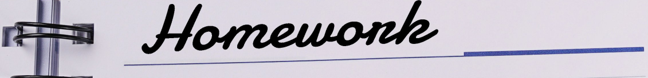
Review the vocabulary and grammar points in Tiếng Anh 10 i-Learn Smart World Notebook on pages 2 & 3
Prepare the next lesson on page 7, SB.
Play the consolidation games in Tiếng Anh 10 i-Learn Smart World DHA App on www.eduhome.com.vn

Slide 30

Have a nice day!

