Slide 1

Unit 2: Family
Lesson 1.2
Page 25

Slide 2
Lesson Outline
Warm-up
Listening
Consolidation
Wrap-up

Slide 3
Objectives
By the end of this lesson, students will be able to introduce family members.
Phonics: /ʌ/
Structure: This is my (father).
Hello, I’m Alfie.
Hello Alfie.

Slide 4

WARM UP

Slide 5




How to play?
Read the questions
Look at the pictures
Click to choose the correct answers
FAMILY GAME

Slide 6




Who is this?
mother
father
brother

Slide 7

Who is this?
sister
mother
brother

Slide 8

Who is this?
father
mother
brother

Slide 9

Who is this?
father
sister
brother

Slide 10

It’s time to learn …

Slide 11

Presentation

Slide 12
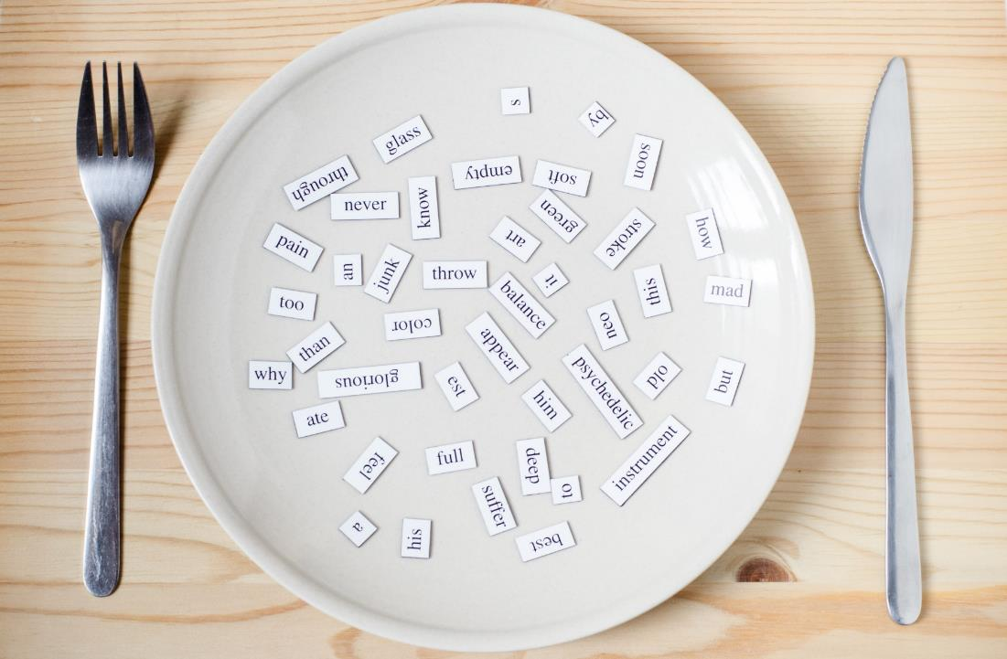
Phonics
/ʌ/

Slide 13
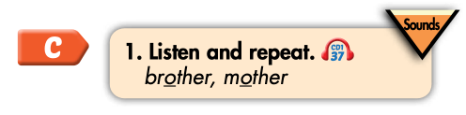

Click on the icon to hear the sound
brother
mother
/ʌ/
/ʌ/

Slide 14

Practice

Slide 15
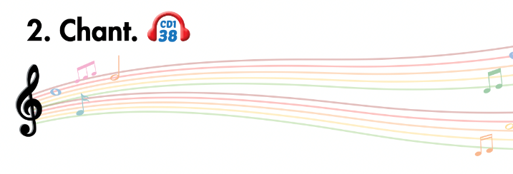
Listen and point
Listen and clap
Listen and chant

Slide 16
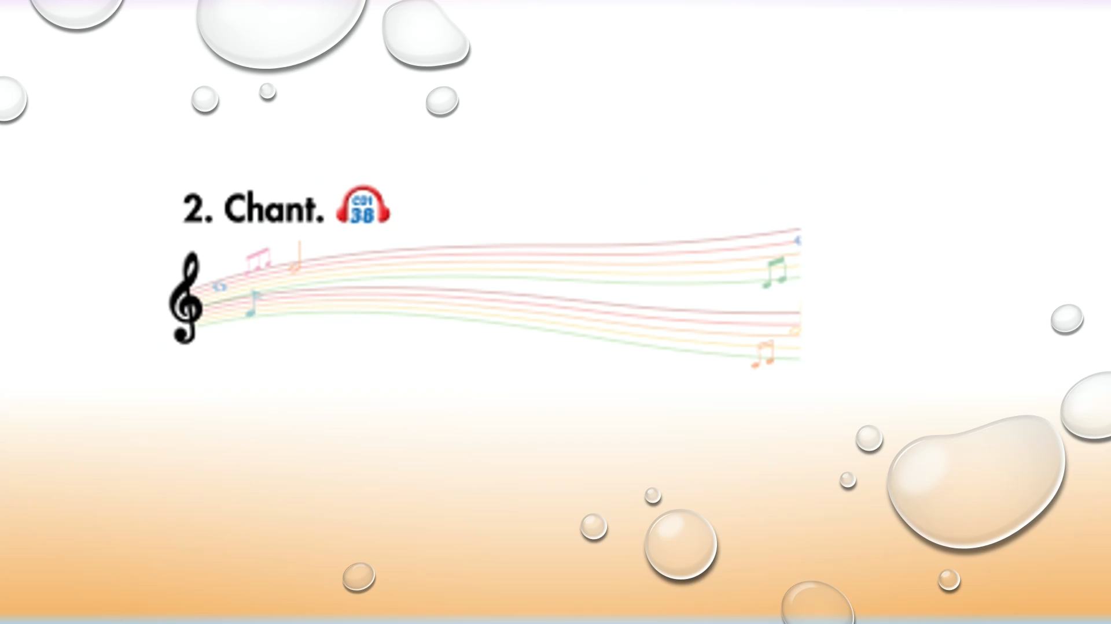

Slide 17

Listening

Slide 18
Pre-Listening
Look at the pictures and answer these questions.

Slide 19
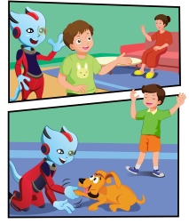
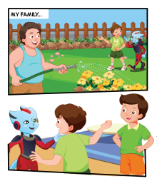
Does Alfie know Tom’s family?
Who can you see?
Where are they?
3.
1.
4.
2.

Slide 20

While-Listening
3.
1.
4.
2.

Slide 21

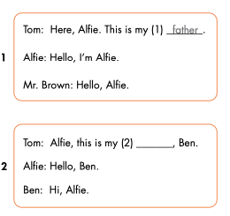
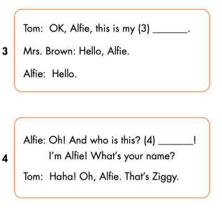

Slide 22
Let’s check!
Tom: Alfie, this is my (2)________, Ben.
Alfie: Hello, Ben.
Ben: Hi, Alfie.
brother

Slide 23
Tom: OK, Alfie, this is my (3)________.
Mrs. Brown: Hello, Alfie.
Alfie : Hello.
mother

Slide 24
Alfie: Oh! And who is this? (4)_______!
Tom: Haha! Oh, Alfie. That’s Ziggy.
Hello

Slide 25

Speaking

Slide 26
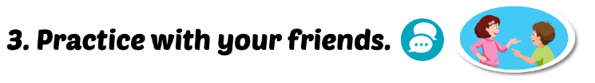
mother
brother
Hello

Slide 27

CONSOLIDATION

Slide 28
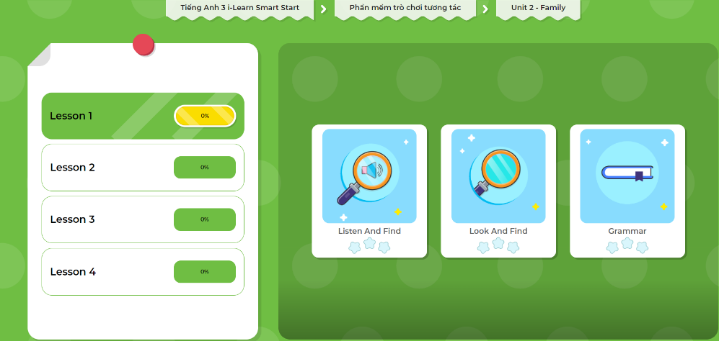
Extra Practice
DHA App
Let’s play!
Click on the picture below

Slide 29

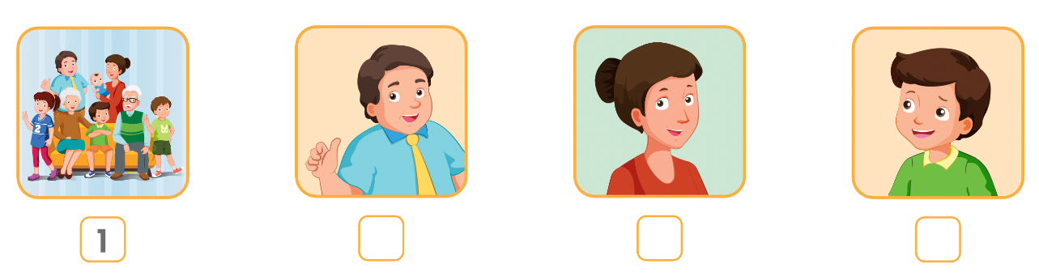
Extra Practice
WB p. 19
Click on the icon to hear the sound
4
2
3

Slide 30

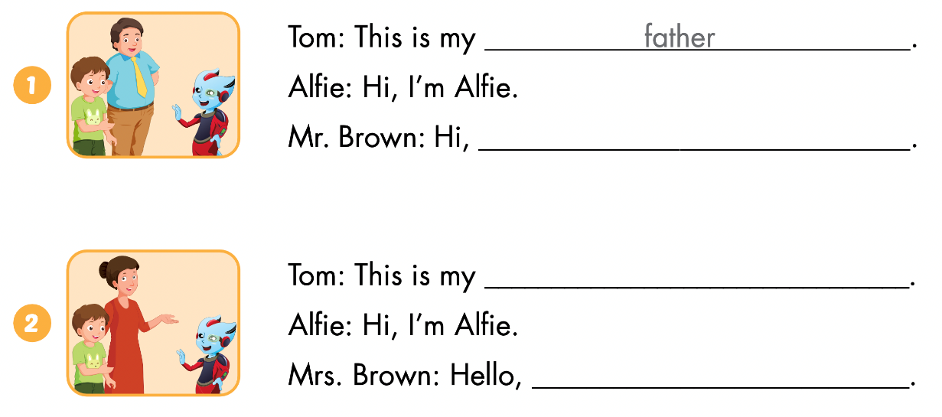
Alfie
mother
Alfie

Slide 31
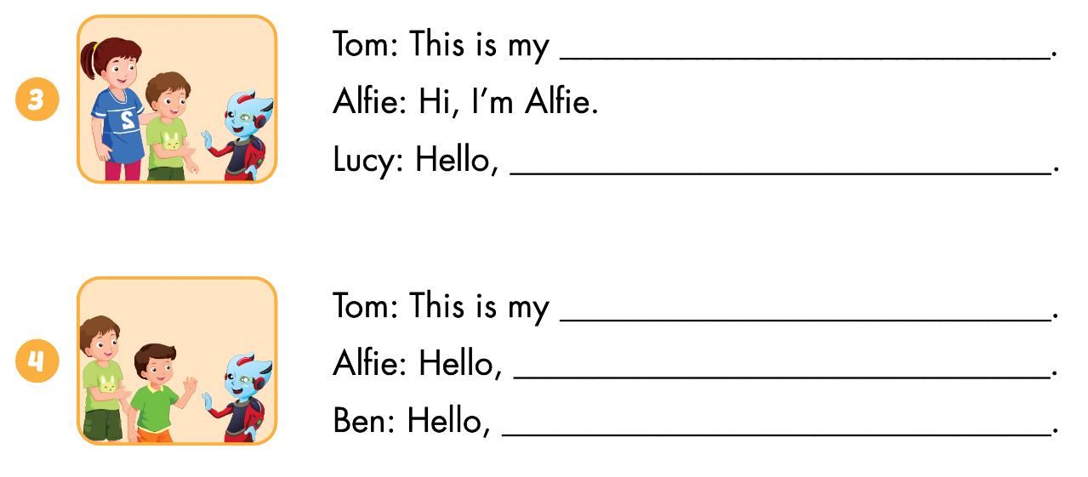
sister
Alfie
brother
Ben
Alfie

Slide 32

Let’s draw.
Draw your family
Work in pairs
Tell your partner about your family

Slide 33

WRAP-UP

Slide 34
Lesson 3
Today’s lesson
Phonics
/ʌ/
Structures/ Sentence patterns
This is my (father).
Hello, I’m Alfie.
Hello Alfie.

Slide 35
Lesson 3
Homework
Learn by hearts vocabularies and make sentences using them.
Do the exercises on page 19 WB
Do the exercises in Tiếng Anh 3 i-Learn Smart Start Notebook on page 17
Prepare the next lesson (page 26 SB)
Play the consolidation games in Tiếng Anh 3 i-Learn Smart Start DHA App on www.eduhome.com.vn

Slide 36

Lesson 3
Stay positive and have a nice day!

