Slide 1

Unit 5: London was Great!
Lesson 5f: Skills
Page 97

Slide 2
Lesson Outline
Warm-up
Speaking
Listening
Writing
Consolidation
Wrap-up

Slide 3
Objectives
By the end of this lesson, students will be able to…
- learn and practise collocations.
- listen for specific information.
- write a letter describing an experience.

Slide 4

WARM-UP

Slide 5
Choose the word that has stress pattern different from that of the other words:
a. relaxing b. transport c. scientist d. island
a. barbeque b. picnic c. actress d. informative
a. tiring b. winter c. arrive d. trainer
a. bottom b. museum c. physicist d. painter
a. interactive b. exciting c. expensive d. ingredient
a. charity b. wizard c. canteen d. stateswoman

Slide 6
1. a. relaxing b. transport c. scientist d. island
/rɪˈlæksɪŋ/ /ˈtrænspɔːt/ /ˈsaɪəntɪst/ /ˈaɪlənd/
2. a. barbecue b. picnic c. actress d. informative
/ˈbɑːbɪkjuː/ /ˈpɪknɪk/ /ˈæktrəs/ /ɪnˈfɔːmətɪv/
3. a. tiring b. winter c. arrive d. trainer
/ˈtaɪərɪŋ/ /ˈwɪntə/ /əˈraɪv/ /ˈtreɪnə/

Slide 7
4. a. bottom b. museum c. physicist d. painter
/ˈbɒtəm/ /mjuˈziːəm/ /ˈfɪzɪsɪst/ /ˈpeɪntə/
5. a. interactive b. exciting c. expensive d. ingredient
/ˌɪntəˈræktɪv/ /ɪkˈsaɪtɪŋ/ /ɪkˈspensɪv/ /ɪnˈɡriːdiənt/
6. a. charity b. wizard c. canteen d. stateswoman
/ˈtʃærəti/ /ˈwɪzəd/ /kænˈtiːn/ /ˈsteɪtˌswʊmən/

Slide 8

It’s time to learn …

Slide 9

Speaking

Slide 10
Pre-speaking
Match the verbs with the correct noun phrase.
go
photos
take
on holiday
a phone call
study
do
homework
make
for an exam
Collocation: words that usually go together.

Slide 11
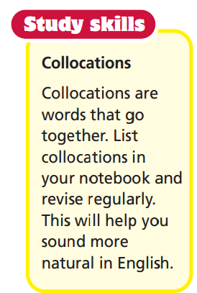

Slide 12
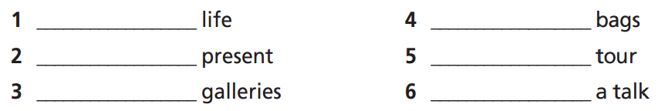
real
sleeping
birthday
guided
main
give

Slide 13
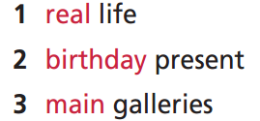
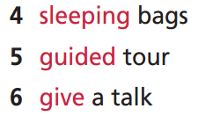
Use the collocations to make sentences based on the text p. 96
1. I can’t believe you can spend the night in a
museum in real life!
2. Spending the night in the Natural History
Museum was a great birthday present.
3. There’s a Brontosaurus in one of the main
galleries.
4. We slept in sleeping bags.
5. People learn more on a guided tour of the
museum.
6. A scientist gave a talk on dinosaurs.

Slide 14
Work in pairs. Ask and answer the following questions:
What is an event from movies that you want to see in real life?
What is your greatest birthday present?
When can you use a sleeping bag?
Where do you want to take a guided tour?
Do you ever give a talk in class?

Slide 15

Listening

Slide 16
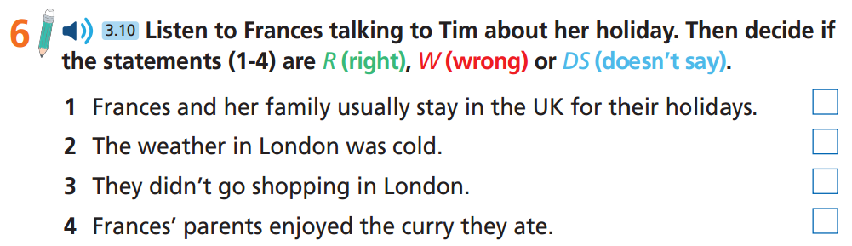
Pre-listening
Underline the key words

Slide 17

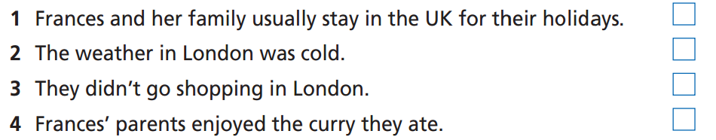
While-listening
Now listen and decide if the statements (1-4) are R (Right), W (Wrong) or DS (Doesn’t Say).  FIRST TIME

Slide 18

Now listen again and check.  SECOND TIME
While-Listening
Tim: I see you’re back from your holiday, Frances. How was it?
Frances: It was great! You know, we usually go abroad on holiday – to France or Italy,
☞ WHY IS THIS ANSWER?

Slide 19

Now listen again and check.  SECOND TIME
While-Listening
Tim: What was the weather like?
Frances: In the week before we went, it was nice and sunny. But on our first day in London, the weather changed and it was really cloudy. The good thing was that it wasn’t cold.
☞ WHY IS THIS ANSWER?

Slide 20

Now listen again and check.  SECOND TIME
While-Listening
There was so much to see that we didn’t have time to go shopping. It wasn’t a relaxing holiday at all!
☞ WHY IS THIS ANSWER?

Slide 21

Now listen again and check.  SECOND TIME
While-Listening
No information about like or not
My mum and dad had a curry one day. I tried some of it, but I didn’t really like it. It was too hot for me!
☞ WHY IS THIS ANSWER?

Slide 22
Extra listening
Listen again and choose the best answer.
1. Where did Frances and her family visit this year?
Italy B. France C. London
2. How was the weather like on their first day?
cloudy B. sunny C. cold
Which one was NOT a place that they visited?
St Paul’s Cathedral
Buckingham Palace
Natural History Museum
4. Why didn’t Frances like the curry?
Because it was very expensive.
Because it was too hot.
Because it was not hot enough.

Slide 23
1. Where did Frances and her family visit this year?
Italy B. France C. London
Frances: It was great! You know, we usually go abroad on holiday – to France or Italy, but, this year, my parents decided to stay in the UK and visit London.

Slide 24
2. How was the weather like on their first day?
cloudy B. sunny C. cold
Frances: In the week before we went, it was nice and sunny. But on our first day in London, the weather changed and it was really cloudy. The good thing was that it wasn’t cold.

Slide 25
Which one was NOT a place that they visited?
St Paul’s Cathedral
Buckingham Palace
Natural History Museum
Frances: We saw all the sights like St Paul’s Cathedral, Buckingham Palace and the British Museum.

Slide 26
4. Why didn’t Frances like the curry?
Because it was very expensive.
Because it was too hot.
Because it was not hot enough.
My mum and dad had a curry one day. I tried some of it, but I didn’t really like it. It was too hot for me!

Slide 27
Tim: I see you’re back from your holiday, Frances. How was it?
Frances: It was great! You know, we usually go abroad on holiday – to France or Italy, but, this year, my parents decided to stay in the UK and visit London.
Tim: What was the weather like?
Frances: In the week before we went, it was nice and sunny. But on our first day in London, the weather changed and it was really cloudy. The good thing was that it wasn’t cold.
Tim: So what did you do there?
Frances: We saw all the sights like St Paul’s Cathedral, Buckingham Palace and the British
Museum. We went somewhere new every day. There was so much to see that we didn’t have time to go shopping. It wasn’t a relaxing holiday at all!
Tim: What was the food like? When I was in London, I had some great fish and chips.
Frances: I’m not a big fan of fish, but there was lots of good food. I had a pie every day. They were really tasty! My mum and dad had a curry one day. I tried some of it, but I didn’t really like it. It was too hot for me!

Slide 28
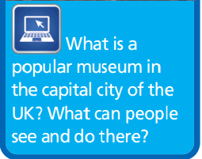
Post-listening
Work in pairs
The British Museum is a popular museum in London, UK. People can see objects from ancient Egypt,
Greece, Rome, and more. They can go on guided tours, eat at the museum café, and buy souvenirs at
the shop.

Slide 29

Writing

Slide 30
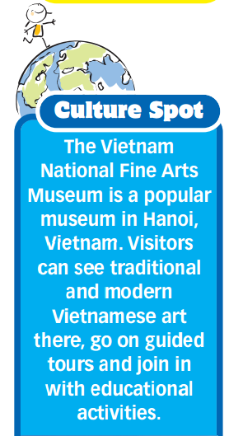
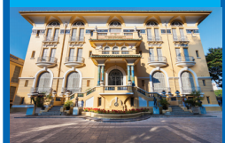

Slide 31
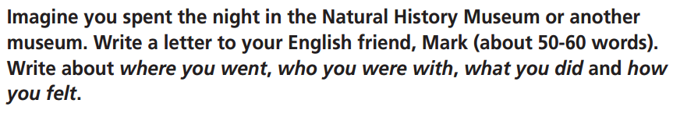
Underline the key words and answer the questions.
1. What are you going to write? To whom?
2. What are you going to write about?
3. How many words are you going to write?

Slide 32
1. What are you going to write? To whom?
Write a letter to Mark.
2. What are you going to write about?
Write about spending a night in the Natural History Museum.
3. How many words are you going to write?
50-60 words.

Slide 33
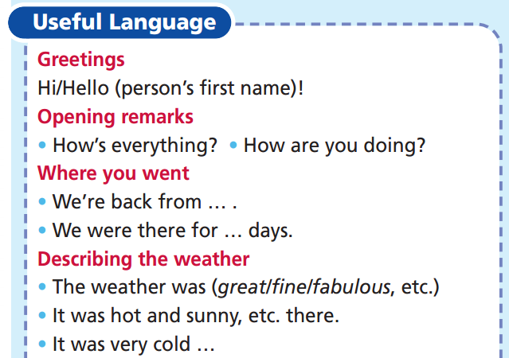
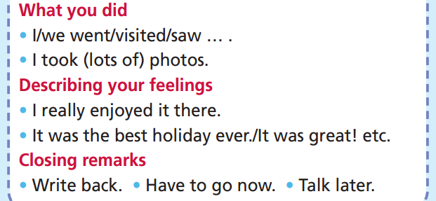
Pre-writing
Letter/Email writing

Slide 34
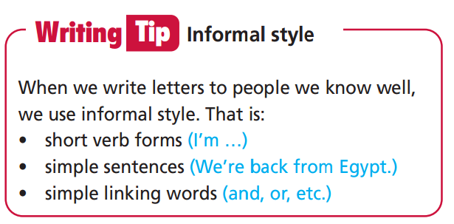

Slide 35
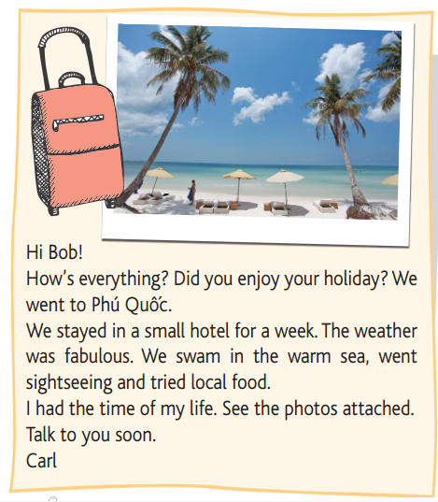

While-writing

Slide 36
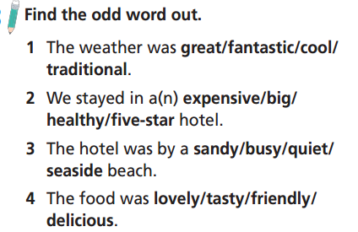
While-writing

Slide 37
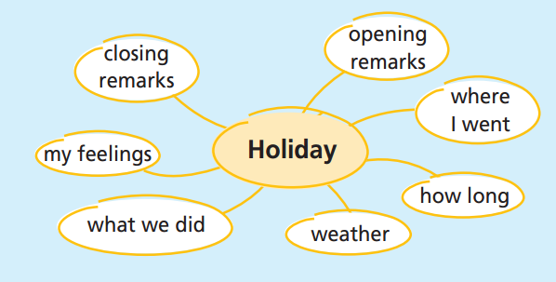
While-writing
Complete the spidergram with
information about your last holiday.

Slide 38
Write your letter. Use your ideas from Spidergram and
phrases from the Useful Language box.
Hi Mark!
How are you? Last night, I spent the night at the Natural History Museum in London! I was with my friend Nadia and lots of other children. First, there was a guided tour of the museum. Then, we made T-shirts and learned about dinosaurs. We slept in one of the main galleries. It was one of the best nights of my life!
Write soon.
Natasha

Slide 39

CONSOLIDATION

Slide 40
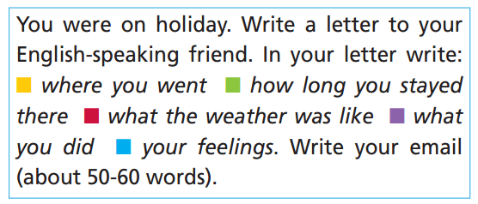

Slide 41

WRAP-UP

Slide 42
Today’s lesson
Listening
Listen for specific information.
Speaking
Learn and practise collocations.
Writing
Write a letter describing an experience.

Slide 43
Homework
Practise the vocabularies and make sentences using them.
Do the exercises in TA 6 Right on Notebook (p. 41).
Prepare the next lesson (p. 98 SB).
Do Unit 5 Test 1 in Bài Tập Bổ Trợ TA 6 Right on (pp. 44-45).

Slide 44
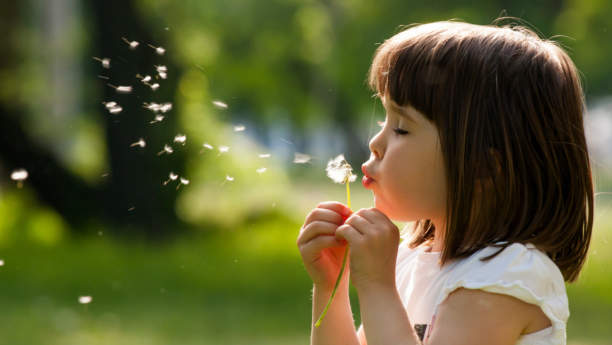
Enjoy your day!

