Slide 1
Click on each verb to see an action.
walk
wake
talk
think
win
swim
throw
wait
watch
read
give
cuddle
sleep
wash
run
pull
open
work
ride
hug
pick
jump
drop
fly
fight
stand
push
cut
feed
play
dance
sit
dream
eat
dig
cry
laugh
caress
climb
close
cook
drink
write
listen
clap
Action Verbs
Pictionary
crawl
build
sing

Slide 2
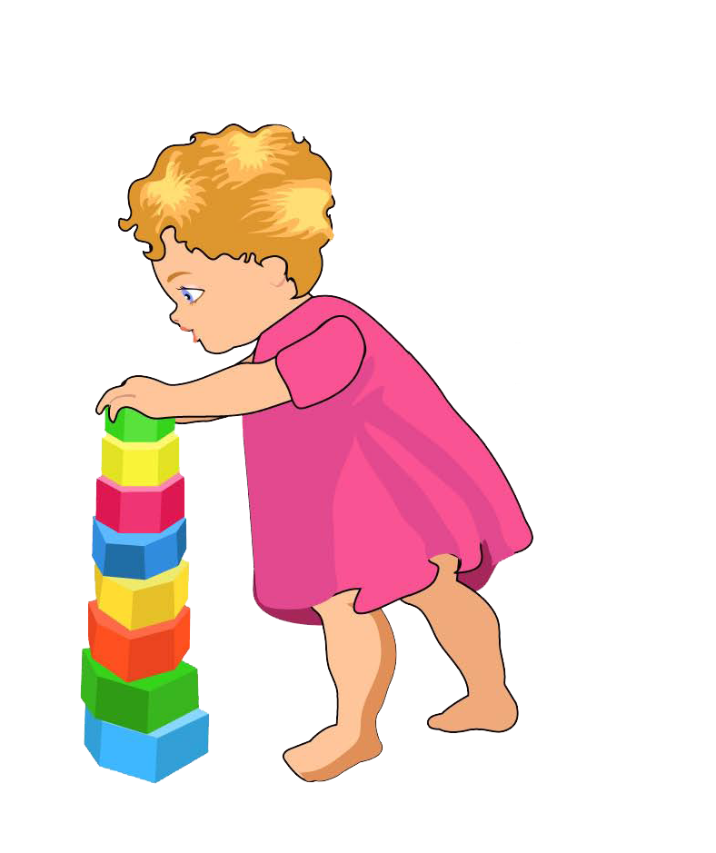
build

Slide 3
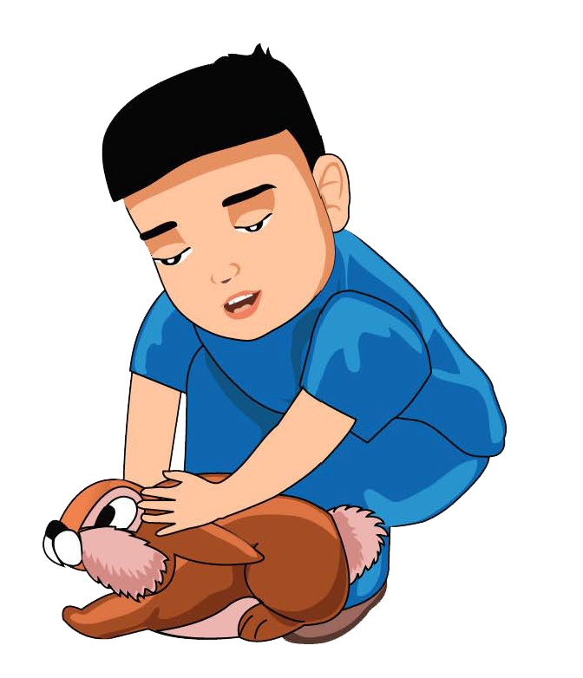
caress

Slide 4
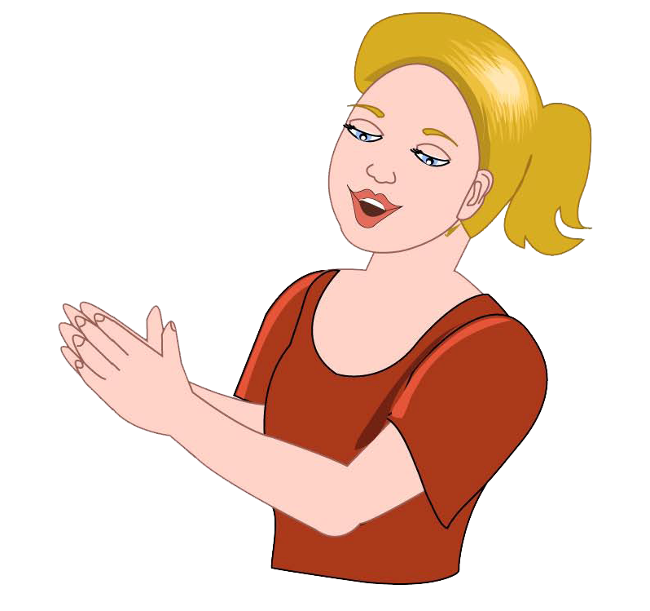
clap

Slide 5
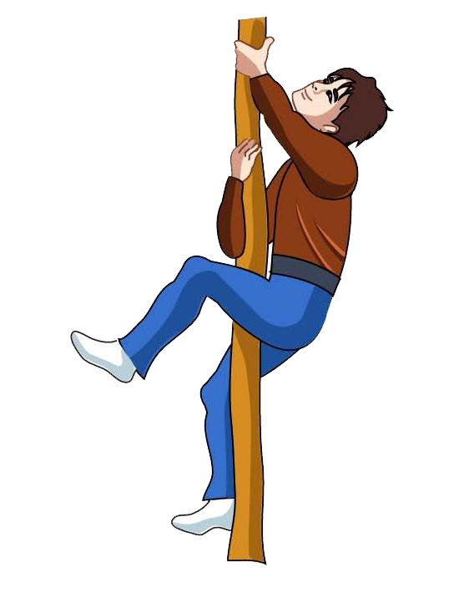
climb

Slide 6
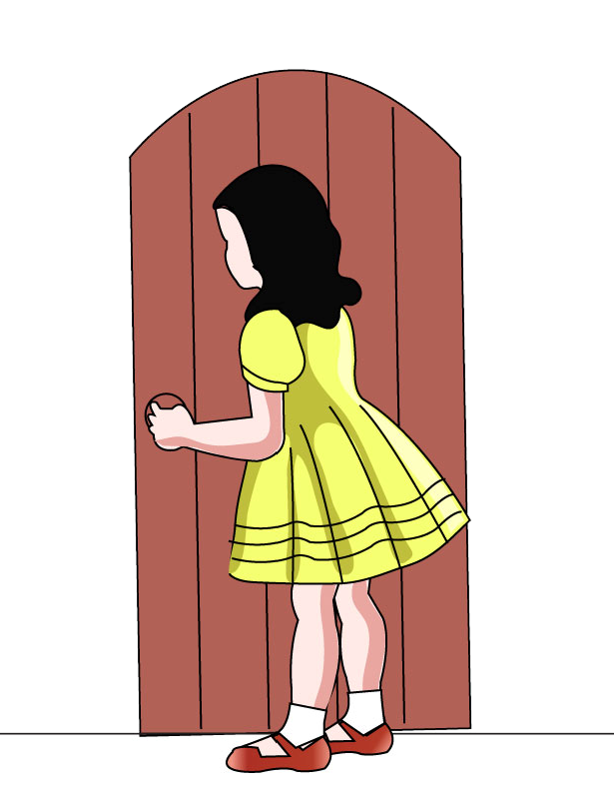
close

Slide 7
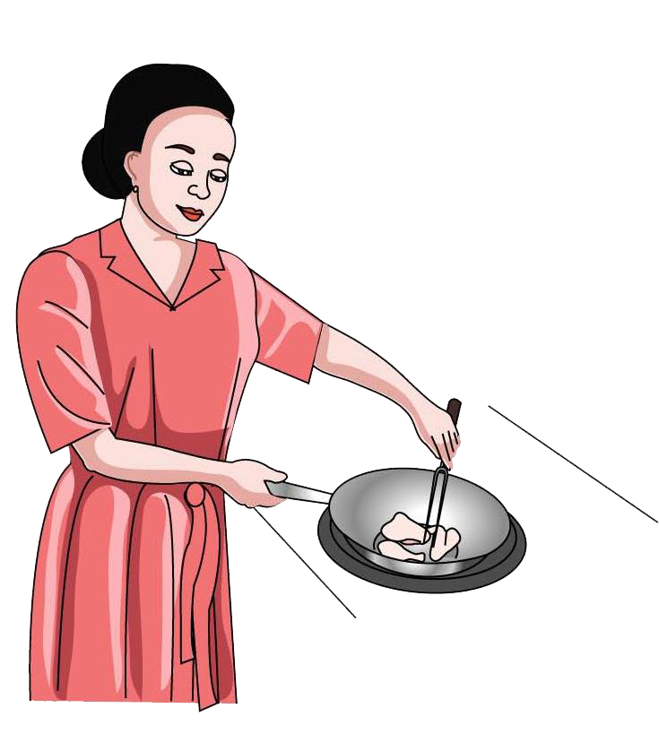
cook

Slide 8
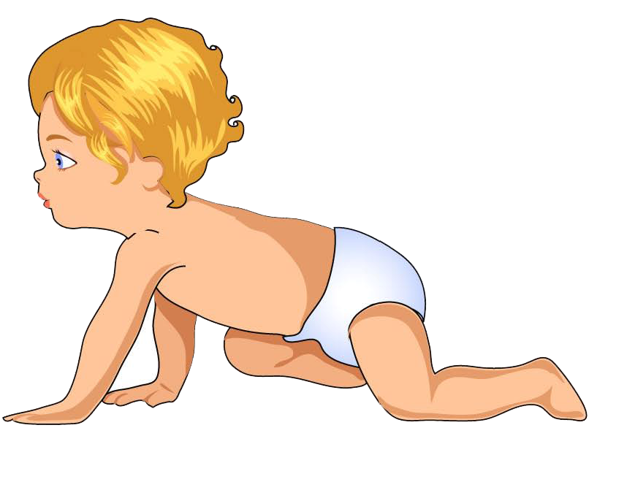
crawl

Slide 9
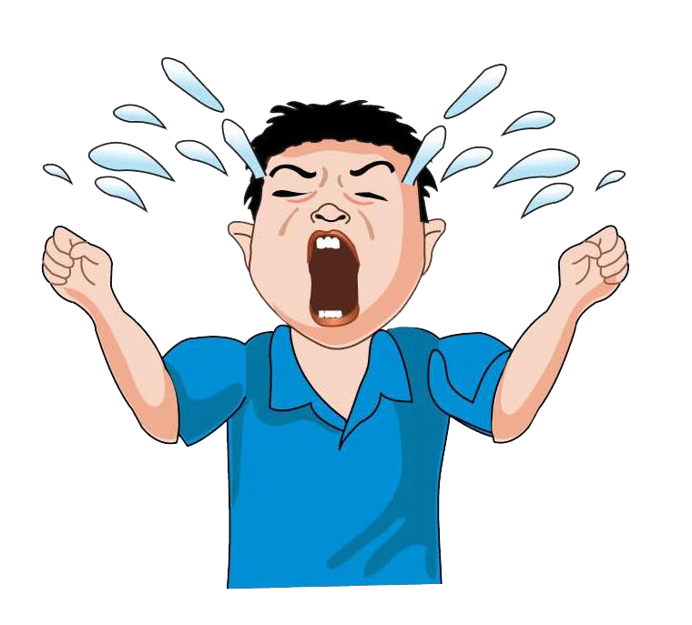
cry

Slide 10
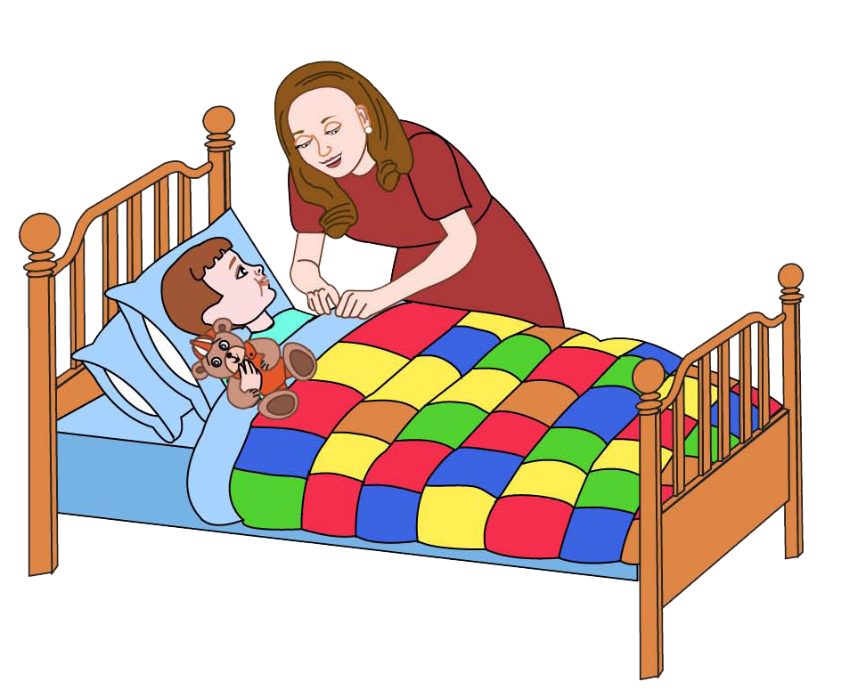
cuddle

Slide 11
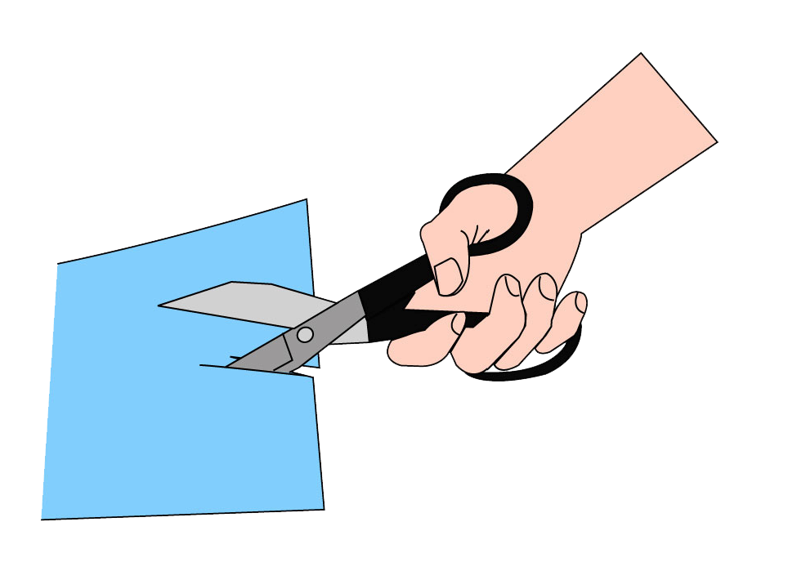
cut

Slide 12
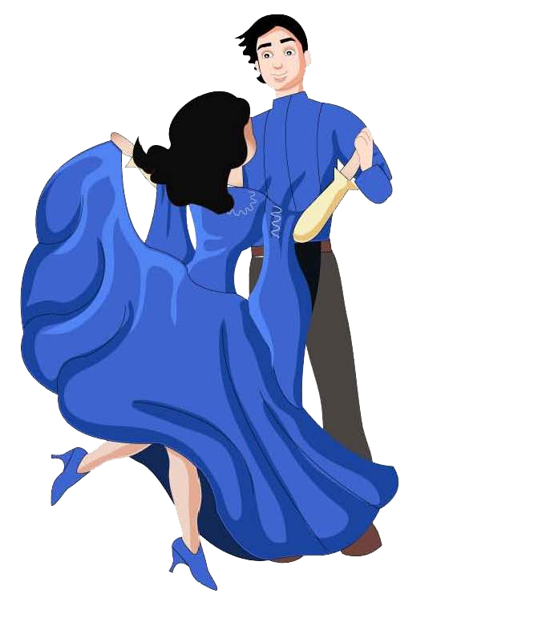
dance

Slide 13
dig

Slide 14
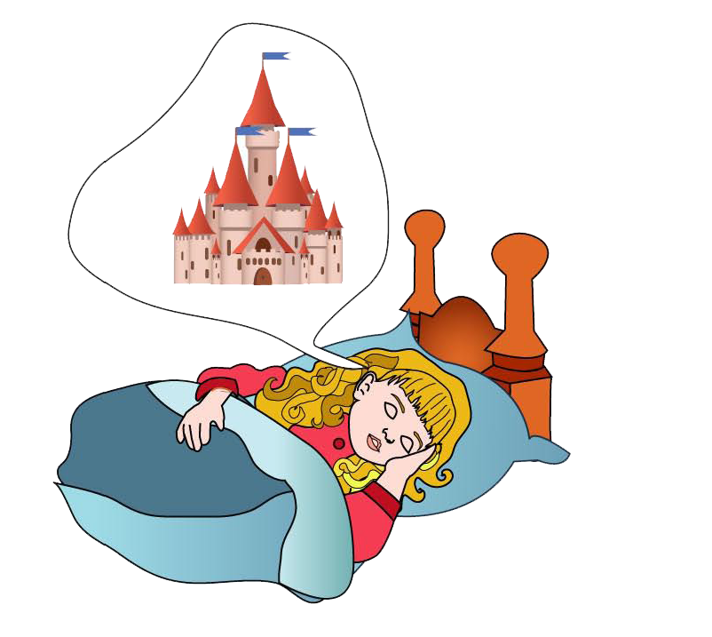
dream

Slide 15
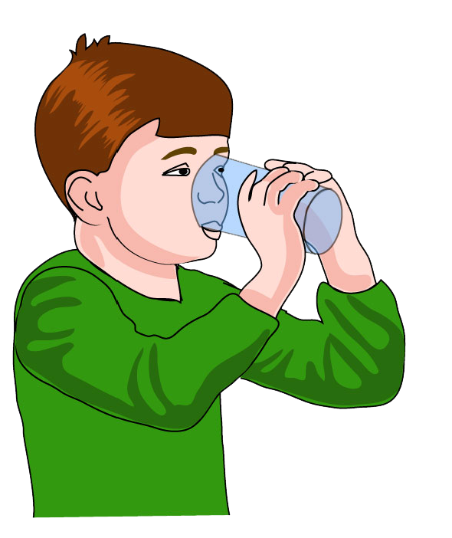
drink

Slide 16
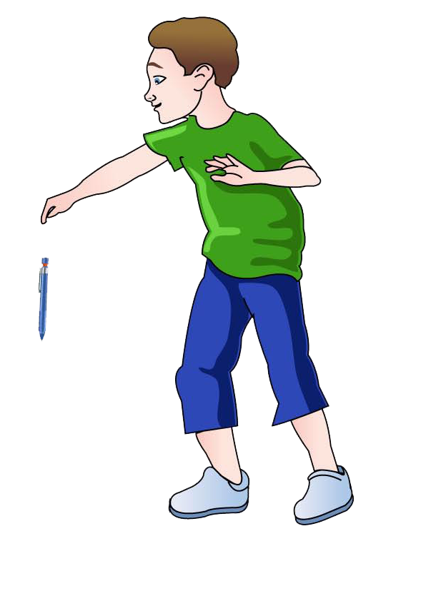
drop

Slide 17
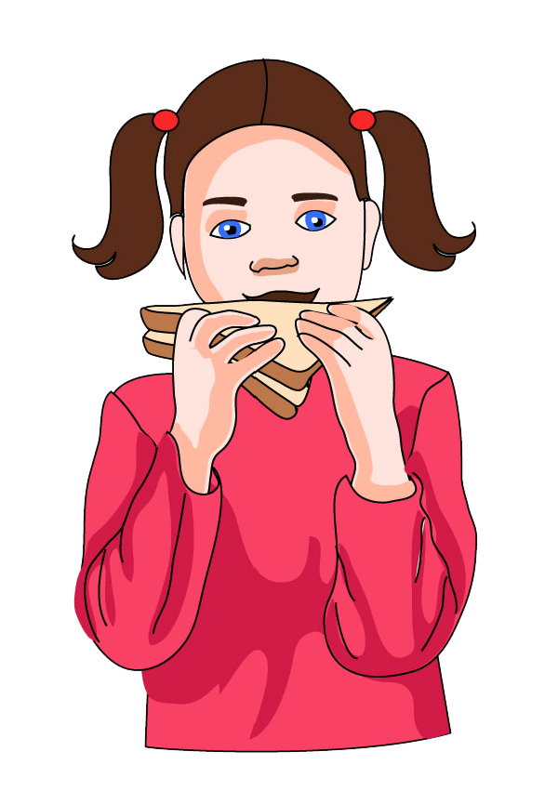
eat

Slide 18
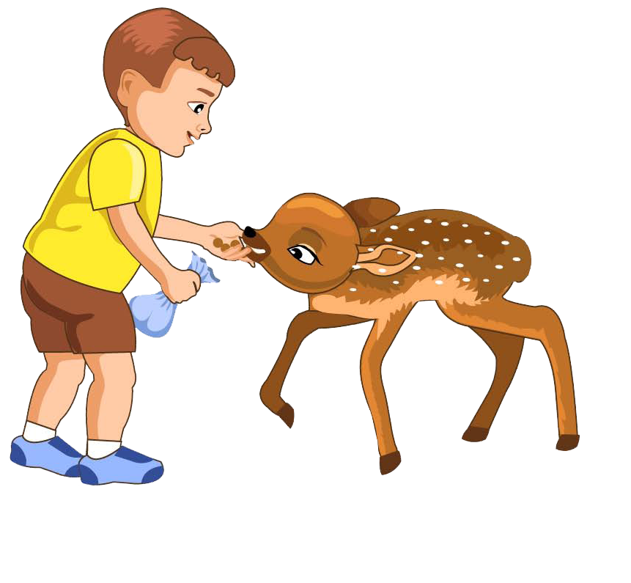
feed

Slide 19
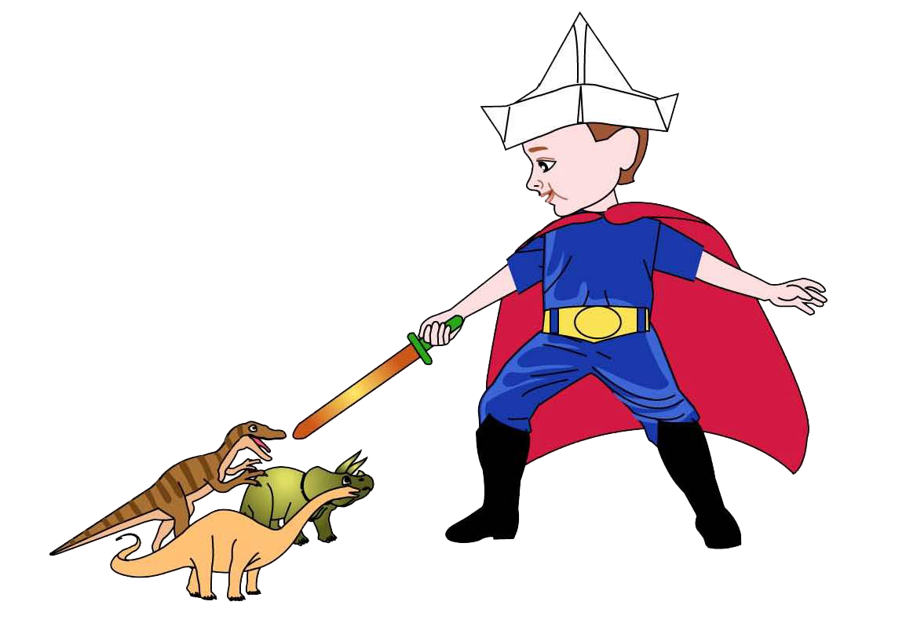
fight

Slide 20
fly

Slide 21
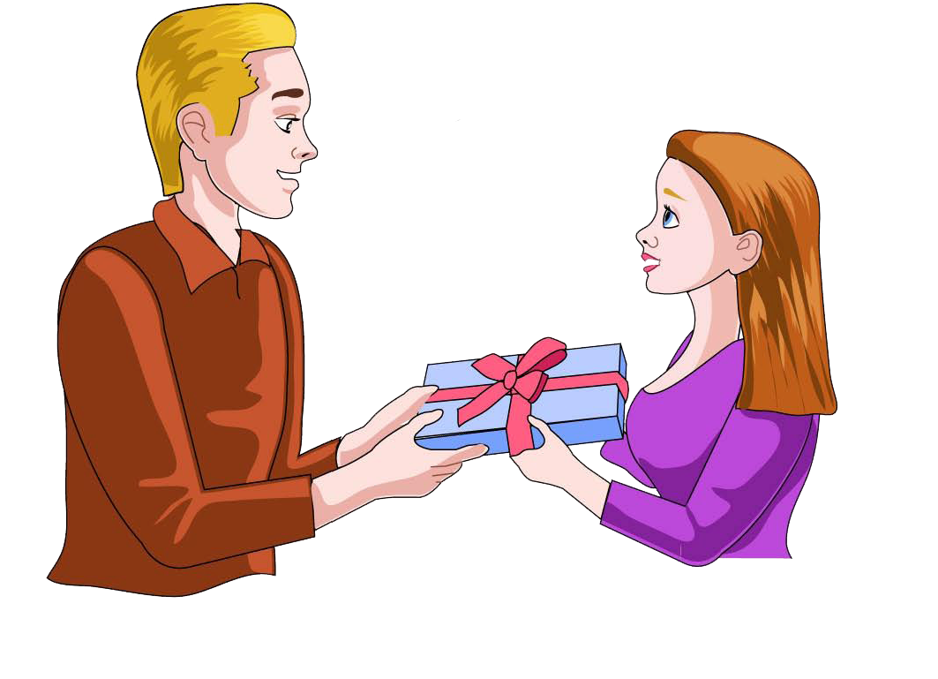
give

Slide 22
hug

Slide 23
jump

Slide 24
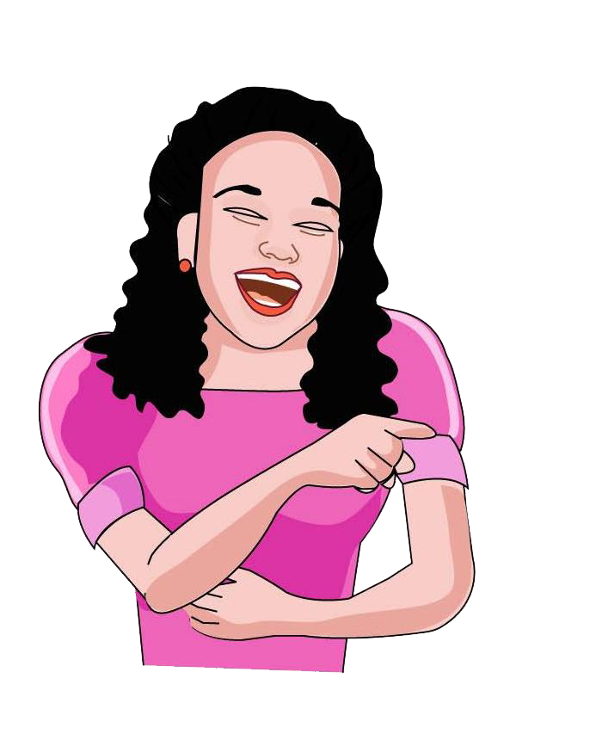
laugh

Slide 25
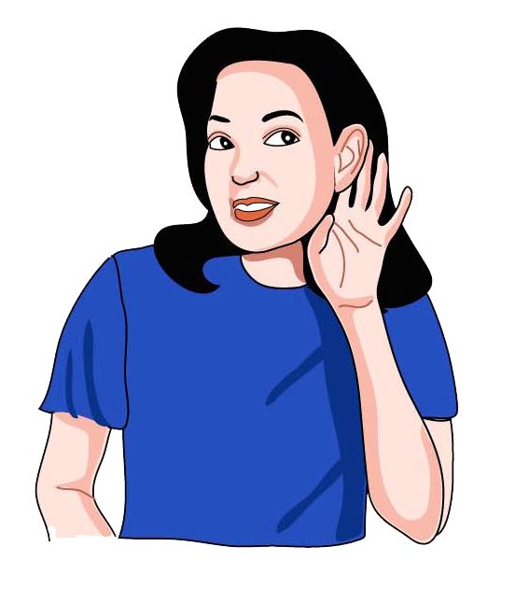
listen

Slide 26
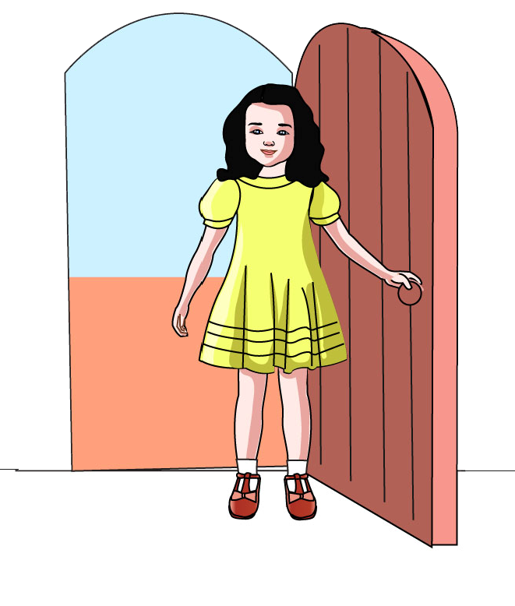
open

Slide 27
pick

Slide 28
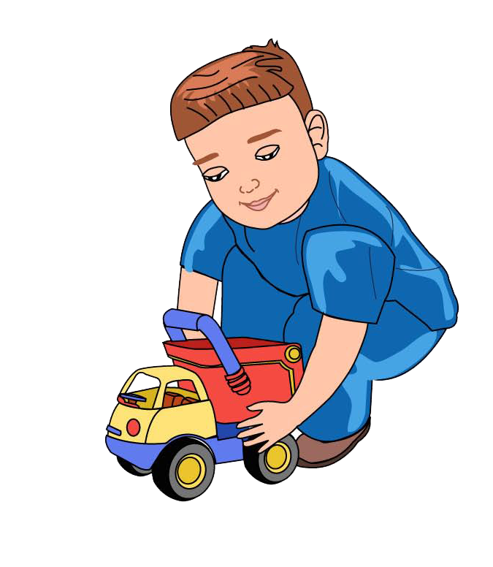
play

Slide 29
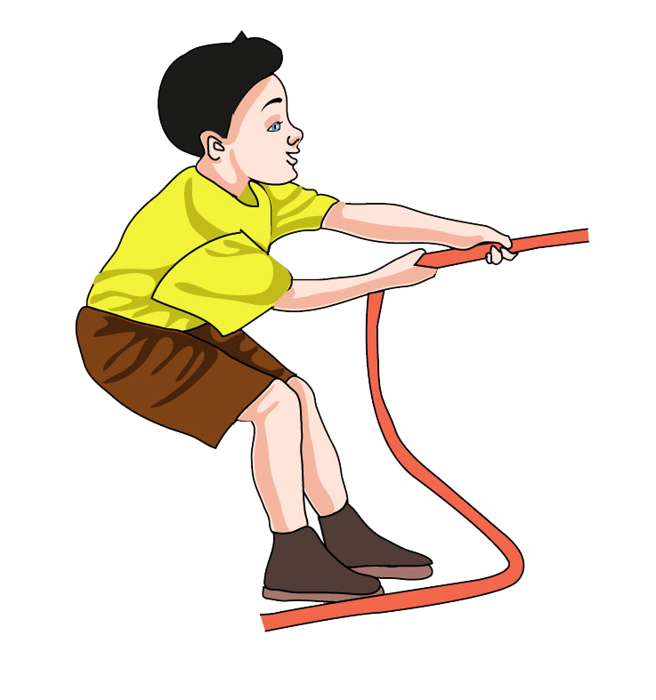
pull

Slide 30
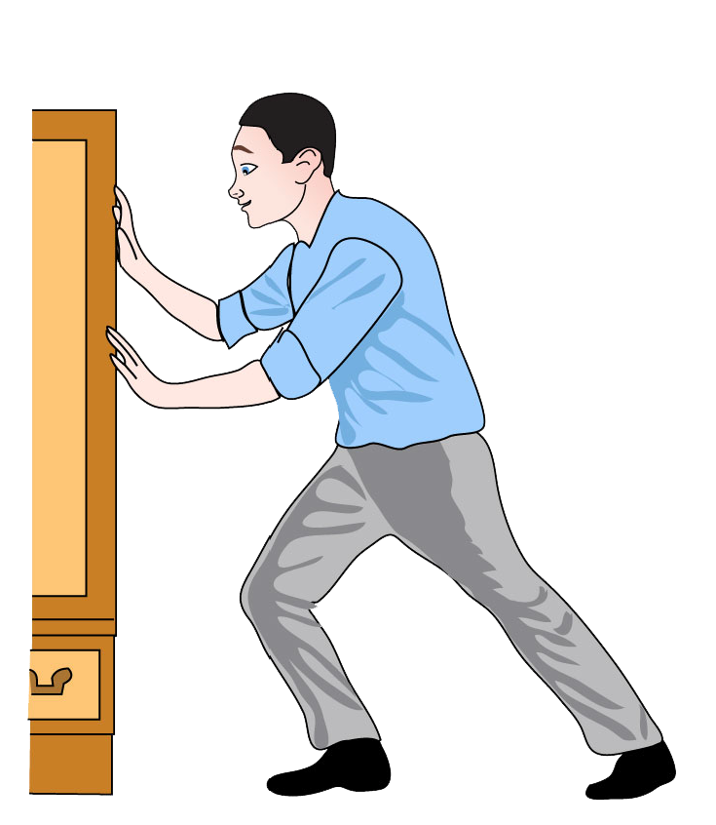
push

Slide 31
read
read

Slide 32
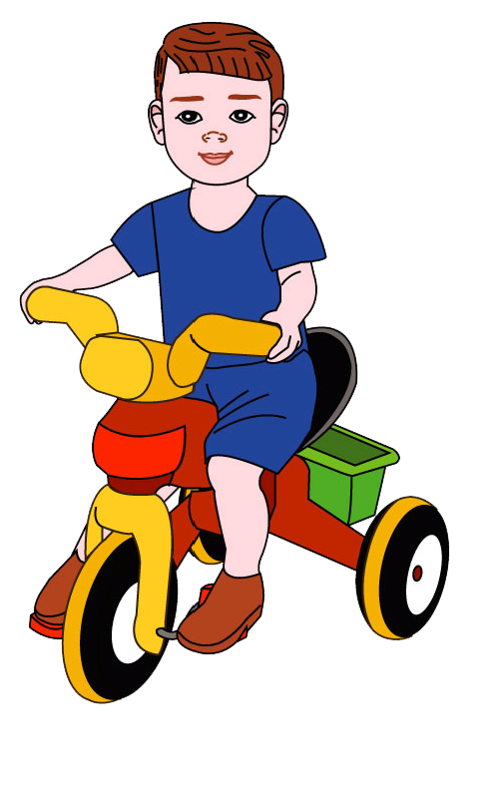
ride

Slide 33
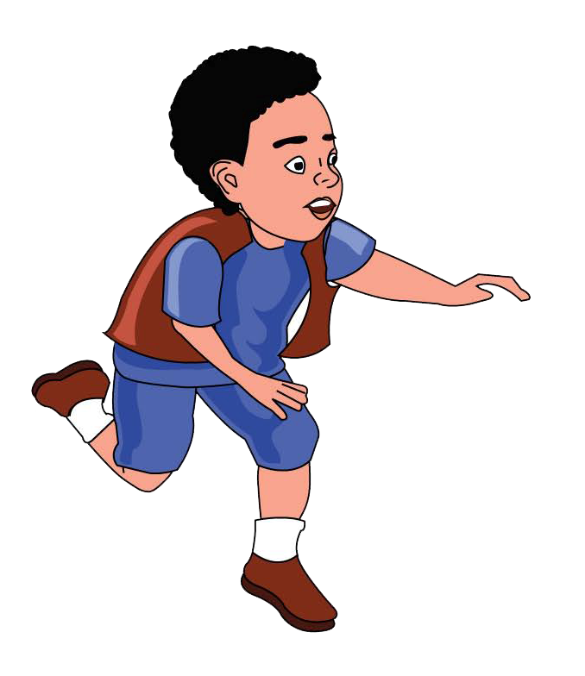
run

Slide 34
sing

Slide 35
sit

Slide 36
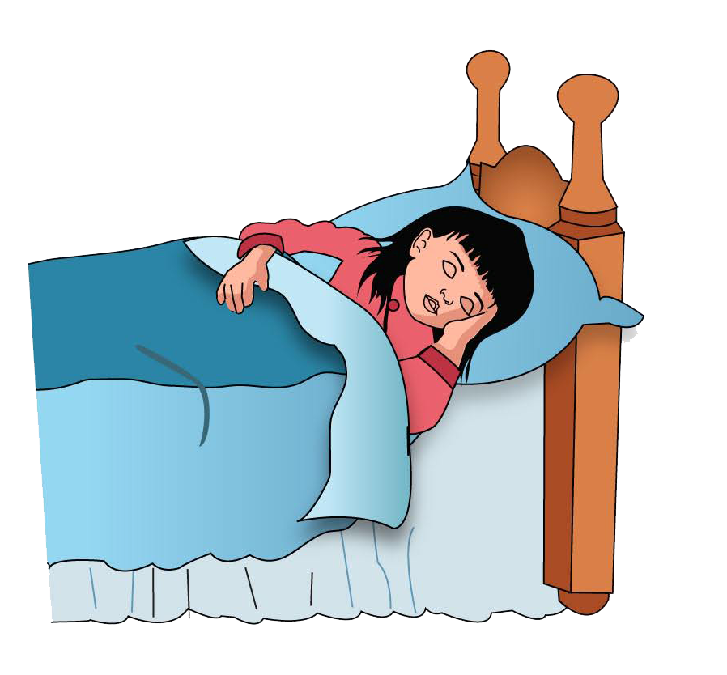
sleep

Slide 37
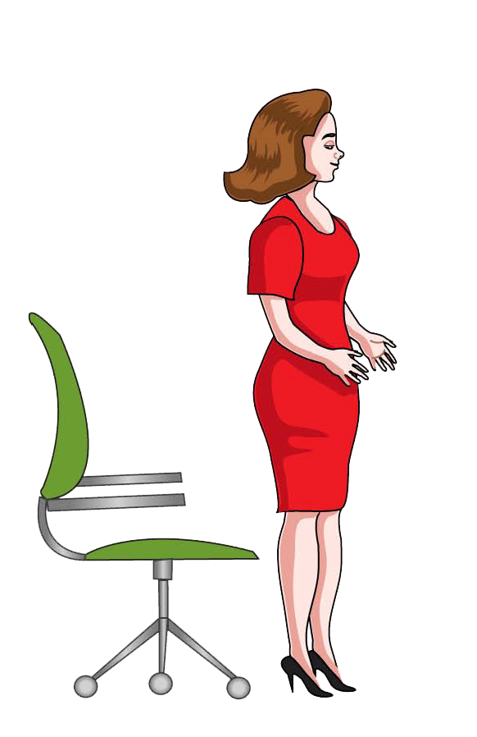
stand

Slide 38
swim

Slide 39
talk

Slide 40
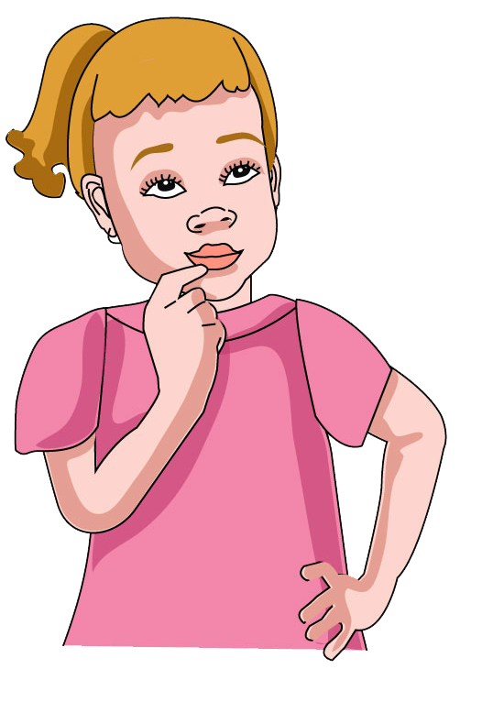
think

Slide 41
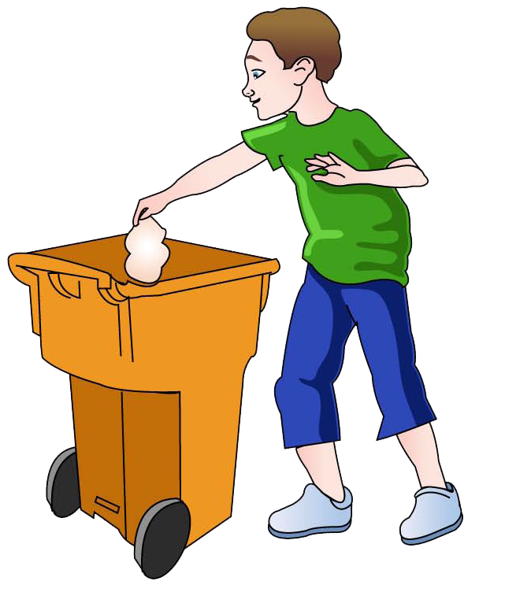
throw

Slide 42
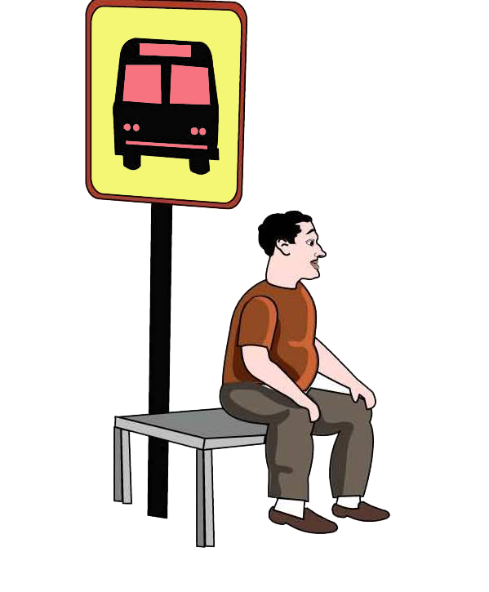
wait

Slide 43
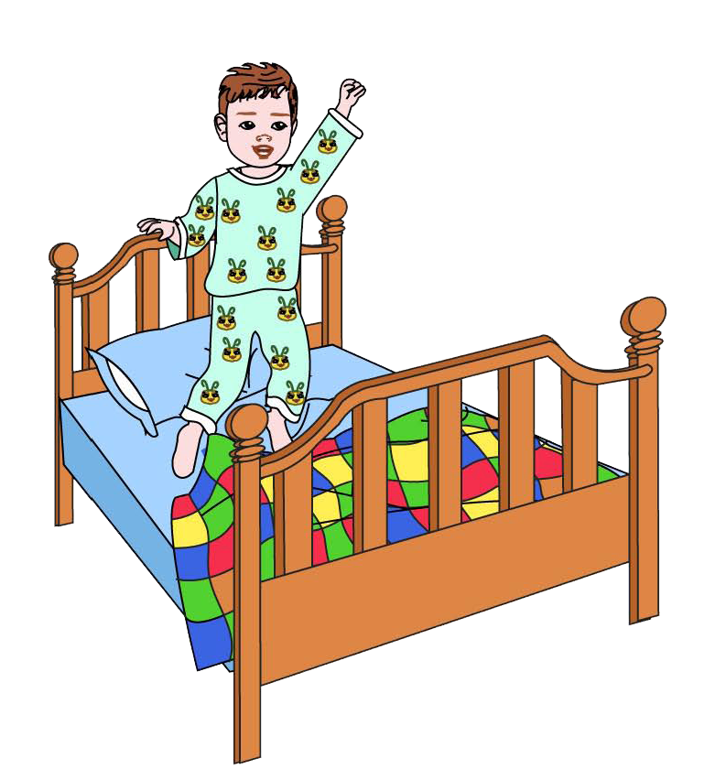
wake

Slide 44
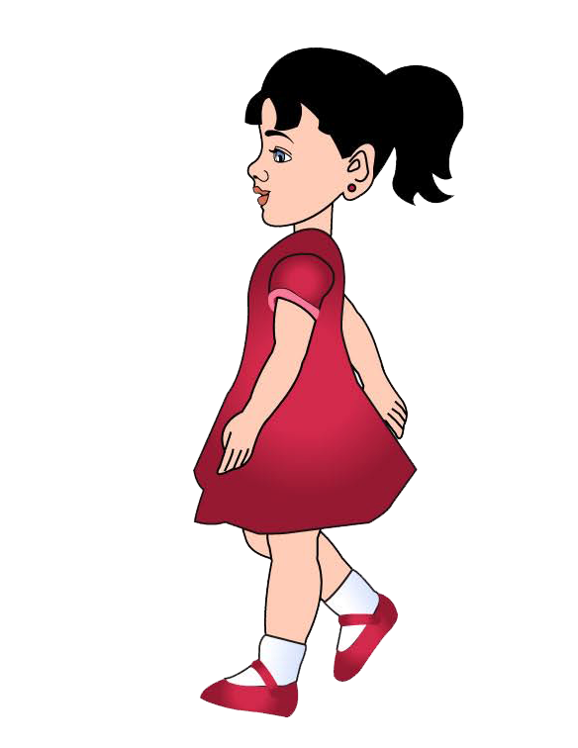
walk

Slide 45
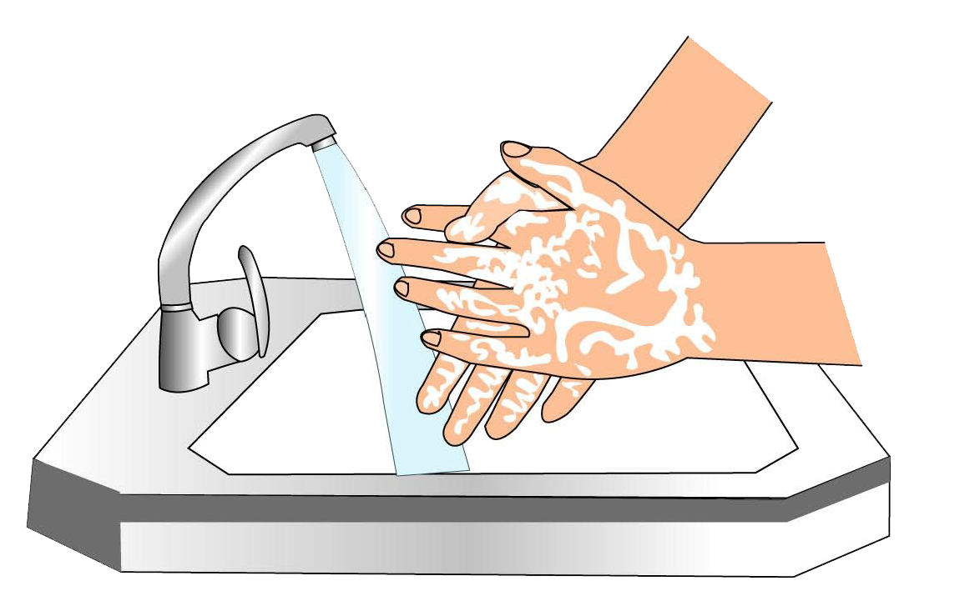
wash

Slide 46
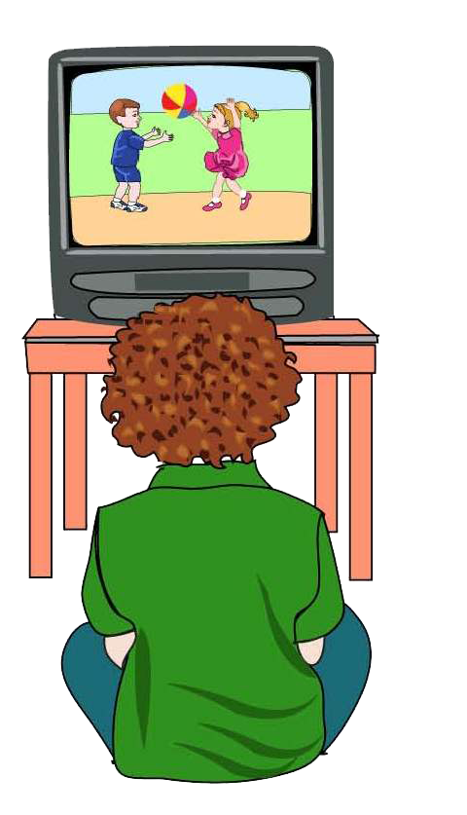
watch

Slide 47
write

Slide 48
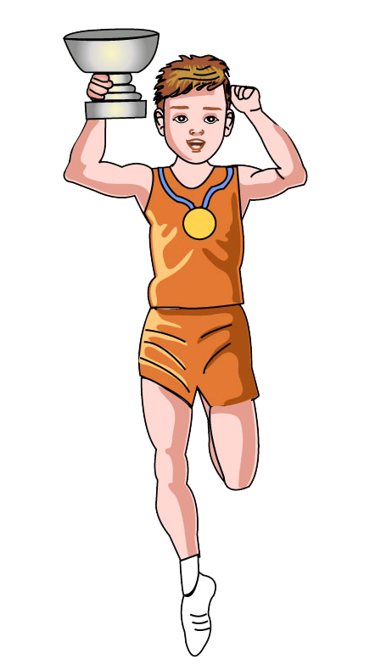
win

Slide 49
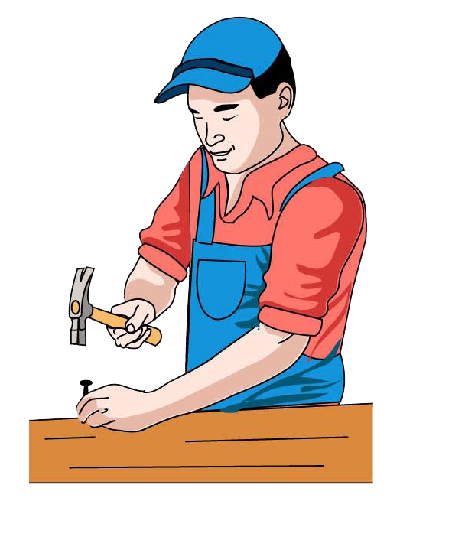
work

Slide 50
write

Slide 51
SƯU TẦM: ĐOÀN VĂN DOANH, NAM TRỰC, NAM ĐỊNH
LINK NHÓM DÀNH CHO GV BỘ MÔN VẬT LÝ TRAO ĐỔI TÀI LIỆU VÀ CHUYÊN MÔN CT 2018
https://www.facebook.com/groups/299257004355186

