Slide 1

Unit 4: All things high-tech
Lesson 4f: Skills (Cont.)
Page 73

Slide 2
Lesson Outline
Warm-up
Vocabulary
Listening
Writing
Consolidation
Wrap-up

Slide 3
Objectives
By the end of this lesson, students will be able to…
- enrich vocabularies for video/PC/mobile games and talk about them.
- listen for details.
- write a letter about a competition.

Slide 4

WARM-UP

Slide 5

Work in pairs.
MATCHING
Match the verbs in column A and phrases in column B to make complete phrases.
A | B
1. fight | a. magic items
2. run | b. over the traps
3. jump | c. with monsters
4. collect | d. really fast

Slide 6

It’s time to learn …

Slide 7

New words
……..
…….
…….
……..

Slide 8
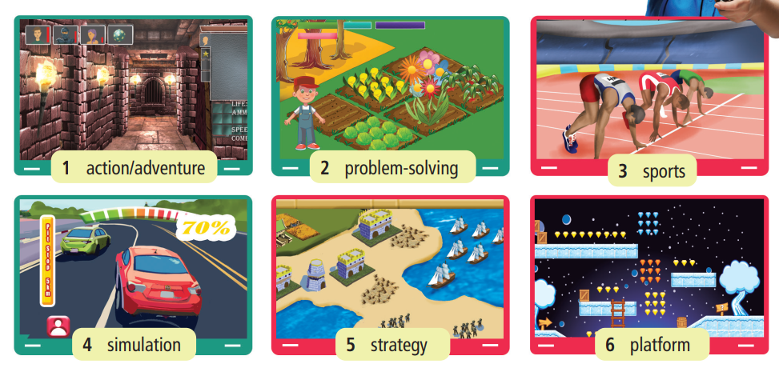
Label the pictures with the prompts
platform
sports
action/ adventure
- problem-solving
- strategy
- simulation

Slide 9
Answer key
action/adventure
problem-solving
sports
simulation
strategy
platform

Slide 10

Listen and repeat. Click each phrase to hear the sound.
action/adventure /ˈækʃən///ədˈventʃər/ (n): hành động/mạo hiểm
problem-solving /ˈprɒbləm ˈsɒlvɪŋ/ (n): giải quyết vấn đề
sports /spɔːt/ (n): thể thao
simulation /ˌsɪmjuˈleɪʃən/ (n): sự mô phỏng
strategy /ˈstrætədʒi/ (n): chiến lược
platform /ˈplætfɔːm/ (n): (trò chơi) đi cảnh
Notes:
GV click vào từng cụm nghe âm thanh

Slide 11
Look at the IPA and meanings of each word to read out the word.
/ˈækʃən///ədˈventʃər/ (n): hành động/mạo hiểm
/ˈprɒbləm ˈsɒlvɪŋ/ (n): giải quyết vấn đề
/spɔːts/ (n): thể thao
/ˌsɪmjuˈleɪʃən/ (n): sự mô phỏng
/ˈstrætədʒi/ (n): chiến lược
/ˈplætfɔːm/ (n): (trò chơi) đi cảnh
Notes:
GV click vào từng cụm nghe âm thanh

Slide 12
Talk about the types of games as in the example.
STUDENT A
STUDENT B
Do you like strategy games?
No, I don’t. I think they’re difficult/boring/easy.
How about sports games?
I’m crazy about them. They’re fun/cool/interesting.

Slide 13

Listening

Slide 14
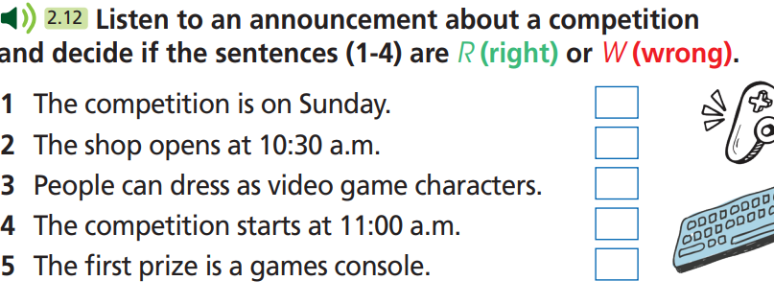
Pre - listening
What is the audio about?
- An announcement about a competition.
What are you going to do?
- Listen and decide if the
sentences are R (right)
or W (wrong).

Slide 15
Pre - listening
Read the questions and underline the key words.
1. The competition is on Sunday.
2. The shop opens at 10:30 a.m.
3. People can dress as video game characters.
4. The competition starts at 11:00 a.m.
5. The first prize is a games console.

Slide 16
While - listening
Now listen and decide if the sentences (1-5) are R (right) or W (wrong). FIRST TIME
1. The competition is on Sunday.
2. The shop opens at 10:30 a.m.
3. People can dress as video game characters.
4. The competition starts at 11:00 a.m.
5. The first prize is a games console.

Slide 17
While - listening
Now listen again and check.  SECOND TIME
While you are listening, focus on what the speaker says.
PinPals is having a competition this Saturday, 14th June.
☞ THE ANSWER IS …
1. Wrong
While you are listening, focus on what the speaker says.
The shop is open as usual from 9:00 in the morning.
☞ THE ANSWER IS …
2. Wrong

Slide 18
While - listening
Now listen again and check.  SECOND TIME
While you are listening, focus on what the speaker says.
All you have to do is come along dressed as your favourite video game character.
☞ THE ANSWER IS …
3. Right
While you are listening, focus on what the speaker says.
The competition is at 11:00.
☞ THE ANSWER IS …
4. Right
While you are listening, focus on what the speaker says.
The lucky winner will receive a fantastic games console.
☞ THE ANSWER IS …
5. Right

Slide 19
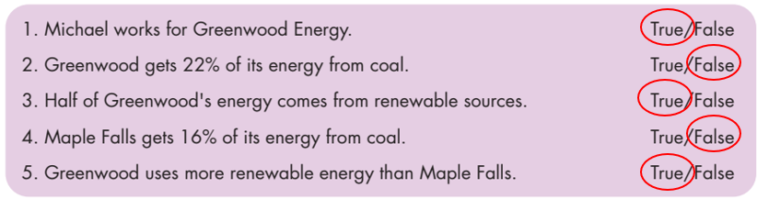
While - listening
While - listening
Now listen again and check.  THIRD TIME
1. The competition is on Sunday.
1. Wrong
2. The shop opens at 10:30 a.m.
2. Wrong
3. People can dress as video game characters.
3. Right

Slide 20
While - listening
While - listening
Now listen again and check.  THIRD TIME
4. The competition starts at 11:00 a.m.
4. Right
5. The first prize is a games console.
5. Right

Slide 21
Post- listening
Extra Practice
Listen again and fill in the blanks.
Morning, listeners. Here’s an announcement for all fans of video games. PinPals is having a competition this Saturday, 14th June, to (1) __________ ten years of being the number one video games shop in town. The shop is open as (2) _________ from 9:00 in the morning till 5:00 in the afternoon but get there by 10:30 because the competition is at 11:00. All you have to do is come along dressed as your (3) _________ video game character! The lucky winner will receive a (4) _________ games console. Other prizes (5) _____________ video games and T-shirts. You can buy snacks all day and there’ll also be music from local (6) ____________. So dress up, come along and maybe win a prize! One thing is certain – you’ll have a great time at PinPals!
celebrate
usual
favourite
fantastic
include
bands

Slide 22
Audio Scripts
Morning, listeners. Here’s an announcement for all fans of video games. PinPals is having a competition this Saturday, 14th June, to celebrate ten years of being the number one video games shop in town. The shop is open as usual from 9:00 in the morning till 5:00 in the afternoon but get there by 10:30 because the competition is at 11:00. All you have to do is come along dressed as your favourite video game character! The lucky winner will receive a fantastic games console. Other prizes include video games and T-shirts. You can buy snacks all day and there’ll also be music from local bands. So dress up, come along and maybe win a prize! One thing is certain – you’ll have a great time at PinPals!

Slide 23

Speaking

Slide 24

Pre - Speaking
Work in pairs.
Listen to the recording again and take notes. Use your answers in Exercise and your notes to ask and answer questions about the competition.
What do you do first?
→ Listen to the recording again and take notes.
And then?
→ Ask and answer questions about the competition.

Slide 25
STUDENT A
STUDENT B
When is it?
On Saturday 14th June.
What time is the competition?
11 o’clock, but we have to be there at 10:30.
What should we dress as?
Video games characters.
What’s the first prize?
A games console, but you can win video games and T-shirts, too.
Is there anything else to do?
Yes, you can eat snacks and listen to local bands.

Slide 26

While - Speaking
Work in pairs.
Make similar conversations with the information below.

Slide 27
Name | Kind | What can you do?
Peaceful Days | Simulation | raise animals, interact with town folks, and take part in interesting festivals
Minecraft | Action | create and break apart various kinds of blocks in three-dimensional worlds
Roblox | Platform | create own game or create another world with friends or 'virtual explorers'
Play together | Strategy | interact and play together with other players to make progress

Slide 28
Post - Speaking
In groups, discuss about your favorite game competition.
You can begin with:
I like … game competition best because …

Slide 29

Writing

Slide 30
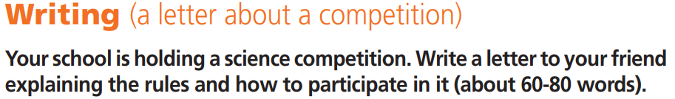

Pre - writing
Work in pairs.
1. What are you going to write?
2. Who are you going to write to?
3. What information are you going to
include?
4 How many words are you going to
write?
- A letter about a competition.
- Our friend.
- Rules and how to participate.
- 60-80 words.

Slide 31
While - writing
Make notes.
Talk about:
• The type of competition
• Date - Time
• What to do
Note
_______________________
________________________
________________________
________________________
________________________
________________________
Designing robots
on Saturday 9th May – 10:00 a.m
design a robot which must be able to move forwards and backwards, turn corners and lift 500g.

Slide 32
Post - writing
Model of an email of invitation
Hi Tom,
How are things? I know you enjoy designing robots, so I thought you would like to take part in the competition at my school. It’s on Saturday 9th May and you have to be there by 10 o’clock. You have to design a robot. It can be any shape or size, but it must be able to move forwards and backwards, turn corners and lift 500 g. Do you want to participate? I can get a form for you from our science teacher, Mr Benson.
Write back.
Lucy

Slide 33

CONSOLIDATION

Slide 34
Talk about a game competition you have joined.
When did it take place?
Where was it?
What did you do?
What prize did you win?

Slide 35

WRAP-UP

Slide 36
Today’s lesson
Vocabularies
action
problem-solving
sports
simulation
strategy
platform
Speaking: talk about video/PC/mobile games.
Listening: for key information.
Writing: a letter about a competition.

Slide 37
Homework
Practise the vocabularies and make sentences using them.
Prepare the next lesson (page 74 SB).

Slide 38

Enjoy your day!

