Slide 1

UNIT 6: COMMUNITY LIFE
Lesson 1.2 – Grammar
Page 49

Slide 2


Lesson 1.2
LESSON OUTLINE
Consolidation

Slide 3

By the end of this lesson,
students will be able to …
practice and use The simple past passive correctly.

Slide 4



Slide 5


Work in pairs.
Who broke the vase?
A: I don’t know.
B: Jim broke the vase.

Slide 6

Presentation
Past Simple passive

Slide 7
Lead in:
Identify the function of underlined words
Jim broke the vase.
Active
S
V
O
Passive
was/were + V-ed/V3
by + O
S
The vase was broken (by Jim).
The Simple Past Passive

Slide 8
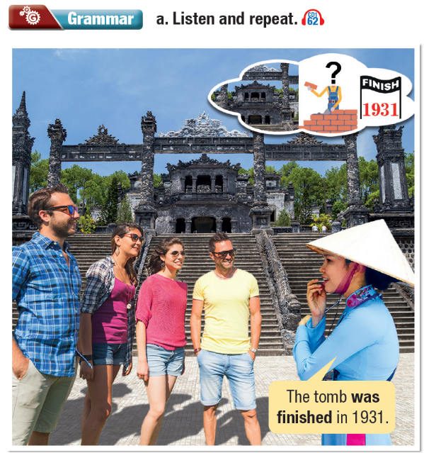


Slide 9

The Past Simple Passive
We can use the Past Simple Passive when we don’t know, or don’t care who did the action.
The castle was built in 1850.

Slide 10

The Past Simple Passive
The house was built in 1653.
Construction wasn't started until 1842.
When was construction finished?

Slide 11

The Past Simple Passive
We don't usually use the passive with increase or decrease.
The population was decreased last year.
The population decreased last year.

Slide 12

Practice

Slide 13
b. Fill in the blanks with the past simple in the passive form of the verbs in brackets.
1. Two factories ____________________ (close) because they caused too much air pollution.
2. The park ____________________ (close) because some parents thought it was unsafe.
3. Some houses in the town ____________________ (build) hundreds of years ago.
were closed
was closed
were built

Slide 14
4. The two supermarkets ____________________ (not open) last year.
5. A bus system ____________________ (develop) to improve transportation in the community.
6. The castle ____________________ (rebuild) in the 15th century after it had been destroyed by fire.
weren’t open
was developed
was rebuilt

Slide 15
c. Look at the information about Notre Dame Cathedral in Ho Chi Minh City and write simple passive sentences.
1. Construction started: 1863
_______________________________________
2. Construction finished: 1880
_______________________________________
3. Bell towers added: 1895
_______________________________________
4. Named Saigon Chief Cathedral: 1960
_______________________________________
5. Repairs to the cathedral started: 2017
_______________________________________
Construction was started in 1863.
Construction was finished in 1880.
The Bell towers were added in 1895.
It was named Saigon Chief Cathedral in 1960.
Repairs to the cathedral were started in 2017.

Slide 16
Extra Practice
WB, page 33
a. Complete the tables with the correct form.
Verb | Past Participle | Verb | Past Participle
1. close 2. change 3. develop 4. move away 5. find |  | 6. provide 7. increase 8. decrease 9. rebuild

Slide 17
a. Complete the tables with the correct form.
Verb | Past Participle | Verb | Past Participle
1. close 2. change 3. develop 4. move away 5. find | closed changed developed moved away found | 6. provide 7. increase 8. decrease 9. rebuild | provided increased decreased rebuilt

Slide 18
b. Fill in the blanks with the correct form of the verbs.
1. In the 2000s, the town _______________ (rebuild) after the earthquake.
2. A lot of roads _______________ (build) in the town in the 2000s.
3. All my friends used to live here, but some _______________ (move away) in the 1990s.
was rebuilt
were built
moved away

Slide 19
4. The swimming pool _______________ (close) by the council because they thought it was unsafe for the children.
5. The number of buses _______________ (increase) in the town last year.
6. The number of cars _______________ (decrease) by 8% last year.
was closed
increased
decreased

Slide 20

Production

Slide 21
c. Change the active sentences into passive sentences.
1. She sang two songs last night. ____________________________________________________
2. They rebuilt three hotels last year. ____________________________________________________
3. They changed the law in 2005. ____________________________________________________
Two songs were sung last night.
Three hotels were rebuilt last year.
The law was changed in 2005.

Slide 22
4. He developed the company from nothing in the 2000s. ____________________________________________________
5. She didn't write that mystery novel. ____________________________________________________
6. We opened a great new restaurant downtown. ____________________________________________________
The company was developed from nothing in the 2000s.
That mystery novel wasn't written by her.
A great new restaurant was opened downtown.

Slide 23

Consolidation

Slide 24
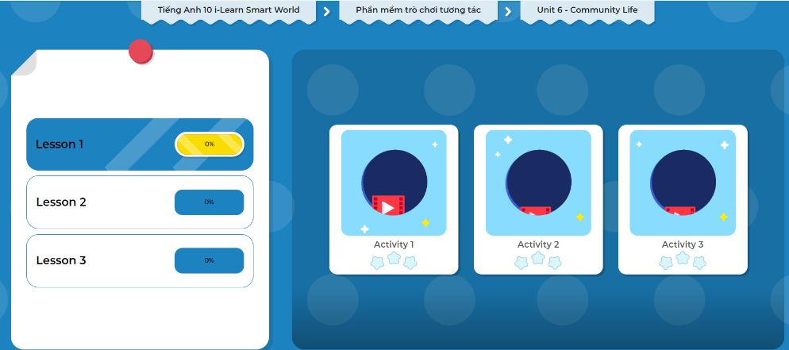
Extra Practice
DHA on Eduhome
Let’s Play!
Click here to play the games.

Slide 25

Work in pairs.
d. Ask each other about Notre Dame Cathedral.
Use the grammar point: The Past Simple Passive
When was the construction started?
It was started in 1863.

Slide 26

WRAP-UP

Slide 27
Today’s lesson
Grammar: The Past Simple Passive
Speaking: asking and answering about Notre Dame Cathedral in HCMC

Slide 28
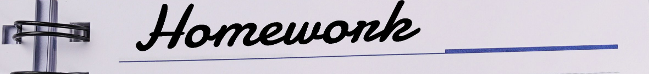
Practice making sentences using The Simple Past Passive.
Do the exercises in WB on page 33 (Writing).
Complete the grammar notes in Tiếng Anh 10 i-Learn Smart World Notebook on page 33.
Prepare the next lesson on page 50 in SB.
Play the consolidation games in Tiếng Anh 10 i-Learn Smart World DHA App on www.eduhome.com.vn

