Slide 1


Slide 2

Unit
1
1
Unit
FAMILY LIFE
FAMILY LIFE
LESSON 8
LOOKING BACK AND PROJECT

Slide 3

Unit
1
1
FAMILY LIFE
Family Life
Unit
OBJECTIVES
1. Knowledge
- review pronouncing the consonant blends /br/, /kr/, /tr/
- review the vocabulary and grammar of Unit 1
- do research on Family Day in Viet Nam or other countries in the world and give a group presentation about it.
2. Core competence
- develop communication skills and creativity;
- develop presentation skills;
- develop critical thinking skills;
- be collaborative and supportive in pair work and team work;
- actively join in class activities.
3. Personal qualities
- be more creative when doing the project;
- develop self-study skills.
- - -

Slide 4
LESSON 8
Looking back and project
Unit
GETTING STARTED
WARM-UP
List topical words
LOOKING BACK
Pronunciation: Listen and write /br/, /kr/ or /tr/.
Vocabulary: Complete the text.
Grammar: Find the mistake & correct it.
PROJECT
Research on “Happy family day”
CONSOLIDATION
Wrap-up
Home work

Slide 5
LESSON 8
Looking back and project
Unit
GETTING STARTED
WARM-UP
List topical words

Slide 6
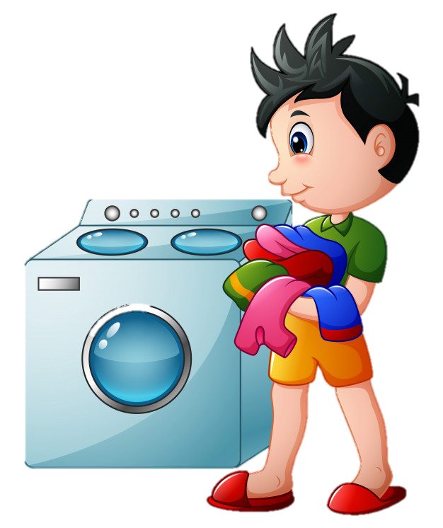

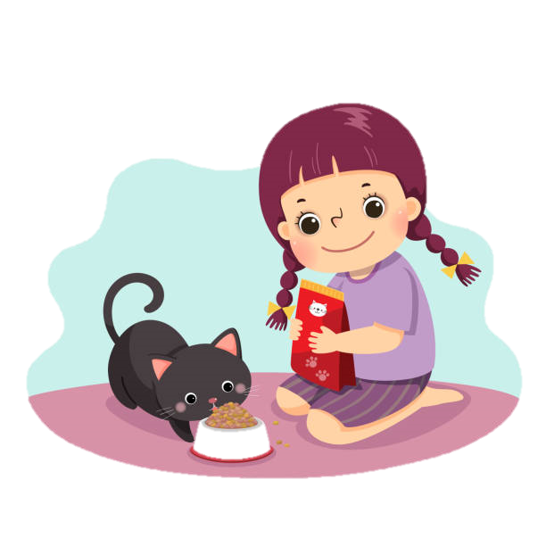
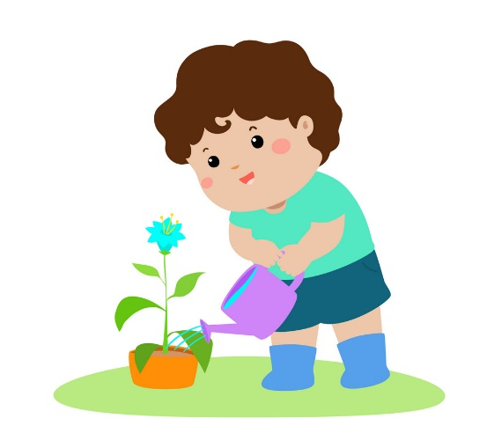
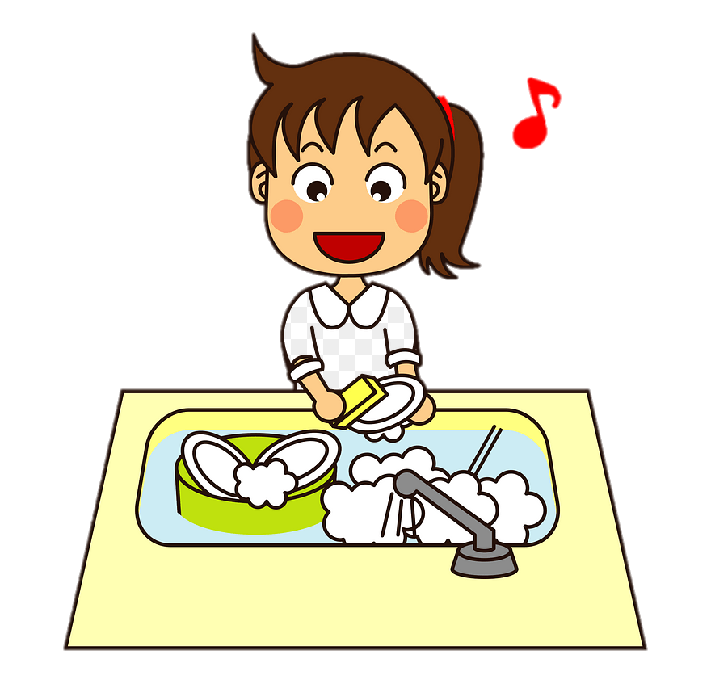

WARM-UP
WRITE DOWN AS MANY WORDS RELATED TO THE TOPIC
‘HOUSEHOLD CHORES’ AS YOU CAN

Slide 7
LESSON 8
Looking back and project
Unit
GETTING STARTED
WARM-UP
List topical words
LOOKING BACK
Pronunciation: Listen and write /br/, /kr/ or /tr/.
Vocabulary: Complete the text.
Grammar: Find the mistake & correct it.

Slide 8

LOOKING BACK
1
PRONUNCIATION
Listen and write /br/, /kr/ or /tr/.
/kr/
/br/
/br/
1. I like ice cream, but my brother likes bread pudding.
2. Tracy crashed her car into a tree and broke her leg.
3. They often have crab soup for breakfast.
/tr/
/kr/
/tr/
/br/
/kr/
/br/

Slide 9
LOOKING BACK
2
VOCABULARY
Complete the text. Use the correct form of the word and phrase in the box.
do the washing-up
do the heavy lifting
do the cooking
clean the house
laundry
In Thanh’s family, everybody shares the housework. His mother (1) _______________. Thanh really enjoys the food she cooks. Thanh’s father is a strong man, so he (2) __________________. Thanh helps with the (3) ________. He feels proud that he knows how to run a washing machine. Thanh’s sister helps with (4) _________________. She does it regularly, so their house is never dirty. She also (5) __________________ after each meal.
does the cooking
does the heavy lifting
laundry
cleaning the house
does the washing-up

Slide 10
LOOKING BACK
3
GRAMMAR
There is a mistake in each sentence below. Find the mistake and correct it.
1. I’m writing to you to tell you how much I’m wanting to see you.
2. Jack is away on business, so now I look after his dog.
3. Nam’s often looking untidy.
4. She can’t answer the phone now. She cooks dinner.
5. Excuse me, do you read the newspaper? Could I borrow it?
6. What are your family doing in the evenings?
→ want
→ ’m / am looking
→ (often) looks
→ ’s / is cooking
→ are you reading
→ do / does ... do

Slide 11
LESSON 8
Looking back and project
Unit
GETTING STARTED
WARM-UP
List topical words
LOOKING BACK
Pronunciation: Listen and write /br/, /kr/ or /tr/.
Vocabulary: Complete the text.
Grammar: Find the mistake & correct it.
PROJECT
Research on “Happy family day”

Slide 12
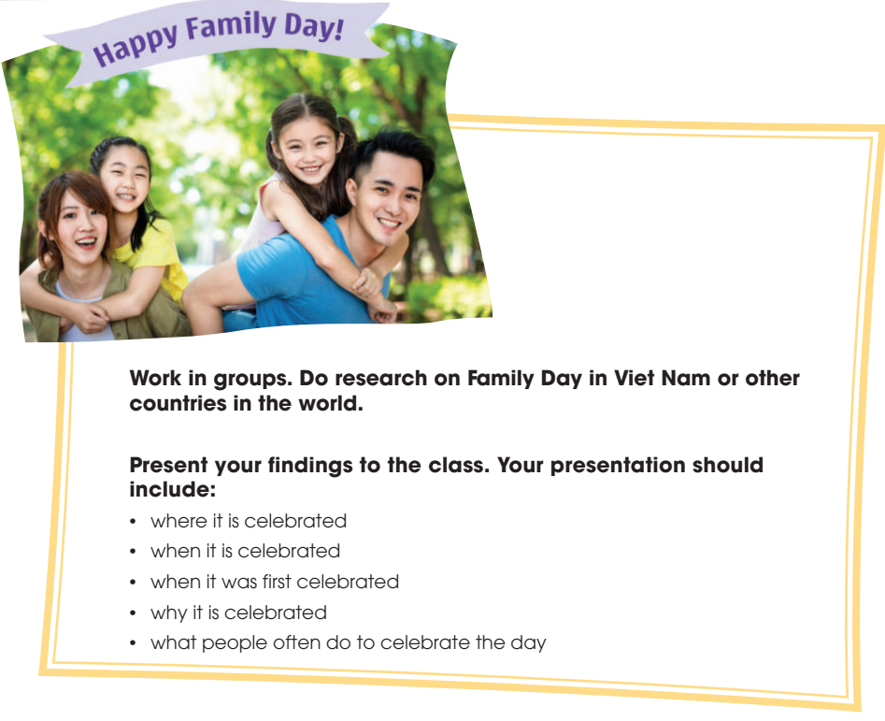
PROJECT

Slide 13
LESSON 8
Looking back and project
Unit
GETTING STARTED
WARM-UP
List topical words
LOOKING BACK
Pronunciation: Listen and write /br/, /kr/ or /tr/
Vocabulary: Complete the text.
Grammar: Find the mistake & correct it.
PROJECT
Research on “Happy family day”
CONSOLIDATION
Wrap-up
Home work

Slide 14
CONSOLIDATION
1
Wrap-up
Revise the consonant blends /br/, /kr/, and /tr/.
Revise words/ phrases related to the topic Household chores.
Revise Present simple and Present continuous.
2
Homework
Exercises in the workbook
prepare for Unit 2 lesson 1

Slide 15

Website: sachmem.vn
Fanpage: facebook.com/sachmem.vn/

