Slide 1
KEY ENGLISH TEST 3
SPEAKING TEST 2

Slide 2
KET SPEAKING
Time allowed - 8-10 minutes
Normally you will do the speaking test with another candidate. The two of you will meet two examiners. One of the examiners will talk to you, the other does not particpate in the conversations.
There are two parts to the speaking test:
Speaking part 1: short questions and answers between you and the examiner
Speaking part 2: the examiner gives you some information or a card with some ideas for questions. You have to talk with the other candidate and ask or answer questions.
How to prepare for KET Speaking
Speak as much as you can, with your friends
Practise asking and asnwering questions about daily life
Practise giving information about yourself

Slide 3
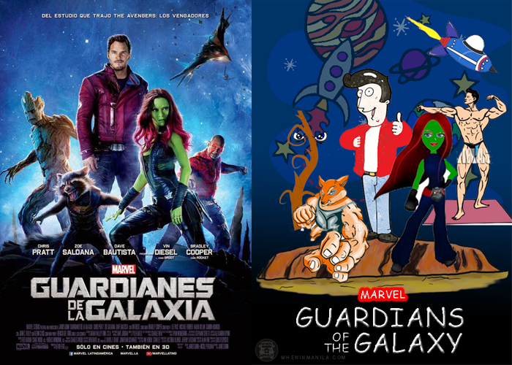
Part 1:
Do you like watching films?
What kinds of film do you like?
Do you usually watch films at home or at the cinema?
How often do you go to the movie theater?
Who is your favorite actor/ actress?
Talk about your favorite film

Slide 4

Film genres

Slide 5

Can you list some films you have watched? Which kinds of films are they?

Slide 6
VOCABULARY
cast (noun): all the actors and actresses in a movie or TV show - It had a good cast, but the story wasn't very interesting.
character (noun): one of the people in a story - Harry likes movies with lots of interesting and unusual characters.
director (noun): the person in charge of making a movie - The director gets really angry when actors forget their lines.
movie star (noun): a very popular movie actor or actress - Movie stars earn millions of dollars every time they play a role.
plot (noun): the series of events that form the main story - It was a good film, but the plot was difficult to follow at times.

Slide 7
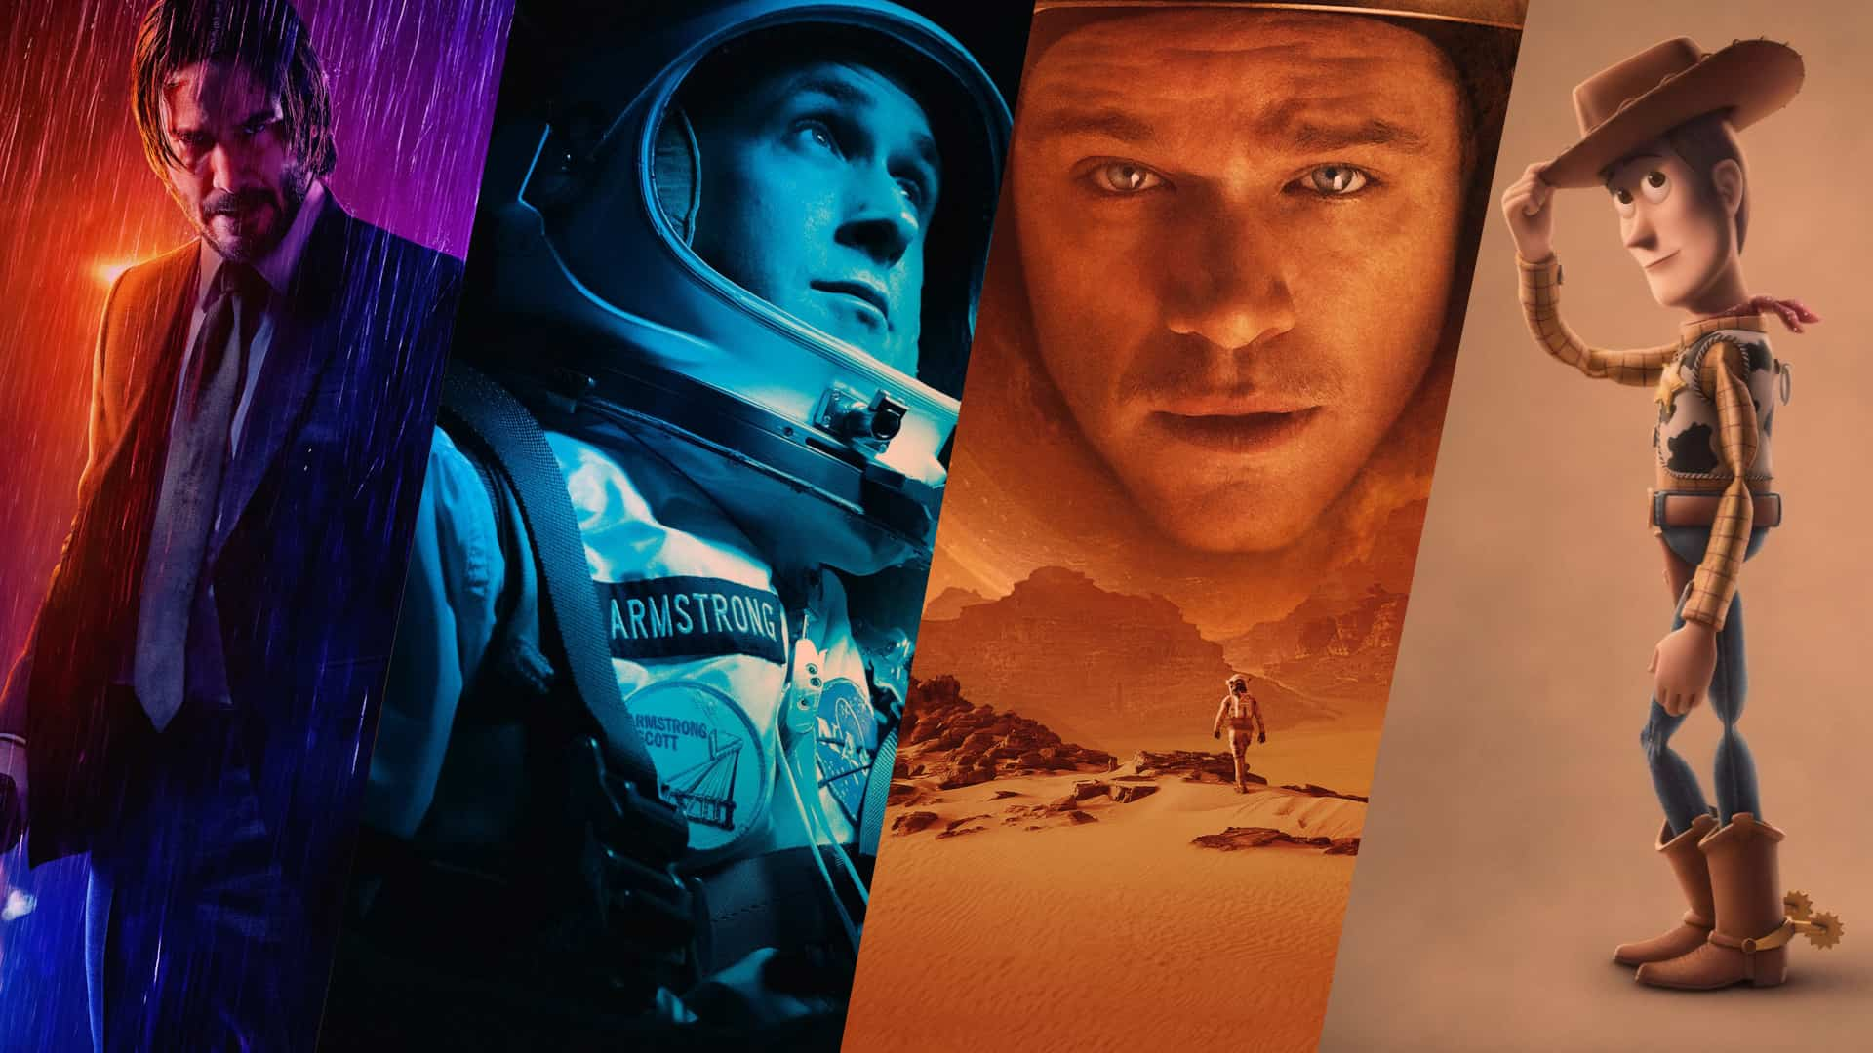
TALK ABOUT A FILM

Slide 8
Telling the plot of a film
Giving your opinion
Tenses to use
Present simple tense
Past simple tense
Film genres
It’s set in…(New York / in the 1950’s).
The film’s shot on location in Arizona.
The main characters are … and they’re played by…
I thought the film was great / OK /fantastic…
The actors / costumes / screenplay are/is …
The special effects are fantastic / terrible
The best scene / the worst scene is when…
The plot is believable / seems a bit unlikely

Slide 9
SPEAKING pART 2
Asking and answering questions using these prompt cards

Slide 10
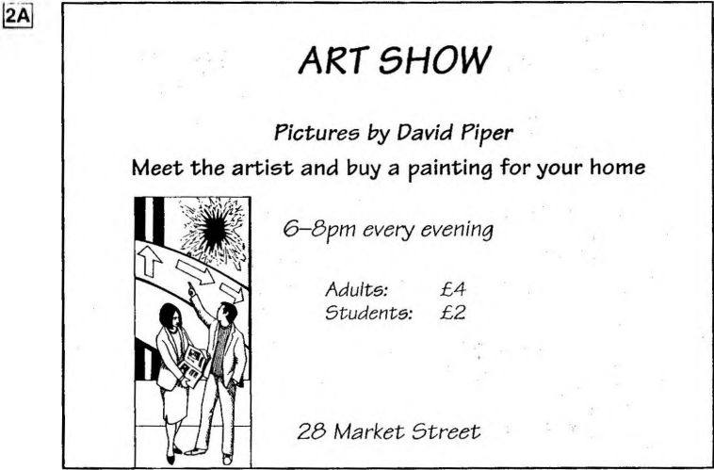
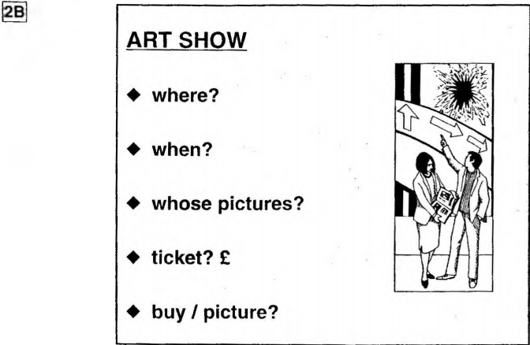
What are other questions and answers you can think of?
Practice asking and answering questions using the words given.

Slide 11

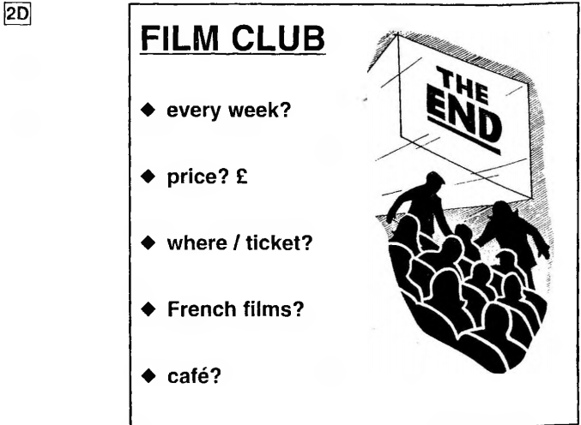
Ask and answer questions using the words given.

Slide 12
Based on the given information, talk about the film club

