Slide 1

REVIEW 4 (Units 9-10)
Lesson 1 – Vocabulary, Listening & Reading
Page 90

Slide 2




LESSON OUTLINE
Consolidation

Slide 3
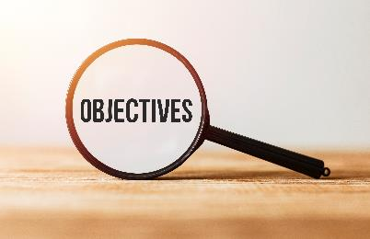
By the end of this lesson,
students will be able to …
practice listening and reading for specific information.
practice test-taking skills.
consolidate and practice vocab. presented in units 9-10

Slide 4
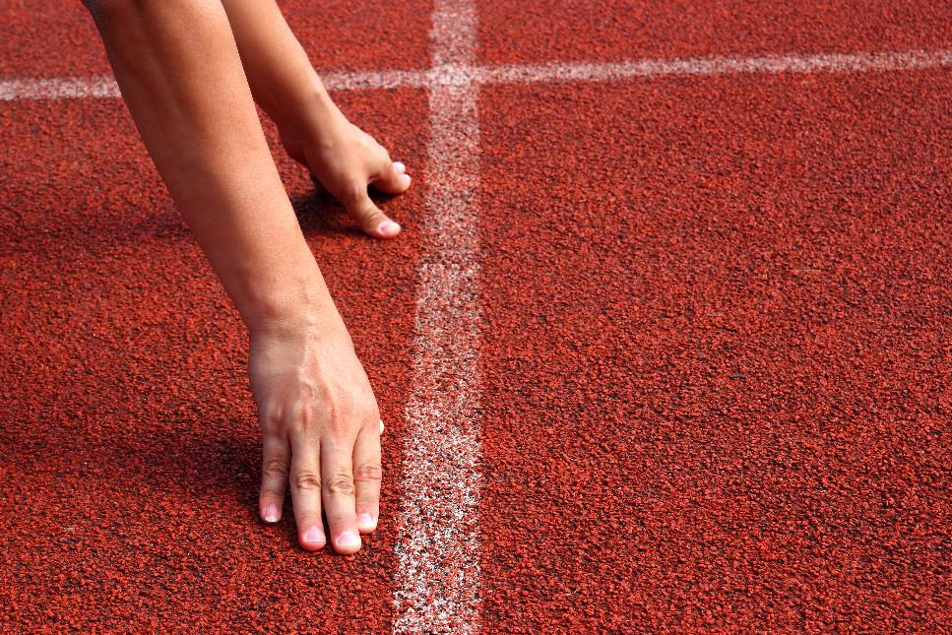


Slide 5

Work in pairs.
Do you use any smart devices at home?
What do you use them for?
How efficient they are?

Slide 6



Slide 7
Pre-Listening
Underline the key words/phrases.
You will hear an interview with a man called Professor Jones, an expert on ecotourism. For each question, choose the correct answer (A, B or C).
1. Who has benefited from tourism in the past?
A. travel companies
B. tourists
C. local communities
2. How many people are interested in ecotourism?
A. everybody
B. sixty percent of Americans
C. most people

Slide 8
3. Why do tourists want to conserve the environment?
A. to see different species
B. so that people can enjoy it in the future
C. to conserve the environment
4. Who often knows most about the environment?
A. companies
B. businesses
C. local communities

Slide 9
5. Sophia says that some resorts are bad because…
A. of their advertising.
B. they are expensive.
C. they don't protect the environment.
6. What will good resorts be able to do?
A. attract tourists
B. answer your questions fully
C. raise tourists awareness

Slide 10

While-Listening
Listen twice and choose the correct answer
The 3rd time to check
1. Who has benefited from tourism in the past?
A. travel companies
B. tourists
C. local communities
2. How many people are interested in ecotourism?
A. everybody
B. sixty percent of Americans
C. most people

Slide 11
3. Why do tourists want to conserve the environment?
A. to see different species
B. so that people can enjoy it in the future
C. to conserve the environment
4. Who often knows most about the environment?
A. companies
B. businesses
C. local communities

Slide 12
5. Sophia says that some resorts are bad because…
A. of their advertising.
B. they are expensive.
C. they don't protect the environment.
6. What will good resorts be able to do?
A. attract tourists
B. answer your questions fully
C. raise tourists awareness

Slide 13

Scripts
Sophia: I'm Sophia Anderson and today we're talking about ecotourism. I'd like to welcome to the program Professor Jones, who is an expert on the topic. Hello, Professor.
Prof. Jones: Hello.
Sophia: First, can you tell us what ecotourism is?
Prof. Jones: Yes. It's a way of doing tourism which aims to conserve the environment, help local communities, and educate tourists.
Sophia: How is that different from traditional tourism?
Prof. Jones: Well, tourism often only used to benefit travel companies. It could often damage the environment and local communities. Now, the environment is becoming a more important topic for everybody. For example, sixty percent of Americans want to try ecotourism.

Slide 14
Sophia: That's amazing. Why is protecting the environment important for tourism?
Prof. Jones: Well, tourists want the environment protected so that their children and grandchildren can enjoy it, too. Companies want to protect it because that is their business.
Sophia: I see.
Prof. Jones: Local communities often know more about different species and their environment. Their knowledge has always been important for making conservation better.

Slide 15
Sophia: Great. Finally, I read that some resorts have advertised that they are green, or eco-friendly, but they haven't done any conservation. How can tourists know they are going to a good resort?
Prof. Jones: Well, they should find out! Tourists should ask resorts exactly how they are protecting the environment. Any good resort should be able to easily explain what they do to help local wildlife, people and animals. If they can't answer that, well, then you should look for another place to stay.
Sophia: Professor Jones, thank you very much.
Narrator: Now, listen again

Slide 16
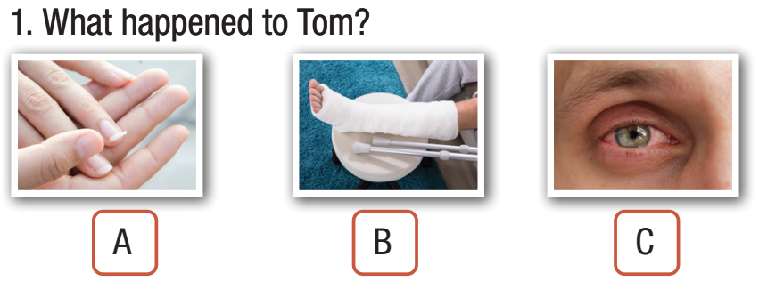
Extra Practice
WB, page 70
Pre-Listening
Underline the key words/phrases.
You will hear five short conversations. You will hear each conversation twice. There is one question for each conversation. For each question, choose the correct answer (A, B, or C).

Slide 17
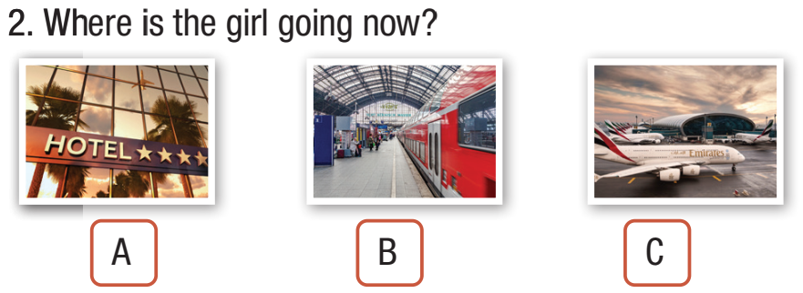
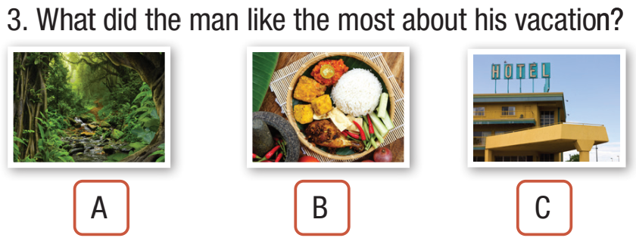

Slide 18
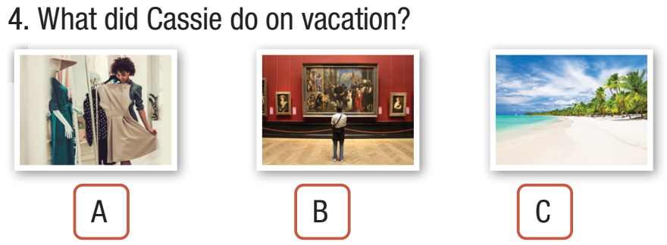
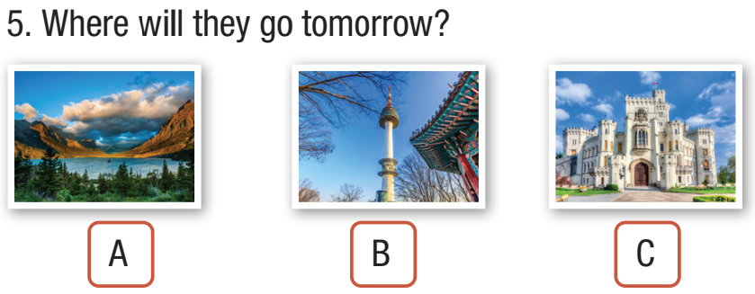

Slide 19
While-Listening
Listen twice and choose the correct answer
The 3rd time to check

Slide 22
1. Narrator: What happened to Tom?
M: How was your trip, Sarah?
W: We had a couple of small accidents, but in the end everything was fine.
M: Oh no, what happened?
W: An insect flew into my eye when we went hiking. I couldn’t see where I was going and walked into Jane.
M: And then?
W: She bumped into Tom while he was looking at the map.
She broke a fingernail, but Tom...
M: What happened to Tom?
W: He fell down the mountain and broke his leg. He spent five days in the hospital.
M: I wouldn’t call that a small accident. Poor Tom.
Scripts

Slide 23
2. Narrator: Where is the girl going now?
M: Hello?
G: Hi, Dad. I’m calling to let you guys know I won’t be coming home tonight.
M: Where are you?
G: I’m in the subway station.
M: What? Why are you there?
G: When we arrived at the airport, it started to snow. There are no flights now.
M: What are you going to do now?
G: We’re going to a hotel. I think there’s one near the railway station.
M: Oh dear.
G: I’ll call you when I arrive at the hotel. OK?
M: OK. I’ll tell your mother. Love you.
G: Thanks, Dad. I love you too.

Slide 24
3. Narrator: What did the man like the most about his vacation?
W: How was your vacation to Indonesia last month?
M: Not so good, I’m afraid.
W: What was wrong?
M: Well, the hotel was awful. It looked nothing like in the website.
W: Oh no.
M: Then I went for a walk in the jungle.
W: Oh, that’s nice.
M: No, it was terrible. Some monkeys took my handbag.
W: Oh dear. Was there anything good about your trip?
M: Yes, the food was pretty amazing.
W: Oh, that’s so nice.
M: Yeah, I loved it

Slide 25
4. Narrator: What did Cassie do on vacation?
W: Did you hear about Cassie’s vacation to Italy?
M: No. What happened? Did she go to the beach?
W: No. She didn’t get a chance.
M: Was she busy visiting museums? I know she loves history.
W: No, because on her first night, while she was sleeping, the hotel caught fire.
M: Oh no!
W: She lost everything in the fire.
M: That’s terrible. So, what did she do?
W: She went shopping for new clothes.
M: Wow! What an awful vacation.

Slide 26
5. Narrator: Where will they go tomorrow?
M: So, what should we do tomorrow?
W: Hmm, what do you think about going to the national park?
M: No, thanks. That’s too far from the city. Can we do something else?
W: There’s a very beautiful castle about an hour away by train.
M: Is there anything else we can do?
W: There is a famous tower near our hotel.
M: Hmm. I think the castle sounds more interesting. Let’s go there.
W: Great!

Slide 27
Extra Practice
WB, page 71
Pre-Listening
Underline the key words/phrases.
You will hear someone talking about the future of education. For each question, write the correct answer in the gap. Write one or two words.

Slide 28
• Many schools will use (1) ________________ and software in their classrooms.
• (2) ________________and digital desks will replace textbooks and paper, and interactive whiteboards will
take the place of the classroom blackboard.
• Online learning and (3) ________________will be an option for many students.
• (4) ________________will also change the way we study.
• Their lessons will be taught (5) ________________ and their activities marked by AI.

Slide 29
While-Listening
Listen twice and write one or two words
The 3rd time to check
• Many schools will use (1) ________________ and software in their classrooms.
• (2) ________________and digital desks will replace textbooks and paper, and interactive whiteboards will
take the place of the classroom blackboard.
• Online learning and (3) ________________will be an option for many students.
• (4) ________________will also change the way we study.
• Their lessons will be taught (5) ________________ and their activities marked by AI.
apps
tablets
virtual classrooms
Artificial Intelligence
online

Slide 30
Scripts
W: On today’s program I’m going to talk about how education will change in the future.
Many schools will use apps and software in their classrooms. Exercises and tests will become more fun for students since they love using technology. Tablets and digital desks will replace textbooks and paper, and interactive whiteboards will take the place of the classroom blackboard.
Not everyone will have to go to school to study. Online learning and virtual classrooms will be an option for many students. They will be able to study in their own homes. Teachers will be able to work with students all around the world, not just ones who attend their local school.

Slide 31
Artificial Intelligence or AI will also change the way we study. Some students won’t have a human teacher. Instead, they will learn from programs run by AI. Their lessons will be taught online and their activities will be marked by AI.
Students will only need to go to school for their graduation ceremony.
These changes are going to improve education and benefit many students.
Narrator: Now, listen again.

Slide 32
Post-Listening
Work in groups.
1. How far will our education change in the future?
2. Is this good or bad?

Slide 33



Slide 34
Pre-Reading
Underline the key words/phrases.
The people below want to try a new way of learning. On the right, there are descriptions of different ways of learning. Decide which way of learning would be the most suitable for each person below. For each question, choose the correct answer (A–D).

Slide 35
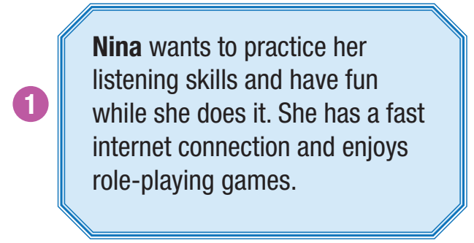
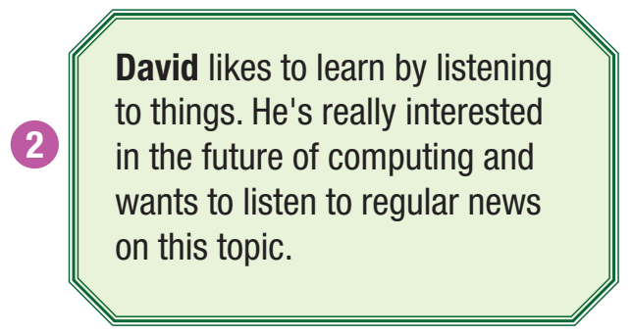

Slide 36
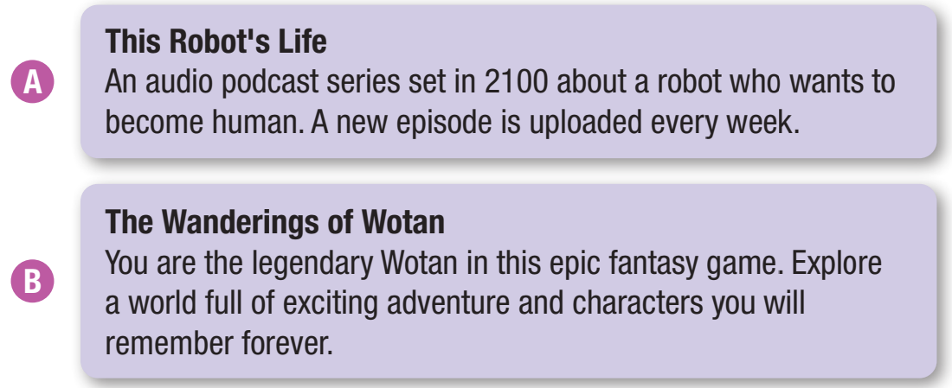

Slide 37
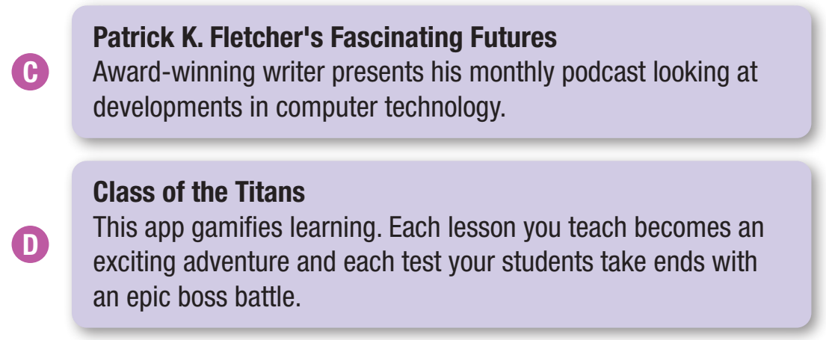

Slide 38
While-Reading
Skim and scan to choose the correct answer.
B
C

Slide 39
Extra Practice
WB, page 70
Pre-Reading
The people below are looking for a place to go for their next vacation. There are descriptions of four tourist destinations. Decide which place would be the most suitable for the people below.
Underline the key words/phrases.

Slide 40
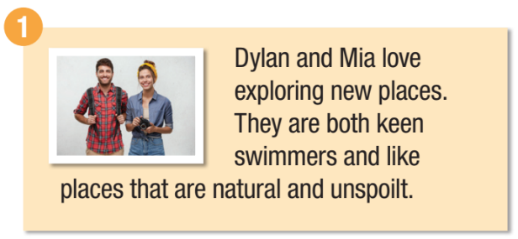
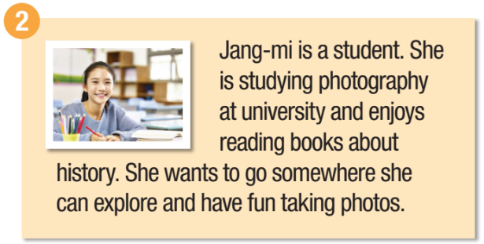
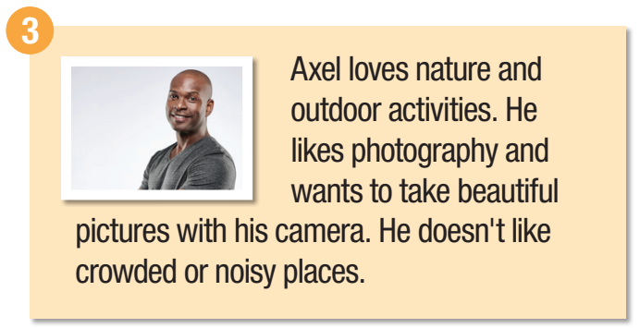

Slide 41
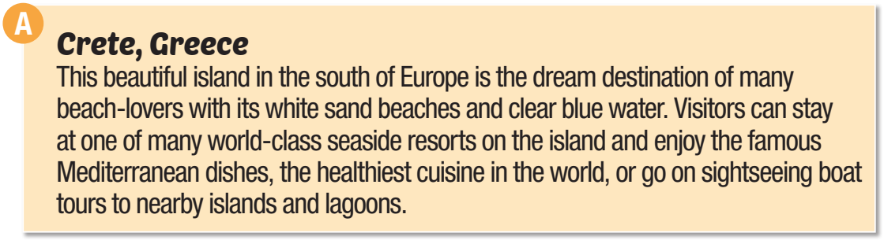
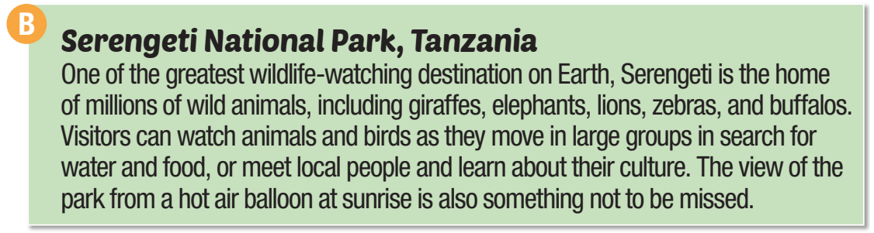

Slide 42
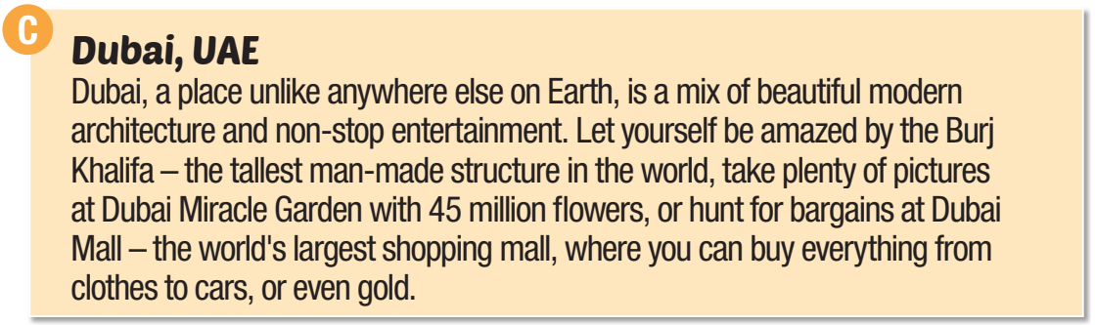
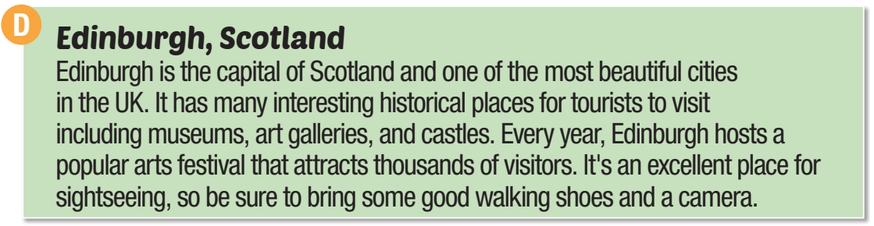

Slide 43
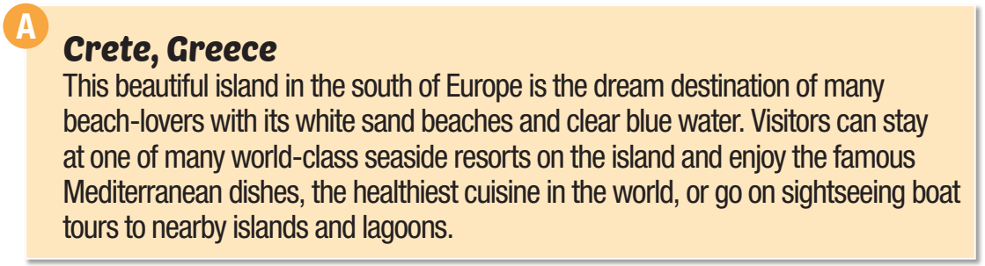
While-Reading
Skim and scan to get the specific information

Slide 44
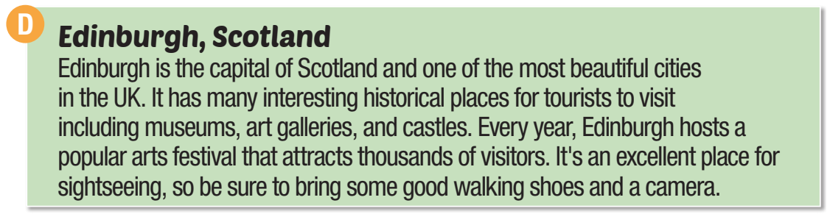

Slide 45
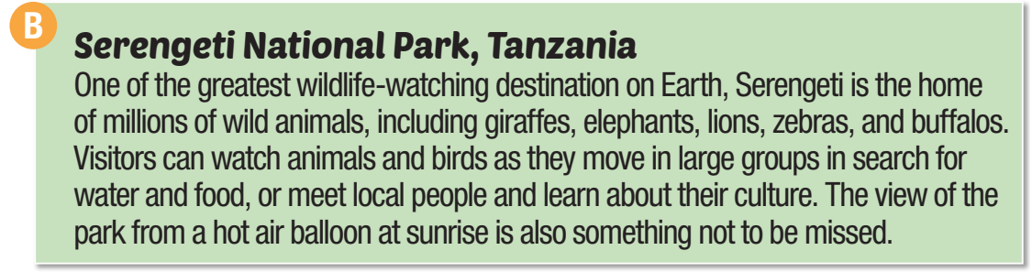

Slide 46
Extra Practice
WB, page 71
Pre-Reading
For each question, choose the correct answer.
Underline the key words/phrases.
Modern Learning
Lucas Brown, Grade 10
__________________________________________________
I'm going to use e-learning apps and play learning games so I can get higher marks at school.
Two of my weakest subjects are math and physics. I'm going to download an app called A+Learning that has a lot of courses for different subjects and levels. You can watch videos and do exercises that are graded by AI. And you can play games!

Slide 47
The best thing is you can chat with other students. I'm going to study at least three times a week to see if my grades improve.
My parents weren't very happy with my history test result because mine was the lowest in the class. I'm going to sign up for an online history course. There are a few students from my school who have studied it already. It's like a virtual classroom with a real teacher. We'll do video calls and give presentations. I think it will be fun.
I want to learn a language, so I'm going to install a computer game called Star City One. It's a Spanish game, and all the voice actors use Spanish, and the instructions are written in Spanish. I think I will be able to learn very easily.

Slide 48
1. Lucas has made a learning plan because...
A. he wants to have fun.
B. he wants to improve his grades.
C. learning is boring to him.
2. What does Lucas say about A+Learning?
A. You have to study online every day.
B. It provides many subjects and levels.
C. Teachers mark your work.

Slide 49
3. What does Lucas think is best about A+Learning?
A. You can watch videos.
B. You can play games.
C. You can communicate with other students.
4. What does Lucas say about his online history course?
A. He can study in a real classroom.
B. He doesn't like giving presentations.
C. He will enjoy it.

Slide 50
5. What would be a good introduction sentence for this essay?
A. I will study in another country in the future.
B. I'm in Grade 10, and my parents want me to improve
my grades, so I've made a plan to help me study better.
C. Education in many countries is going to change
in the future.

Slide 51
While-Reading
Skim and scan to get the specific information
1. Lucas has made a learning plan because...
A. he wants to have fun.
B. he wants to improve his grades.
C. learning is boring to him.
2. What does Lucas say about A+Learning?
A. You have to study online every day.
B. It provides many subjects and levels.
C. Teachers mark your work.

Slide 52
3. What does Lucas think is best about A+Learning?
A. You can watch videos.
B. You can play games.
C. You can communicate with other students.
4. What does Lucas say about his online history course?
A. He can study in a real classroom.
B. He doesn't like giving presentations.
C. He will enjoy it.

Slide 53
5. What would be a good introduction sentence for this essay?
A. I will study in another country in the future.
B. I'm in Grade 10, and my parents want me to improve
my grades, so I've made a plan to help me study better.
C. Education in many countries is going to change
in the future.

Slide 54

Post-Reading
Work in pairs.
Which way of learning do you prefer, traditional or modern?
Tell three advantages of modern learning.

Slide 55

Fill in the blanks with a word from Units 9 and 10. The first letter is already there. You will need to change the form of some words.
1. Many movies used the c_____ as the inspiration for their settings. It was built in 1869 by King Ludwig II. (Unit 9)
2. Someone broke into our hotel room and s_____ our camera. We've taken so many beautiful photos, but now they're all gone. (Unit 9)
astle
tole

Slide 56
3. Food that is stored incorrectly can lead to f_____ p________. Make sure that you keep cooked food in the fridge and always reheat your food. (Unit 9)
4. There are many great educational a_____ on your phone that you can install and use to learn something new. (Unit 10)
5. It is predicted that v_____ classrooms will become more popular in the future and may replace traditional classrooms. (Unit 10)
ood
oisoning
pps
irtual

Slide 57

WRAP-UP

Slide 58
Today’s lesson
Listening and Reading: practice listening and reading for specific information
Vocabulary: consolidate and practice presented in units 9-10

Slide 59

Do exercises in Tiếng Anh 10 i-Learn Smart World Notebook on page 66, 67.
Prepare the next lesson on page 73 in SB.

