Slide 1

Unit 6: Be green
Lesson: CLIL
Page 106

Slide 2
Lesson Outline
Warm-up
Reading
Consolidation
Wrap-up

Slide 3
Objectives
By the end of this lesson, students will be able to…
- to read for gist, to read for cohesion and coherence.
- to talk about community service activities.

Slide 4

WARM-UP

Slide 5
Answer the question
What can you do to help the environment in your daily life?
Suggested answer
I can plant trees, collect litter from parks and take part in clean-up days in my daily life to help the environment.

Slide 6

It’s time to learn …

Slide 7
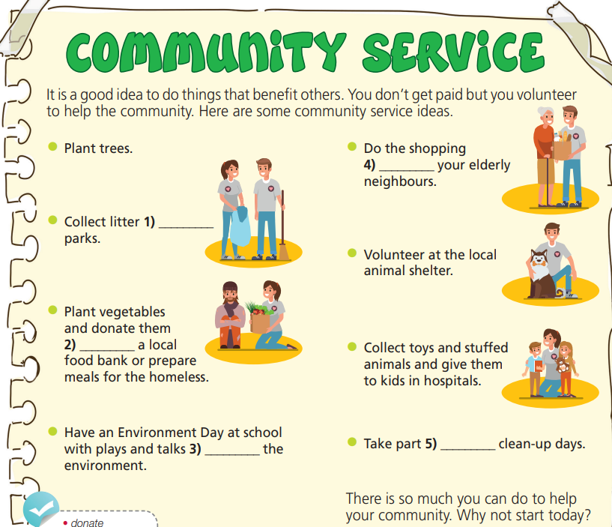
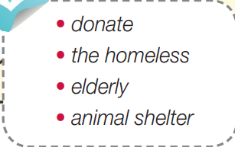
Pre-reading
Find these words in the text, try to guess what are their meanings.

Slide 8

Vocabulary
Listen and repeat.
donate /dəʊˈneɪt/ (v) quyên góp, cho, tặng
the homeless /ðə ˈhəʊmləs/ (pl n) người vô gia cư
elderly /ˈeldərli/ (adj) có tuổi, cao tuổi
animal shelter /ˈænɪml ˈʃeltər/ (n) trung tâm nhận nuôi động vật

Slide 9
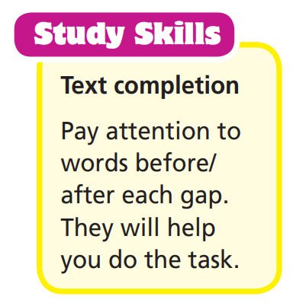
Pre-reading
Read the text and fill in the missing prepositions.

Slide 10
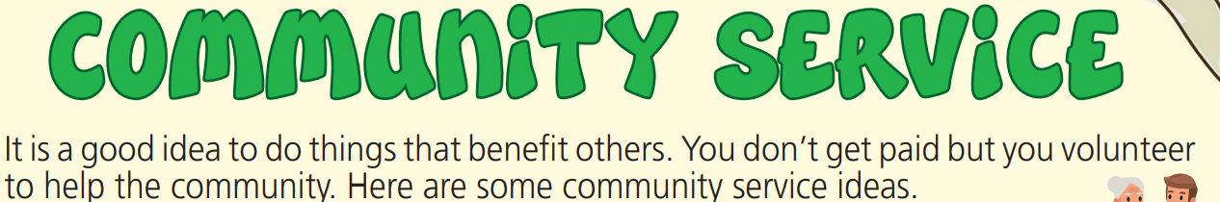
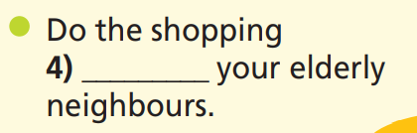



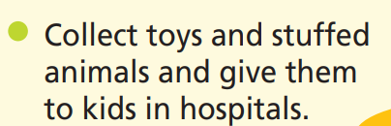
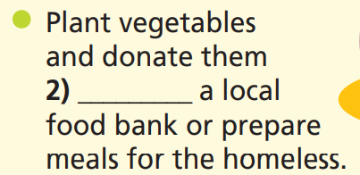
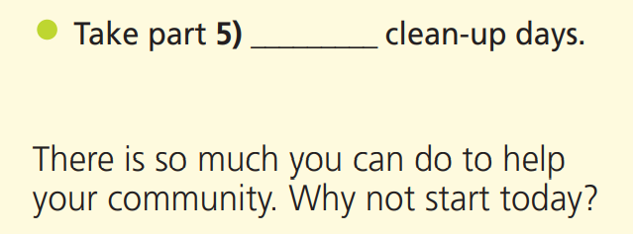
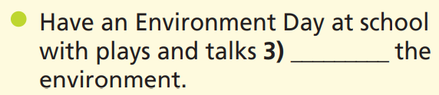
While-reading
Read the text and fill in the missing prepositions.
for
from
to
in
about

Slide 11
While-reading
Extra-task
Read the text and choose the best answer.
First, underline the key words.
1. According to the text, when helping the community,
you get paid.
You help the community.
You get some benefits.
2. Where can you organize plays and discussions about the environment?
At school.
At the hospitals.
At the parks.

Slide 12
While-reading
Extra-task
Read the text and choose the best answer.
First, underline the key words.
3. Where can you donate your Teddy Bear?
To local food bank.
To animal shelter.
To hospitals.
4. How can you help the elderly?
Prepare meals for them.
Have talks with them.
Help them buy food.

Slide 13
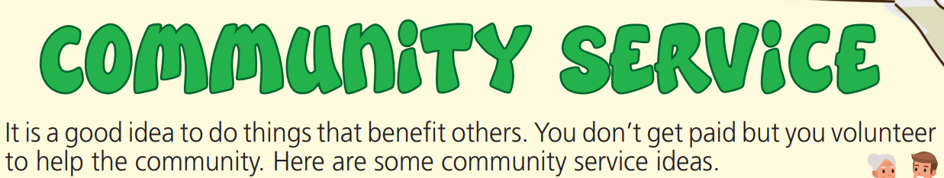
While-reading
Extra-task
Read the text and choose the best answer.
1. According to the text, when helping the community,
you get paid.
you help the community.
you get some benefits.

Slide 14
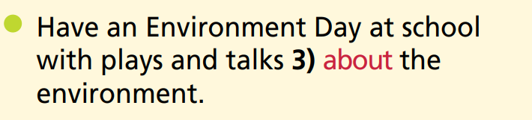
While-reading
Extra-task
Read the text and choose the best answer.
2. Where can you organize plays and discussions about the environment?
At school.
At the hospitals.
At the parks.

Slide 15
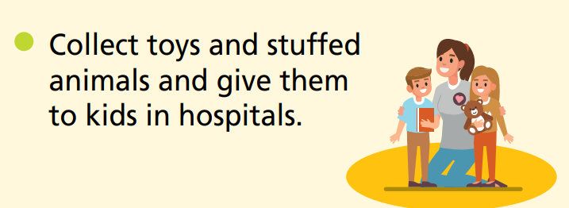
While-reading
Extra-task
Read the text and choose the best answer.
3. Where can you donate your Teddy Bear?
To local food bank.
To animal shelter.
To hospitals.

Slide 16
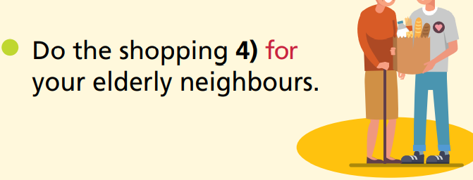
While-reading
Extra-task
Read the text and choose the best answer.
4. How can you help the elderly?
Prepare meals for them.
Have talks with them.
Help them buy food.

Slide 17
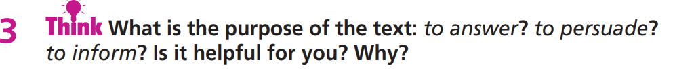
The purpose of the text is to + Vo
It helped me + Vo
Suggested answer
  The purpose of the text is to inform and let people know how they can help the environment and people.
  It helped me understand what I should do to help out my community and make it a better place.

Slide 18

Post-reading
Answer the following questions:
What community service activities in the reading text would you choose?
What are the benefits of each service?
E.g. We’ve decided to collect toys and stuffed animals and give them to kids in the hospital. In this way, we can make old things useful and make the kids happy.

Slide 19

CONSOLIDATION

Slide 20
What are you doing to help the community? Write a paragraph (at least 40 words) to describe your volunteer activities and/or your future plan.
Are you doing any community service activities?
How do you feel when you help the community?
What will you do to help the community?
What are the benefits of those activities?

Slide 21

WRAP-UP

Slide 22
Today’s lesson
To read for gist, to read for cohesion and coherence.
To talk about community service activities.

Slide 23
Homework
Practise the vocabularies and make sentences using them.
Prepare the next lesson (page 107 SB).
Do the exercises in WB (pages 54 & 55).
Do the exercises in TA 7 Right on Notebook (pages 52 & 53).

Slide 24

Enjoy your day!

