Slide 2
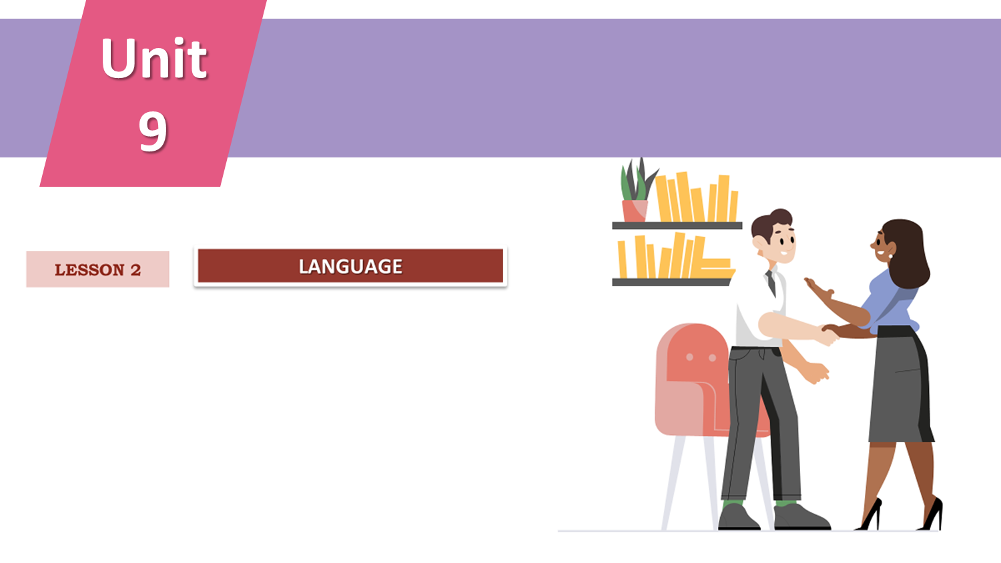

CAREER PATHS

Slide 3




LESSON 2
LANGUAGE
WARM-UP
Game: Hide and seek
Task 1: Listen and repeat
Task 2: Underline the stressed words
PRONUNCIATION
Task 1: Match the words and phrases with their meanings.
Task 2: Complete the sentences.
VOCABULARY
Task 1: Task 1: Match the verbs in 1–4 with the adverbs (a–d).
Task 2: Work in pairs. Make true sentences.
GRAMMAR
CONSOLIDATION
Wrap-up
Homework

Slide 4




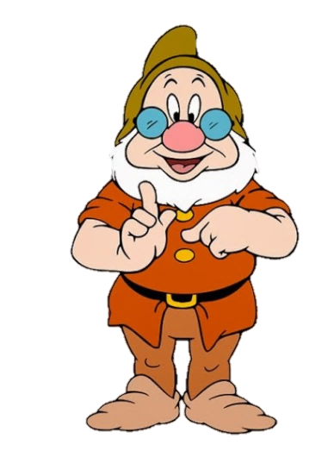
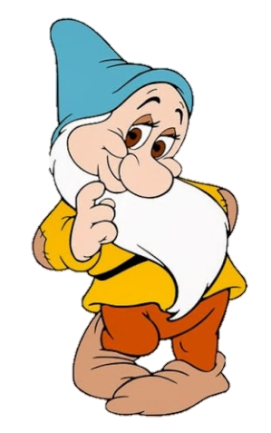
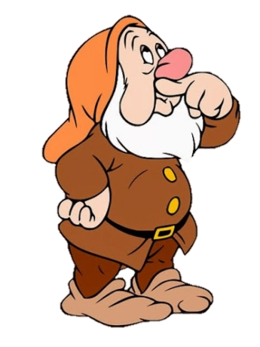


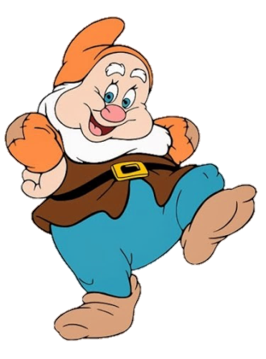
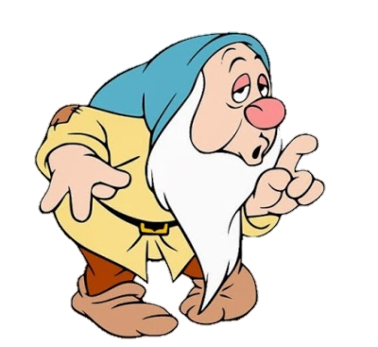
WARM-UP
HIDE AND SEEK
Snow White and the Seven Dwarfs

Slide 5

WARM-UP
HIDE AND SEEK
Snow White and the Seven Dwarfs
- Read the job descriptions.
- Raise your hands and answer what the job is.
- Bonus for every correct answer.

Slide 6

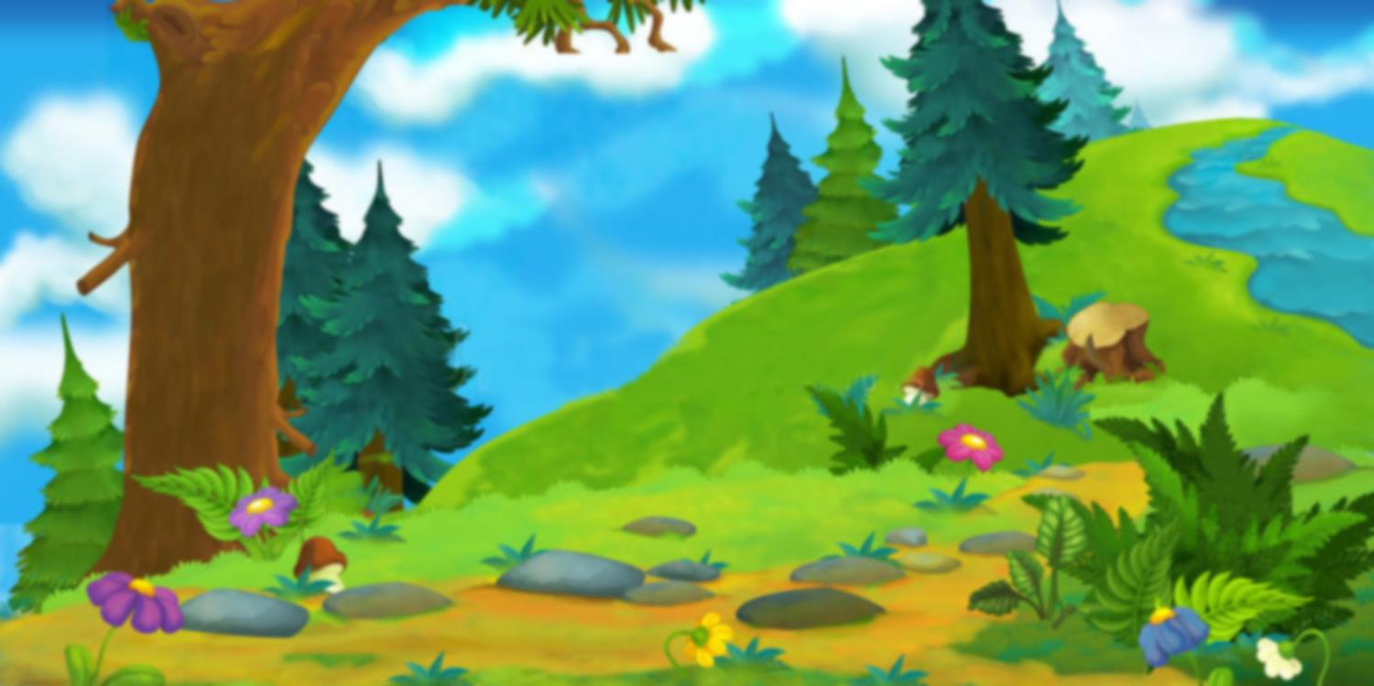



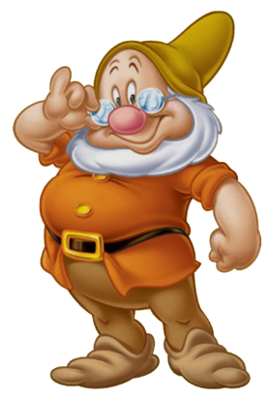
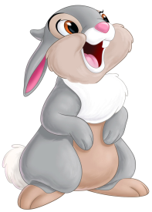

1. A member of an organization whose job is to make people obey the law and to prevent and solve crime
A. cook
B. police officer
C. IT
D. breadwinner
CORRECT

Slide 7



2. a person who has been trained in medical science, whose job is to treat people who are ill or injured
A. Tiktoker
B. pharmacist
C. doctor
D. explorer
correct

Slide 8

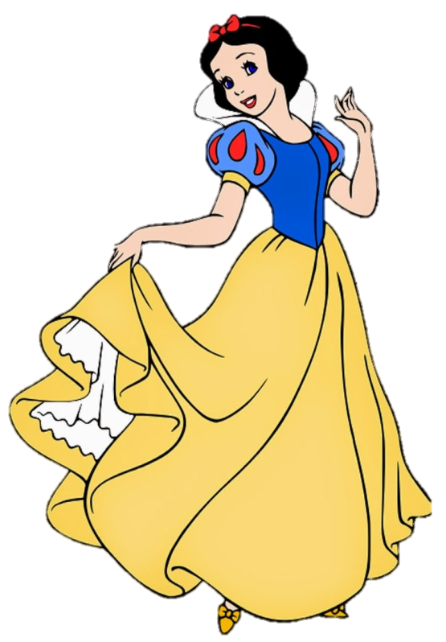
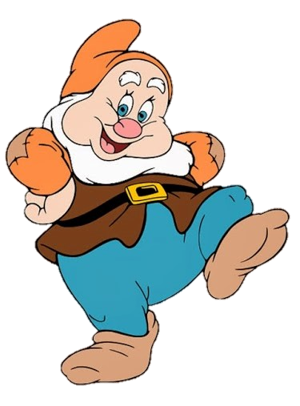
3. a person whose job is to manage, observe, and cook in a restaurant, hotel, etc..
A. chef
B. cook
C. waiter
D. waitress
correct

Slide 9
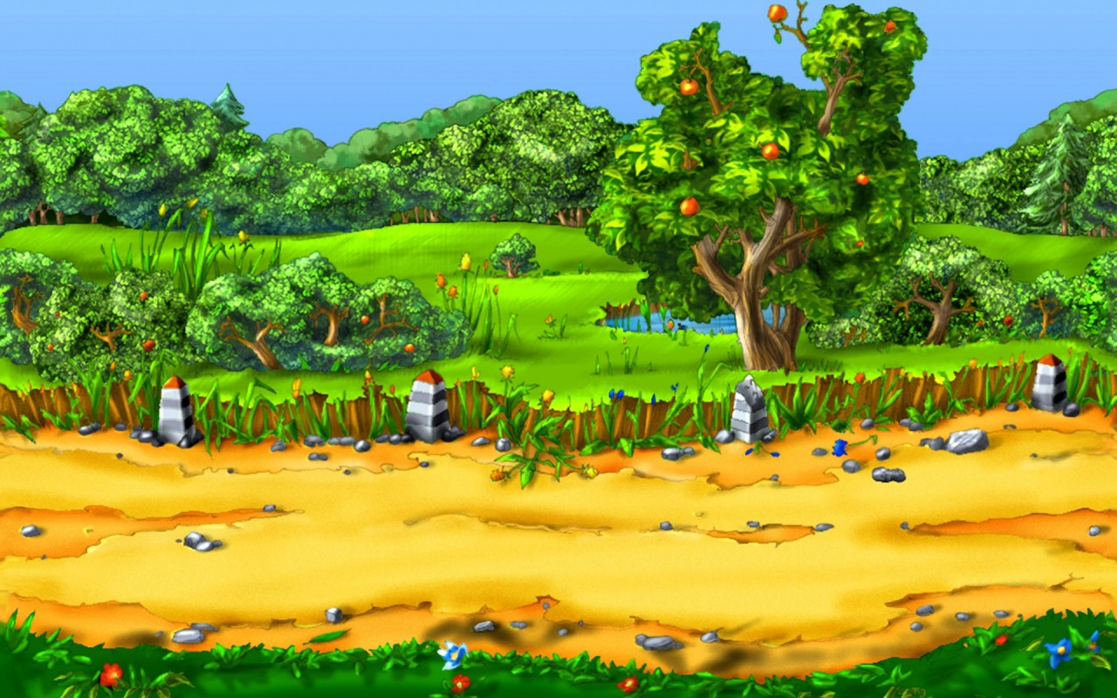
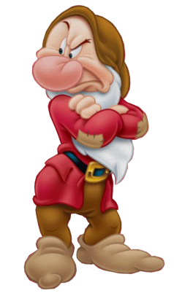
4. a university teacher of the highest rank.
A. tutor
B. teacher
C. doctor
D. professor
correct

Slide 10

5. a man whose job is to collect and deliver letters, etc.
A. poster
B. postman
C. collector
D. post officer
correct

Slide 11

6. people who belong to an organization whose job is to put out fires and to rescue people from fires
A. firemen
B. fire brigade
C. firefighters
D. All of them
correct

Slide 12
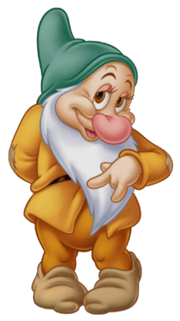
7. a person whose job is to keep or check financial accounts.
A. cashier
B. carpenter
C. accountant
D. CEO
correct

Slide 13


PRONUNCIATION
1
Listen and repeat.
Pay attention to the sentence stress and rhythm.
1. It depends on the industry and the field of work that you're interested in.
2. There're many jobs that don’t require a university degree.
3. These soft skills will help you adapt to changes and come up with solutions to challenging problems.

Slide 14

PRONUNCIATION
2
Underline the stressed words in the sentences.
Listen and check.
Then practice saying the sentences with a natural rhythm.
1. I’d like to apply for the position of Assistant Teacher.
2. We’ve received a lot of application letters.
3. We’ve chosen the best applicants to interview.
4. Successful applicants will start work in the new office

Slide 15

VOCABULARY
passion (n)
/ˈpæʃn/
a very powerful feeling, for example of sexual attraction, love, hate, anger, or other emotion

Slide 16
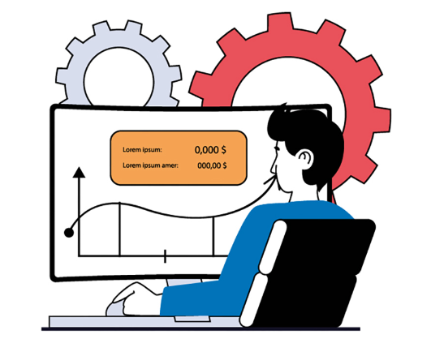
VOCABULARY
passionate (adj)
/ˈpæʃənət/
showing or caused by strong feelings or a strong belief.

Slide 17

VOCABULARY
work experience (n)
/ˈwɜːk ɪkspɪəriəns/
a period of time that a young person, especially a student, spends working in a company as a form of training

Slide 18
PRESENTATION
Form | Pronunciation | Meaning | Vietnamese equivalent
1. passion (n) | /ˈpæʃn/ | a very powerful feeling, for example of sexual attraction, love, hate, anger, or other emotion | Đam mê
2. passionate (adj) | /ˈpæʃənət/ | showing or caused by strong feelings or a strong belief | Say đắm
3. work experience (n) | /ˈwɜːk ɪkspɪəriəns/ | a period of time that a young person, especially a student, spends working in a company as a form of training | Kinh nghiệm làm việc

Slide 19

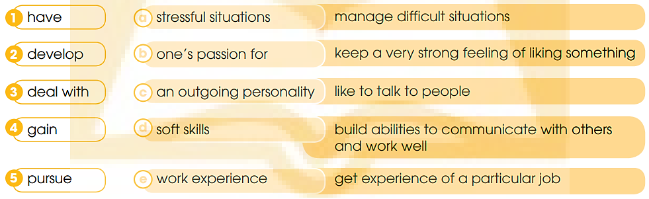

VOCABULARY
1
Match the words/phrase (1–5) with the phrases (a–e) to make phrases with the meanings below.

Slide 20

VOCABULARY
2
Complete the sentences using the correct forms of the phrases in
1
pursue her passion for
1. She left her current job in order to ___________________ music.
gained work experience
2. I have earned some money and ____________________ from my previous part-time jobs.
have an outgoing personality
3. If you ________________________,
it will be an advantage when you apply for this job.

Slide 21

VOCABULARY
2
Complete the sentences using the correct forms of the phrases in
1
4. In addition to technical knowledge, you also need to _______________ such as communication and teamwork skills.
develop soft skills
5. Your working environment may not always be pleasant. Sometimes, you have to ________________________.
deal with stressful situations

Slide 22

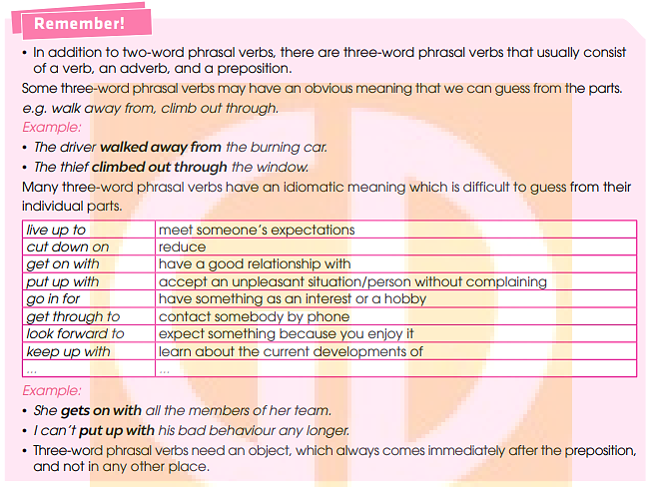

GRAMMAR

Slide 23
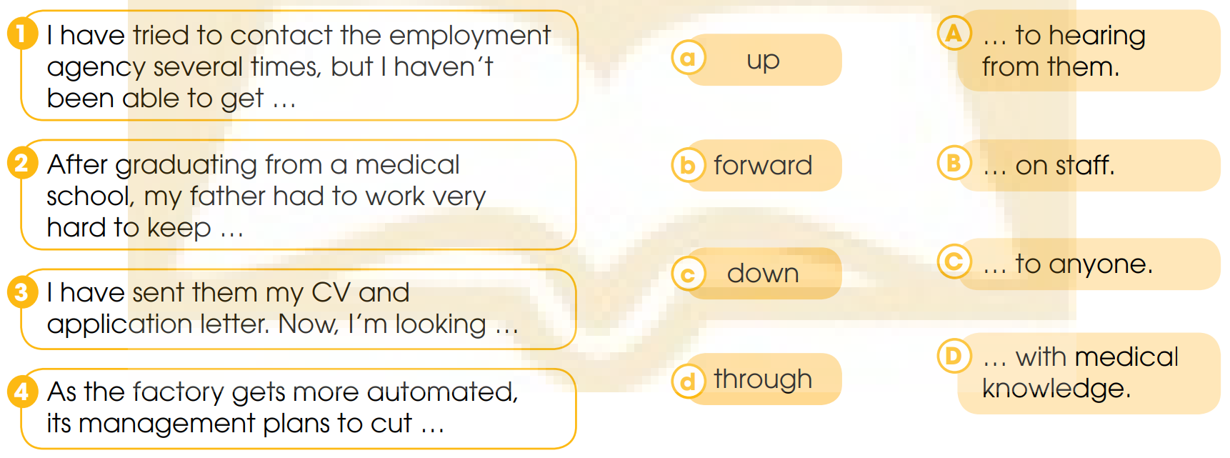
GRAMMAR
1
Match the verbs in 1–4 with the adverbs (a–d) and the prepositions in A-D to make complete sentences.

Slide 24
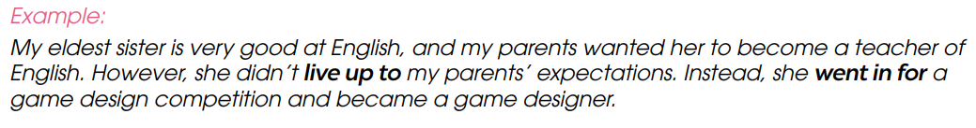
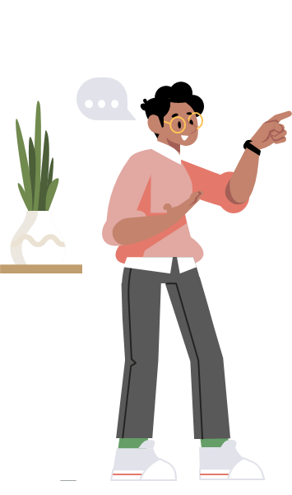
GRAMMAR
2
Work in pairs. Make true sentences about the career path of someone you know, using three-word phrasal verbs.

Slide 25

CONSOLIDATION
1
Wrap-up
What have you learnt today?
Some lexical items about career path
Reading for specific information
Three-word phrasal verbs

Slide 26

CONSOLIDATION
2
Homework
Learn by heart new Vocabulary.
Do exercises in the workbook.
Prepare for Lesson 3 - Unit 9.

Slide 27
Website: hoclieu.vn
Fanpage: facebook.com/www.tienganhglobalsuccess.vn

