Slide 2

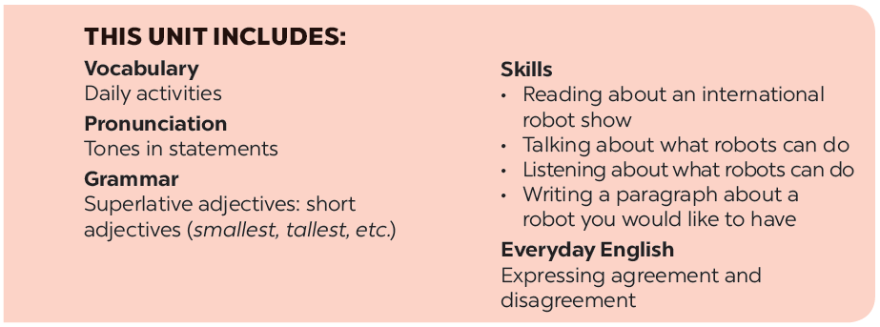

Slide 3







Everyday English
My robot’s abilities
Expressing agreement and disagreement
Listen to the radio programme from 4Teen News. Then fill the blanks with the words you hear.
Listen and read the dialogues.
Pay attention to the highlighted sentences.
Interview three friends about what abilities they want their robots to have. Note their answers in the table below.
Work in pairs. Express your opinions about the following statements. Use the highlighted phrases in the dialogues above.
Report your results to the class.

Slide 4
Everyday English
Expressing agreement and disagreement

Slide 5



Listen and read the dialogues.
Pay attention to the highlighted sentences.
A: I think robots can help us a lot in our daily life.
B: I agree with you.
A: Peter says robots can do everything like humans.
B: I don’t agree with him.

Slide 6

Work in pairs. Express your opinions about the following statements. Use the highlighted phrases in the dialogues above.
Home robots are the most useful of all types of robots.
Some people can use robots to do bad things.
Robots will use too much electricity in the future.

Slide 7
My robot’s abilities

Slide 8

Listen to the radio programme from 4Teen News. Then fill the blanks with the words you hear.
Speaker: Today we ask our friends: Tom from Australia, Linh from Viet Nam and Nobita from Japan to tell us about their robots. Tom, would you like to start?
Tom: Well, my robot can (1)
my feelings. It’s the (2)
Speaker: Linh?
Linh: My robot is my best friend. It does a lot for me: clean the ﬂoor, (3)
Speaker: And Nobita?
Nobita: My robot is very useful. It helps me a lot. It can (4)
my plants and even work as a (5)
_______ what I say. It can also understand
understand what I say. It can also understand
smartest robot.
_______ robot.
_______ my toys away, and ...
put my toys away, and ...
water
_______
_______.
guard.

Slide 9

Interview three friends about what abilities they want their robots to have. Note their answers in the table below.
Friends |  | Abilities he / she wants his / her robot to have
1.
2.
3.
Notes:
City landmarks phải ở trên mục 3

Slide 10


Report your results to the class.

Slide 11






Website: hoclieu.vn
Fanpage: facebook.com/www.tienganhglobalsuccess.vn/

