Slide 1


Slide 2

Unit
9
1
Unit
FAMILY LIFE
Protecting The Environment
LESSON 3
READING
Environmental problems

Slide 3

Unit
1
1
FAMILY LIFE
Family Life
Unit
OBJECTIVES
Practise reading for the main idea and specific information in a text about Environmental problems

Slide 4
LESSON 3
READING
Unit
GETTING STARTED
WARM-UP
Slap the board game
PRESENTATION
Vocabulary
Task 1: Look at the pictures and answer the question.
Task2: Read the text and choose the best title for it.
Task 3: Read the text again and decide which paragraph contains the following information.
Task 4: Complete the sentences.
Task 5: Work in group. Discuss the question. Give short talks.
PRACTICE
CONSOLIDATION
Wrap-up
Home work

Slide 5
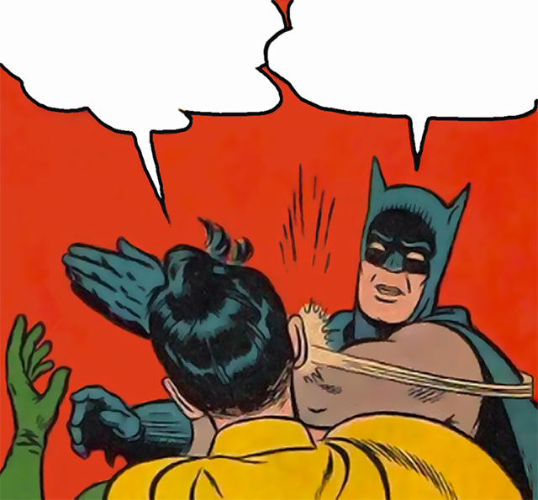

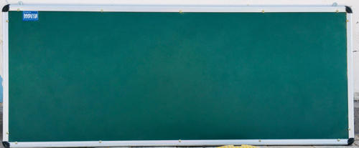
LESSON 3
READING
Unit
GETTING STARTED
WARM-UP
Slap the board game

Slide 6
SLAP THE BOARD GAME
LESSON 3
READING
Unit
WARM-UP
ENVIRONMENTAL ISSUES
- There are 12 pictures of environmental issues on the board.
- Teacher will say the name of one environmental issue and students will have to slap their hands on the appropriate picture.

Slide 7
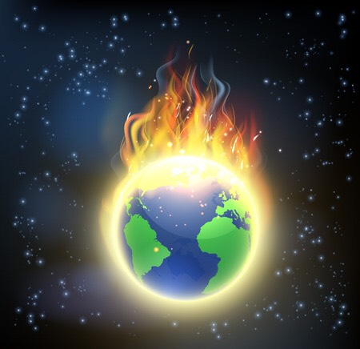
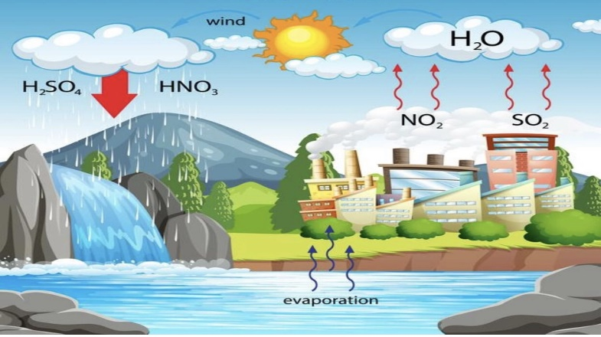
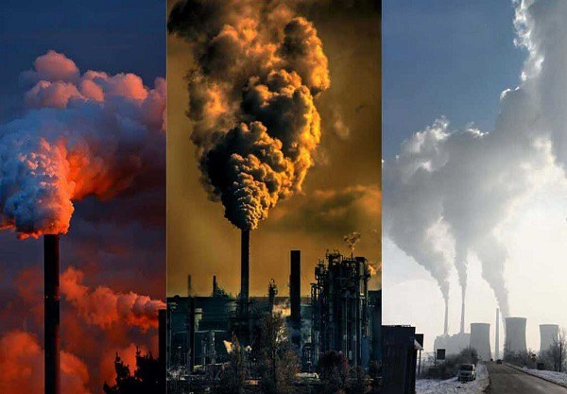
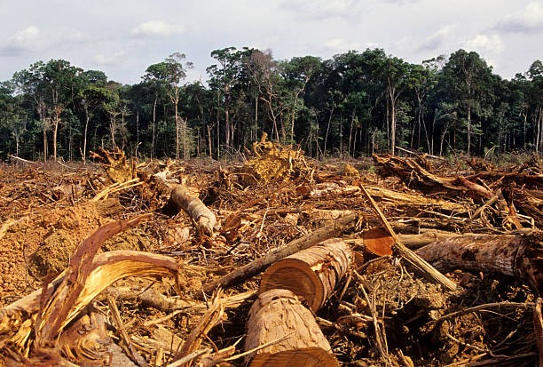
LESSON 3
READING
Unit
WARM-UP
SLAP THE BOARD GAME
1
2
3
4

Slide 8
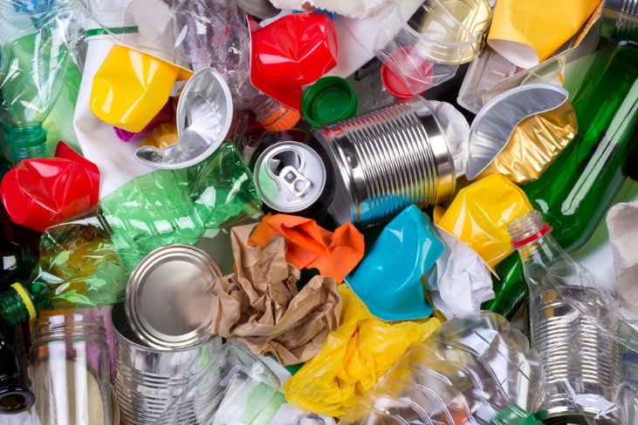
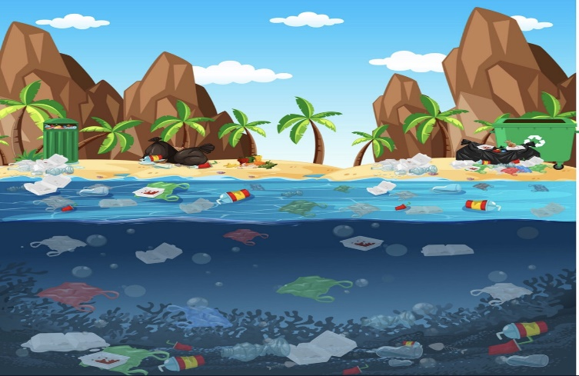
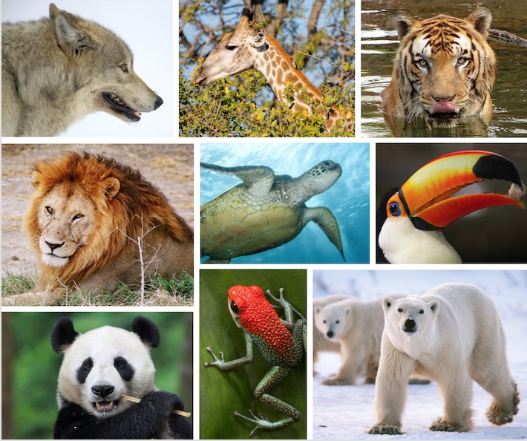
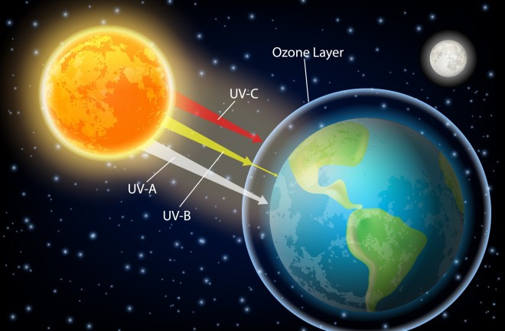
LESSON 3
READING
Unit
WARM-UP
SLAP THE BOARD GAME
5
6
7
8

Slide 9
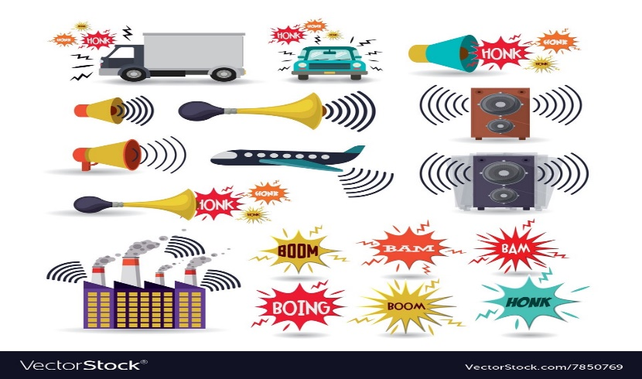
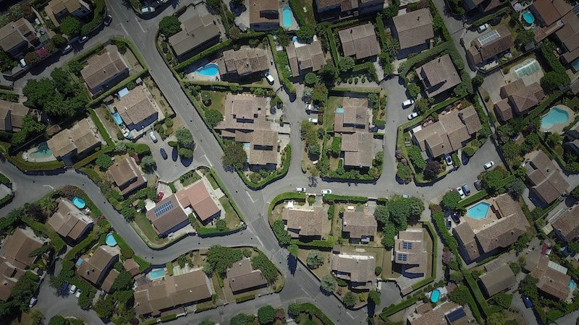
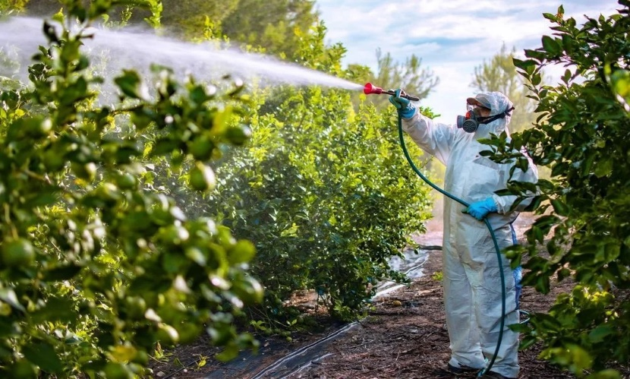
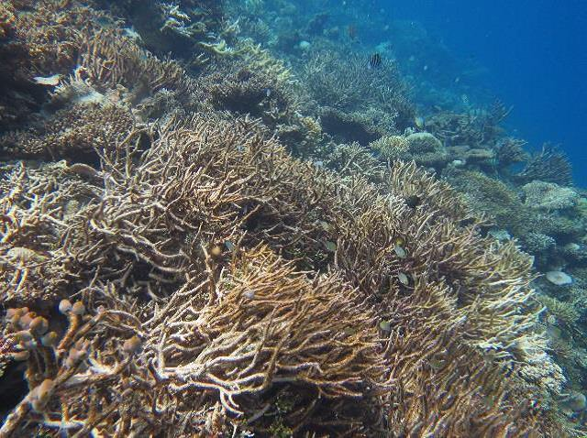
LESSON 3
READING
Unit
WARM-UP
SLAP THE BOARD GAME
9
10
11
12

Slide 10
SLAP THE BOARD - KEY
LESSON 3
READING
Unit
WARM-UP
1. Global warming | 2. Acid rain
3. Air pollution | 4. Deforestation
5. Rubbish | 6. Water pollution
7. Endangered animals | 8. Ozone layer depletion
9. Noise pollution | 10. Urban sprawl
11. Pesticide | 12. Ocean acidification
ENVIRONMENTAL ISSUES

Slide 11
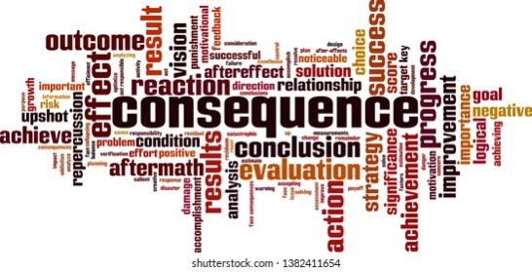

PRESENTATION
Consequence (n)
/ˈkɒnsɪkwəns/
a result of something that has happened, especially an unpleasant result

Slide 12
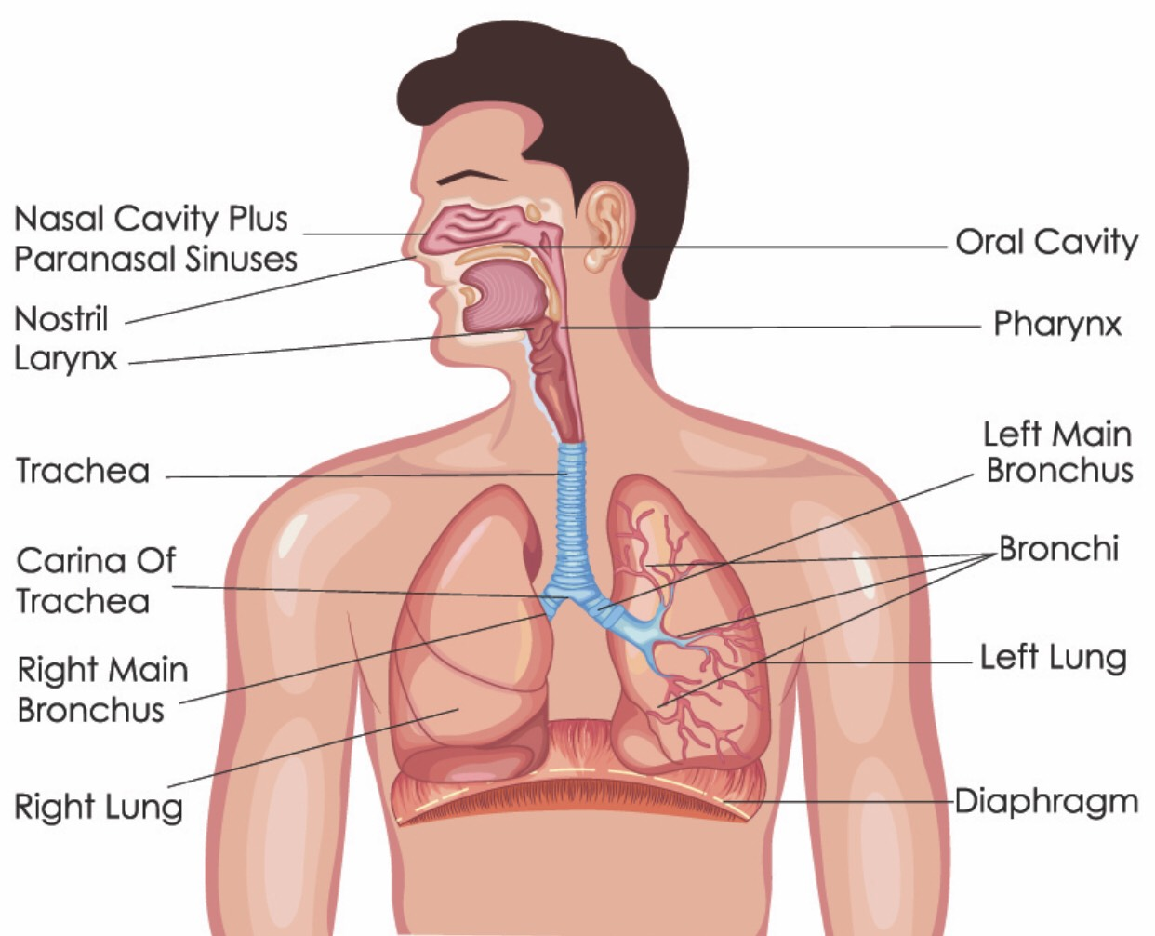
PRESENTATION
Respiratory (a)
/rəˈspɪrətri/
connected with breathing

Slide 13
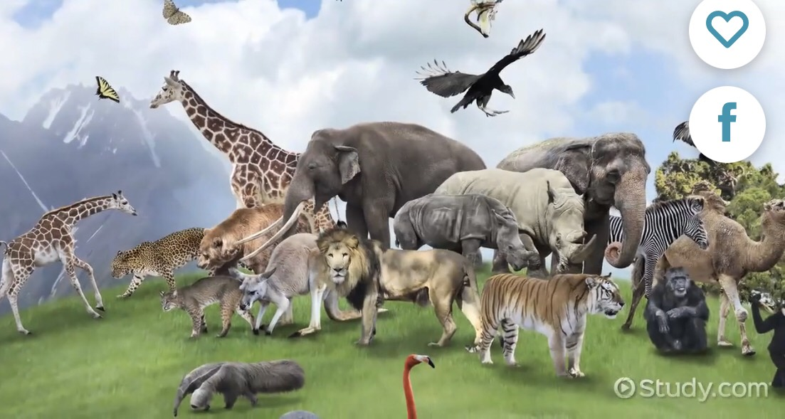
PRESENTATION
Upset (v)
/ʌpˈset/
to change the usual state or order of something, especially in a way that stops it from happening or working

Slide 14
PRESENTATION
New words | Pronunciation | Meaning
Consequence | /ˈkɒnsɪkwəns/ | a result of something that has happened, especially an unpleasant result
Respiratory | /rəˈspɪrətri/ | connected with breathing
Upset | /ʌpˈset/ | to change the usual state or order of something, especially in a way that stops it from happening or working

Slide 15
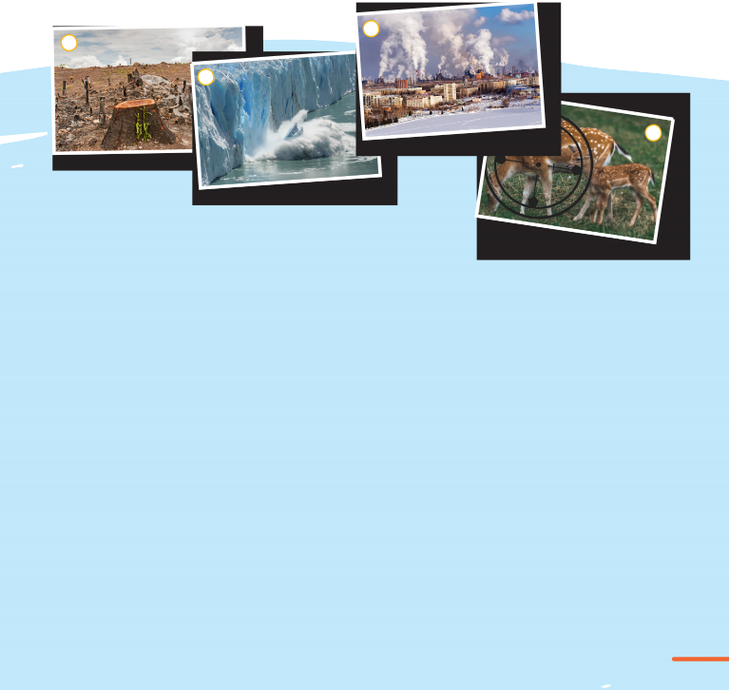
PRACTICE
1
Look at the pictures and answer the question:
What environmental problems do you see in the pictures?
Ảnh minh họa
a. Cutting of forests b. Global warming c. Air pollution d. Endangered animals

Slide 16
PRACTICE
2
Read the text and choose the best title for it.
1
a. Environmental problems: What are they?
b. Environmental protection: How important is it?
c. Environmental solutions: How practical are they?
KEY: a

Slide 17
PRACTICE
3
Read the text again and decide which paragraph contains the following information
Information | Paragraph
1. An example of harmful substances in the air and water | C
2. One of the reasons for destroying wildlife habitats | B
3. An increase in the level of the world’s oceans | A
4. An effect of illegal hunting on the ecosystem | D

Slide 18
PRACTICE
PRACTICE
4
Complete the sentences with information from the text. Use no more than TWO words for each answer .
Global warming can cause extreme ___________ floods or heatwaves.
The natural ___________ of many animals can be destroyed in the process of cutting down forests.
One of the main causes of air pollution is ___________ produced by machines and factories.
When many animals disappear, this damages the natural balance of ___________ .
weather events
habitats
waste gases
ecosystem

Slide 19
PRACTICE
PRACTICE
5
Work in 8 groups.
- Discuss the question:
Which of the problems mentioned in the text do you think is the most serious in Vietnam?
Global warming
Cutting of forests
Air pollution
Endangered animals
- Each group prepares a 3-minute talk on the very question.

Slide 20

PRACTICE
PRACTICE
5
Two group leaders take turns giving their talks to the whole class

Slide 21
LESSON 3
READING
Unit
GETTING STARTED
WARM-UP
Small talk
PRESENTATION
Vocabulary
Task 1: Read the text and choose the best title for it.
Task 2: Read the text again and decide which paragraph contains the following information.
Task 3: Complete the sentences.
Task 4: Work in group. Discuss the question. Give short talks.
PRACTICE
CONSOLIDATION
Wrap-up
Home work

Slide 22
CONSOLIDATION
1
Wrap-up
Develop such reading skills as reading for the main idea and specific information in a text about Environmental problems

Slide 23
CONSOLIDATION
2
Homework
Do exercises in the workbook

Slide 24


