Slide 1

Unit 3: School
Lesson 1.2
Page 39

Slide 2
Lesson Outline
Warm-up
Listening
Consolidation
Wrap-up

Slide 3
Objectives
By the end of this lesson, students will be able to pronounce the sounds /eɪ/, /ɪə/ and ask and answer who owns different school supplies.
Phonics: /eɪ/ and /ɪə/
Structure: Is this your (eraser)?
- Yes, it is./No, it isn't.
Are these your (notebooks)?
- Yes, they are./No, they aren't.

Slide 4

Notes:
459539764

Slide 5

WARM UP

Slide 6

LET’S CHANT!

Slide 7
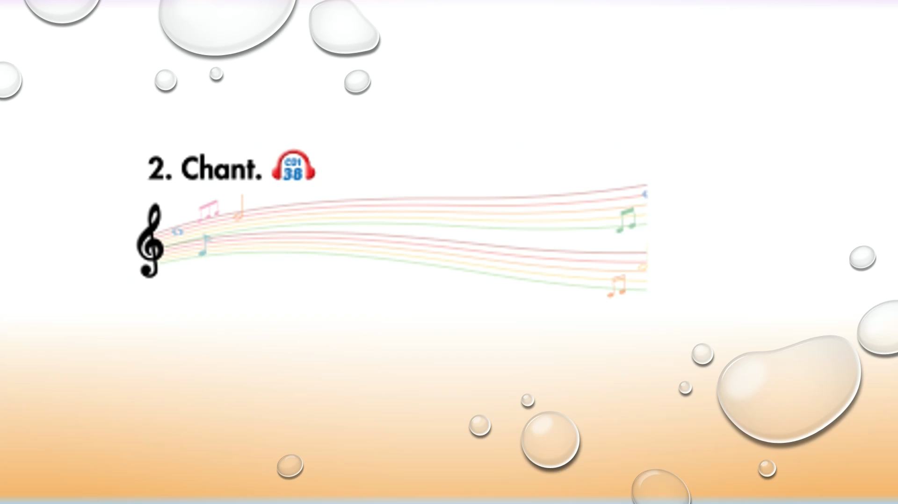

Slide 8

It’s time to learn …

Slide 9

Presentation

Slide 10
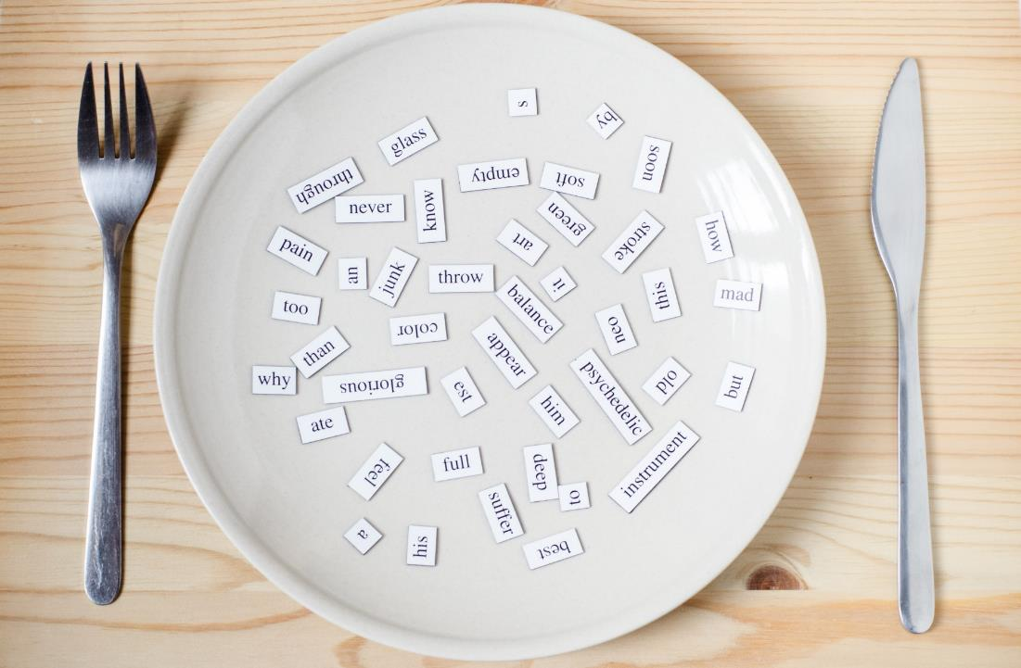
Phonics
/eɪ/ and /ɪə/

Slide 11


Click on the icon to hear the sound
Click on each word to hear the sound
eraser
here
/eɪ/
/ɪə/

Slide 12

Practice

Slide 13
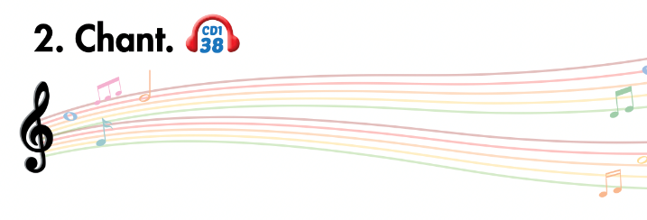
Listen and point
Listen and clap
Listen and chant

Slide 14


Slide 15

Let’s play!
Let’s Dance Game

Slide 16
How To Play
Students must take turns reading the words in order.
Each time a student can choose to say the words in 1 square, 2 squares or a maximum of 3 squares.
The student who says the last word must dance!

Slide 17

pen
pencil
eraser
ruler
pencil case
book
bag
note-book
friends
mother
books
bags
DANCE!!
father
pencils
brother
rulers
pens
sister
uncle
note-books
pencil cases
school
here
friend
aunt
eraser
ruler
pencils
cousin
erasers

Slide 18

Listening

Slide 19
Pre-Listening
Look at the pictures and answer these questions.

Slide 20
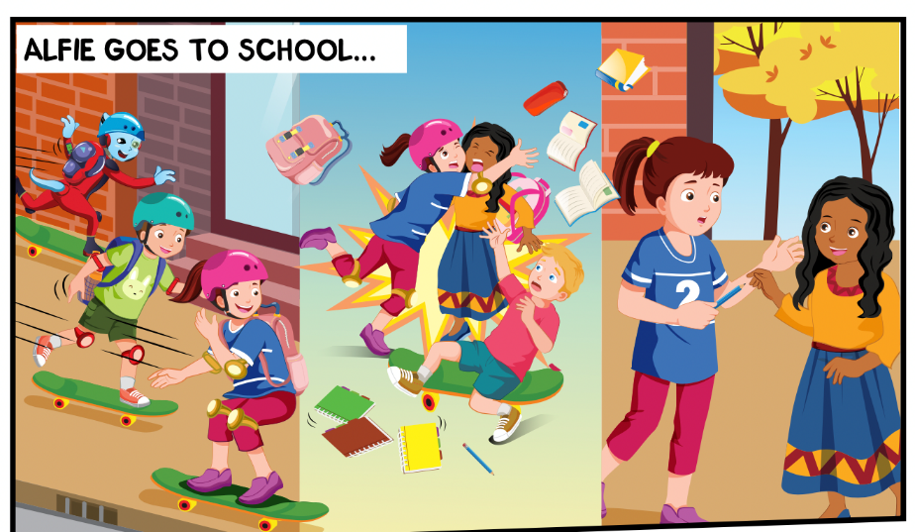
What things can you see?
Where are they?
Who can you see?

Slide 21
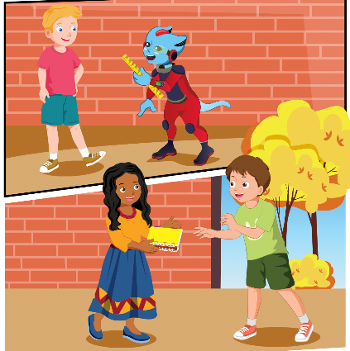

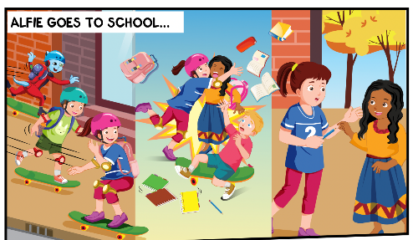
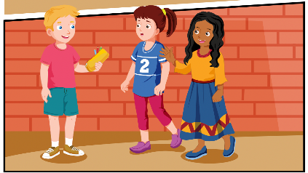
While-Listening
2.
Click on the icon to hear the sound
3.
1.
4.

Slide 22

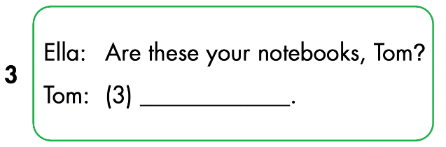
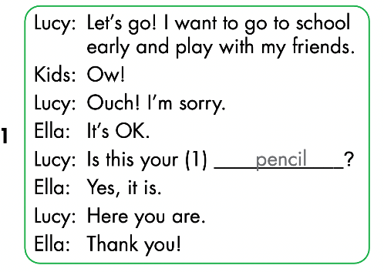
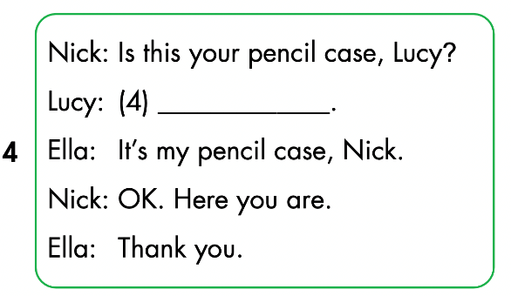
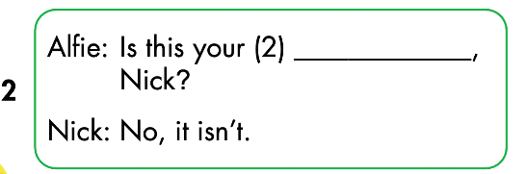
Click on the icon to hear the sound

Slide 23
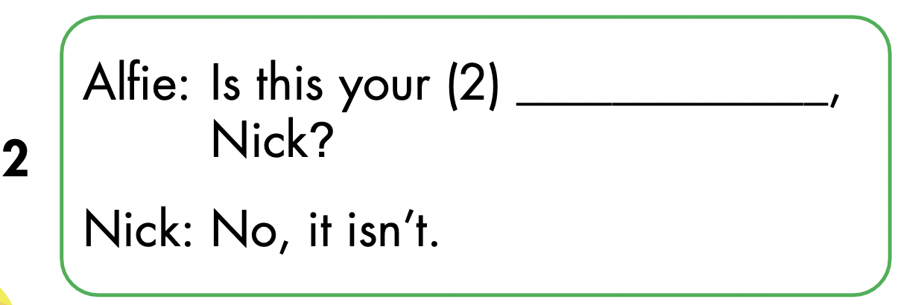
Let’s check!
ruler

Slide 24
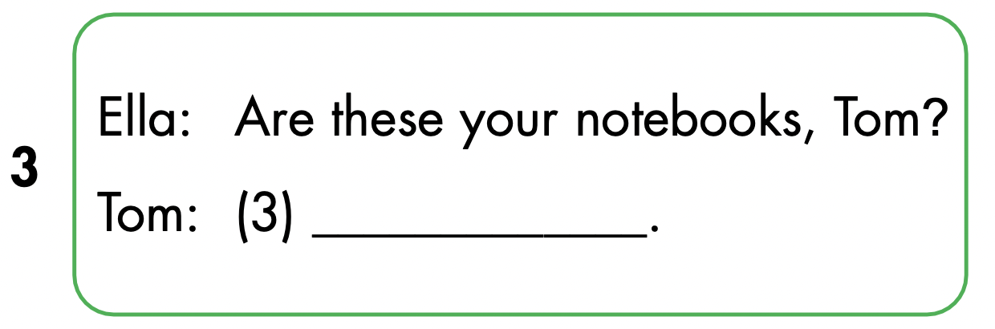
Yes, they are

Slide 25

No, it isn’t

Slide 26

Speaking

Slide 27


Yes, they are
No, it isn’t
ruler

Slide 28

CONSOLIDATION

Slide 29

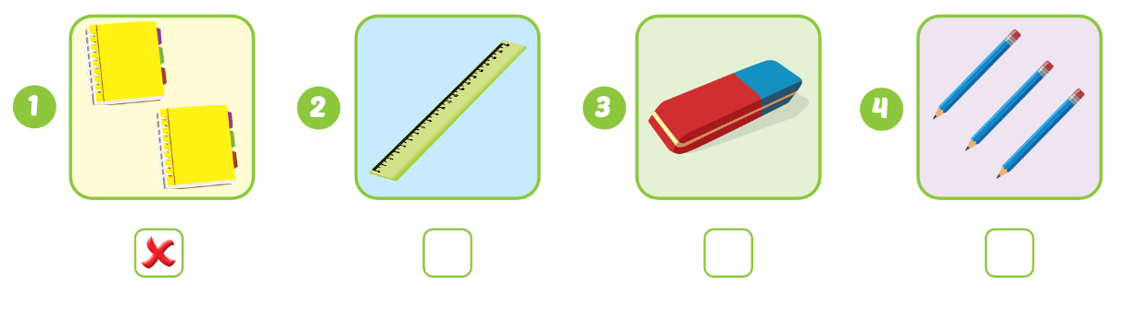


Extra Practice
WB p. 29
Click on the icon to hear the sound

Slide 30

Let’s draw!
Work in pairs
Draw your favorite school thing
Tell your friend about your picture
Notes:
134722862

Slide 31
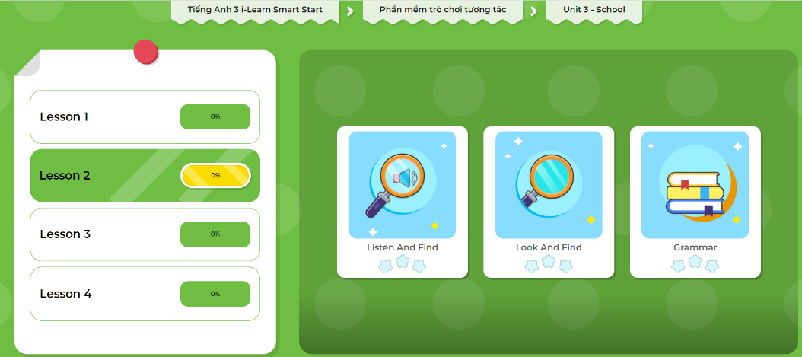
Extra Practice
DHA App
Let’s play!
Click on the picture below

Slide 32

WRAP-UP

Slide 33
Lesson 3
Today’s lesson
Phonics
/eɪ/ and /ɪə/
Structures/ Sentence patterns
Is this your (eraser)?
- Yes, it is./No, it isn't.
Are these your (notebooks)?
- Yes, they are./No, they aren't.

Slide 34
Lesson 3
Homework
Review by hearts vocabularies, structures and make sentences using them.
Do the exercises on page 29 WB
Do exercises in Tiếng Anh 3 i-Learn Smart Start Notebook on page 22.
Prepare the next lesson (page 40 SB)
Play the consolidation games in Tiếng Anh 3 i-Learn Smart Start DHA App on www.eduhome.com.vn.

Slide 35

Lesson 3
Stay positive and have a nice day!

