Slide 1
Unit 3:
Protecting the Environment
REVIEW 1
Page 90

Slide 2
Lesson Outline
Warm-up
Listening
Reading
Consolidation
Wrap-up

Slide 3
By the end of this lesson, students will be able to…
-review vocabularies and grammar points in Unit 3.
- practice listening, reading, and speaking skills.
- practice test taking skills.

Slide 4
Lesson 1
WARM UP

Slide 5
In pairs: Ask and answer about pollution.
Where do you live?
What is the biggest issue in your neighborhood?
What will happen if we don’t improve it?
What people should do?

Slide 6
A: Where do you live?
B: I live in Ho Chi Minh city.
A: What is the biggest issue in your neighborhood?
B: The biggest issue in my neighborhood is water pollution.
A: What will happen if we don’t improve it?
B: All the fish will die if we don’t improve it.
A: What people should do?
B: They should clean up the river.
A: What else?
B: And they shouldn’t throw trash into the water.
Example

Slide 7
Listening

Slide 8
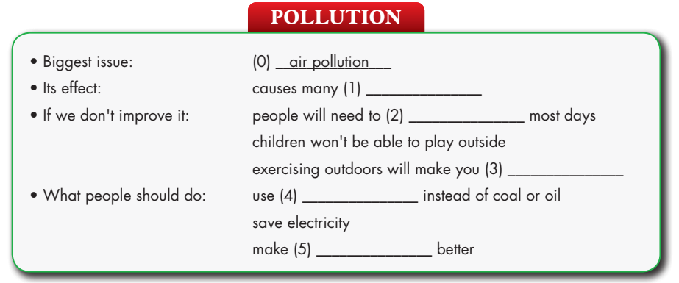
diseases
stay indoors
sick
renewable energy/
solar or wind
public transportation

Slide 9
Audio Scripts
It causes many diseases. Every year, thousands of people die because of air pollution. If we don’t do anything to improve it, we will need to stay indoors most days. Children won’t be able to play outside, and exercising outdoors will make you sick. So, what can we do to reduce air pollution? Power plants often cause lots of air pollution. Our government should use renewable energy like solar or wind instead of coal or oil. Each of us should save electricity because it takes lots of energy to make electricity. The town should make public transportation better so people will use it more. If we all walk, ride our bikes, or use public transportation, there will be less traffic and air pollution.
Narrator: Now, listen again
Example:
Narrator: You will hear a teacher talking about pollution. Listen and fill in the blanks. You will hear the information twice. W: Pollution is a problem in many places, but air pollution affects our town the most.
In pairs, practice the talk.

Slide 10
Reading

Slide 11
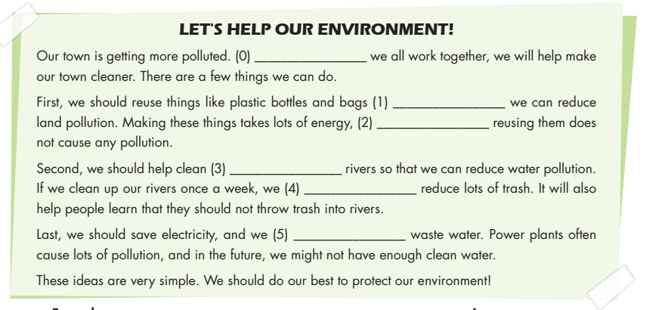

Slide 17
Work in pairs:
Do you agree with the solutions given in the Reading passage?
Do you have any other suggestions?

Slide 18
CONSOLIDATION

Slide 19
Write down vocabulary in unit 3 and make at least 5 sentences related to the words.
Example:
The pollution affects tourism.
Air pollution causes heart and lung diseases.
People should protect the environment.
Storms can damage trees and building.

Slide 20
WRAP-UP

Slide 21
Today’s lesson:
Review:
- Grammar of Unit 3: First Conditional, Compound and Complex sentences
- Vocabulary of Unit 3: Words of the topic “Protecting the Environment”: (affect, cause, pollute, disease, wildlife, tourism, environment, damage, recycle, reuse, reduce, save, waste, clean up, electricity, air conditioner, provide).
- Listening and Reading Practice to review the topic “Protecting the Environment”

Slide 22
Homework
- Review vocabulary, grammar and language skills of unit 3
- Do the exercises in WB: Unit 3 Review - Part 1 (page 52)
- Prepare: Review – SB (page 91)

Slide 23
Lesson 3
Stay positive and have a nice day!

