Slide 1

Unit 6. Community Services
Lesson 1.3: Pronunciation & Speaking
Page 48

Slide 2
Lesson Outline
Warm-up
Pronunciation
Practice
Speaking
Consolidation
Wrap-up

Slide 3
Objectives
By the end of this lesson, students will be able to…
- Pronounce /st/ sound correctly.
- Ask and give directions.
- Write about community services in your neighborhood.

Slide 4

WARM-UP

Slide 5

Work in pairs.
Choose the word whose main stress is placed
differently from the others.
1. A. under B. behind C. above D. across
2. A. library B. hospital C. customer D. container
3. A. bottle B. plastic C. mistake D. order
/ˈʌndə/
/bɪˈhaɪnd/
/əˈbʌv/
/əˈkrɑːs/
/ˈlaɪbreri/
/ˈhɑːspɪtəl/
/ˈkʌstəmə/
/kənˈteɪnə/
/ˈbɑːtəl/
/ˈplæstɪk/
/mɪˈsteɪk/
/ˈɔːrdə/

Slide 6
Work in pairs.
Choose the word whose underlined part is
pronounced differently from that of the other words.
A. bag B. can C. jar D. trash
2. A. make B. say C. play D. have
3. A. north B. south C. ground D. town
/bæɡ/
/cæn/
/dʒɑːr/
/træʃ/
/meɪk/
/seɪ/
/pleɪ/
/hæv/
/nɔːrθ/
/saʊθ/
/ɡraʊnd/
/taʊn/

Slide 7

Presentation

Slide 8
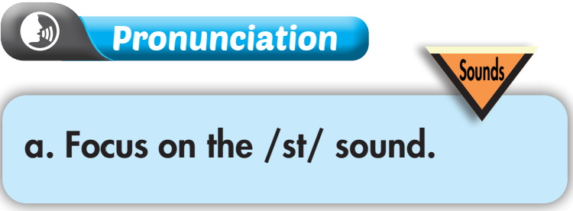

b. Listen to the words and focus on the underlined letters.
station post office

Slide 9
c. Listen and repeat.
station post office
d. Read the words with the correct sound to a partner.

Slide 10

Practice

Slide 11
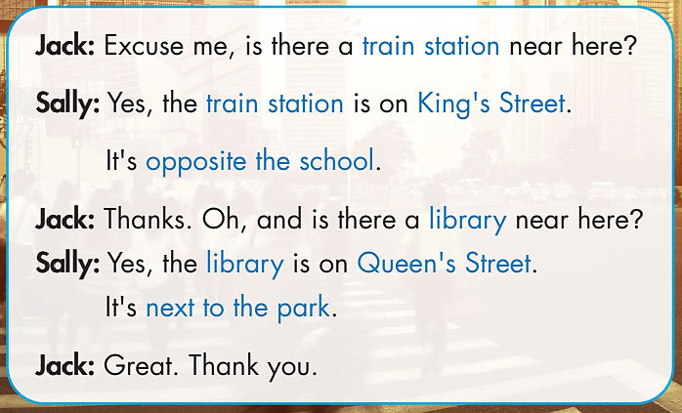
How many people are there in the conversation? Who are they?
→ Two. Jack and Sally
What are you going to do?
→ Practice the conversation.
And then?
→ Swap roles and repeat.

Slide 12
Jack: Excuse me, is there a train station near here?
Sally: Yes, the train station is on King's Street. It's opposite the school.
Jack: Thanks. Oh, and is there a library near here?
Sally: Yes, the library is on Queen's Street. It's next to the park.
Jack: Great. Thank you.

Slide 13

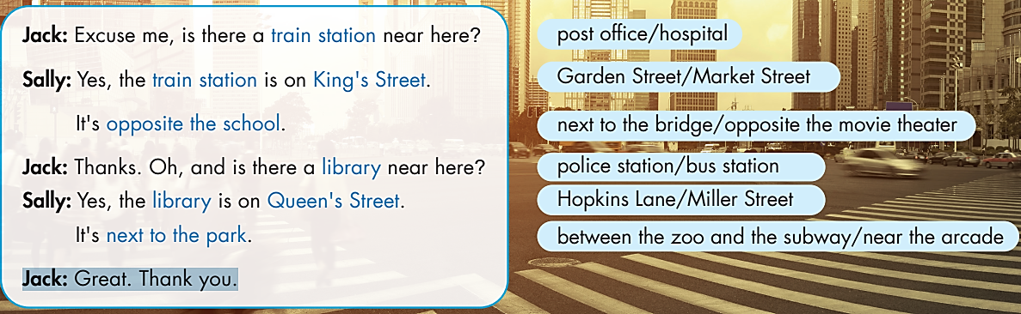
Swap roles and repeat

Slide 14

Production

Slide 15

Work in pairs.
Practice with your own ideas.

Slide 16
STUDENT A
STUDENT B
Excuse me, is there a supermarket near here?
Yes, the supermarket is on Hung Vuong Street. It's next to the bakery.
Thanks. Oh, and is there a park near here?
Yes, the park is on Dong Da Street. It's opposite the library.
Great. Thank you.
You’re welcome.

Slide 17

Speaking

Slide 18

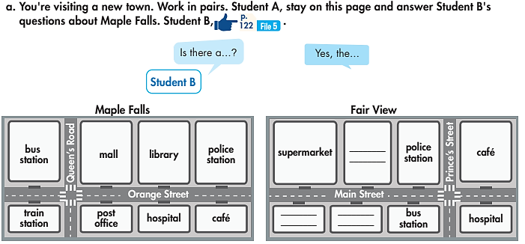
Pre-Speaking
Work in pairs.
Is There a Library near Here?
What is this?
→ A map.
What are you going to do?
→ Ask and give directions.

Slide 19
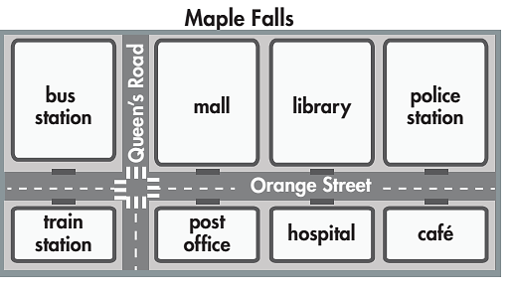
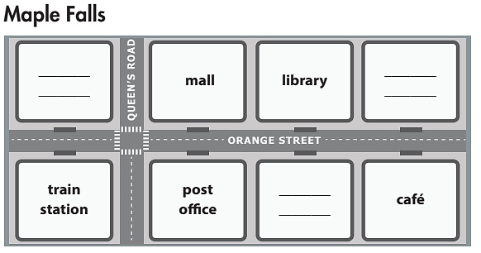
Work in pairs.
While-Speaking
Student A - answers Student B's
questions about Maple Falls.
Student B - looks at the map of Maple Falls and ask about these places: hospital, bus station, and police station.

Slide 20
STUDENT A
STUDENT B
Hello. Do you need any help?
Yes, is there a hospital near here?
Yes, the hospital is on Orange Street. It’s between the post office and the café.
Is there a bus station near here?
Yes, the hospital is on Queen’s Road. It’s opposite the train station.
Is there a police station near here?
Yes, the police station is on Orange Street. It’s next to the library.
Thank you very much.

Slide 21

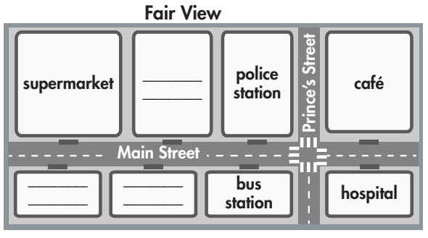
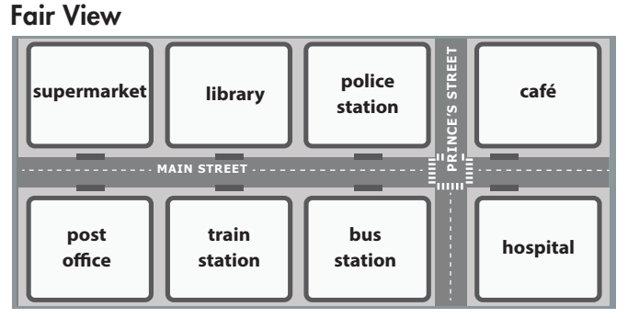
While-Speaking
Student B, answer Student A's questions about Fair View.
Student A - looks at the map of Fair View and ask about these places: post office, library, and train station.
Student B - answers Student A's
questions about Fair View.

Slide 22
STUDENT A
STUDENT B
Excuse me, is there a library near here?
Yes, the library is on Main Street. It’s between the supermarket and the police station.
Is there a post office near here?
Yes, the post office is on Main Street. It’s opposite the supermarket.
Is there a train station near here?
Yes, the train station is on Main Street. It’s between the post office and the bus station.
Thank you very much.
You’re welcome.

Slide 23
Post - Speaking
In groups, discuss the community services in your neighborhood and how to get there.
You can begin with:
My neighborhood is very convenient. There is a….

Slide 24

CONSOLIDATION

Slide 25
Write about community services in your neighborhood.
Write about 60-80 words.

Slide 26

WRAP-UP

Slide 27
Today’s lesson
- Pronounce /st/ sound correctly.
- Ask and give directions.
- Write about community services in your neighborhood.

Slide 28
Homework
Practice pronouncing /st/ sound correctly.
Prepare the next lesson (page 49 - SB)
Play the consolidation games in Tiếng Anh 6 i-Learn Smart World DHA App on www.eduhome.com.vn.

Slide 29

Enjoy your day!

