Slide 2


Unit
11
OUR GREENER WORLD
LESSON 6: SKILLS 2
1

Slide 3
LESSON 6: SKILLS 2
LESSON 1: GETTING STARTED
WARM-UP
Warm-up: Discussion
Listening
PRESENTATION
Task 1: Listen to two students talking about what they will do if they become the president of the 3Rs Club. Fill each blank with a word or a number.
Task 2: Listen again and tick (v) T (True) or F (False)
PRACTICE
Writing:
Task 3: Interview a classmate. Ask him/her what two things he/she will do if he/she becomes the president of the 3Rs Club. Take notes below.
Task 4: Write a paragraph about your classmate’s ideas in 3. Write about 50 words.
PRODUCTION
CONSOLIDATION
Wrap-up
Homework

Slide 4

Listening

Slide 5
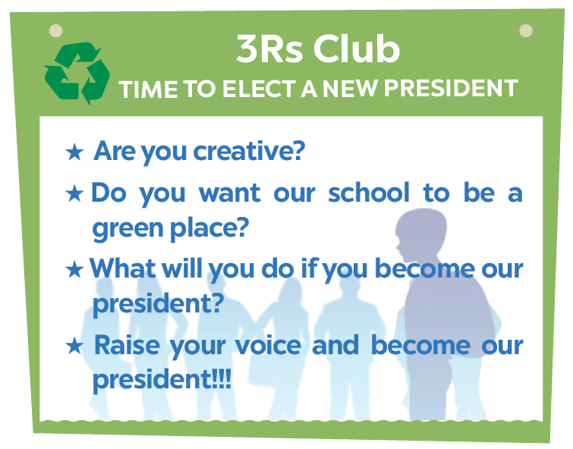
WARM-UP
DISCUSSION

Slide 6
PRESENTATION
Vocabulary
New words | Pronunciation | Meaning
1. president (n) | /ˈprezɪdənt/ | Chủ tịch
2. fair (n) | /feə(r)/ | Hội chợ
3. encourage (v) | /ɪnˈkʌrɪdʒ/ | Khuyến khích

Slide 7

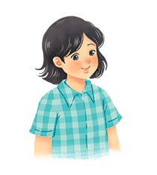
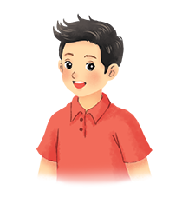

PRACTICE
Listen to two students talking about what they will do if they become the president of the 3Rs Club. Fill each blank with a word or a number.
Mi
Nam

Slide 8
PRACTICE
Listen to two students talking about what they will do if they become the president of the 3Rs Club. Fill each blank with a word or a number.
Name | Mi
Class | (1)
Idea 1 | Putting a (2) bin in every classroom
Idea 2 | Having (3) fairs
6A
recycling
book
Audio script

Slide 9

PRACTICE
Listen to two students talking about what they will do if they become the president of the 3Rs Club. Fill each blank with a word or a number.
AUDIO SCRIPT
Mi: I'm Mi from class 6A. If I become the president of the Club, I'll first talk to my friends about putting a recycling bin in every classroom. We can reuse the things we have in these bins. Secondly, I'll organise some book fairs. Students can exchange their used books at these fairs.

Slide 10
PRACTICE
Listen to two students talking about what they will do if they become the president of the 3Rs Club. Fill each blank with a word or a number.
Name | Nam
Class | (4)
Idea 1 | Encouraging students to use (5)
Idea 2 | Organizing (6) fairs
6E
bus
uniform
Audio script

Slide 11
PRACTICE
Listen to two students talking about what they will do if they become the president of the 3Rs Club. Fill each blank with a word or a number.
AUDIO SCRIPT
Nam: I'm Nam from class 6E. If I become the president of the Club, I'll encourage students to go to school by bus. It'll be fun and help the environment. Next, I'll organise some uniform fairs. This is where students can exchange used uniforms with other students.

Slide 12

PRACTICE
Listen again and tick () T (True) or F (False).
 | T | F
1. Mi thinks they can recycle things in the bins.
2. At book fairs, students can exchange their old books.
3. Nam thinks students will save money if they go to school by bus.
4. Students can exchange their used uniforms at uniform fairs.




Audio script

Slide 13
PRACTICE
AUDIO SCRIPT
Mi: I'm Mi from class 6A. If I become the president of the Club, I'll first talk to my friends about putting a recycling bin in every classroom. We can reuse the things we have in these bins. Secondly, I'll organise some book fairs. Students can exchange their used books at these fairs.
Nam: I'm Nam from class 6E. If I become the president of the Club, I'll encourage students to go to school by bus. It'll be fun and help the environment. Next, I'll organise some uniform fairs. This is where students can exchange used uniforms with other students.

Slide 14
Writing

Slide 15


PRODUCTION
Interview a classmate. Ask him/ her what two things he / she will do if he / she becomes the president of the 3Rs Club. Take notes below.
Name ___________________________
Idea 1 ___________________________
Idea 2 ___________________________
Study Skill - Writing
Giving explanations and / or examples is an important writing skill.
You should give explanations and / or examples to support your ideas.
Example:
Secondly, I’ll organise some book fairs. At these events students can exchange their used books.

Slide 16

PRODUCTION
Write a paragraph about your classmate’s ideas in 3. Write about 50 words.
My classmate is _________________. If she/he becomes the president of the 3Rs Club,he/she will do two things. Firstly, she/he will + Vo__________________________________.
Secondly, he/she will + Vo__________________________.

Slide 17

CONSOLIDATION
1
Wrap-up
What have we learnt in this lesson?
Listen about ideas for a green club.
Write a paragraph about ideas for a green club.

Slide 18

CONSOLIDATION
2
Homework
Do exercises in the workbook.
E1/ page 38, E2,3/page 39

Slide 19







