Slide 2

WARM-UP
Listen to a song!
-

Slide 3


Unit
11
OUR GREENER WORLD
LESSON 2: A CLOSER LOOK 1

Slide 4
LESSON 2: A CLOSER LOOK 1
Warm up: Listen to a song
WARM-UP
Vocabulary
Task 1: The three Rs stand for Reduce- Reuse- Recycle. Draw a line from a symbol in column A to its matching word in column B and its meaning in column C.
Task 2: Write a word/phrase in the box under each picture.
Task 3: Work in pairs. Put the words from 2 into groups. Some words can belong to more than one group.
PRESENTATION
PRACTICE
Pronunciation: Rhythm in sentences
PRODUCTION
Task 4: Listen to these sentences, then repeat. Pay attention to the bold syllables.
Task 5: Listen to the conversation. Pay attention to the bold syllables. Then practice the conversation with a classmate.
CONSOLIDATION
Wrap-up
Homework

Slide 5

Vocabulary

Slide 6




Vocabulary
PRESENTATION
The three Rs stand for Reduce – Reuse – Recycle. Draw a line from a symbol in column A to its matching word in column B and its meaning in column C.
A | B | C
 | Reduce | using something again
 | Reuse | creating new products from used materials
 | Recycle | using less of something

Slide 7

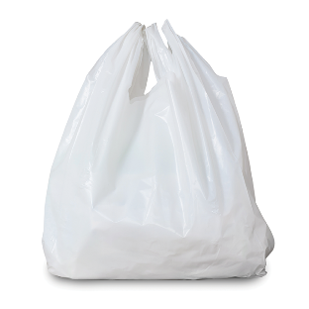
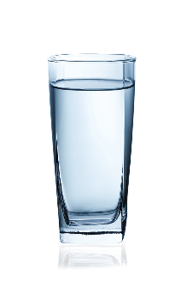
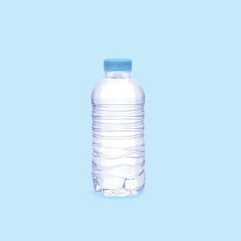
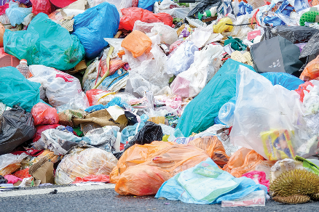

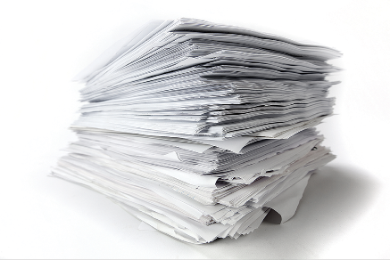

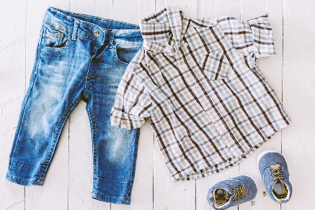
Vocabulary
PRACTICE
Write a word / phrase in the box under each picture.
rubbish
plastic bottle
glass
noise
plastic bag
paper
water
clothes

Slide 8
Vocabulary
PRACTICE
Write a word / phrase in the box under each picture.
rubbish
plastic bottle
glass
noise
plastic bag
paper
water
clothes
rubbish
plastic bag

Slide 9
Vocabulary
PRACTICE
Write a word / phrase in the box under each picture.
rubbish
plastic bottle
glass
noise
plastic bag
paper
water
clothes
glass
plastic bottle

Slide 10
Vocabulary
PRACTICE
Write a word / phrase in the box under each picture.
rubbish
plastic bottle
glass
noise
plastic bag
paper
water
clothes
noise
paper

Slide 11
Vocabulary
PRACTICE
Write a word / phrase in the box under each picture.
rubbish
plastic bottle
glass
noise
plastic bag
paper
water
clothes
water
clothes

Slide 12

Vocabulary
PRACTICE
Work in pairs. Put the words from 2 into groups. Some words can belong to more than one group.
Reduce | Reuse | Recycle

Slide 13
Vocabulary
PRACTICE
Work in pairs. Put the words from 2 into groups. Some words can belong to more than one group.
Reduce | Reuse | Recycle
rubbish
plastic bag
rubbish
plastic bag
glass
plastic bag
noise
plastic bottle
glass
plastic bottle
paper
plastic bottle
paper
water
paper
water
clothes

Slide 14
Pronunciation
Rhythm in sentences
In a sentence, the stressed and unstressed syllables combine to make rhythm.

Slide 15


PRONUNCIATION
PRACTICE
Listen to these sentences, then repeat. Pay attention to the bold syllables.
1.
If you cycle, it’ll help the Earth.
2.
Water is good for your body.
3.
The students are planting trees in the garden.
4.
Is it better to use paper bags?
5.
We are happy to walk to school.

Slide 16

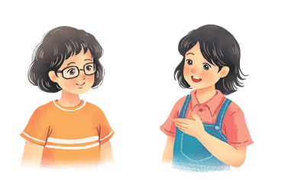
PRONUNCIATION
PRACTICE
Listen to the conversation. Pay attention to the bold syllables. Then practise the conversation with a classmate.
Vy: What are you doing?
Mi: I’m writing an article about going green.
Vy: Great! I’m writing a poem about the 3Rs.
Mi: Let me read it.
Vy: I’m still writing. Wait for a minute.

Slide 17

CONSOLIDATION
1
Wrap-up
What have we learnt in this lesson?
Vocabulary: The lexical items related to the 3 Rs and 3 Rs products.
Pronunciation: Rhythm in sentences

Slide 18

CONSOLIDATION
2
Homework
Do the exercises in the workbook.
A1,2/page 32
B1/page 32
B2/ page 33

Slide 19







