Slide 1

Unit 6: Entertainment
Progress Check
Page 116

Slide 2
Lesson Outline
Warm-up
Vocabulary
Grammar
Speaking
Consolidation
Wrap-up

Slide 3
Objectives
By the end of this lesson, students will be able to…
- review vocabulary related to entertainment and free time activities.
- review grammar and structures: will/ be going to - Conditional type 1

Slide 4

WARM-UP

Slide 5
Choose the word whose underlined part is pronounced differently from that of the others.
1. A. hear B. year C. heat D. clear
/hɪə/ /jɪə/ /hiːt /klɪə/
2. A. place B. care C. lake D. day
/pleɪs/ /keə/ /leɪk/ /deɪ/
3. A. bear B. wear C. learn D. pear
/beə/ /weə/ /lɜːn/ /peə/

Slide 6
Choose the word whose main stress is placed differently from that of the others.
1. A. adventure B. outdoor C. weather D. session
/ədˈventʃə/ /ˈaʊtdɔː/ /ˈweðə/ /ˈseʃən/
2. A. special B. science C. advice D. circus
/ˈspeʃəl/ /ˈsaɪəns/ /ədˈvaɪs/ /ˈsɜːkəs/
3. A. summer B. childish C. vanish D. protect
/ˈsʌmə/ /ˈtʃaɪldɪʃ/ /ˈvænɪʃ/ /prəˈtekt/

Slide 7

It’s time to learn …

Slide 8
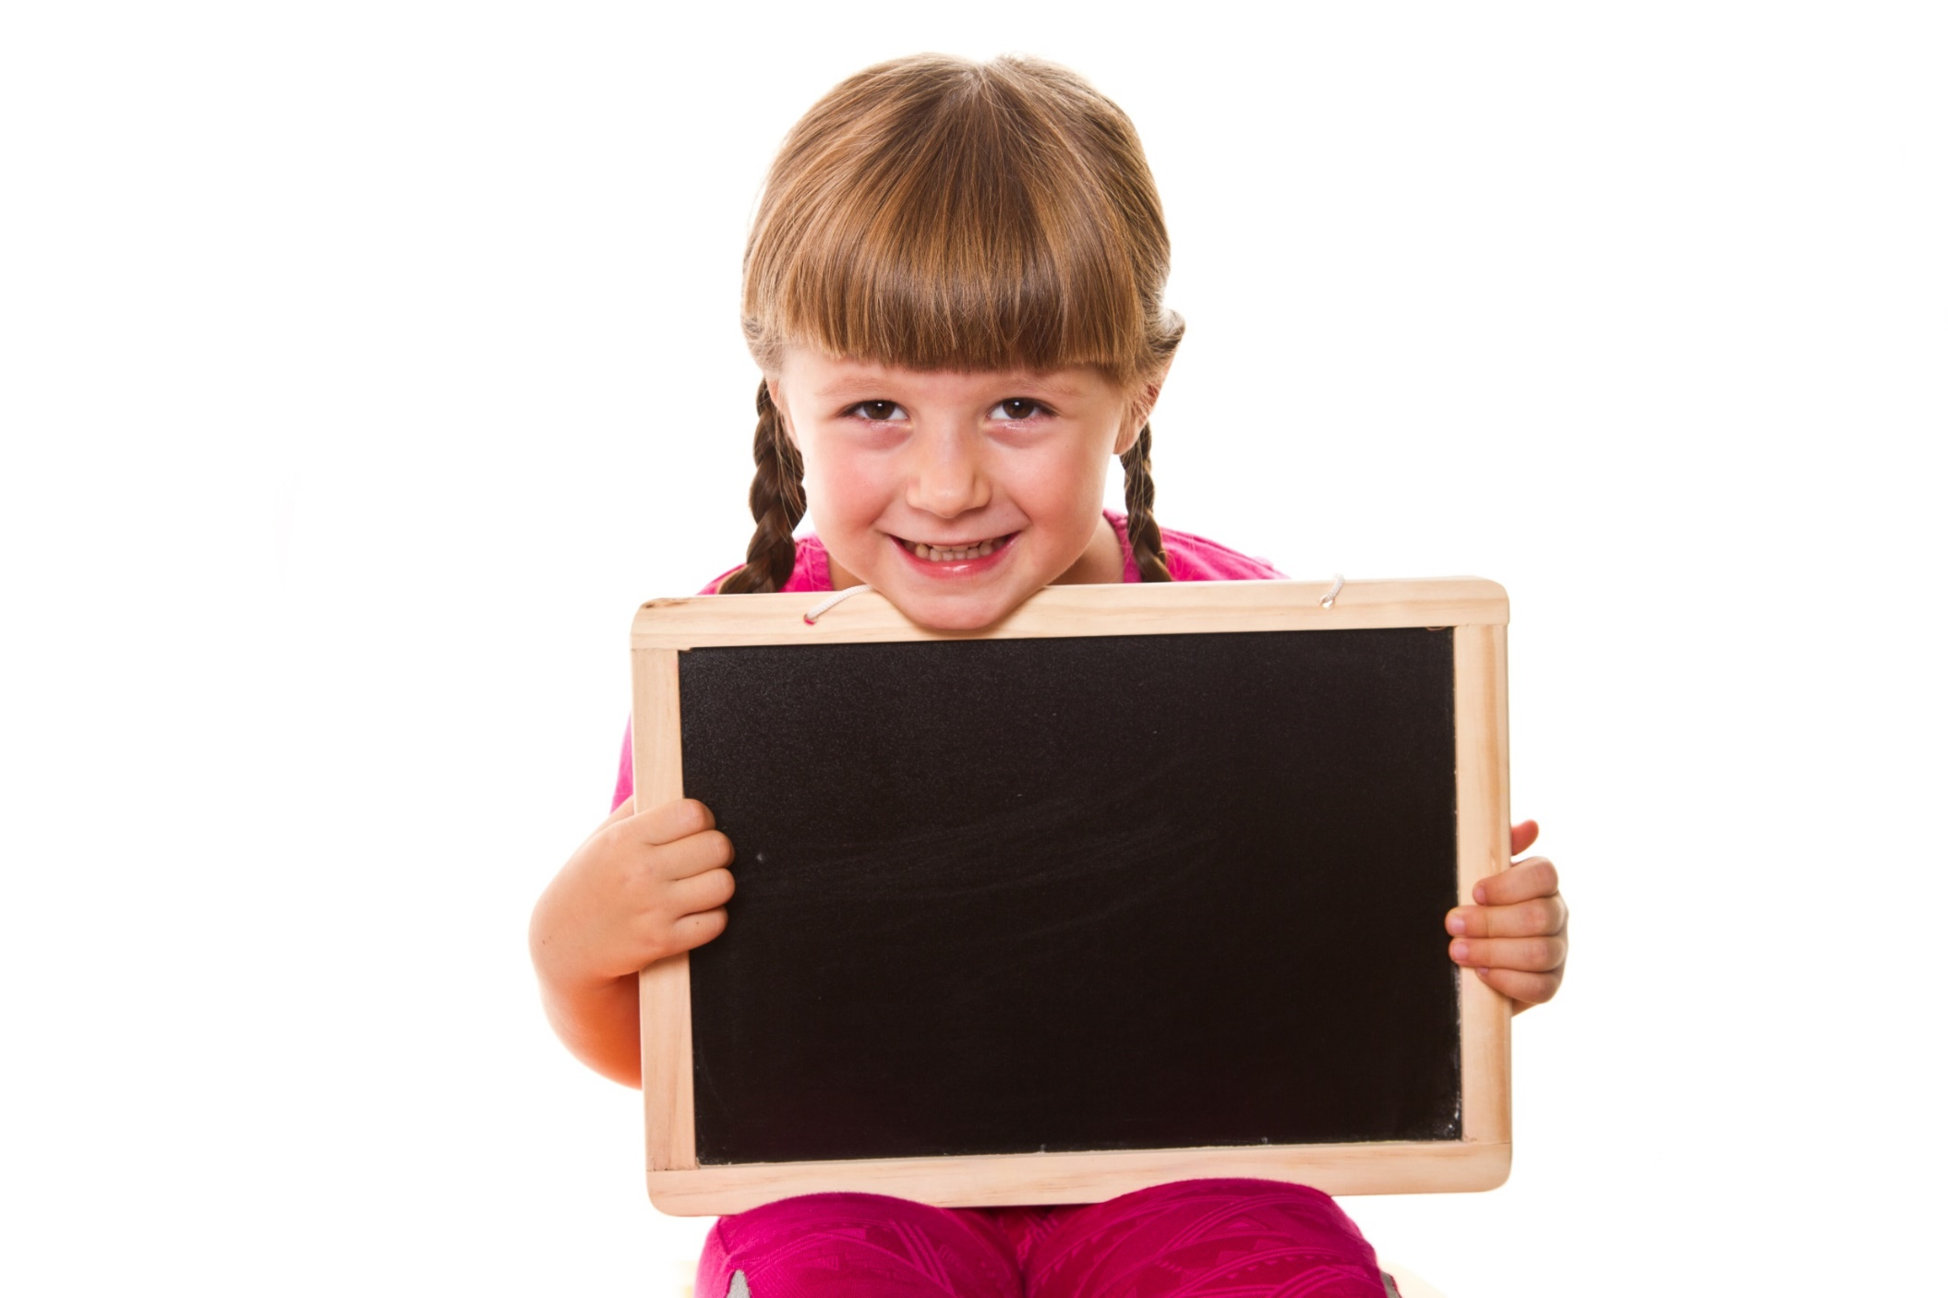
Vocabulary

Slide 9
1 Fill in the gaps with circus, theatre, stadium, concert hall, amusement park, and exhibition centre.
1 You can watch a performance with actors at a(n) _________________ .
2 You can see a robotics exhibition at a(n) _________________ .
3 You can listen to classical music at a(n) _________________ .
4 You can see a sports event at a(n) _________________ .
5 You see clowns and acrobats at a(n) _________________ .
6 You can go on a roller coaster at a(n) ________________ .
theatre
exhibition centre
concert hall
stadium
circus
amusement park

Slide 10
2 Choose the correct item.
1 Let’s do/go paintballing next weekend.
2 Lisa is going to have/do a sleepover with her school friends.
3 How often do you go/do rollerskating?
4 Henry usually plays/goes windsurfing at the weekend.
5 I enjoy watching documentaries/ thrillers because they are educational.
6 Let’s do/go Vovinam.
7 He likes picking/sampling up bargains at markets.
8 He enjoys watching soap shows/operas.

Slide 11
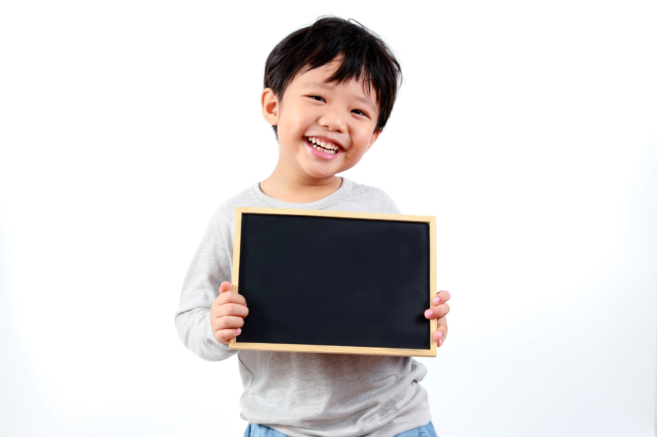
Grammar

Slide 12
3 Choose the correct item.
1 We will travel/are going to travel to Warsaw next Saturday.
2 It’s too cold. I will close/am closing the window.
3 If you go to Rome, you are seeing/will see the Colosseum.
4 They are leaving/will leave tomorrow morning at 7:30 by train.
5 We will travel/travel abroad this summer if we have enough money.

Slide 13
More Practice
GB p. 71
Fill in the gaps with will or won’t.
1 John ________come to the cinema with us today. He’s working late.
2 It’s really cold outside. I ________ stay home.
3 I promise I ________ meet you at the exhibition later. I’m looking forward to it.
4 I hope she ________ miss the show. She’s wanted to see it for weeks.
5 Are you hot? I ________ open the window for you.
6 I think you ________ be a great actor one day.
won’t
will
will
won’t
will
will

Slide 14
4. Put the verbs in brackets in the correct tense.
1 If I _____________ (be) tired, I’ll go home.
2 If you ask her, she _____________ (help) you.
3 If you _____________ (leave) now, you’ll be there before the lecture starts.
4 If it rains this afternoon, we _____________ (not/go) to the park.
5 They _____________ (not/come) if they finish late.
am
will help
leave
won’t go
won’t come

Slide 15
More Practice
GB p. 72
Put the verbs in brackets into the correct tense.
1 A: How do we get the colour purple?
B: If you ___________ (mix) blue and red, you ___________ (get) purple.
2 A: Are you coming to the cinema with us this Saturday?
B: I ___________ (go) if Jane ___________ (want) to go as well.
3 A: It’s raining again.
B: Yes, but when it ___________ (rain), plants ___________ (grow) more.
4 A: Is Carmen coming to the theatre with us?
B: She ___________ (not/come) unless there ___________ (be) a good show on.
5 A: Can I borrow your guitar, Nathan?
B: Well, if you ___________ (be) careful with it, I ___________ (lend) it to you.
mix
will get
will go
wants
rains
will grow
won’t come
is
are
will lend

Slide 16
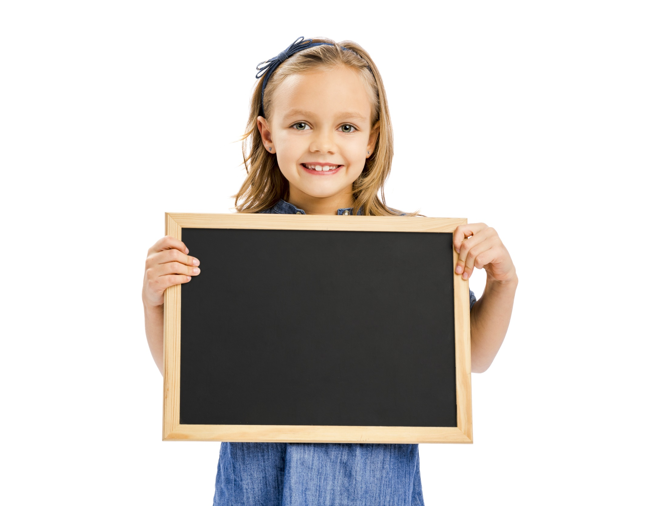
Speaking

Slide 17
5 Complete the dialogue. Use the statements (a-e).
a What time is it on?
b Do you want to watch it?
c Don’t worry.
d Oh, I know that one.
e What else is on?
A: Paul, your favourite cookery show is on TV. (1) ______________________
B: Not really. I’m not interested in that show anymore. (2) ______________________
A: Well, there’s this film on – it looks like an action film.
B: (3) ______________________ It’s called Fifth Gear. Let’s watch it.
A: OK, but don’t forget I want to watch a documentary later.
B: (4) ______________________
A: It’s at 7:00 on Channel 4.
B: (5) ______________________ The film will be over before it starts.
A: Great. I’ll get some snacks.

Slide 18

CONSOLIDATION

Slide 19
Make 5 sentences using the Conditional type 1.

Slide 20

WRAP-UP

Slide 21
Today’s lesson
Vocabulary
vocabulary related to free time activities.
Grammar
- will/be going to/Present Continuous
- Conditional type 1

Slide 22
Homework
Practise the vocabularies and grammar and make sentences using them.
Do the exercises in TA 6 Right on WB (pp. 71 & 72).
Do the exercises in TA 6 Right on Notebook (pp. 60 & 61).
Prepare the next lesson (p. 117 SB).
Do Unit 6 Test 2 in Bài Tập Bổ Trợ TA 6 Right on (pp. 54 & 55).

Slide 23
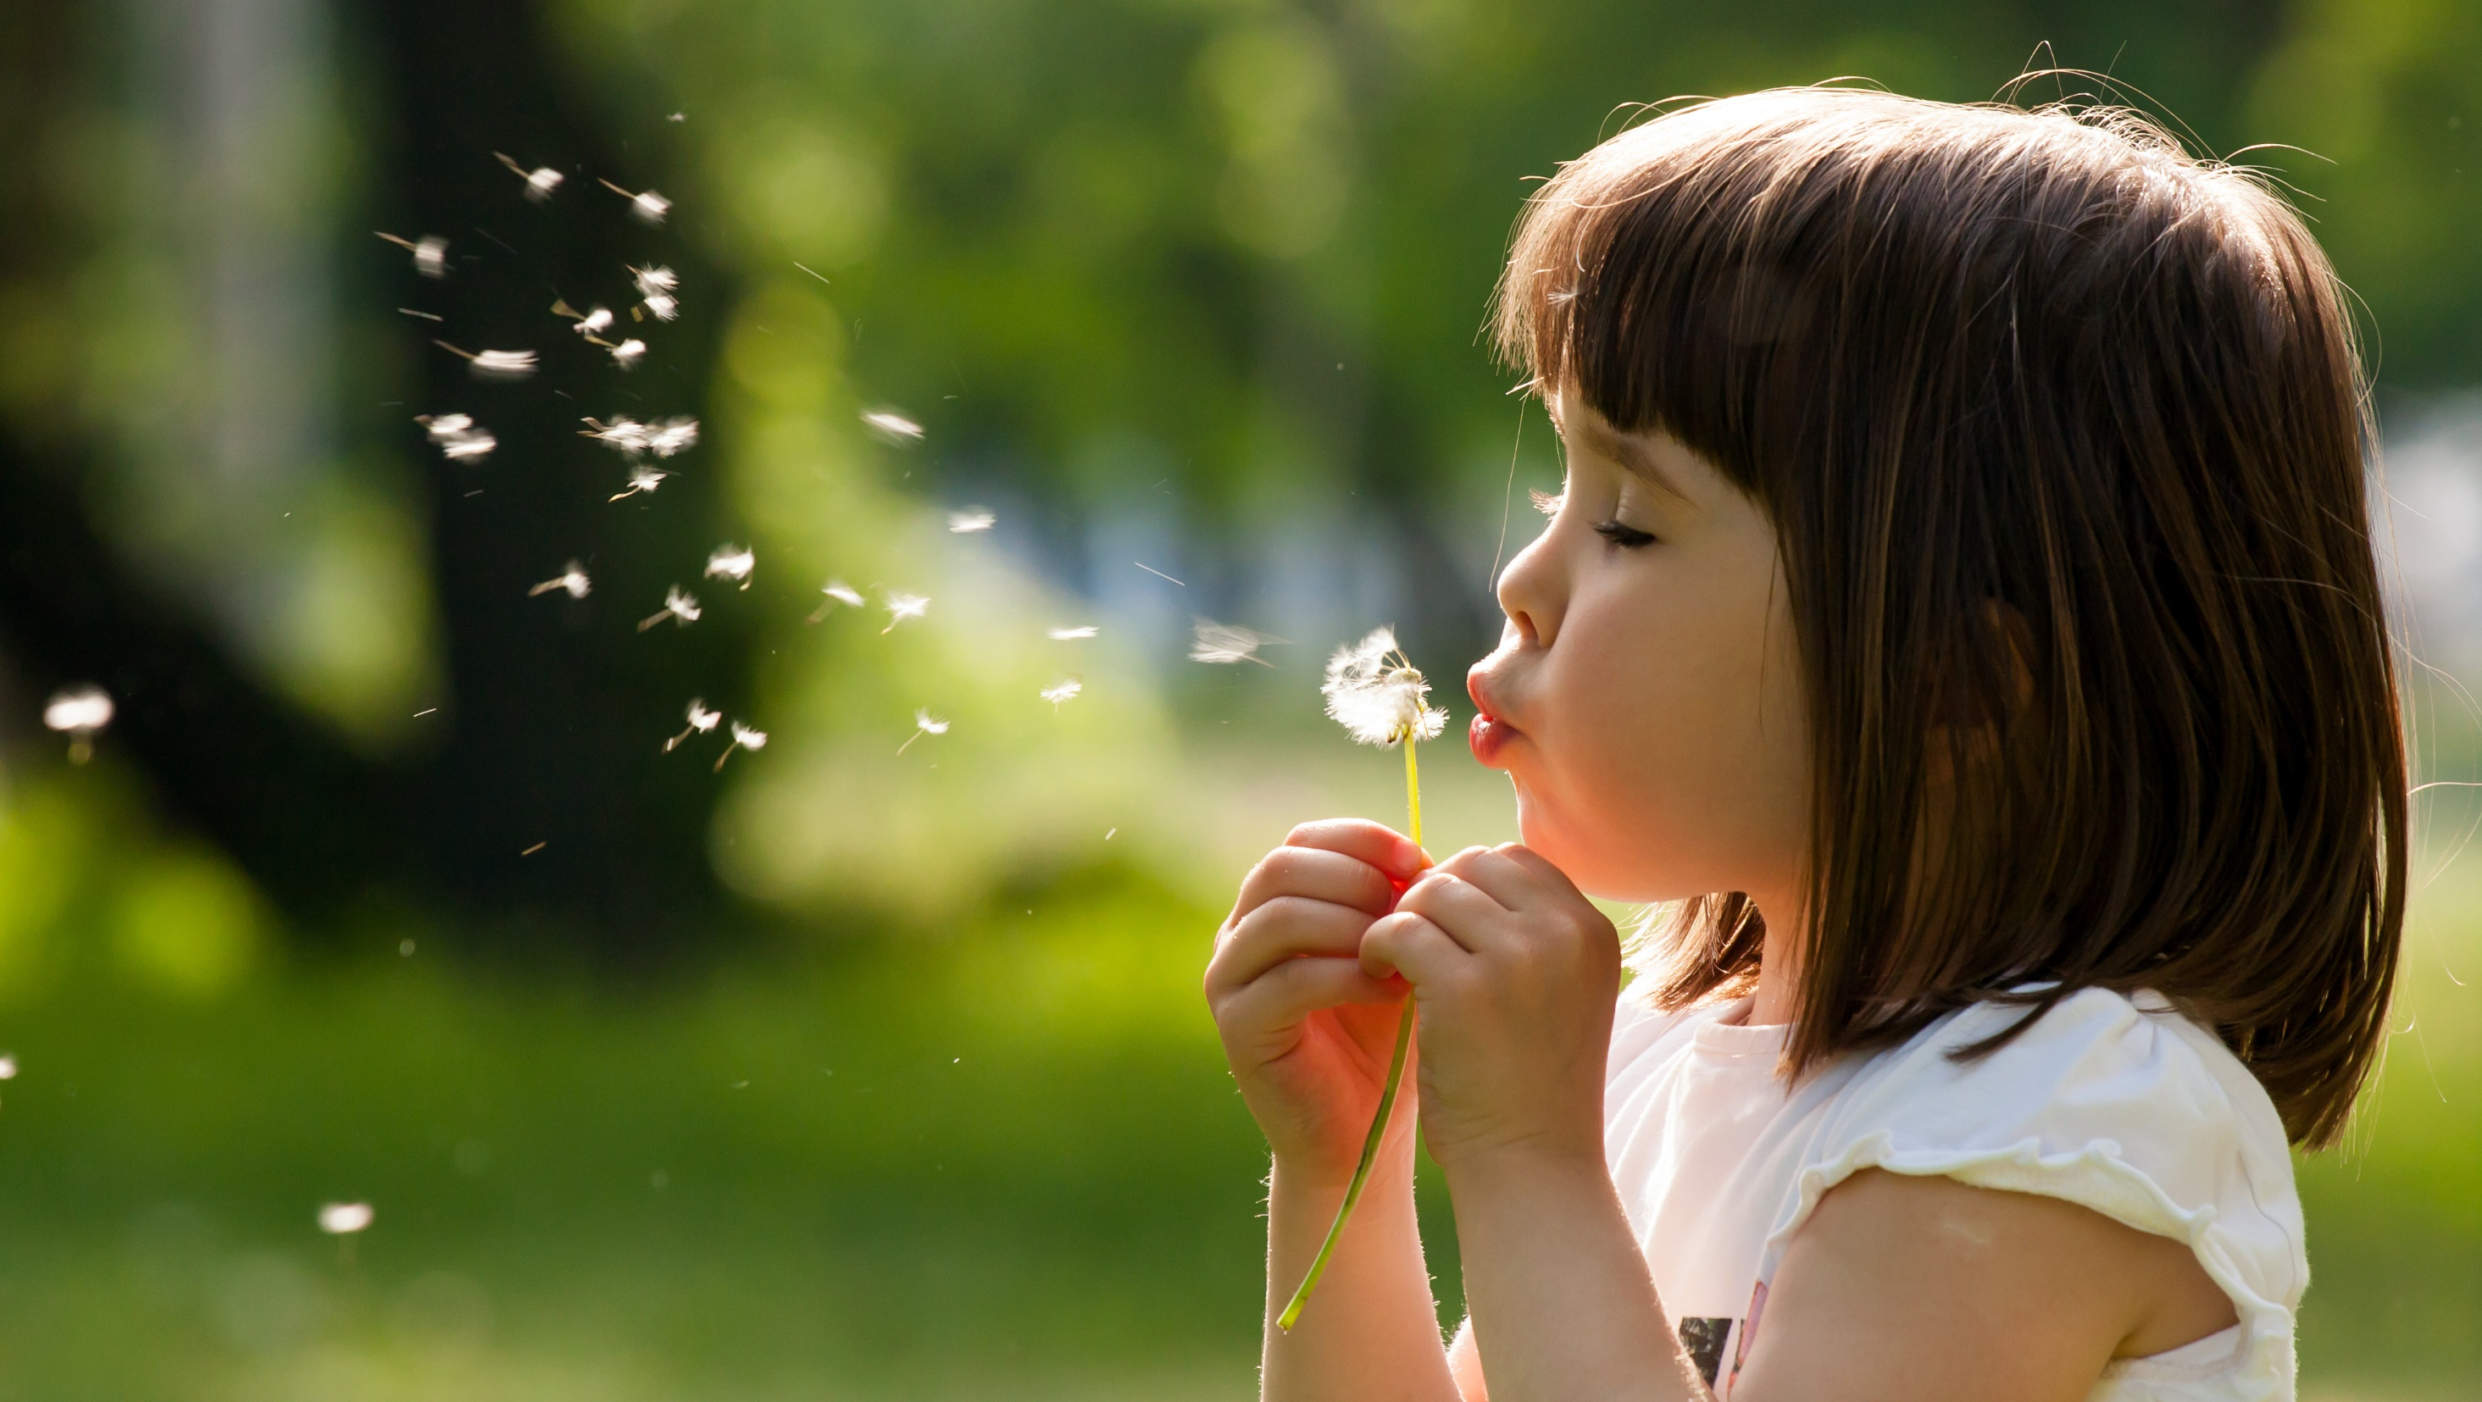
Enjoy your day!

