Slide 1
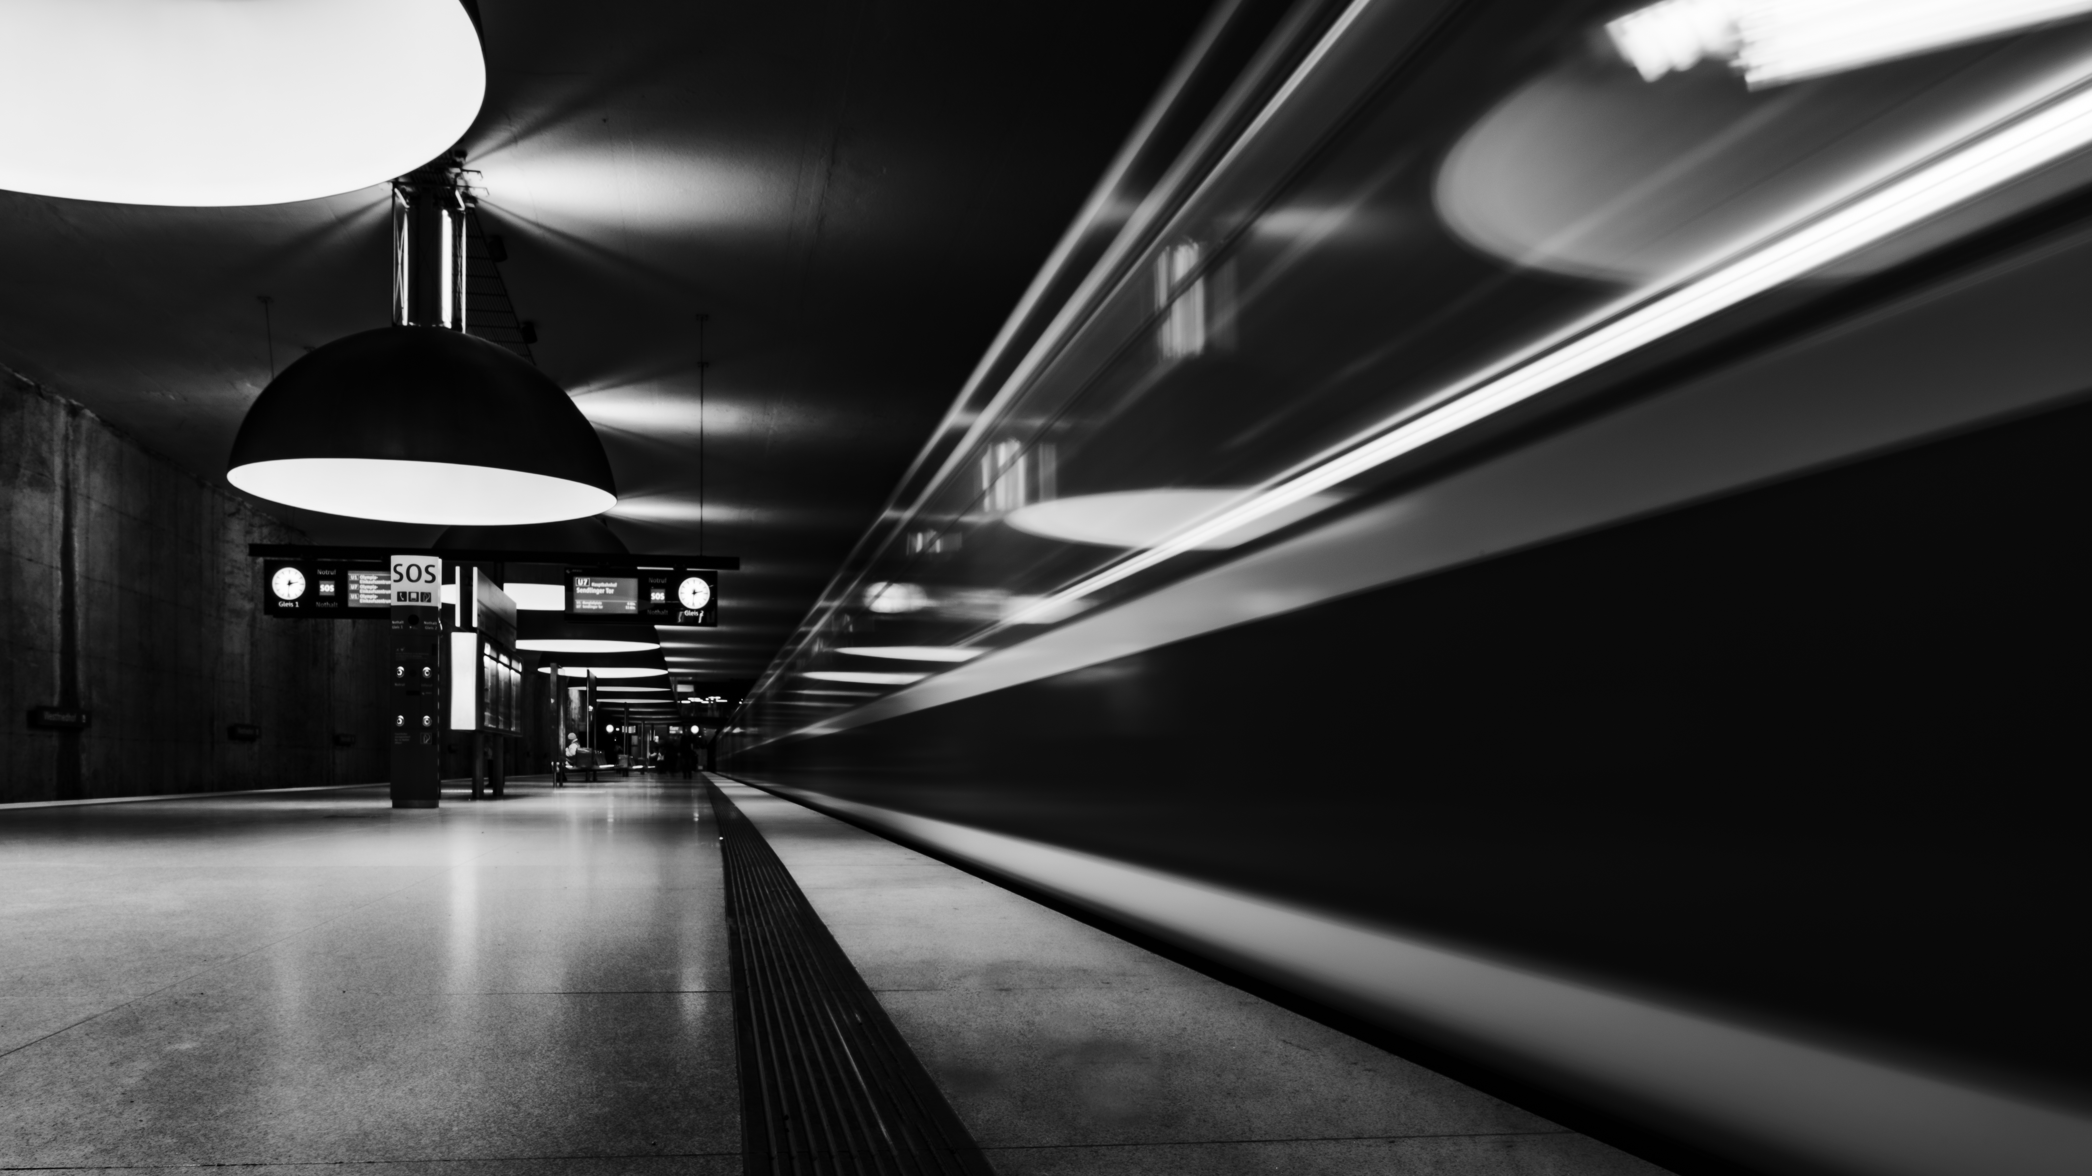

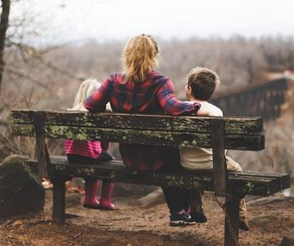


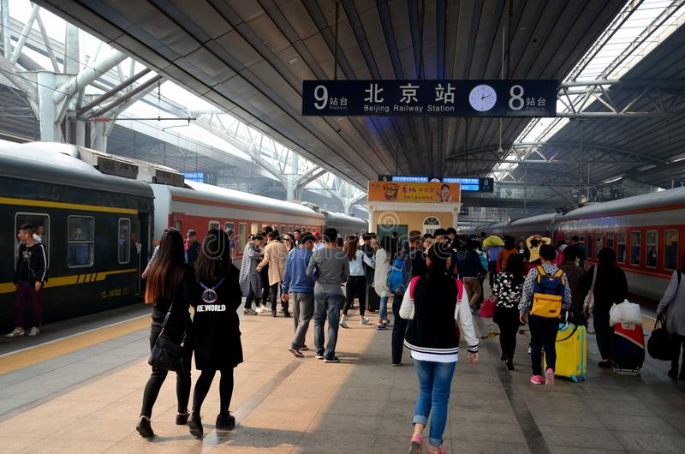
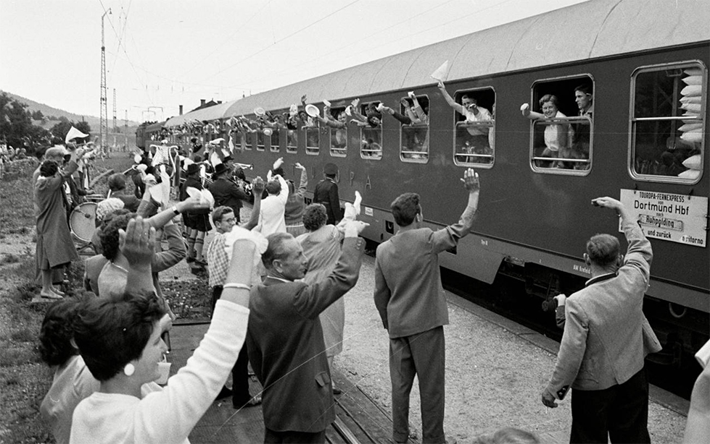

Slide 2



Unit 2: Adventure
Lesson 2B: Grammar

Slide 3


Ex1. Listen to the story. Why does the narrator notice the tall man?
www.phuongnam.edu.vn

Slide 5

Ex1. Listen to the story. Why does the narrator notice the tall man?
Because the tall man is standing very still, wearing summer clothes and staring at the narrator.
www.phuongnam.edu.vn

Slide 6
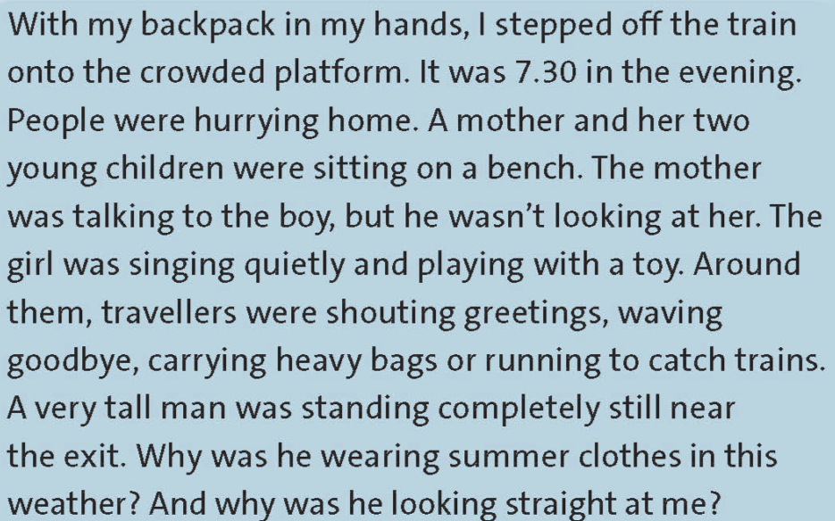
Ex2. Now underline all the past continuous forms in the text.
www.phuongnam.edu.vn

Slide 7



UNIT 2:
ADVENTURE
www.phuongnam.edu.vn

Slide 8

Tense reminder
Past continuous
Past
Present
Future
Use: to set the scene
    to talk about an action that was in progress at
    a particular time.
E.g.: It was snowing. Two men were walking home.
At midnight, I was doing my homework.
It was eight o'clock. I was writing a letter.
www.phuongnam.edu.vn

Slide 9
Tense reminder
Past continuous
Affirmative | Negative
I/He/She/It + was + V-ing You/We/They + were + V-ing | I/He/She/It + wasn’t + V-ing You/We/They + weren’t + V-ing
( = was not)
( = were not)
I was thinking about him last night.
We were just talking about it before you arrived.
I wasn’t thinking about him last night.
We weren’t talking about it before you arrived.
www.phuongnam.edu.vn

Slide 10
Tense reminder
Past continuous
Questions | Short answers
Was + I/he/she/it + V-ing? Were + you/we/they + V-ing? | →Yes, I was. / No, she wasn’t. → Yes, we were. / No, they weren’t.
Was your mother going to the market at 7 A.M yesterday?
Yes, she was.
No, she wasn’t.
www.phuongnam.edu.vn

Slide 11
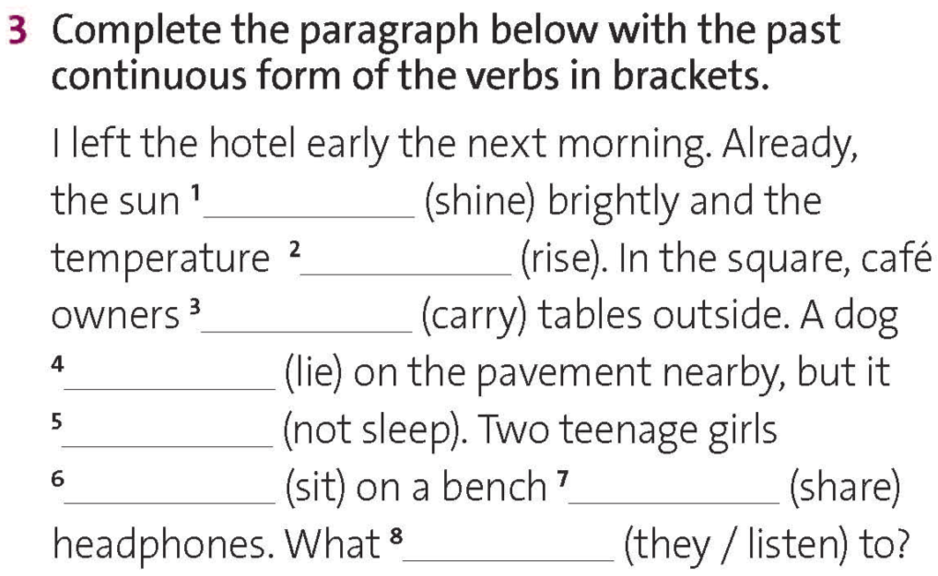
was shining
was rising
were carrying
was lying
wasn’t sleeping
were sitting
sharing
were they listening
www.phuongnam.edu.vn

Slide 12
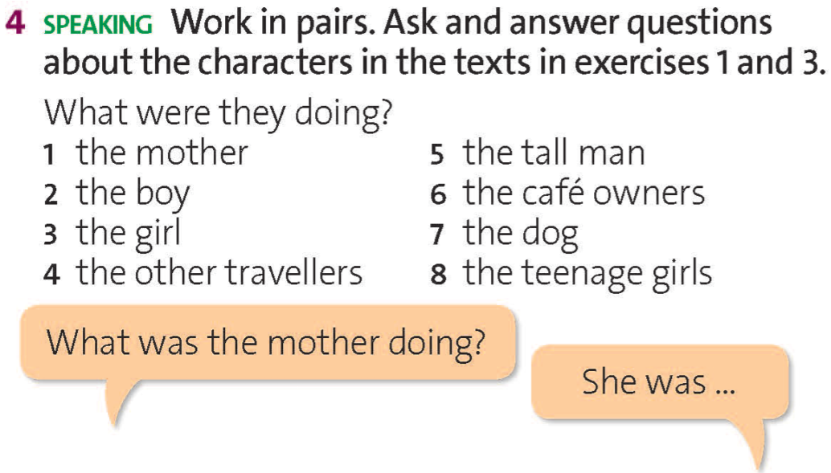

Pair - Work
www.phuongnam.edu.vn

Slide 13
Ex4. Take turns to ask and answer the question in pairs.
2. What was the boy doing?
He wasn’t looking at his mother.
www.phuongnam.edu.vn

Slide 14
Ex4. Take turns to ask and answer the question in pairs.
3. What was the girl doing?
She was singing quietly and playing with a toy.
www.phuongnam.edu.vn

Slide 15
Ex4. Take turns to ask and answer the question in pairs.
4. What were the other travelers doing?
They were shouting greetings, waving goodbye, carrying heavy bags or running to catch train.
www.phuongnam.edu.vn

Slide 16
Ex4. Take turns to ask and answer the question in pairs.
5. What was the tall man doing?
He was standing completely still near the exit.
www.phuongnam.edu.vn

Slide 17
Ex4. Take turns to ask and answer the question in pairs.
6. What were the café owners doing?
They were carrying tables outside.
www.phuongnam.edu.vn

Slide 18
Ex4. Take turns to ask and answer the question in pairs.
7. What was the dog doing?
It was lying on the pavement nearby.
www.phuongnam.edu.vn

Slide 19
Ex4. Take turns to ask and answer the question in pairs.
8. What was the teenage girls doing?
They were sitting on a bench sharing headphones.
www.phuongnam.edu.vn

Slide 20

GROUP DISCUSSION
www.phuongnam.edu.vn

Slide 21








Ex5. WHO’S FASTER!
Rules:
Work in groups
Use suggested words on the left and right columns to form sentences
www.phuongnam.edu.vn

Slide 22

START TIMER
TIME LIMIT:
5 minutes
TIME’S UP!
a tourist
some birds
two taxi drivers
a street vendor
a police officer
some schoolchildren
a shop owner
some workmen
some shoppers
Suggested answers:
A tourist was reading a book.
Some birds were eating bread.
A shop owner was smiling at me.
Two taxi drivers were arguing very loudly.
A street vendor was talking on the phone.
stand / sit
argue / fight
take photos
eat / drink
talk on the phone
read a book / magazine
laugh / smile / sing
walk / run / ride a bike
5
4
1
3
2
www.phuongnam.edu.vn

Slide 23

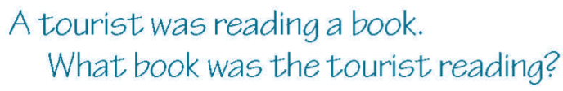
Ex6. Choose five of the sentences from the game above and write a question about
each one using the past continuous.

Slide 24
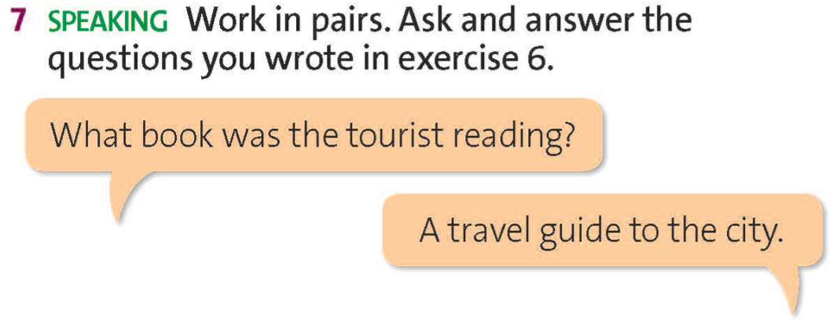
www.phuongnam.edu.vn

Slide 25

Homework
Prepare next lesson: listening – adrenaline junkies.
+ Learn by heart all past continuous forms.
+ Write the opening paragraph of a story using ideas from the game and exercise 7.
www.phuongnam.edu.vn

Slide 26

www.phuongnam.edu.vn

Slide 27



Thank you!
CTCP ĐẦU TƯ VÀ PHÁT TRIỂN GIÁO DỤC PHƯƠNG NAM

